Slide 1
VIROTEAM
10-12 Septembre2015
Marseille

Slide 2
HIV-1–specific T-cell responses in exposed seronegative subjects suggest that a viral breach of the exposure site is more common than current transmission rates would suggest and that host immunity can extinguish subsequent infection foci.
The Preexposure Prophylaxis Initiative (iPrEx) chemoprophylaxis trial provided an opportunity to investigate these responses in a case–control immunology study
Objectives
  to corroborate previous reports of HIV-1 antigen-specific IFN-γ responses in exposed but uninfected individuals.
  to test the hypothesis that HIV-1–specific T-cell responses in persistently HIV-1–Exposed SeroNegative iPrEx participants (HESN) differed from preinfection T-cell responses in those who eventually seroconverted [SeroConverter–before infection (SC-BI)], thus relating such responses to infection risk.
    84 preinfection PBMC samples from SC-BI individuals
    matched with
    480 PBMC samples from HESN subjects (from both the placebo and active treatment arms).
Notes:
HIV-1–specific immune responses have been documented in some HIV-1–exposed but uninfected individuals (1–11). These responses are thought to have been generated by exposure to HIV-1 or cross-reactivity to other antigens (12–14). Irrespective of how they are induced, the relationship of these immune responses to infection is controversial. Some groups have not reliably detected such responses, possibly because of the differences in strength or frequency in exposed uninfected subjects relative to those with a systemic infection (15–17).
Thus, characterization of immune responses in exposed uninfected individuals and verification of how they relate to protection would require a well-designed study with clinical outcomes, similar to the immune correlates analysis for the RV144 vaccine trial (18–20). Such a study could reveal characteristics desirable for T-cell responses, which then could be used to inform the design of T-cell immunogens for a preventative HIV-1 vaccine (21).
Preexposure chemoprophylaxis studies, where there are long follow-up periods and infection outcomes, have the potential for discovery of naturally acquired or induced immunity related to HIV-1 infection risk.We designed a hypothesis-driven case–control immunology study nested within the global Preexposure Prophylaxis Initiative (iPrEx) chemoprophylaxis trial (22).
Our study leveraged the rigorous design of the iPrEx trial to examine naturally acquired HIV-1–specific T-cell responses.
The first objective of our study was to corroborate previous reports of HIV-1 antigen-specific IFN-γ responses in exposed but uninfected individuals.
The second objective was to test the hypothesis that HIV-1–specific T-cell responses in persistently HIV-1–seronegative iPrEx participants [designated HIV-1–exposed seronegative (HESN)] differed from preinfection T-cell responses in those who eventually seroconverted [designated seroconverter–before infection (SC-BI)], thus relating such responses to infection risk.

Slide 3
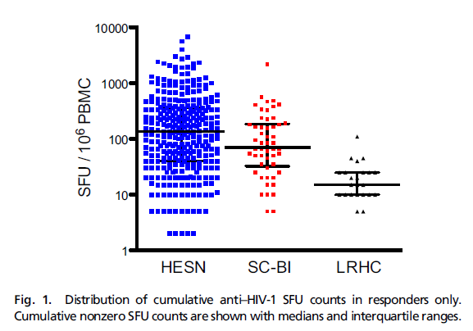
Distribution of HIV-1–Specific IFN-γ Responses Differentiates Cases from controls
T-cell responses to HIV-1 Gag, Protease, Integrase, Reverse Transcriptase, Vif, and Nef antigens were quantified for all subjects in an IFN-γ ELISpot (mesure de la mémoire des LT)
HESN:
  A positive response was more prevalent for Gag (P = 0.007), Integrase (P < 0.001), Vif (P < 0.001), and Nef (P < 0.001).
  A greater cumulative anti–HIV-1 SFU count compared with SC-BI subjects
  We found a statistically significant difference between LRHCs and both HESN (P < 0.0001) and SC-BI (P < 0.0001) subjects.
  Antigen-specific responses were independent of FTC/TDF use.
cohort of 30 unmatched healthy controls (LRHCs)
Notes:
HESN subjects had a greater proportion of responders compared with SC-BI subjects for the cumulative anti–HIV-1 response, but the difference did not reach statistical significance (Table 1 and Fig. S1).
Among the individual antigens, responses were more prevalent in HESN subjects for Gag (P = 0.007), Integrase (P < 0.001), Vif (P < 0.001), and Nef (P < 0.001) antigens, whereas the differences did not reach significance for Reverse Transcriptase (RT) and Protease (Table 1 and Fig. S2).
When summarizing the magnitude of responders only, HESN subjects had a greater cumulative anti–HIV-1 SFU count compared with SC-BI subjects (Fig. 1 and Table 1). A greater magnitude of SFU counts was also observed in responding HESN subjects among the individual antigen pools of RT, Integrase, Vif, and Nef, whereas the magnitude of both Gag and Protease SFU counts were numerically greater for SC-BI subjects (Fig. 2 and Table 1).
When combining responders and nonresponders, the SFU count for HESN subjects was greater compared with for SC-BI subjects for Gag (P = 0.0161), RT (P = 0.022), Integrase (P = 0.007), Vif (P < 0.001), and Nef (P < 0.001) antigens but not Protease (Table 1).
Anti–HIV-1 SFU counts for HESN and SC-BI subjects are represented in Fig. S3 as histograms inclusive of zero and nonzero values. A sample of imaged ELISpot wells from HESN and SC-BI subjects can be found in Figs. S4 and S5, respectively.
Peripheral blood mononuclear cells (PBMCs) from a cohort of 30 unmatched low-risk healthy controls (LRHCs) were also tested in the ELISpot. The median (interquartile range) of the cumulative anti–HIV-1 IFN-γ response magnitude was 15 (10–25) SFUs (Fig. 1).
We used a t test to compare cumulative SFUs in LRHCs with those in both HESN and SC-BI subjects among those who had a measureable response. We found a statistically significant difference between LRHCs and both HESN (P < 0.0001) and SC-BI (P < 0.0001) subjects. No LRHCs had an individual antigen response ≥55 SFUs (Fig. S3 B–G). Cumulative and antigen-specific anti–HIV-1 SFU counts for LRHC are represented in Fig. S3 A–G as histograms inclusive of zero and nonzero values. A sample of imaged ELISpot wells from LRHCs can be found in Fig. S6. Because of the unmatched nature of this control group and the low frequencies and magnitudes of LRHC responses relative to HESN and SC-BI responses, no additional analyses of LRHC responses were conducted.

Slide 4
HIV-1–Specific IFN-γ Responses Correlate with Infection Risk in the iPrEx trial.
Correlated with outcomes: Vif- and Integrase-specific T-cell responses were associated with reduced HIV-1 infection risk [HR = 0.36, 95% CI = 0.19–0.66 and HR = 0.52, 95% CI = 0.28–0.96, respectively].
Responses directed against Integrase observed in previous HESN studies → Integrase immunogens included in vaccine studies (+Nef ) but not Vif in humans and primate studies
Vif-specific IFN-γ responses were associated with the greatest reduction in infection risk relative to all others tested in this study.
  In the SIV model system, cellular immune responses to Vif have been used to track postchallenge viral replication, observed in SIV elite controllers (associated with reduced SIV load and higher CD4+ T-cell counts postinfection).
  In humans, T-cell responses against Vif have been found in HIV-1 elite controllers and HESN subjects.
The observed T-cell responses could also be a biomarker of exposure resulting from occult, controlled, abortive, or defective virus infection
HIV-1–specific T-cell immunity can be detected in exposed but uninfected individuals and these T-cell responses can differentiate individuals according to infection outcomes.
Ultimately, a prospectively designed vaccine efficacy trial would be required to definitively establish protective mechanisms discovered in humans or nonhuman primates as correlates of protection .
Notes:
A multivariate conditional logistic regression model including all measured antigens was used as the primary analysis (because of the correlated nature of the responses) to elucidate the individual contributions of each antigen to HIV-1 infection risk (Table 2).
Because we hypothesized that antigen responses arose from sexual exposure to HIV-1, reported noncondom receptive anal intercourse (ncRAI) was included in the model to address potential confounding between sexual practices, antigen response, and HIV-1 infection risk. Neither randomization to nor detectable levels of emtricitabine/tenofovir disoproxil fumarate were associated with antigen responses, and therefore, randomization was excluded from the model.
Higher magnitudes of Vif and Integrase responses were associated with a statistically significant reduction in HIV-1 infection risk [hazard ratio (HR) = 0.36, 95% confidence interval (95% CI) = 0.19–0.66 and HR = 0.52, 95% CI = 0.28–0.96, respectively]. That is, for every 10-fold increase in the Vif and Integrase SFU count, the risk of HIV-1 infection decreased by 64% and 48%, respectively. In contrast, higher anti-Protease responses were associated with a statistically significant increase in infection risk (HR = 2.50).
The HR for Nef (HR = 0.52) also reached statistical significance with backward selection of covariates (Table 2). We found similar results after limiting the analysis to include only those HESN subjects with HIV-1–negative antibody tests at subsequent protocol visits, arguing against the presence of an incubating or otherwise undetectable infection in those seronegatives with measureable antigen-specific IFN-γ responses.
IFN-γ secretion in response to the positive control pool of pool of CMV, EBV, and influenza peptides was not associated with HIV-1 infection risk.
IFN-γ Responses Are Attributable to Effector Memory CD4+ and CD8+ T Cells.
IFN-γ secretion was attributed to CD4+ or CD8+ T cells, with 14 responses (82%) attributed to a CD8+ dominant phenotype. both responses were determined to be from effector memory cells (Fig. 3 C and D). In this study, the association of Integrase-specific responses with reduced infection risk was modest but statistically significant. Responses directed against Integrase have been observed in previous HESN studies. Integrase immunogens have also been included in recent vaccine studies along with Nef immunogens but not Vif in humans and nonhuman primate studies (31, 35).
Vif-specific IFN-γ responses were associated with the greatest reduction in infection risk relative to all others tested in this study. In the SIV model system, cellular immune responses to Vif have been used to track postchallenge viral replication (36), observed in SIV elite controllers (37), and associated with reduced SIV viral load and higher CD4+ T-cell counts postinfection (38). In humans, T-cell responses against Vif have been found in HIV-1 elite controllers (39) and HESN subjects (4).
The accessory protein Vif is critical for HIV-1 replication, because it targets the intrinsic antiviral cytidine deaminase APOBEC to the proteasome where it is degraded. Without Vif, HIV-1 is highly attenuated. Thus, the observed HR associated with a Vif response could indicate that the mechanistically related APOBEC in concert with T-cell responses or even alone provides the necessary reduction in R0, resulting in the control or clearance of infection foci. Supporting this notion are the colocation of T-cell epitopes with regions of the Vif protein associated with degradation of APOBEC3G/F, which was identified in a previous HESN study (4), and the relationship of APOBEC haplotypes to transmission (41).

Slide 5
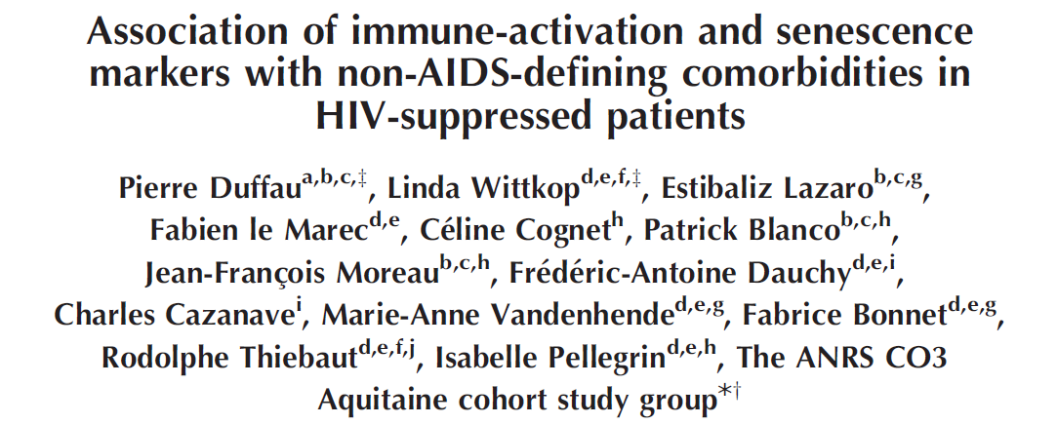
Background/Objectives
AIDS, september 2015
Chronic immune activation (IA) only partially restored under cART.
IA may result in immunosenescence (IS) and non-AIDS-related comorbidities.
We describe IA and IS and their association with comorbidities
Methods
Patients were included irrespective of their immunological (CD4 count) and virological status (HIV RNA, HCV/HBV coinfections).
CD4 and CD8 activation (HLA-DR+), maturation (naïve (TN), memory cells (TEMRA)) and senescence (CD57+CD28-) were measured.
Definition of non-AIDS-related comorbidities
Kidney disease : eGFR using the Modification of Diet in Renal Disease formula (MDRD)
Diabetes : ICD codes, hypoglycemic drug use or insulin, 2 consecutive glucose measurements ≥ 7 mmol/L
Dyslipidemia : ICD codes, statin or fibrate treatment
Cardiovascular events : ICD codes, bypass surgery or angioplasty treatment, CNS ICD codes, peripheral vascular ICD codes or endarterectomy treatment
Hypertension : 2 consecutive systolic BP ≥ 140 mm/Hg or diastolic BP ≥ 90 mm/Hg Degenerative CNS disorders : ICD codes
Cancer : AIDS-related or non-AIDS-related cancer.

Slide 6
Methods
Main outcome variable
  A score of comorbidities was generated by summing the following comorbidities : eGFR < 60, diabete+, dyslipidemia+, cardiovascular events+, hypertension+, degenerative CNS+, and cancer+.
Main explicative variables
  Immune score
  The first PC was selected as a continuous « immune score ». The following variables were included to build the « immune score »: CD4+ and CD8+ DR, TN, TEMRA and CD57+CD28-.
  VACS index score (HIV patients)
    IRP (Immune risk profile (elderly patients)
Association between the “immune score”, the VACS index score, IRP and comorbidities.
Models were adjusted for age, last CD4 count, gender, AIDS state, HIV-1 RNA and HCV infection.
Notes:
Principal component analysis A principal component analysis (PCA) based on a Spearman’s correlation matrix was performed on eight immune markers (percentages of activated, senescent, naı¨ve, and terminally differentiated CD4þ and CD8þ T cells) in order to understand correlations between them. The main goal of PCA is to reduce the dimensionality of a dataset consisting of inter-related variables. This is achieved by transforming the original variables to a new set of variables, the principal components, which are linear combinations of the original variables and which retain most of the variation present in all original variables [24].We used two-dimensional (2D) plots to project data on the plane spanned by the first two components which explained most variability of data (>68.7%). On this plane, the contribution of markers is unequal and depends on the contribution of each marker on each axis/principal component. A given marker may contribute on the third axis and therefore would not be well represented on the first two axes (those represented close to the origin of the figure). Non-AIDS-related comorbidities and individual history of HIV infection were projected as supplementary variables to visualize the correlation between the components and these variables. We selected the first principal component that explained 51.5% of the variability as a continuous ‘immune score’ called CIADIS score throughout the study.
Main outcome variable We counted the number of comorbidities present for each patient (comorbidity score) among: eGFR below 60 ml/ min, diabetes, dyslipidemia, cardiovascular events, hypertension, degenerative CNS disorders, and cancer. We defined a high comorbidity score (at least three comorbidities) as the main outcome variable. The decision on combining comorbidities was also supported by a multiple correspondence analysis that showed an association of most of the comorbidities (dyslipidemia, hypertension, kidney function impairment, cardiovascular events, as well as diabetes) to each other.
Adjustment variables The following variables were described and tested in univariable analyses: HIV-related variables included mode of HIV transmission, last CD4þ T-cell count, last CD4þ/CD8þ T-cell ratio, CD4þ T-cell nadir, time from CD4þ T-cell nadir, duration of CD4þ T-cell count below 350/ml, time since first HIV-positive test, viral suppression duration, Center for Disease Control (CDC) classification, use of ART, time since the first ART, cytomegalovirus (CMV) serology status, and hepatitis B
and C coinfections.
The Veterans Aging Cohort Study (VACS) index was calculated as previously described [25,26]. This score is specifically constructed to indicate increasing risk of all-cause mortality in HIV patients with increasing score [25,26]. The immune risk profile (IRP) represents a cluster of factors that were strongly predictive of earlier mortality
among a very old Swedish cohort, as well as in younger individuals [27]. We calculated the IRP counting one point if the following criteria were fulfilled: CD4þ/ CD8þ ratio less than 1, positivity of CMV serology, percentage of CD4þCD57þCD28 above the third quartile observed in the study population (Q3), percentage of CD8þCD57þCD28 above Q3, percentage of naı¨ve CD4þ below the first quartile in the study population (Q1), percentage of naı¨ve CD8þ below Q1, percentage of CD4þTEMRA above Q3, percentage of CD8þTEMRA above Q3.

Slide 7
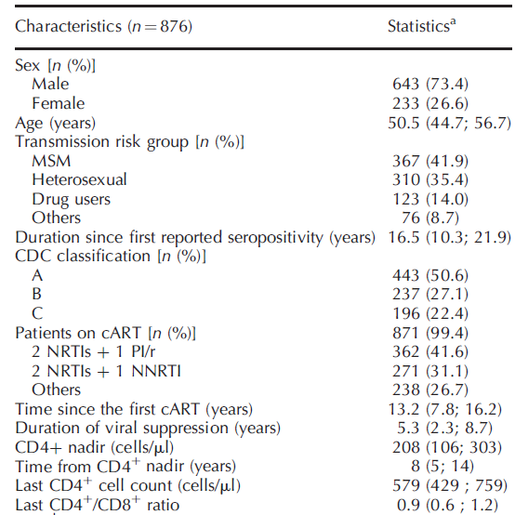
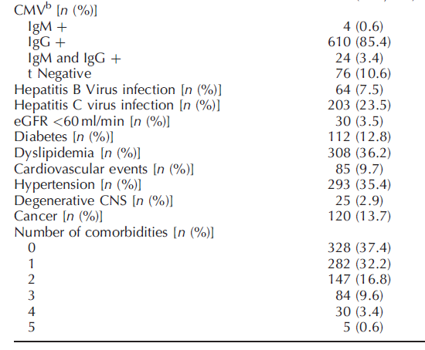
Characteristics of the 876 patients included in the CIADIS substudy of the ANRS CO3 Aquitaine cohort (2011–2013).
VACS index score | n (%)
< 35 | 823 (84)
35-49 | 108 (11)
50-69 | 36 (4)
≥ 70 | 6 (1)
VACS score (mortalité):
Age, CD4+, ARN VIH, HB, Fib-4, eGFR, VHC

Slide 8
Immune markers
Immune markers | Median (IQR)
CD4+, VA | 554 (415;728)
CD4+, % | 33 (26;40)
CD4+DR+ among CD4+, % | 14 (10;19)
CD4+CD57+CD28- among CD4+, % | 3 (1;8)
CD4+TN among CD4+, % | 40 (29;51)
CD4+TEMRA among CD4+, % | 1 (0;4)
CD8+, VA | 684 (495;942)
CD8+, % | 40 (33;48)
CD8+DR+ among CD8+, % | 36 (26;48)
CD8+CD57+CD28-among CD8+, % | 26 (18;36)
CD8+TN among CD8+, % | 38 (29;49)
CD8+TEMRA among CD8+, % | 26 (16;36)

Slide 9
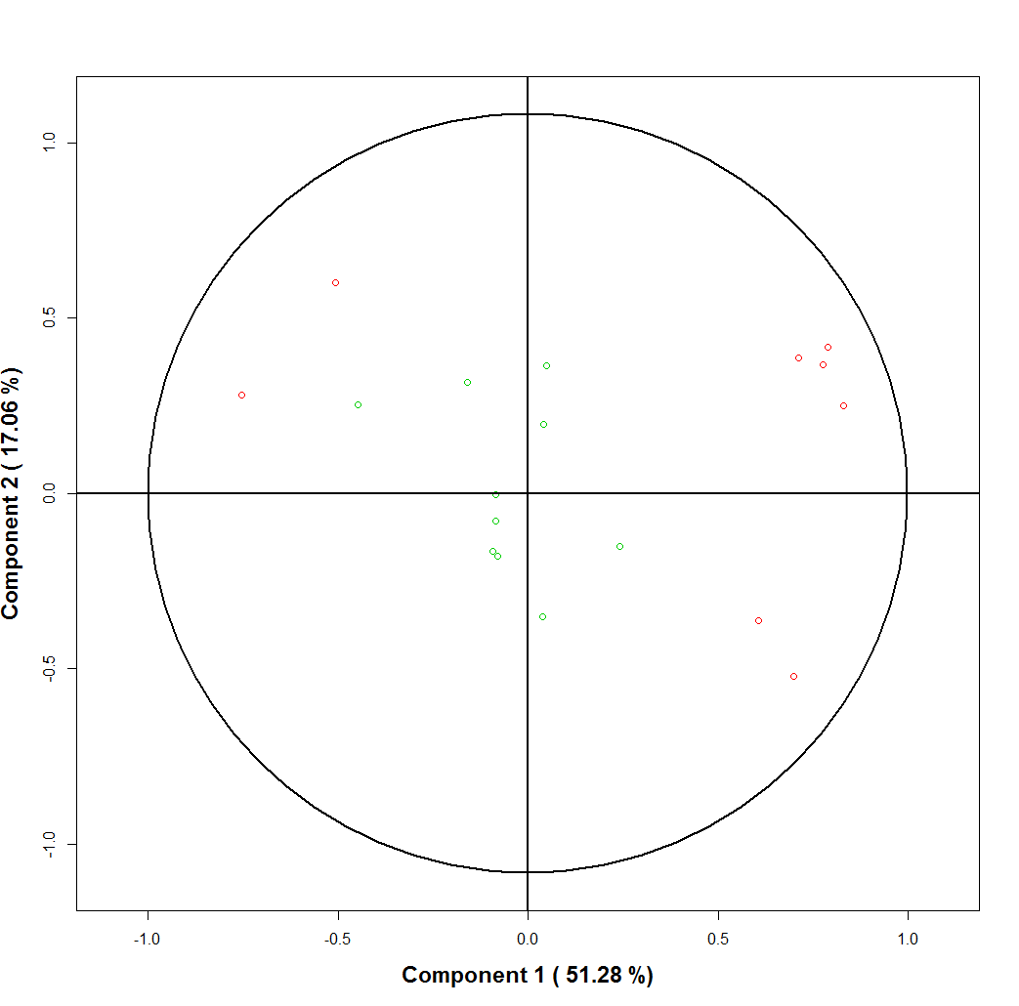
Immunological profiles and association with comorbidities and patient characteristics
CD4+ TN
CD8+ TEMRA
CD8+ TN
CD4+ TEMRA
CD8+ CD57+CD28-
CD4+ CD57+CD28-
CD8+ DR
CD4+ DR
Notes:
The first two principal components accounted for 68.7% of the variability among immunological markers (Fig. 1a).
The first principal component, accounting for 51% of the marker variability, separated naı¨ve T cells (CD45RAþCD27þ) from activated T cells (HLADR þ on CD4þ and CD8þ grouped together), as well as senescent T cells (CD4þ and CD8þ CD57þCD28- and CD4þ and CD8þ CD27-CD45RAþ terminally differentiated T cells grouped together).
Comorbidities were also projected onto the plan spanned by the first two principal components (Fig. 1b) that needs to be read in conjunction with Fig. 1a. Patients with comorbidities are found on the right side and thus were more often found in patients presenting an immune phenotype with high T-cell activation, high expression of terminal differentiation, and senescence markers. HCV coinfection, plotted on the left bottom corner, was not associated with either T-cell activation or senescence.
Quantitative variables related to HIV (CD4þ T-cell nadir, last CD4þ T-cell count, CD4þ T-cell count at treatment start, duration of CD4þ T cell <350/ml, duration of infection, duration of cART) were mostly located at the center of the circle and were not associated with activation or senescence phenotypes (Fig. 2a).
The projection of qualitative HIV and non-HIV-related variables onto the plan spanned by the first two components are represented on Fig. 2b that needs to be read in conjunction with Fig. 2a. These variables were not associated with a particular T-cell phenotype in most of the cases.
The distribution of comorbidities is represented in Table 1. Dyslipidemia and hypertension were the most frequent comorbidities accounting for 36.2 and 35.4% of patients, respectively. Severe kidney function impairment (eGFR <60 ml/min) and CNS degenerative disorders only concerned, respectively, 3.5 and 2.9% of patients. Also, 37.4% of patients had no comorbidity and 13.6% of patients suffered from at least three comorbidities.

Slide 10
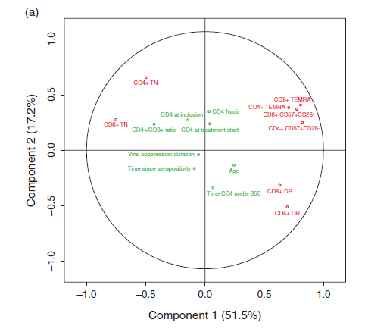
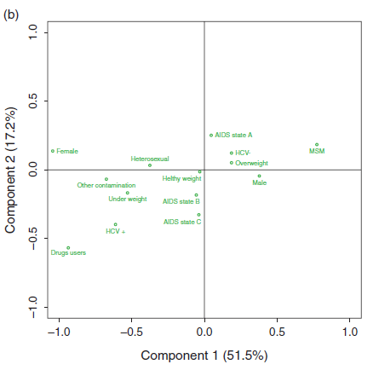
Immunological profiles and association with comorbidities and patient characteristics
Notes:
The first two principal components accounted for 68.7% of the variability among immunological markers (Fig. 1a).
The first principal component, accounting for 51% of the marker variability, separated naı¨ve T cells (CD45RAþCD27þ) from activated T cells (HLADR þ on CD4þ and CD8þ grouped together), as well as senescent T cells (CD4þ and CD8þ CD57þCD28- and CD4þ and CD8þ CD27-CD45RAþ terminally differentiated T cells grouped together).
Comorbidities were also projected onto the plan spanned by the first two principal components (Fig. 1b) that needs to be read in conjunction with Fig. 1a. Patients with comorbidities are found on the right side and thus were more often found in patients presenting an immune phenotype with high T-cell activation, high expression of terminal differentiation, and senescence markers. HCV coinfection, plotted on the left bottom corner, was not associated with either T-cell activation or senescence.
Quantitative variables related to HIV (CD4þ T-cell nadir, last CD4þ T-cell count, CD4þ T-cell count at treatment start, duration of CD4þ T cell <350/ml, duration of infection, duration of cART) were mostly located at the center of the circle and were not associated with activation or senescence phenotypes (Fig. 2a).
The projection of qualitative HIV and non-HIV-related variables onto the plan spanned by the first two components are represented on Fig. 2b that needs to be read in conjunction with Fig. 2a. These variables were not associated with a particular T-cell phenotype in most of the cases.
The distribution of comorbidities is represented in Table 1. Dyslipidemia and hypertension were the most frequent comorbidities accounting for 36.2 and 35.4% of patients, respectively. Severe kidney function impairment (eGFR <60 ml/min) and CNS degenerative disorders only concerned, respectively, 3.5 and 2.9% of patients. Also, 37.4% of patients had no comorbidity and 13.6% of patients suffered from at least three comorbidities.

Slide 11
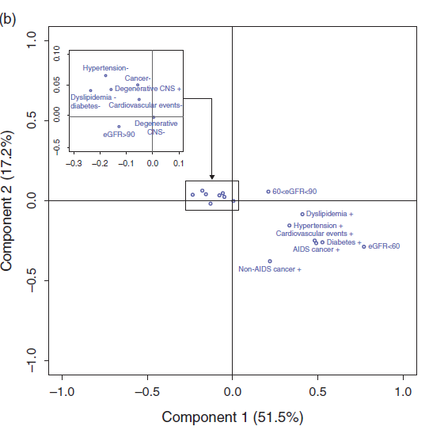
Immunological profiles and association with comorbidities and patient characteristics
CD4+ TN
CD8+ TEMRA
CD8+ TN
CD4+ TEMRA
CD8+ CD57+CD28-
CD4+ CD57+CD28-
CD8+ DR
CD4+ DR
Notes:
The first two principal components accounted for 68.7% of the variability among immunological markers (Fig. 1a).
The first principal component, accounting for 51% of the marker variability, separated naı¨ve T cells (CD45RAþCD27þ) from activated T cells (HLADR þ on CD4þ and CD8þ grouped together), as well as senescent T cells (CD4þ and CD8þ CD57þCD28- and CD4þ and CD8þ CD27-CD45RAþ terminally differentiated T cells grouped together).
Comorbidities were also projected onto the plan spanned by the first two principal components (Fig. 1b) that needs to be read in conjunction with Fig. 1a. Patients with comorbidities are found on the right side and thus were more often found in patients presenting an immune phenotype with high T-cell activation, high expression of terminal differentiation, and senescence markers. HCV coinfection, plotted on the left bottom corner, was not associated with either T-cell activation or senescence.
Quantitative variables related to HIV (CD4þ T-cell nadir, last CD4þ T-cell count, CD4þ T-cell count at treatment start, duration of CD4þ T cell <350/ml, duration of infection, duration of cART) were mostly located at the center of the circle and were not associated with activation or senescence phenotypes (Fig. 2a).
The projection of qualitative HIV and non-HIV-related variables onto the plan spanned by the first two components are represented on Fig. 2b that needs to be read in conjunction with Fig. 2a. These variables were not associated with a particular T-cell phenotype in most of the cases.
The distribution of comorbidities is represented in Table 1. Dyslipidemia and hypertension were the most frequent comorbidities accounting for 36.2 and 35.4% of patients, respectively. Severe kidney function impairment (eGFR <60 ml/min) and CNS degenerative disorders only concerned, respectively, 3.5 and 2.9% of patients. Also, 37.4% of patients had no comorbidity and 13.6% of patients suffered from at least three comorbidities.

Slide 12
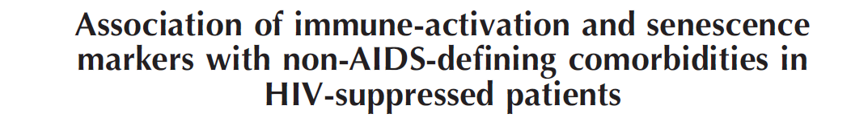
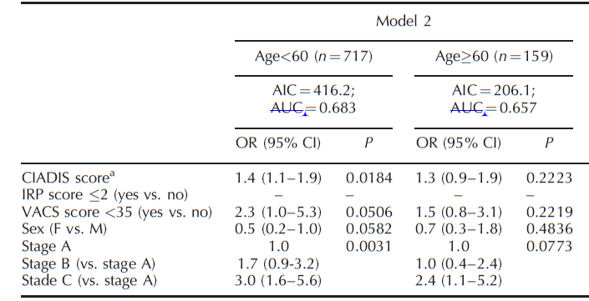
Factors associated with the presence of at least three comorbidities adjusted for HIV related characteristics stratified by age (multivariable analysis)
Notes:
Multivariable analyses Logistic regression models were used to analyze the association between the ‘CIADIS score’, the VACS index, the IRP score, and having at least three comorbidities. We did separate models for each of these markers (Table 2, models 1, 3, and 5), and in order to test for independent association of the CIADIS score and the
other scores, we included the IRP immune score and the VACS index as covariates (Table 2, models 2 and 4).
Furthermore, variables with a P value less than 0.25 in univariable analyses were included in a full model. Final models were obtained using a stepwise modeling Activation and senescence markers procedure. Sex was maintained in the final model. All final models were adjusted for age (years), sex (female versus male), AIDS stage (stage C and B versus stage A).
We further did separate analyses for patients younger than 60 years and those aged at least 60 years, and tested whether the association between the CIADIS score, IRP, and VACS score, and having at least three comorbidities, was modified by age. We also performed sensitivity analysis including patients with detectable HIV viral load.
The discriminative power of the model was assessed with the AUC and the fit was assessed with a Hosmer and Lemeshow approach.
In multivariable analysis (Table 2), after adjustment for age, sex, and AIDS stage, a higher CIADIS score was significantly associated with the presence of at least three comorbidities [model 1: odds ratio (OR) 1.3, 95% confidence interval (CI) 1.0–1.7, P¼0.02] and was also significantly associated after additional adjustment with
the VACS index (model 2: OR 1.3, 95% CI 1.0–1.6, P¼0.02).
As comorbidities might occur in younger ages in HIV patients compared to the general population, we did separate analysis in younger patients (<60 years old) versus older patients (60 years old) (Table 3).We found that the CIADIS score as well as IRP were significantly associated with a high comorbidity score in younger patients (OR 1.4, 95% CI 1.1–1.9, P¼0.02; and OR 1.8, 95% CI 1.0–4.4, P¼0.047, respectively). The VACS index was significantly associated in the model including
the IRP and CIADIS scores only (Table 3). We did not find any significant association between the CIADIS score, the VACS index, or the IRP score with a high comorbidity score in patients older than 60 years.

Slide 13
Comments
Individual history of HIV infection, immunosuppression as well as different causes of IA could lead to multiple pathways of IA and in turn lead to different profiles of IS and thus the occurrence of different comorbidities.
The CIADIS immune score (elevated IA and IS and a decrease in naive T cells) was associated with at least 3 comorbidities independently of age, sex, AIDS stage, and the VACS score.
The CIADIS and the IRP scores were significantly associated with at least three comorbidities in adjusted models restricted to patients younger than 60 years. None of the tested scores were associated with at least three comorbidities in patients older than 60 years.
Perspectives:
  Measurement of 12 inflammatory cytokines (combined-score)
  Inflammatory profile according to each comorbidity
  Elucidation of biological mechanisms: activation of inflammasome by circulating metabolites.
Prognostic tools for chronic immune activation and senescence may provide opportunities for limiting progression to adverse aging-related clinical states among HIV-infected persons… and others...
Notes:
In a large assessment of cellular activation markers in patients under routine care, we found a significant association between the CIADIS score and a high comorbidity score, whereas the VACS index score as well as the IRP score were not associated with a high comorbidity score in multivariable analysis.
Our results are in contrast with the recently published data from the study by Tenorio et al. [23] where T-cell activation was not significantly related to the occurrence of non-AIDS-defining events. In this study, all comorbidities usually associated to HIV infection were not studied simultaneously. Immune activation was assessed 1 year after cART initiation and at the timepoint immediately preceding the event, which occurred at a median of 2.9 years after initiation.
The different findings might be explained by the differences in patients’ characteristics as in our study population, the median duration since diagnosis was 17.3 years, with a median duration of viral load suppression of 5.8 years in patients under cART since a median of 14.1 years. In a recent study by Guaraldi et al. [28], duration since diagnosis was a major factor associated with comorbidities. Even after adjustment for duration since HIV diagnosis, we confirmed a statistically signification association between the CIADIS
score and the presence of more than two Comorbidities Evidence is accumulating that the risk of non-AIDSrelated comorbidities is elevated in HIV-positive individuals, they may be occurring at a younger age than what is typically observed among comparable HIV-negative populations [4,29]. Guaraldi et al. [4] demonstrated that the prevalence of polypathology (defined as the concurrent presence of at least two comorbidities) in HIV-infected persons anticipated polypathology prevalence observed in the general
population among persons who were 10 years older.
These data call for an earlier screening of noninfectious comorbidities in HIV-infected patients. Among a broad array of factors that may be contributing to the emergence of comorbidities at younger ages in the HIV population, HIV-specific cofactors have been already described [30]. However, HIV-related characteristics do not fully explain the occurrence of comorbidities that could also be linked to immune dysfunctions that persist even after long-term viral suppression and CD4þ reconstitution, especially T-cell activation [31,32]. To study immune activation and immunosenescence, we used a PCA approach to evaluate the association of activation (as measured by the percentage of HLA-DRþ T cells among CD4þ and CD8þ cells), senescence (as measured by the percentage of CD57þCD28- cells among CD4þ and CD8þ cells),
and differentiation (with a focus on naive and terminally differentiated CD4þ and CD8þ cells).
Activation and senescence markers were inversely associated with naı¨ve markers. It led us to identify two patterns of patients: a cluster of patients characterized by high expression of activation and senescence markers and low levels of naive T cells, and a cluster of patients exhibiting high levels of naı¨ve T cells and low expression of activation and senescence markers. If cellular activation is associated with AIDSdefining outcomes in untreated and treated HIV infection [14,18], the impact of cellular immune
activation on comorbidities is less well studied. Most of the studies on this topic examined the relationship between immune activation and morbidity before cART initiation, but do not address whether elevated immune activation after a defined and uniform period of cART-induced viral suppression is associated with outcomes. As HCV has the ability to stimulate the adaptative immune system, it was interesting to look at the role of HCV coinfection in T-cell activation and comorbidities. In our study, we found that HCV
coinfection seemed to be protective against T-cell activation and senescence. It perhaps explains why we did not find any correlation between HCV coinfection and a high score of comorbidities. These data suggest that HIV-associated T-cell activation and senescence are involved in comorbidities in suppressed HIV recipients and points to immune activation being involved in comorbidities independently of a unique cardiovascular pathway. T-cell activation in the context of HIV infection is usually assessed by HLA-DR and CD38
coexpression on CD4þ and CD8þ cells, whereas HLADR alone is regularly studied as a marker of T-cell activation in non-HIV populations, based upon the fact that CD38 is also expressed by naı¨ve T cells. In patients who achieved viral suppression, Cockerham et al. [33]
found a strong association between the frequencies of CD4þ or CD8þ cells expressing HLA-DR and HIVDNA levels in resting CD4þ cells. Similar correlations were also observed when activation was defined by the percentage of CD4þ or CD8þ cells coexpressing CD38 and HLA-DR; however, the strength of these heavily relied on HLA-DR expression by T cells, as no correlation was observed with CD38 alone [33]. We therefore studied association between comorbidities and T-cell activation assessed by coexpression of HLADR
and CD38, and found the same pattern of data we found with HLA-DR expression (data not shown).
The development and validation of a multivariable risk index for people with HIV has been a priority. The VACS has raised the challenge with the rollout of the pointsbased VACS index [26]. Because the impact of HIV infection on the immune system mirrors that of aging in many respects, IRP defined as a cluster of immunological factors that are strongly predictive of earlier mortality among a non-HIVelderly cohort should be interesting to study in the context of HIV infection. The CIADIS score was significantly associated with a high comorbidity score, especially in younger patients. However, the added discriminant power was little and an external validation of our findings should be done using a completely independent sample. Furthermore, the CIADIS crosssectional study cannot show that immune activation, as well as immunosenescence, is involved in the occurrence of non-AIDS-related comorbidities. Other markers such as soluble inflammation markers may also be relevant for predicting non-HIV-related comorbidities. Thus, future analyses using longitudinal data from patients included in the CIADIS study are planned.
In conclusion, the weighted CIADIS score based on activation, senescence, and maturation markers might be a tool to help physicians identify patients at a higher risk for non-AIDS-related comorbidities in the future.

Slide 14
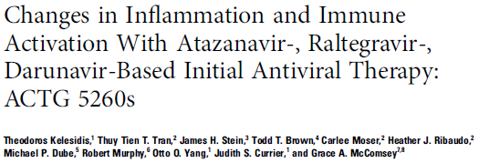
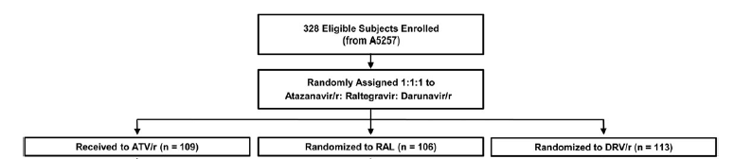
Background. It is unclear whether raltegravir (RAL) reduces inflammation and immune activation compared with ritonavir-boosted PIs.
Methods. In a prospective, randomized, multicenter clinical trial that included HIV-1–infected, treatment-naive participants were randomized to receive TDF/FTC + ATV/r, DRV/r, or RAL.
A total of 234 participants (71%) with HIV-1 RNA levels <50 copies/mL by W24 were included.
  Plasma biomarkers of inflammation and coagulation were analysed : hsCRP, iIL-6, GlycA, D-dimer, sCD14, sCD163, and sIL-2r;
  Cellular markers : %CD38+DR+ of T-cell and %CD14+CD16+ and%CD14(dim)CD16+ monocyte
  Changes from baseline were examined at earlier (24 or 48 weeks) and later (96 weeks) time points on fold-change.
Notes:
Understanding how different initial ART regimens reduce chronic immune activation in treated HIV-1 infection is an ongoing research priority. Several studies have shown a significant reduction in markers of microbial translocation in people randomized to raltegravir (RAL) compared with people randomized to nonnucleoside reverse transcriptase inhibitors (NNRTIs) [16–18]. However, prior switch and intensification studies with RAL have not consistently demonstrated reduced low-level viral replication or changes in systemic inflammation and immune activation [19, 20].
Our objective in this study was to characterize and evaluate longitudinally the changes in biomarkers of inflammation and immune activation among treatment-naive individuals undergoing randomized ART initiation with an integrase-based regimen containing RAL or a protease inhibitor–based regimen containing either atazanavir/ritonavir (ATV/r) or darunavir/ritonavir (DRV/r). Our study was part of the AIDS Clinical Trials Group (ACTG) A5260s, a prospective, metabolic substudy of the clinical trial ACTG A5257 [21].
In this prospective study of ART-naive participants who initiated RAL, ATV/r, or DRV/r with TDF/FTC and successfully achieved virologic suppression, no consistent pattern in differences in biomarkers emerged that favored any of the ART regimens. our findings suggest that RAL did not have a more comprehensive impact on decreasing systemic inflammation and immune activation compared with PIs.
Other studies have suggested that integrase inhibitors may reduce inflammation more effectively than other antiretroviral agents [16, 27–29]. In the SPIRAL trial of 233 (119 RAL, 114 PI/r) otherwise healthy, virologically suppressed HIV-infected patients treated with PI/r who randomly switched from PI/r to RAL or continued with PI/r for 48 weeks, hsCRP, IL-6, tumor necrosis factor-alpha, and D-dimer decreased in the RAL group relative to the PI/r group [30]. Consistent findings show a rapid decrease of viral load in the first weeks of RAL treatment, with an almost absent second-phase decay [31, 32].
Although the reason for this effect remains unclear, the possibility of a differential effect of RAL on HIV-1 reservoirs, including monocytes and macrophages, has been suggested [33].
However, RAL intensification has demonstrated inconsistent improvements in T-cell activation [28, 29] and improved D Ddimer [29] and lipopolysaccharide (LPS) levels [34] but not sCD14 levels [20, 34]. Despite the potential mechanisms mentioned above, our study does not corroborate any advantage of
the integrase inhibitor RAL over PIs on reducing immune activation during the first 96 weeks of treatment. A strength of our study is the enrollment of ART-naive participants. Thus, the investigation of the effect of RAL vs PIs on immune activation is not confounded by prior ART experience; this is the case for ART switch or intensification-related studies.
Changes in systemic inflammation and immune activation that may occur during the initial phase of controlling HIV replication may not be present
with longer follow-up. Thus, longer follow-up may be needed to determine the differential effects of ART on biomarkers of systemic inflammation and immune activation.
All study participants received TDF/FTC, but further research should investigate whether the effects of RAL would differ with alternative nucleoside reverse
transcriptase inhibitor backbones. These results also highlight the need to examine newer ART regimens with more potent antiinflammatory effects
as a possible means to effectively prevent long-term comorbidities in the setting of HIV-1 infection.
Conclusions. Despite some differences in specific markers of inflammation and immune activation between the antiretroviral therapy (ART) regimens, we found no consistent evidence that the reduction of inflammation and immune activation with ART initiation was different between RAL and PI-based regimens.

Slide 15
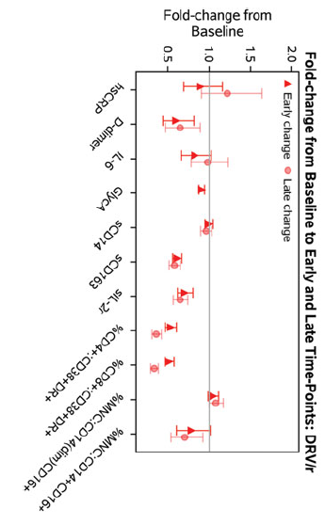
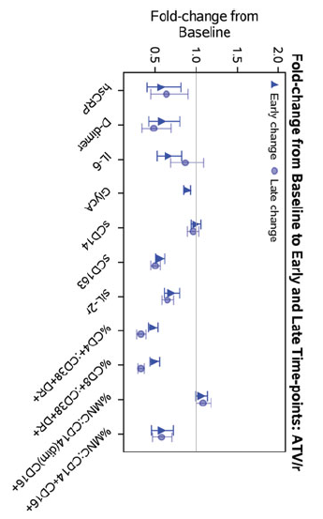
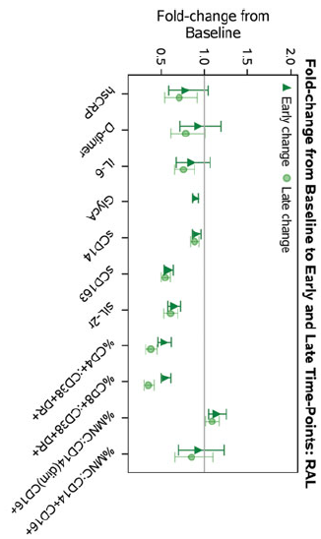
Despite some differences in specific markers of inflammation and immune activation between the ART regimens, biomarkers declined by regimen during the 96 weeks of FU
In ART-naive participants who initiated RAL, ATV/r, or DRV/r with TDF/FTC and successfully achieved virologic suppression: no consistent pattern in differences in biomarkers emerged that favored any of the ART regimens.
RAL did not have a more comprehensive impact on decreasing systemic inflammation and immune activation compared with PIs.
Notes:
Understanding how different initial ART regimens reduce chronic immune activation in treated HIV-1 infection is an ongoing research priority. Several studies have shown a significant reduction in markers of microbial translocation in people randomized to raltegravir (RAL) compared with people randomized to nonnucleoside reverse transcriptase inhibitors (NNRTIs) [16–18]. However, prior switch and intensification studies with RAL have not consistently demonstrated reduced low-level viral replication or changes in systemic inflammation and immune activation [19, 20].
Our objective in this study was to characterize and evaluate longitudinally the changes in biomarkers of inflammation and immune activation among treatment-naive individuals undergoing randomized ART initiation with an integrase-based regimen containing RAL or a protease inhibitor–based regimen containing either atazanavir/ritonavir (ATV/r) or darunavir/ritonavir (DRV/r). Our study was part of the AIDS Clinical Trials Group (ACTG) A5260s, a prospective, metabolic substudy of the clinical trial ACTG A5257 [21].
In this prospective study of ART-naive participants who initiated RAL, ATV/r, or DRV/r with TDF/FTC and successfully achieved virologic suppression, no consistent pattern in differences in biomarkers emerged that favored any of the ART regimens. our findings suggest that RAL did not have a more comprehensive impact on decreasing systemic inflammation and immune activation compared with PIs.
Other studies have suggested that integrase inhibitors may reduce inflammation more effectively than other antiretroviral agents [16, 27–29]. In the SPIRAL trial of 233 (119 RAL, 114 PI/r) otherwise healthy, virologically suppressed HIV-infected patients treated with PI/r who randomly switched from PI/r to RAL or continued with PI/r for 48 weeks, hsCRP, IL-6, tumor necrosis factor-alpha, and D-dimer decreased in the RAL group relative to the PI/r group [30]. Consistent findings show a rapid decrease of viral load in the first weeks of RAL treatment, with an almost absent second-phase decay [31, 32].
Although the reason for this effect remains unclear, the possibility of a differential effect of RAL on HIV-1 reservoirs, including monocytes and macrophages, has been suggested [33].
However, RAL intensification has demonstrated inconsistent improvements in T-cell activation [28, 29] and improved D Ddimer [29] and lipopolysaccharide (LPS) levels [34] but not sCD14 levels [20, 34]. Despite the potential mechanisms mentioned above, our study does not corroborate any advantage of
the integrase inhibitor RAL over PIs on reducing immune activation during the first 96 weeks of treatment. A strength of our study is the enrollment of ART-naive participants. Thus, the investigation of the effect of RAL vs PIs on immune activation is not confounded by prior ART experience; this is the case for ART switch or intensification-related studies.
Changes in systemic inflammation and immune activation that may occur during the initial phase of controlling HIV replication may not be present
with longer follow-up. Thus, longer follow-up may be needed to determine the differential effects of ART on biomarkers of systemic inflammation and immune activation.
All study participants received TDF/FTC, but further research should investigate whether the effects of RAL would differ with alternative nucleoside reverse
transcriptase inhibitor backbones. These results also highlight the need to examine newer ART regimens with more potent antiinflammatory effects
as a possible means to effectively prevent long-term comorbidities in the setting of HIV-1 infection.
Conclusions. Despite some differences in specific markers of inflammation and immune activation between the antiretroviral therapy (ART) regimens, we found no consistent evidence that the reduction of inflammation and immune activation with ART initiation was different between RAL and PI-based regimens.

