Slide 1
Les essais thérapeutiques dans la coinfection VIH VHC 2014 -2015
Ion 4
Ally 2
Quadrih
Edge 4
Viroteam 2015

Slide 2
ION-4: LDV/SOF x 12 weeks in HCV/HIV Co-infection
Phase 3, multicenter,
Platelets ≥50,000/mm³, hemoglobin ≥10 g/dL, CrCl ≥60 mL/min
HIV-1 positive, HIV RNA <50 copies/mL; CD4 cell count >100 cells/mm³
GT 1 and 4
TN and TE
N=335
LDV/SOF
SVR12
Wk 0
Wk 12
Wk 24
Demographics
Median age, yr (IQR) | 52 (48-58)
Male, n (%) | 276 (82)
Black, n (%) | 115 (34)
Mean BMI, kg/m² (range)² | 27 (18-66)
IL28B CC, n (%) | 81 (24)
GT 1a, n (%) | 250 (75)
GT 1b, n (%) | 77 (23)
HCV treatment experienced, n (%) | 185 (55)
Cirrhosis, n (%) | 67 (20)
Demographics
Median HCV RNA, log₁₀ IU/mL (IQR) | 6.9 (6.3-7.2)
Median CD4 cell count, cells/mm³ (IQR) | 628 (469-823)
HIV ART, n (%)
Efavirenz + FTC + TDF | 160 (48)
Raltegravir + FTC + TDF | 146 (44)
Rilpivirine + FTC + TDF | 29 (9)
FTC, emtricitabine; TDF, tenofovir disoproxil fumarate
TN, treatment naïve; TE, treatment experienced
1. Naggie S, et al. NEJM July 2015. DOI: 10.1056/NEJMoa15011
2. Naggie S, et al. IAS 2015, Vancouver, Canada. Oral # TUAB0202
Notes:
Transition: This slide shows the study design for the ION-4 trial and the demographics of the patients who were enrolled.
Main Message:
In this multicenter, open-label trial, all patients received a fixed-dose combination tablet containing 90 mg of ledipasvir and 400 mg of sofosbuvir, administered orally once daily for 12 weeks.
335 GT1 (227) and GT4 patients (8) at 60 sites in the United States, Puerto Rico, Canada, and New Zealand.
Patients were required to be on a stable, protocol-approved antiretroviral regimen for at least eight weeks prior to screening and have evidence of HIV viral suppression (HIV RNA <50 copies/mL) with CD4 cell counts above 100 cells/mm³.
A minimum creatinine clearance of 60 mL/min was required for enrollment.
In the absence of IFN and RBV in the regimen, the hematological inclusion criteria were also lower relative to other co-infection studies which have included RBV +/- IFN.
Based on healthy volunteer drug interaction data available at the time of protocol development, allowable antiretroviral drugs (ARV) included emtricitabine and tenofovir disoproxil fumarate plus efavirenz, raltegravir, or rilpivirine.
During the study period, switches to other antiretroviral combinations were allowable when medically indicated to prevent interruption of HIV therapy. Planned enrollment included approximately 50% of patients previously treated for HCV and 20% with cirrhosis.
With no upper limit to age or BMI, patients as old as 72 and with range of BMI from 18-66 were enrolled.
34% of patients were black, 76% had the unfavorable IL28B non-CC genotype and 20% of patients had cirrhosis.
55% had received previous treatment for HCV (of whom 36% had received prior DAAs) without achieving sustained virologic response (including 13 patients who were SOF+RBV relapsers from PHOTON-1).
75% of patients were infected with HCV genotype 1a, 23% with HCV genotype 1b, and 2% with HCV genotype 4.
The median CD4 cell count at baseline was 628 cells/µL (with a range of 106 to 2069 cells/µL).
All patients were receiving emtricitabine and tenofovir disoproxil fumarate; 48% with efavirenz, 44% with raltegravir, and 9% with rilpivirine.
Overall TE = 185/335 (55.2%); DAA + PEG + RBV = 53 (28.6%); PEG + RBV = 113 (61.1%); DAA + RBV = 14 (7.6%) incl. 13 SOF+R relapsers from PHOTON-1 and a single SMV+R; Other = 5 (2.7%) (Data on file)

Slide 3
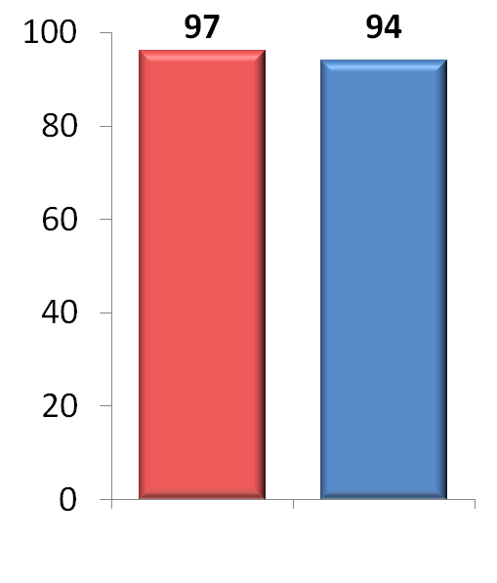
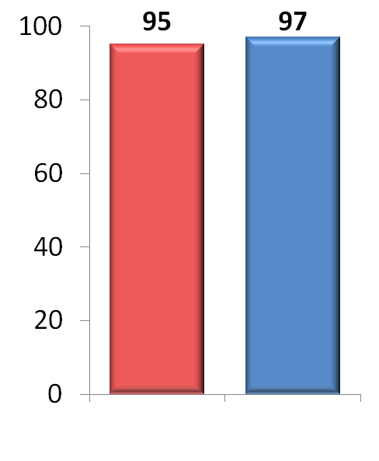
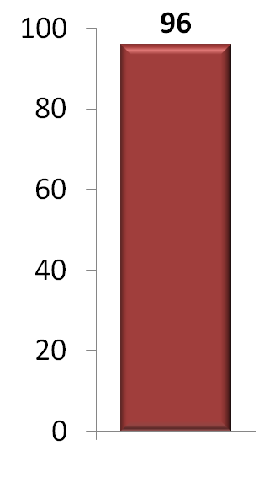
ION-4: LDV/SOF x 12 weeks in HCV/HIV Co-infection
Overall
Naïve vs Experienced^{2,3}
Cirrhosis Status^{2,3}
SVR12 (%)
321/335
143/150
179/185
259/268
63/67
LDV/SOF 12 Weeks
Naïve
Experienced
No Cirrhosis
Cirrhosis
Among those who were treatment-experienced with cirrhosis, 98% (46/47) achieved an SVR12²
1. Naggie S, et al. NEJM July 2015. DOI: 10.1056/NEJMoa15011
2. Supplement to : Naggie S, et al. NEJM July 2015. DOI: 10.1056/NEJMoa15011
3. Naggie S, et al. IAS 2015, Vancouver, Canada. Oral # TUAB0202
Notes:
Transition: This slide shows the overall SVR 12 rates for the ION-4 trial as well as response rates by various subgroups.
Main Message:
Among the 335 patients enrolled and treated, 321 (96%) had a sustained virologic response at 12 weeks after the end of treatment. This response rate in HCV/HIV co-infected patients is similar to that seen in HCV mono-infected patients
In total, 14 patients did not achieve a sustained virologic response. One of the 14 patients who did not achieve sustained virologic response was lost to follow-up after post-treatment week 4 and had undetectable HCV RNA at last visit. One patient died after treatment week 4, not related to study drug but related to active injecting drug use. Additionally, two of the 14 patients experienced virologic breakthrough during treatment; both patients were non-adherent, per the investigators. Finally, ten patients had virologic relapse, eight by post-treatment week 4 and two between post-treatment weeks 4 and 12.
The rates of sustained virologic response were similar in treatment-naïve and previously treated patients and in patients with and without cirrhosis, even treatment-experienced with cirrhosis.
All 13 patients who failed a prior sofosbuvir-containing regimen achieved sustained virologic response.
Of the patients who were treatment experienced with cirrhosis 98% (46/47) achieved an SVR12.

Slide 4
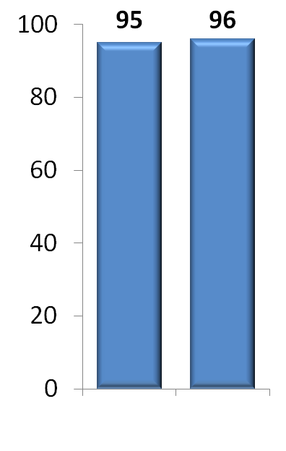
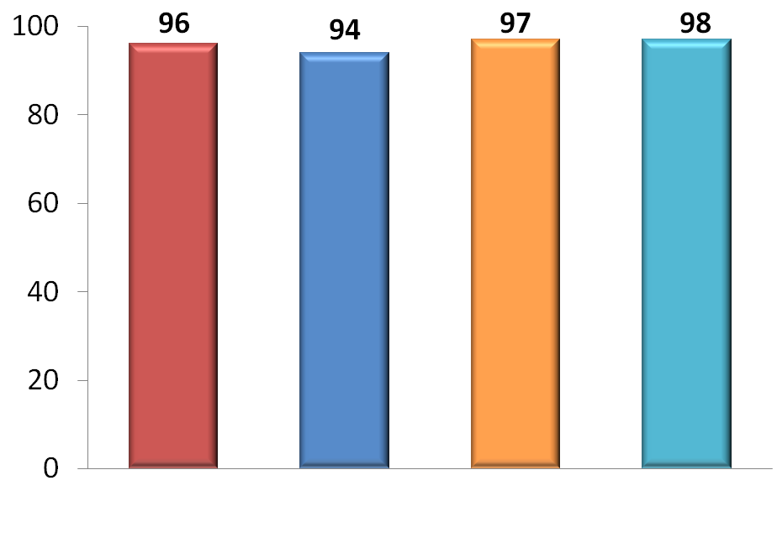
ION-4: LDV/SOF x 12 weeks in HCV/HIV Co-infection
Overall
HIV ARV Regimen²
CD4 Count²
SVR12 (%)
SVR12 (%)
322/335
151/160
28/29
143/146
35/37
287/298
Overall
EFV +
FTC + TDF
RPV +
FTC + TDF
RAL +
FTC + TDF
BL CD4 <350
BL CD4 ≥350
No patient had confirmed HIV virologic rebound¹
Stable CD4 counts through treatment¹ and follow-up phase³
EFV= efavirenz; FTC= emtricitabine; RAL= raltegravir; RPV= rilpivirine; TDF= tenofovir disoproxil fumarate
1. Naggie S, et al. NEJM July 2015. DOI: 10.1056/NEJMoa15011
2. Supplement to : Naggie S, et al. NEJM July 2015. DOI: 10.1056/NEJMoa15011
3. Naggie S, et al. IAS 2015, Vancouver, Canada. Oral # TUAB0202
Notes:
Transition: This slide shows the response rates by various subgroups.
Main Message:
The rates of sustained virologic response were similar in patients receiving various concomitant HIV antiretroviral regimens, and in patients with baseline CD4 counts above and below 350.
In the absence of RBV and IFN from the HCV treatment regimen, no patient had confirmed HIV virologic rebound and all patients had stable CD4 counts through treatment and follow-up phase.

Slide 5
Ally 2 : Daclatasvir + Sofosbuvir for HCV GT 1-4 and HIV Coinfection
Week
0
8
12
20
24
Treatment-Naïve
N = 101
Daclatasvir + Sofosbuvir
SVR12
Treatment-Naïve
N = 50
Daclatasvir + Sofosbuvir
SVR12
Treatment-Experienced
N = 52
Daclatasvir + Sofosbuvir
SVR12
Wyles DL, et al. N Engl J Med. 2015;373:714-25.

Slide 6
Ally 2 : Daclatasvir + Sofosbuvir for HCV GT 1-4 and HIV Coinfection
Characteristic | Treatment-Naïve 12-Week Group (n=101) | Treatment-Naïve 8-Week Group (n=50) | Previously Treated 12-Week Group (n=52)
HCV genotype 1A 1B 2 3 4 | 71 (70%) 12 (12%) 11 (11%) 6 (6%) 1 (1%) | 35 (70%) 6 (12%) 6 (12%) 3 (6%) 0 | 33 (63%) 11 (21%) 2 (4%) 4 (8%) 2 (4%)
Cirrhosis | 9 (9%) | 5 (10%) | 15 (29%)
Median HCV RNA log₁₀ | 6.7 (3.3-7.6) | 6.4 (4.2-7.5) | 6.7 (3.9-7.9)
Darunavir-ritonavir Atazanavir-ritonavir Lopinavir-ritonavir Efavirenz Nevirapine Rilpivirine Raltegravir Dolutegravir | 19% 19% 9% 18% 5% 5% 22% 3% | 44% 10% 6% 17% 2% 2% 17% 2% | 22% 24% 0 16% 6% 2% 20% 8%
Source: Wyles DL, et al. N Engl J Med. 2015;373:714-25.

Slide 7
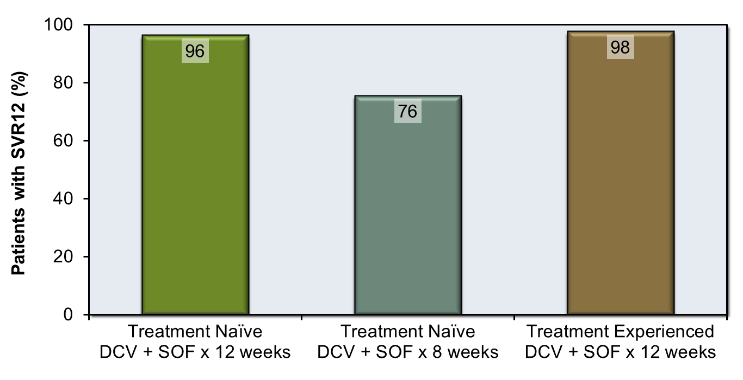
Ally 2 : Daclatasvir + Sofosbuvir for HCV GT 1-4 and HIV Coinfection
SVR12, Genotype 1
80/83
31/41
43/44
Abbreviations: DCV = daclatasvir; SOF = sofosbuvir
Source: Wyles DL, et al. N Engl J Med. 2015;373:714-25.

Slide 8
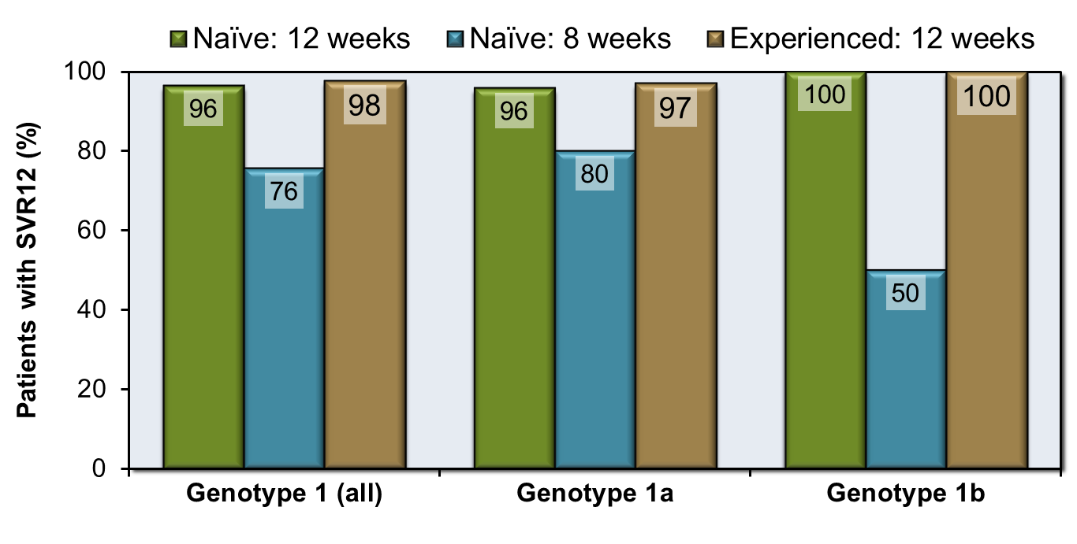
Ally 2 : Daclatasvir + Sofosbuvir for HCV GT 1-4 and HIV Coinfection
SVR12, Genotype 1 and subtypes
80/83
31/41
43/44
68/71
28/35
32/33
12/12
3/6
11/11
N= 11 had missing or inconclusive findings for cirrhosis & not included in denominators
Source: Wyles DL, et al. N Engl J Med. 2015;373:714-25.

Slide 9
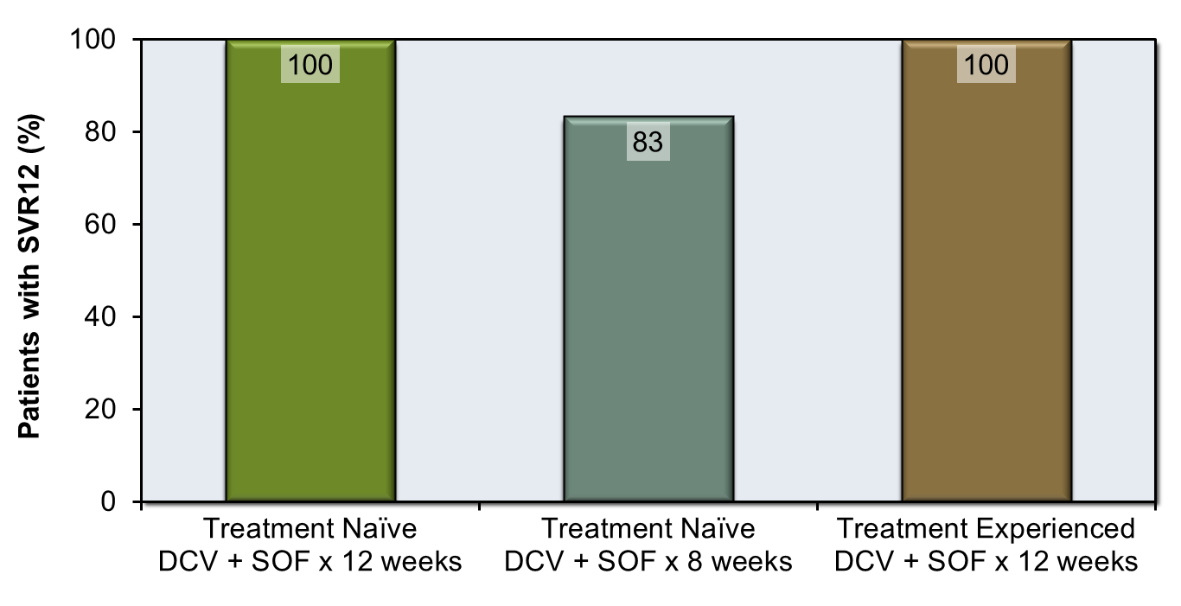
Ally 2 : Daclatasvir + Sofosbuvir for HCV GT 1-4 and HIV Coinfection
SVR12, Genotype 2
11/11
5/6
2/2
Abbreviations: DCV = daclatasvir; SOF = sofosbuvir
Source: Wyles DL, et al. N Engl J Med. 2015;373:714-25.

Slide 10
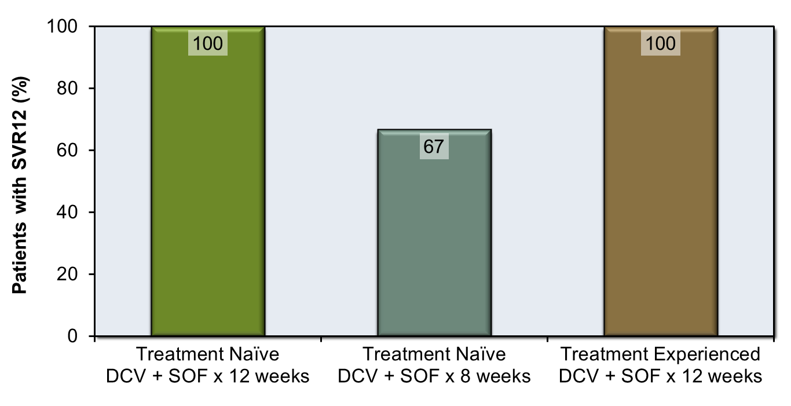
Ally 2 : Daclatasvir + Sofosbuvir for HCV GT 1-4 and HIV Coinfection
SVR12, Genotype 3
6/6
2/3
4/4
Abbreviations: DCV = daclatasvir; SOF = sofosbuvir
Source: Wyles DL, et al. N Engl J Med. 2015;373:714-25.

Slide 11
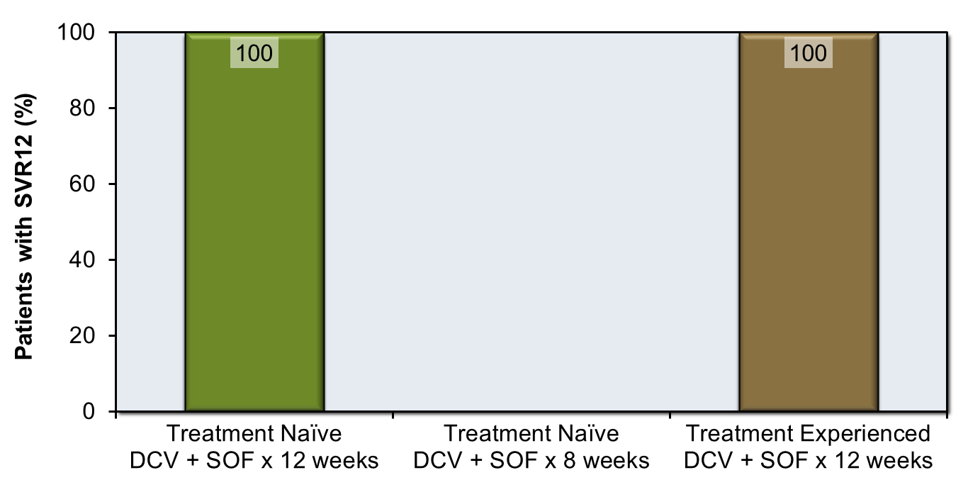
Ally 2 : Daclatasvir + Sofosbuvir for HCV GT 1-4 and HIV Coinfection
SVR12, Genotype 4
1/1
No GT4 patients enrolled in this arm
2/2
Abbreviations: DCV = daclatasvir; SOF = sofosbuvir
Source: Wyles DL, et al. N Engl J Med. 2015;373:714-25.

Slide 12
Essai ANRS HC30 : daclatasvir + asunaprevir + PR chez les co-infectés VHC/VIH de génotype 1 ou 4 non répondeurs à une PR antérieure
134
Daclatasvir (DCV)
Asunaprevir (ASV) = inhibiteur de protéase du VHC (génotypes 1 et 4)
Etude phase 2 pilote, ouverte, simple bras, multicentrique, 75 patients
Infection VIH
CV < 400 c/ml depuis au moins 3 mois
Traitement ARV comprenant RAL depuis au moins 1 mois
Infection VHC
27 patients avec cirrhose (> 14,5 kPa ou F4)
Critère principal = RVS12
S0
S4
S16
S28
S40
S52
Induction
Quadrithérapie
RVS12
RVS24
P + R
DCV 60 mg qd + ASV 100 mg bid+ P + R
Piroth L, CROI 2015, A Clin Infect Dis. 2015 Sep 1;61(5):817-25.
Notes:
Répondeurs nuls à interferon ribavirine

Slide 13
Essai ANRS HC30 : daclatasvir + asunaprevir + PR chez les co-infectés VHC/VIH
135
RVS12 (%)
RVS12 = 96,0 % (72/75) (IC 95 % = 91,6-100)
RVS12 = 92,6 % chez les patients avec cirrhose
2 patients en EV avec sélection de mutations de résistance :
NS3 = R155T/R + D168V et NS5A = R30E
NS3 = D168T et NS5A = Y43N
4 arrêts (5 %) = 3 pour complications infectieuses dont 1 décès et 1 arrêt pour chimiothérapie anti-cancéreuse
Piroth L, CROI 2015, A Clin Infect Dis. 2015 Sep 1;61(5):817-25.
Piroth L, CROI 2015, Abs. 146
Notes:
Quand est-il traitement sans interferon et ribavirine chez ces répondeurs nuls ?
Bonne réponse pour génotype 1b avec seulement dacla + asunaprevir
Par contre insuffisant RVS 36 % 1a
Place réduite dans l’arsenal car utilise interferon autre association possible interressant en sauvetage cirrhotique et geno 4

Slide 14
C-EDGE Coinfection: Grazoprevir/Elbasvir for Pts Coinfected With HIV/HCV
Multicenter, single-arm, open-label phase III trial
Wk 12
HCV treatment-naive pts coinfected with HIV and GT1, 4, or 6 HCV; stable on ART ≥ 8 wks (N = 218)
Grazoprevir/Elbasvir HCV NS3/4A inhibitor/HCV NS5A inhibitor
Coformulation dosed orally 100/50 mg QD
66% GT1a HCV, 60% had HCV RNA > 800,000 IU/mL, 16% cirrhotic
Baseline ART Characteristic, % | Grazoprevir/Elbasvir (N = 218)
Undetectable HIV-1 RNA on ART | 96.8
ART regimen
Abacavir containing | 21.6
TDF containing | 75.2
Raltegravir | 51.8
Dolutegravir | 27.1
Rilpivirine | 17.4
Rockstroh JK, et al. IAS 2015. Abstract TUAB0206LB. Rockstroh JK, et al. Lancet HIV. 2015;2:e319-e327.
Notes:
ART, antiretroviral therapy; GT, genotype; HCV, hepatitis C virus; QD, once daily; TDF, tenofovir disoproxil fumarate.
For more information about this study, go to http://www.clinicaloptions.com/HIV/Conference%20Coverage/IAS%202015/Other%20Highlights/Capsules/TUAB0206LB.aspx

Slide 15
C-EDGE Coinfection: Grazoprevir/Elbasvir for Pts Coinfected With HIV/HCV
SVR12 With 12 Wks GZR/EBV According to Genotype
No subgroup provided efficacy advantage or disadvantage, including ART regimen
New NS3, NS5A RAVs detected at failure in 4 of 5 pts who relapsed
Short-lived HIV-1 RNA increases in 2 pts on ART during GZR/EBV treatment
Both resuppressed HIV-1 RNA without change of ART
During GZR/EBV Tx, no significant changes in CD4+ cell count
GZR/EBV well tolerated: no pt discontinued for AEs and no serious treatment-related AEs
96.3
96.5
95.5
96.4
100
80
60
SVR12 (%)
40
20
210/ 218
139/ 144
42/ 44
27/ 28
n/N =
0
All Pts
GT1a
GT1b
GT4
Discontinued* | 1 | 0 | 1 | 0
Relapse | 5 | 4 | 0 | 1
Reinfection | 2 | 1 | 1 | 0
*Unrelated to virologic failure.
Rockstroh JK, et al. IAS 2015. Abstract TUAB0206LB. Rockstroh JK, et al. Lancet HIV. 2015;2:e319-e327. Reproduced with permission.
Notes:
AE, adverse event; ART, antiretroviral therapy; EBV, elbasvir; GT, genotype; GZR, grazoprevir; HCV, hepatitis C virus; RAV, resistance associated variant; SVR, sustained virologic response; Tx, treatment.
For more information about this study, go to http://www.clinicaloptions.com/HIV/Conference%20Coverage/IAS%202015/Other%20Highlights/Capsules/TUAB0206LB.aspx

Slide 16
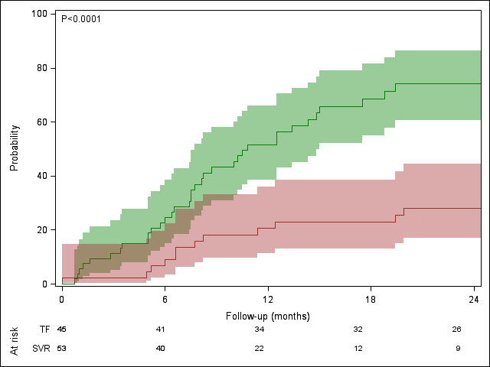
Bénéfices du traitement sur l’élastométrie
98 HIV/HCV co-infected patients followed by Elastometry after Interferon α based regimen)
Those with SVR had significantly more often a decrease in liver stiffness
100
Logrank
Cumulative probability of achieving a decrease of liver stiffness
80
SVR
60
40
Treatment
Failure
20
0
0
6
Follow-up (months)
18
24
Salmon D. Hepavih, AIDS september 2015

Slide 17
Risque résiduel d’évènements hépatiques après RVS chez les patients coinfectés VIH VHC
Parmi 326 patients dont 75 cirrhotiques, suivi en médiane 3,5 ans après la RVS, six patients ont développé un évènement hépatique
Délai médian de survenue: 7 mois après la RVS
Patient 1 :
Patient 2 :
Patient 3 :
Patient 4 :
Patient 5 :
Patient 6 :
RVS
CHC
DCP
Décès cause hépatique
RVS
CHC
DCP
Décès cause hépatique
RVS
DCP
RVS
DCP
RVS
DCP
RVS
DCP
Salmon D. JNI 2015

Slide 18
Incidence d’évènements hépatiques chez les patients coinfectés VIH VHC
 | Nombre de patients-années | Taux d’incidence /1000 PA (IC)
Population globale (n=324) | 1437,37 | 4,17 (0,83-7,51)
Patients F3/F4 (n=75) | 263,55 | 11,38 (0,50-22,26)
Patients F0/F1/F2 (n=222) | 991,06 | 2,02 (0,78-3,26)
Salmon D. JNI 2015

Slide 19
Rechute tardive ou ré-infection VHC : méta-analyse
Base de données MEDLINE et EMBASE : 11 071 patients (66 études) avec RVS24 et suivi > 6 mois (la grande majorité traités par PEG-IFN + RBV)
Incidence récurrence VHC 5 ans après RVS24 (%)
Faible risque
(mono-infectés VHC
non UDIV et non
prisonniers)
43 études, n = 9 419
Suivi moyen = 4,1 + 2,1 ans
Risque élevé
(UDIV ou prisonniers)
16 études, n = 819
Suivi moyen = 2,9 + 1,6 ans
Co-infectés VIH/VHC
7 études, n = 833
Suivi moyen = 3,1 + 1,2 ans
30
21,7 %
(IC 95 % 18,3-25,5%)
25
20
13,2%
(IC 95 % 9,9-17,2%)
15
10
5
1,1%
(IC 95 % 0,9-1,4%)
0
Hill A, CROI 2015, Abs. 654
Notes:
Inclusion des patients coinfectés VIH/VHC exclusion transplantés hépatiques
Le taux considérablement plus élevé de «rechute » tardive VHC chez les sujets à haut risque ou co-infectés VIH suggère qu’il s’agit dans la très grande majorité des cas, de réinfection.
Groupe co infecté essentiellement étude MSM

