Slide 1
STRATEGIE THERAPEUTIQUE
JL Meynard
Hôpital Saint-Antoine
75012 PARIS

Slide 2
START: Immediate vs Deferred Therapy for Asymptomatic, ART-Naive Pts
Study closed by DSMB
following interim analysis
International, randomized trial
Composite primary endpoint: any serious AIDS-related (AIDS-related death or AIDS-defining event) or non-AIDS–related event (non-AIDS–related death, CVD, end-stage renal disease, decompensated liver disease, non-AIDS–defining cancer)
Mean follow-up: 3 yrs; median baseline CD4+ cell count: 651 cells/mm³; median baseline HIV-1 RNA: 12,759 copies/mL
Median CD4+ cell count at initiation of ART for deferred group: 408 cells/mm³
Immediate ART ART initiated immediately following randomization (n = 2326)
HIV-positive, ART-naive adults with CD4+ cell count > 500 cells/mm³
(N = 4685)
Deferred ART Deferred until CD4+ cell count ≤ 350 cells/mm³,
AIDS, or event requiring ART
(n = 2359)
INSIGHT START Study Group. N Engl J Med. 2015;[Epub ahead of print]. Lundgren J, et al. IAS 2015. Abstract MOSY0302.
Notes:
ART, antiretroviral therapy; CVD, cardiovascular disease; DSMB, data and safety monitoring board.
For more information about this study, go to http://www.clinicaloptions.com/HIV/Conference%20Coverage/IAS%202015/Treatment/Capsules/MOSY03.aspx

Slide 3
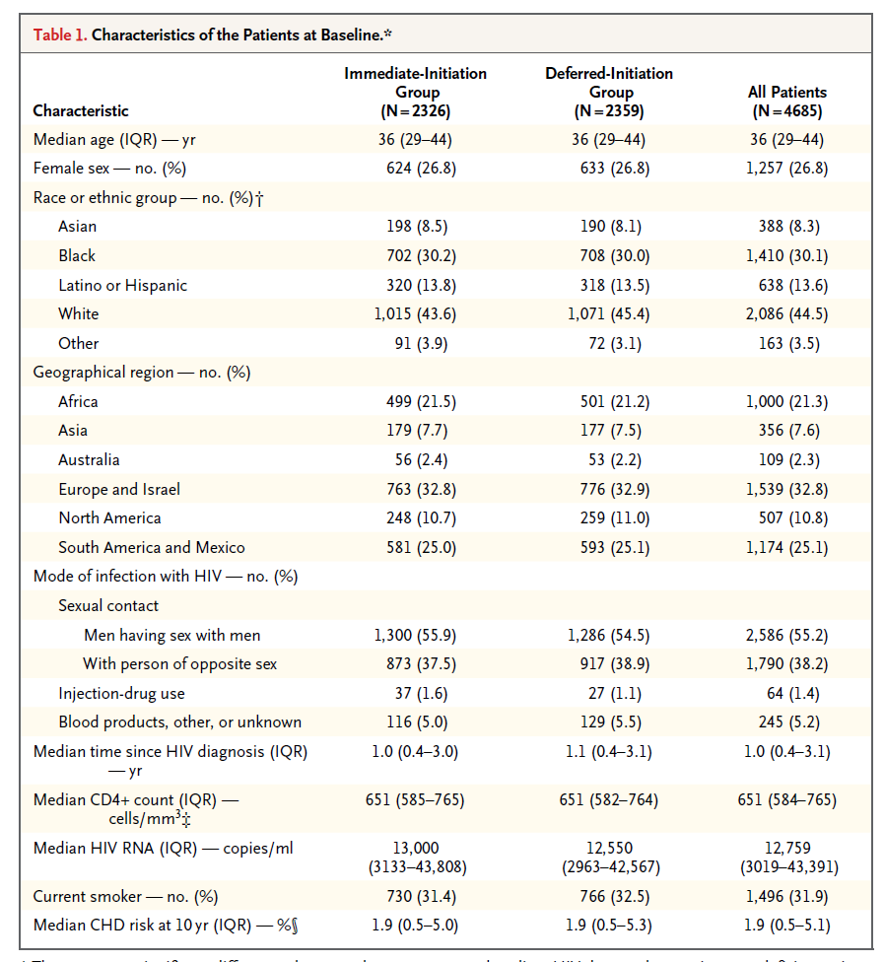

Slide 4
START: 57% Reduced Risk of Serious Events or Death With Immediate ART
4.1% vs 1.8% in deferred vs immediate arms experienced serious AIDS or non-AIDS–related event or death (HR: 0.43; 95% CI: 0.30-0.62; P < .001)
10
8
Deferred ART
6
Cumulative Percent With Event
4
2
Immediate ART
0
0
6
12
18
24
30
36
42
48
54
60
Mo
INSIGHT START Group. N Engl J Med. 2015;[Epub ahead of print]. Lundgren J, et al. IAS 2015. Abstract MOSY0302. Reproduced with permission.
Notes:
ART, antiretroviral therapy.
For more information about this study, go to http://www.clinicaloptions.com/HIV/Conference%20Coverage/IAS%202015/Treatment/Capsules/MOSY03.aspx

Slide 5
START: Primary Endpoint Components With Immediate vs Deferred ART
Endpoint | Immediate ART (n = 2326) |  | Deferred ART (n = 2359) |  | HR (95% CI) | P Value
 | N | Rate/100 PY | N | Rate/100 PY
Serious AIDS-related event | 14 | 0.20 | 50 | 0.72 | 0.28 (0.15-0.50) | < .001
Serious non-AIDS–related event | 29 | 0.42 | 47 | 0.67 | 0.61 (0.38-0.97) | .04
All-cause death | 12 | 0.17 | 21 | 0.30 | 0.58 (0.28-1.17) | .13
Tuberculosis | 6 | 0.09 | 20 | 0.28 | 0.29 (0.12-0.73) | .008
Kaposi’s sarcoma | 1 | 0.01 | 11 | 0.16 | 0.09 (0.01-0.71) | .02
Malignant lymphoma | 3 | 0.04 | 10 | 0.14 | 0.30 (0.08-1.10) | .07
Non-AIDS–defining cancer | 9 | 0.13 | 18 | 0.26 | 0.50 (0.22-1.11) | .09
CVD | 12 | 0.17 | 14 | 0.20 | 0.84 (0.39-1.81) | .65
INSIGHT START Group. N Engl J Med. 2015;[Epub ahead of print]. Lundgren J, et al. IAS 2015. Abstract MOSY0302.
Notes:
ART, antiretroviral therapy; CVD, cardiovascular; PY, patient-years.
For more information about this study, go to http://www.clinicaloptions.com/HIV/Conference%20Coverage/IAS%202015/Treatment/Capsules/MOSY03.aspx

Slide 6
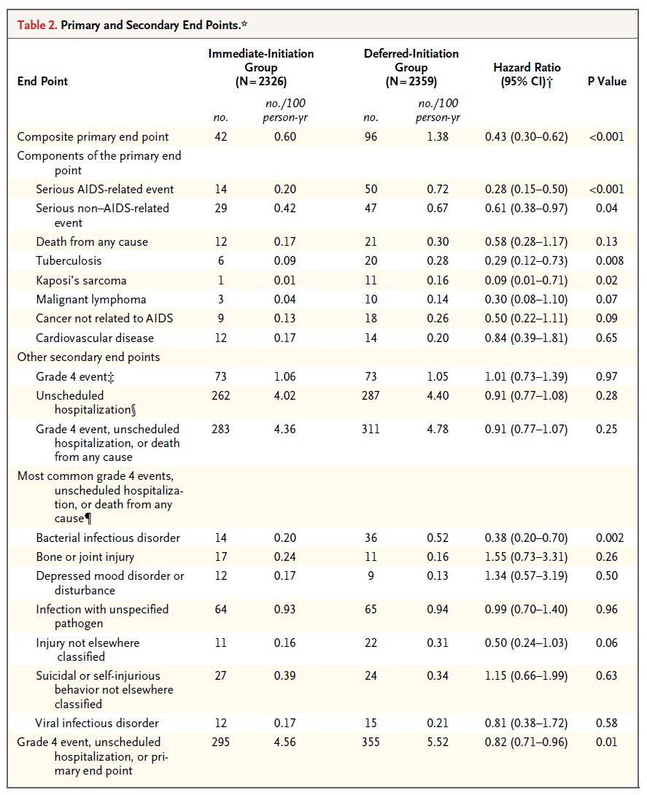

Slide 7
START: Cancer Events With Immediate vs Deferred ART
Cancer Event, n | Immediate ART (n = 2326) | Deferred ART (n = 2359)
Total | 14 | 39
Kaposi’s sarcoma | 1 | 11
Lymphoma, NHL + HL | 3 | 10
Prostate cancer | 2 | 3
Lung cancer | 2 | 2
Anal cancer | 1 | 2
Cervical or testis cancer | 1 | 2
Other types* | 4 | 9
Time to Cancer Event
10
Rate/100 PY: immediate, 0.20; deferred, 0.56
(HR: 0.36; 95% CI: 0.19-0.66; P = .001)
8
6
Cumulative % With Event
Deferred ART
4
2
0
Immediate ART
0
12
24
36
48
60
Mo
*Immediate ART: squamous cell carcinoma, plasma cell myeloma, bladder cancer, fibrosarcoma.
Deferred ART: gastric adenocarcinoma, breast cancer, ureteric cancer, malignant melanoma, myeloid leukemia, thyroid cancer, leiomyosarcoma, liver cancer, squamous cell carcinoma of head and neck.
INSIGHT START Group. N Engl J Med. 2015;[Epub ahead of print]. Lundgren J, et al. IAS 2015. Abstract MOSY0302. Reproduced with permission.
Notes:
ART, antiretroviral therapy; HL, Hodgkin lymphoma; NHL, non-Hodgkin lymphoma; PY, patient-years.
For more information about this study, go to http://www.clinicaloptions.com/HIV/Conference%20Coverage/IAS%202015/Treatment/Capsules/MOSY03.aspx

Slide 8
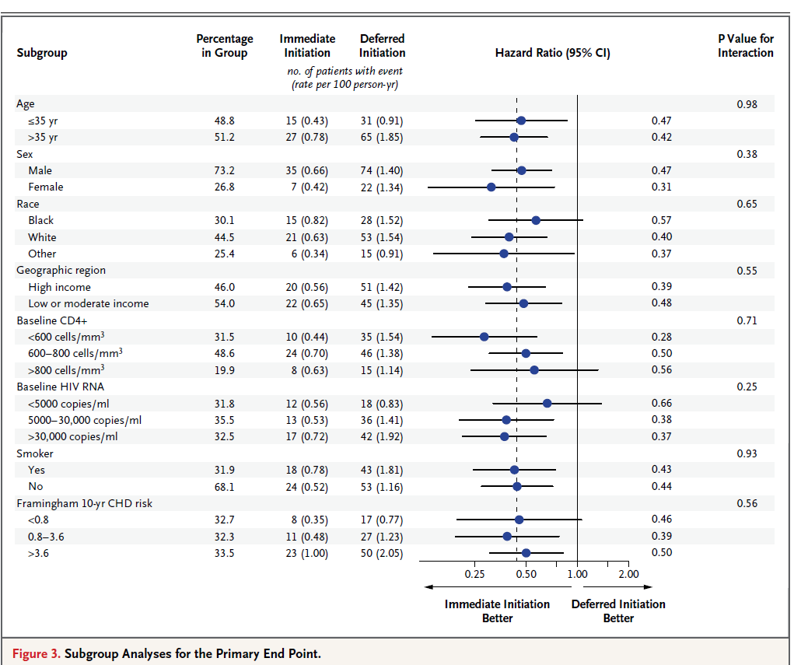

Slide 9
START: Primary Endpoint Events by Latest CD4+ Cell Count
Immediate ART
Deferred ART
No. of Pts With Events (Rates/100 PY)
No. of Pts With Events (Rates/100 PY)
Latest CD4+ count > 500 cells/mm³
60
2 (4.7)
3 (0.8)
6 (0.4)
11 (0.6)
20 (0.6)
5 (1.8)
34 (2.0)
34 (1.5)
9 (0.6)
14 (1.1)
 | Immediate ART | Deferred ART
Primary events, % (n/N) | 88 (37/42) | 59 (57/96)
Rate/100 PY | 0.6 | 1.1
50
40
30
Percent of Follow-up Time
20
10
0
350-499
< 350
< 350
500-649
≥ 800
650-799
≥ 800
350-499
500-649
650-799
Latest CD4+ Cell Count (cells/mm³)
INSIGHT START Group. N Engl J Med. 2015;[Epub ahead of print]. Lundgren J, et al. IAS 2015. Abstract MOSY0302. Reproduced with permission.
Notes:
ART, antiretroviral therapy; PY, patient-years.
For more information about this study, go to http://www.clinicaloptions.com/HIV/Conference%20Coverage/IAS%202015/Treatment/Capsules/MOSY03.aspx

Slide 10
TEMPRANO: Immediate or Deferred ART Initiation ± IPT for African Pts
Randomized, controlled, unblinded, multicenter (Ivory Coast), 2 x 2 factorial
Immediate ART† (n = 515)
Pts with HIV infection and CD4+ cell count < 800 cells/mm³
who did not meet WHO criteria for initiating ART*
(N = 2056)
Immediate ART† + IPT‡ (n = 518)
Deferred ART§ (n = 511)
Deferred ART§ + IPT‡ (n = 512)
*WHO criteria evolved during the study (updates 2006, 2010, 2013). †ART initiated immediately following randomization. ‡IPT = 300 mg daily isoniazid initiated 1 mo after enrollment and terminated 7 mos after enrollment. §Deferred until meeting WHO criteria for initiating ART.
Pts in the treatment arms well matched at baseline
First-line ART primarily EFV + TDF/FTC (68% to 71%) or LPV/RTV + TDF/FTC (22% to 24%)
Median duration of follow-up: 29.9 mos
TEMPRANO ANRS 12136 Study Group. N Engl J Med. 2015;[Epub ahead of print].
Notes:
ART, antiretroviral therapy; EFV, efavirenz; FTC, emtricitabine; IPT, isoniazid preventive therapy; LPV, lopinavir; RTV, ritonavir; TDF, tenofovir disoproxil fumarate; WHO, World Health Organization.

Slide 11
TEMPRANO: Immediate vs Deferred ART Initiation and IPT Delivery for African Pts
30-Mo Probability, % 14.1 8.8
7.4
5.7
Deferred ART Deferred ART + IPT Immediate ART Immediate ART + IPT
25
20
Cumulative Probability of Death or Severe HIV-Related Illness (%)
15
10
5
0
0
6
12
18
24
30
Mos From Randomization
TEMPRANO ANRS 12136 Study Group. N Engl J Med. 2015;[Epub ahead of print].
Notes:
ART, antiretroviral therapy; IPT, isoniazid preventive therapy.

Slide 12
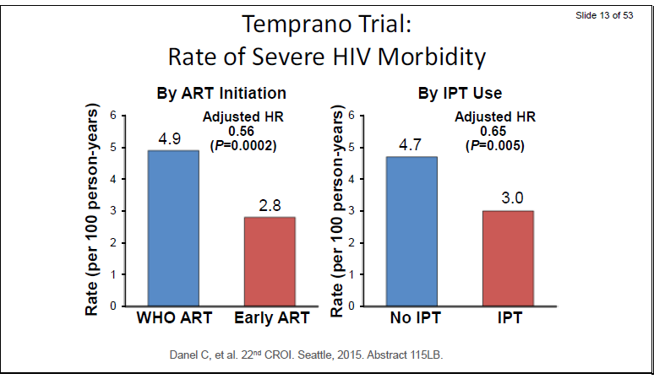

Slide 13
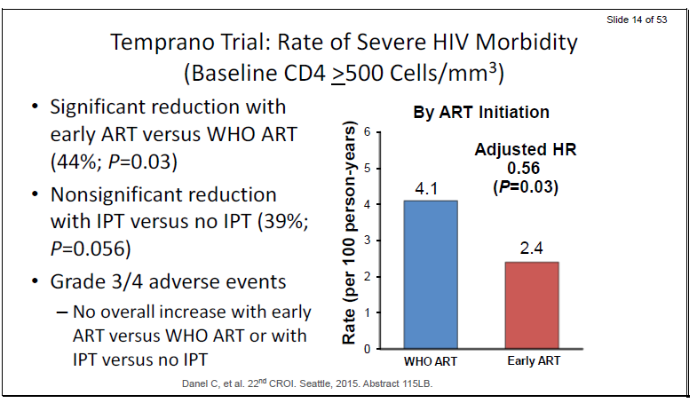

Slide 14
Conclusion
Bénéfice clairement démontré d’une introduction précoce des antirétroviraux
Bénéfice déjà démontré d’une réduction du risque de transmission du VIH sous tt ARV efficace
Nécessité d’un dépistage précoce et d’un large accès aux ARV

