Slide 1
risque cardiovasculaire et comorbidités liées à l'âge
P de Truchis
Hôpital Raymond Poincaré
Garches 92

Slide 2
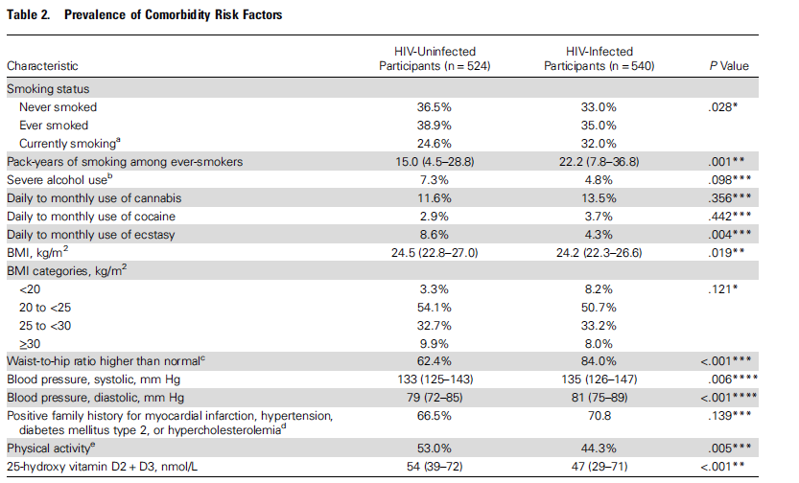

Slide 3
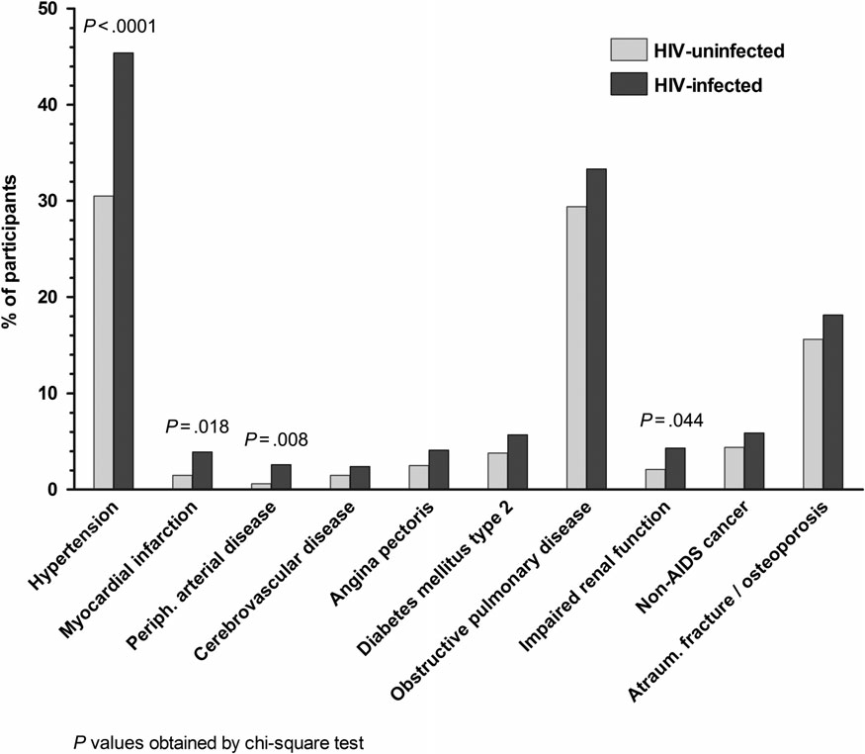
Prévalence des Comorbidités liées à l’age
Patients HIV+ HPA: 44%
Cvasc: 13%
Diabète: 6%
COPD: 33%
CKD: 4%
Cancers: 5%
Os: 18%

Slide 4
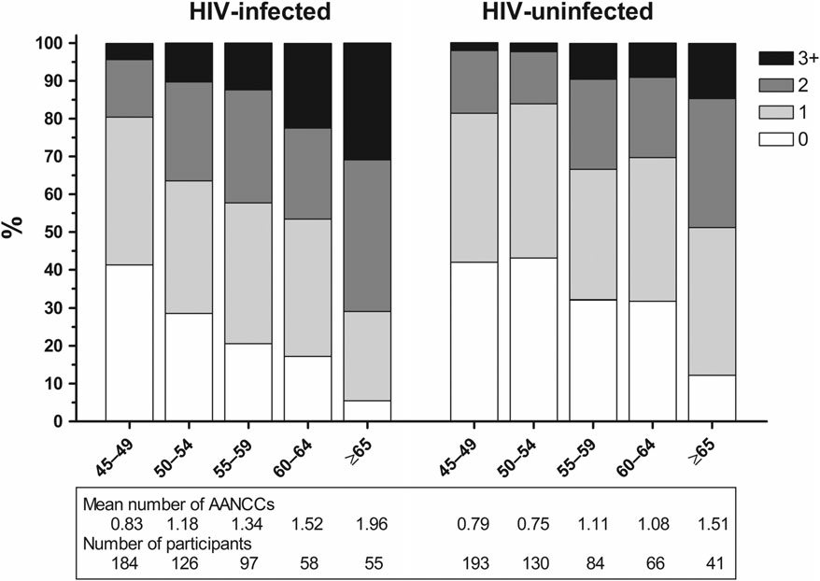

Slide 5
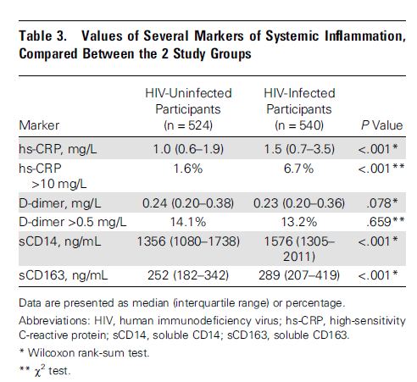

Slide 6
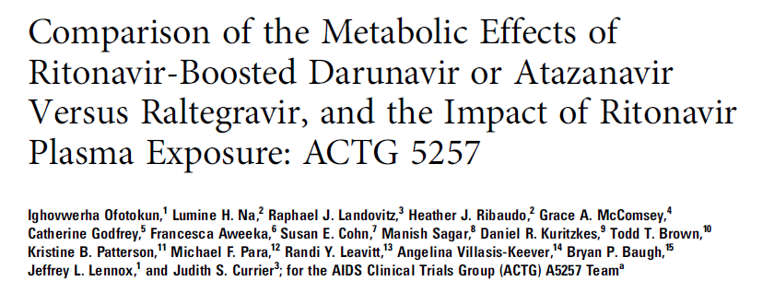
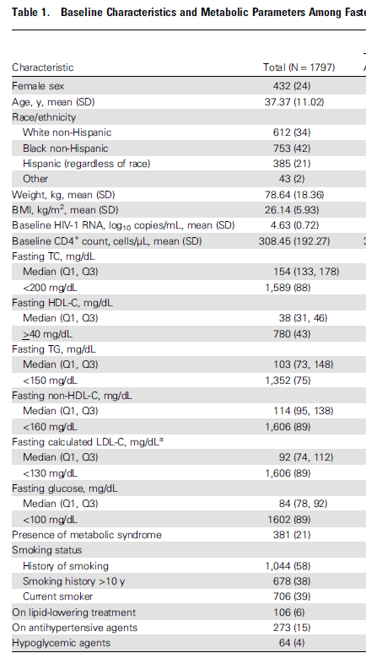
1809 Patients naïfs d’ARV
randomisés en 3 bras: - RAL 400 x2 ] - r/ATV300 x1 ] + TDF/FTC - r/DRV800 x1 ]
1797 patients analysés dans l’étude métabolique:

Slide 7
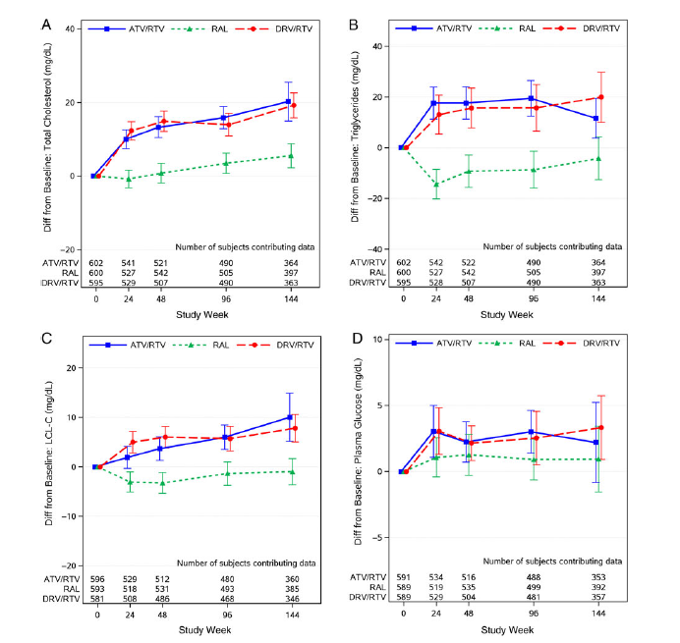
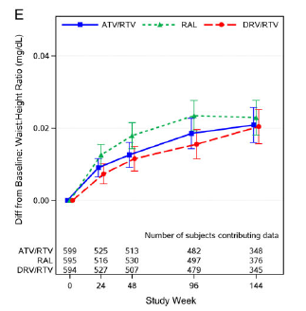
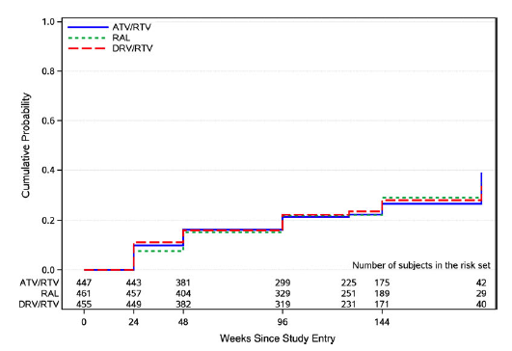
TC
TG
ACTG 5257
WH ratio
LDL-C
Gl
Sd métabolique

Slide 8
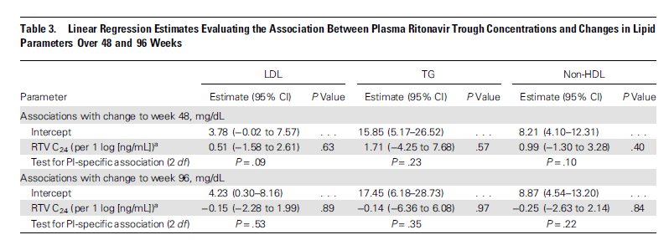
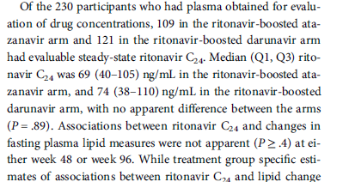

Slide 10
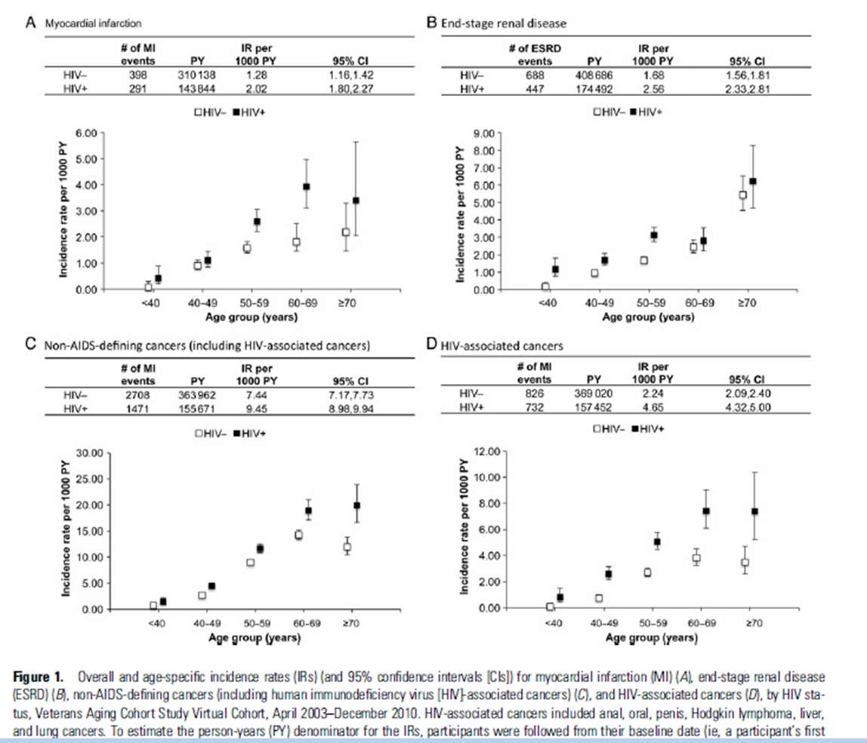

Slide 11
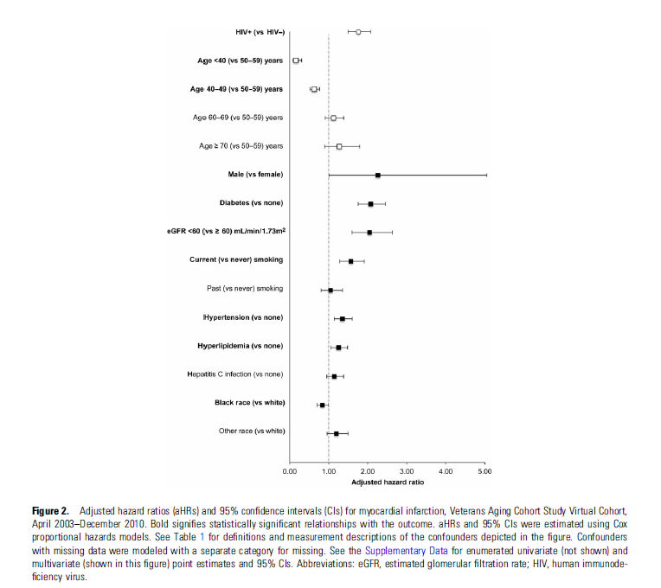
Risque Inf myoc

Slide 12
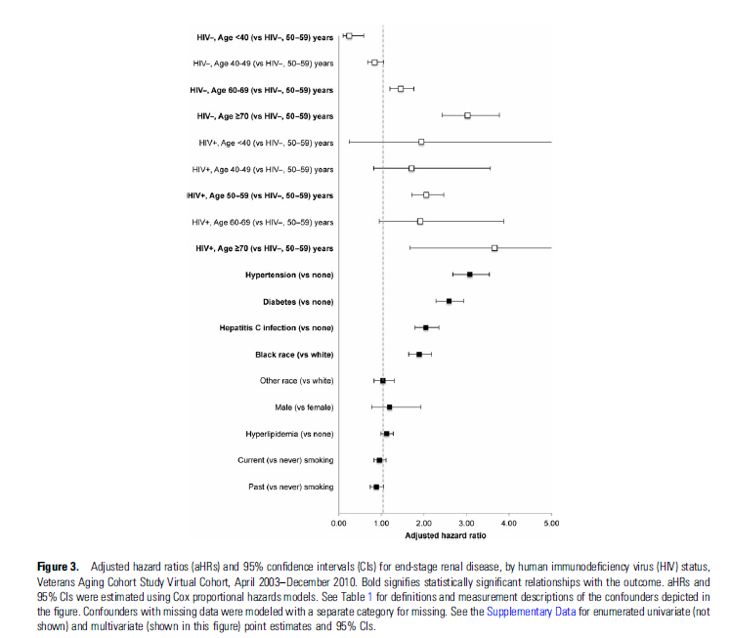
Risque endstage Renal Dis

Slide 13
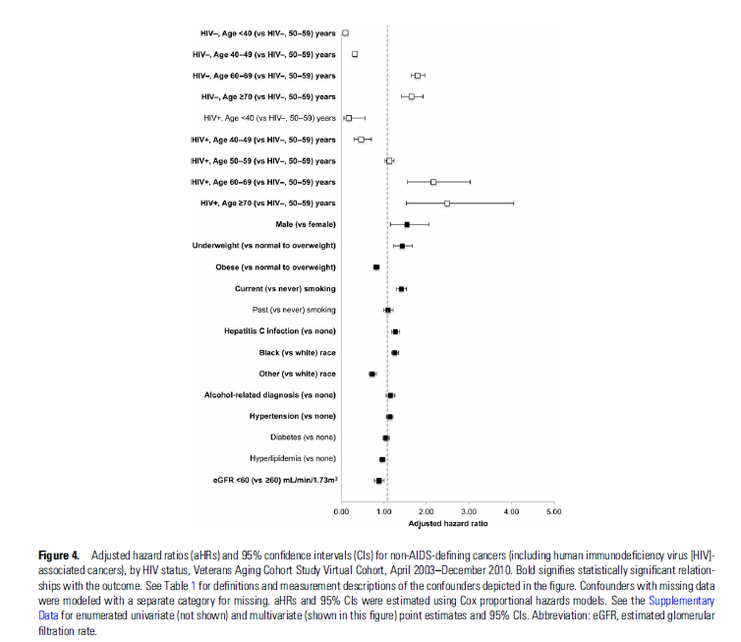
Risque nonAIDS def. Cancers

Slide 14
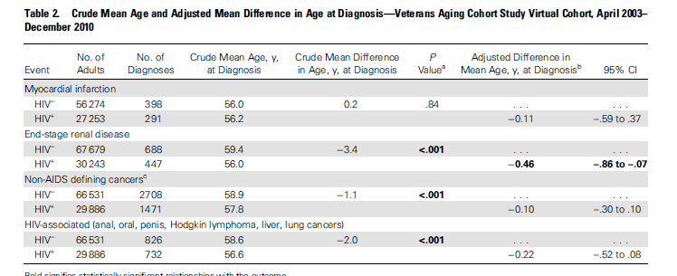

Slide 15
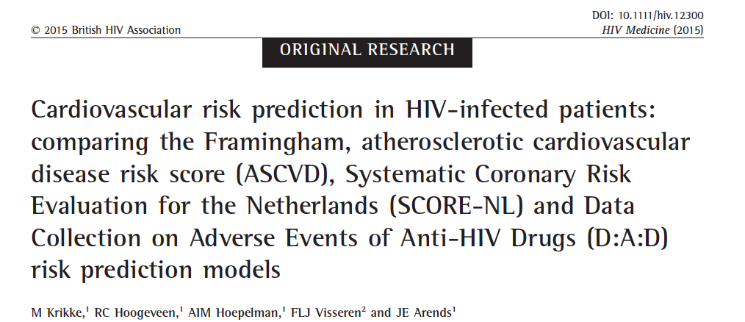
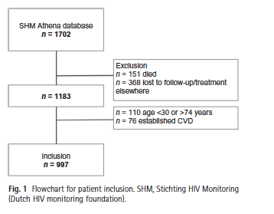
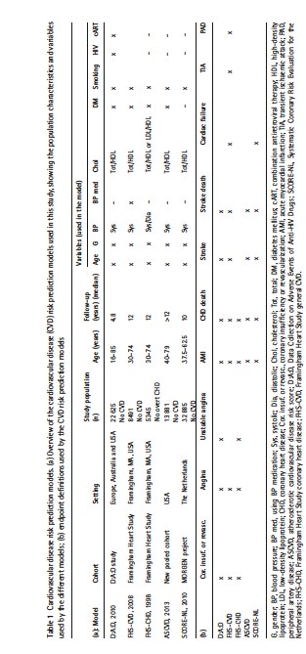

Slide 16
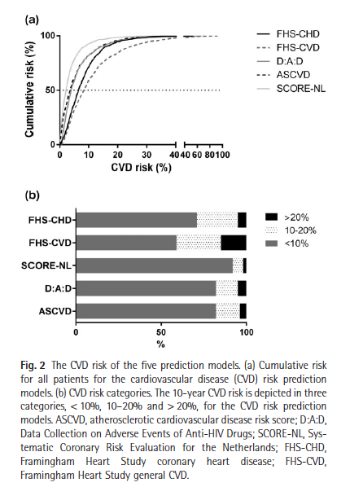
In conclusion, in this study in HIV-infected patients, the D:A:D, ASCVD and SCORE-NL models had similarly low CVD risk predictions when compared with both FHS models (FHS-CVD and FHS-CHD).

Slide 17
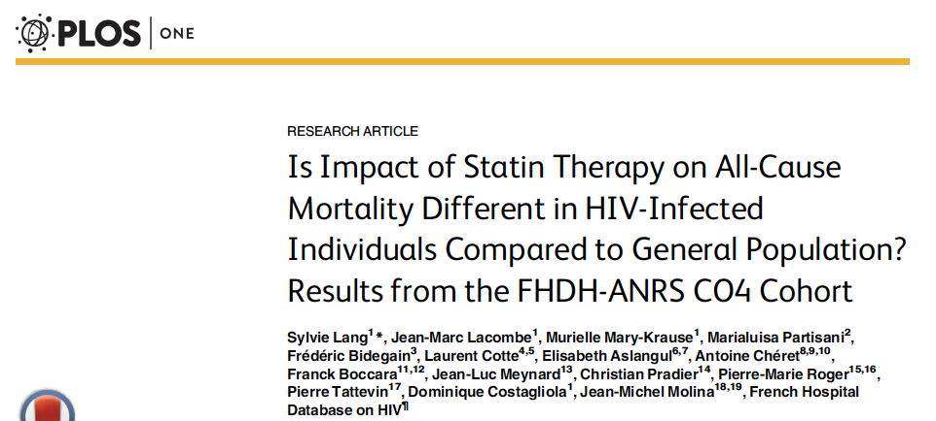
The patients selected were the controls from a case-control study of myocardial infarction (MI) [10 ], nested within the FHDH-ANRS CO4. Enrolments took place from January 2000 through December 2009. Patients with prior cardiovascular or cerebrovascular disorders were not eligible.
Among 1,776 HIV-infected individuals included in the study, 138 (8%) were statin users. The use of statins rose from 3% in 2000/01 to 13% in 2008/09. The most frequently prescribed statins were pravastatin (56%), rosuvastatin (32%) and atorvastatin (8%).
The outcome measure was all-cause mortality, censored at 7 years of follow-up.

Slide 18
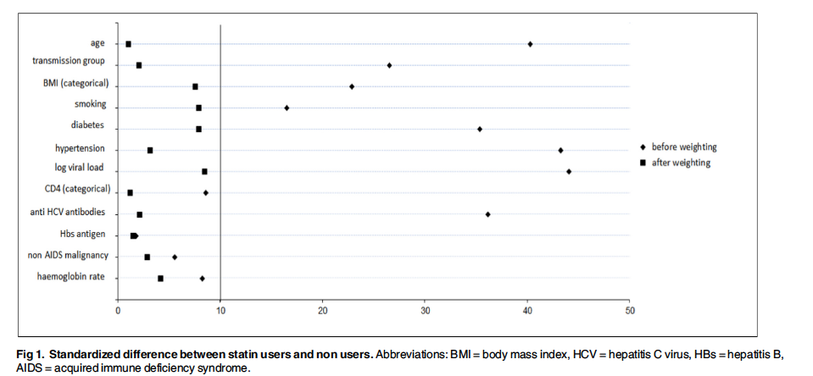

Slide 19
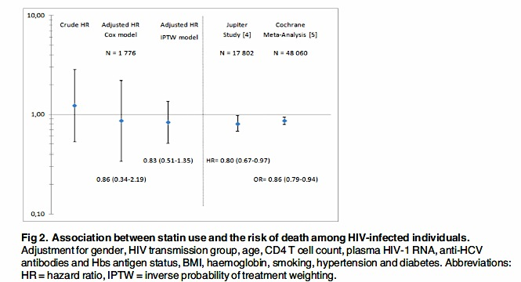
Conclusion
The effect of statins on all-cause mortality appears to be similar in HIV-infected and-uninfected populations. The potential benefits of statin therapy in HIV-infected patients should be weighed up in view of the risk of drug-drug interactions and known adverse effects such as the increased risk of diabetes and myopathy [15 ].

Slide 20
Statines et diabète
Statin Use Is Associated With Incident Diabetes Mellitus Among Patients in the HIV Outpatient Study. Lichtenstein KA, Hart RL, Wood KC, Bozzette S, Buchacz K, Brooks JT; HIV Outpatient Study Investigators. J Acquir Immune Defic Syndr. 2015 Jul 1;69(3):306-11.
Rosuvastatin Worsens Insulin Resistance in HIV-Infected Adults on Antiretroviral Therapy. Erlandson KM, Jiang Y, Debanne SM, McComsey GA. Clin Infect Dis. 2015 Jul 8.

