Slide 1
COMPLICATIONS INFECTIONS OPPORTUNISTES
JL MEYNARD

Slide 2
Kaiser Permanente: Life Expectancy in HIV-Infected vs Uninfected Persons
Analysis of life expectancy in 24,768 HIV-infected and 257,600 HIV-uninfected adult pts in Kaiser Permanente California 1996-2011; 2 groups matched for age, sex, medical center, yr
HIV positive
HIV negative
8000
13-Yr Gap
80
7077
65
Lines: Deaths per 100,000 PYs
6000
63
53
60
Dots:
Expected yrs of life remaining at age 20
4000
40
2000
19
20
P < .001
1054
439
P = .062
381
0
0
1996-
1997
1998-
1999
2000-
2001
2002-
2003
2004-
2005
2006
2007
2008
2009
2010
2011
Marcus JL, et al. CROI 2016. Abstract 54. Reproduced with permission.
Slide credit: clinicaloptions.com
Notes:
The first one is looking at life expectancy, a really nice presentation from Kaiser Permanente. These are all insured people, mostly men, mostly white. What this graph shows is that the orange dots are the life expectancy of a 20 year old that's not HIV infected and the blue dots are life expectancy of a 20 year old with HIV going from 19 years (in 1996) all the way up to 53 years (in 2011). At the 2011 end of their analysis, there's still a gap of 12 years between HIV uninfected and HIV infected in their model. And you can also see deaths per 100,000 patient years—that's the line going down—on the Y axis on the left. And you can see there's a decline in HIV-infected people that is approaching uninfected, not exactly, but certainly getting quite a bit closer.

Slide 3
KP: Factors Contributing to Reduced Life Expectancy With HIV (2008-11)
Factor | Expected Yrs of Life Remaining at Age 20 Yrs
 | HIV Infected and Began ART With CD4+ ≥ 500 cells/mm³ | HIV Uninfected | Difference (95% CI)
Overall | 54.5 | 62.3 | 7.9 (5.1-10.6)
No HBV or HCV | 55.4 | 62.6 | 7.2 (4.4-10.0)
No drug or alcohol abuse | 57.2 | 63.8 | 6.6 (3.9-9.3)
No smoking | 58.9 | 64.3 | 5.4 (2.2-8.7)
None of the above | 59.2 | 65.0 | 5.7 (2.4-9.0)
Marcus JL, et al. CROI 2016. Abstract 54. Reproduced with permission.
Slide credit: clinicaloptions.com
Notes:
ART, antiretroviral therapy; HBV, hepatitis B virus; HCV, hepatitis C virus; KP, Kaiser Permanente.
The next slide looks at life expectancy at age 20 for people who began ART with CD4+ cell counts > 500. If you get rid of factors, like if there's no HBV or HCV, then life expectancy is a little longer. Then if you get rid of drug and alcohol abuse, it's a little bit longer, and if you don’t smoke it’s even longer. And if you have none of the above, although it doesn't quite reach the same as HIV-uninfected people, it does get quite a bit closer, arguing for healthy lifestyle and starting therapy earlier.

Slide 4
REALITY: Enhanced OI Prophylaxis at ART Initiation in Immunocompromised Pts
Prospective, randomized trial conducted in Zimbabwe, Malawi, Uganda, and Kenya
Primary endpoint: mortality at 24 wks
Additional randomizations
conducted in factorial fashion*
ART-naive HIV-infected adults
and children older than 5 yrs of age with CD4+ cell counts < 100 cells/mm³
(N = 1805)
Enhanced Prophylaxis initiated at time of ART†
(n = 906)
Standard Prophylaxis
initiated at time of ART‡
(n = 899)
*Raltegravir added to ART for 12 wks; food supplementation for 12 wks.
†Cotrimoxazole, isoniazid/vitamin B6 300/25 mg/day for 12 wks (IPT), fluconazole 100 mg/day for 12 wks, azithromycin 500 mg/day for 5 days, albendazole 400 mg (single dose).
‡Cotrimoxazole, IPT added after 12 wks (except in Malawi).
In both prophylaxis regimens, cotrimoxazole and IPT given at half doses if younger than 12 yrs of age.
Hakim J, et al. AIDS 2016. Abstract FRAB0101LB.
Slide credit: clinicaloptions.com
Notes:
ART, antiretroviral therapy; IPT, isoniazid preventive therapy; OI, opportunistic infection.
For more information about this study, go to http://www.clinicaloptions.com/HIV/Conference%20Coverage/AIDS%202016/Highlights/Capsules/FRAB0101LB.aspx

Slide 5
REALITY: Mortality Benefit With Enhanced OI Prophylaxis for Pts Initiating ART
Deaths, %^{[1]} | Enhanced Prophylaxis (n = 906) | Standard Prophylaxis (n = 899) | HR (95% CI) | P Value
Wk 24* | 8.9 | 12.2 | 0.73 (0.54-0.97) | .03
Wk 48 | 11.0 | 14.4 | 0.75 (0.58-0.98) | .04
*Primary endpoint.
3.3 lives saved for every 100 treated with enhanced prophylaxis^{[1]}
Additional REALITY factorial randomization assessed mortality for ART initiation with 2 NRTIs + NNRTI + RAL vs 2 NRTIs + NNRTI^{[2]}
Addition of RAL to standard 3-drug ART did not affect all-cause mortality at 24 or 48 wks
1. Hakim J, et al. AIDS 2016. Abstract FRAB0101LB.
2. Kityo C, et al. AIDS 2016. Abstract FRAB0102LB.
Slide credit: clinicaloptions.com
Notes:
ART, antiretroviral therapy; OI, opportunistic infection; RAL, raltegravir.
For more information about this study, go to http://www.clinicaloptions.com/HIV/Conference%20Coverage/AIDS%202016/Highlights/Capsules/FRAB0101LB.aspx AND
http://www.clinicaloptions.com/HIV/Conference%20Coverage/AIDS%202016/Highlights/Capsules/FRAB0102LB.aspx

Slide 6
REALITY: Additional Outcomes Favor Enhanced OI Prophylaxis
Favors Enhanced Prophylaxis
Favors Standard Prophylaxis
P Value
WHO stage 4 disease or death
.006
WHO stage 3/4 disease or death
.007
New TB disease
.01
New cryptococcal disease
.01
New candida disease
.02
Presumptive severe bacterial infection
.35
Serious AE
.06
Hospitalizations
.04
Grade 4 AE
.07
Grade 3/4 AE
.21
Grade 4 AE definitely/probably/possibly related to prophylaxis
.60
Grade 4 AE definitely/probably related to prophylaxis
.21
AE causing OI drug modification
.97
0.3
0.5
0.7
1.0
1.5
2.0
HR (Enhanced Prophylaxis:Standard Prophylaxis)
Hakim J, et al. AIDS 2016. Abstract FRAB0101LB.
Reproduced with permission.
Slide credit: clinicaloptions.com
Notes:
AE, adverse event; OI, opportunistic infection; TB, tuberculosis; WHO, World Health Organization.
For more information about this study, go to http://www.clinicaloptions.com/HIV/Conference%20Coverage/AIDS%202016/Highlights/Capsules/FRAB0101LB.aspx

Slide 7
RAFA: ART With Standard- vs High-Dose Rifampicin in HIV/TB-Coinfected Pts
Multicenter, open-label, randomized phase III trial
Pts in Benin, Guinea, and Senegal
Primary outcome: mortality at 12 mos post-randomization
Intensive Phase
Wk 8
Continuation Phase
ART-naive HIV/TB-coinfected adults with CD4+ cell count ≥ 50 cells/mm³ (N = 778)
High-Dose Rifampicin,* Start ART at Wk 8
(n = 258)
All pts received rifampicin 10 mg/kg + isoniazid
Standard-Dose Rifampicin,† Start ART at Wk 8
(n = 258)
Standard-Dose Rifampicin,† Start ART at Wk 2
(n = 262)
*Rifampicin 15 mg/kg plus ethambutol, isoniazid, pyrazinamide. †Rifampicin 10 mg/kg plus ethambutol, isoniazid, pyrazinamide.
ART regimen: EFV 600 mg + 2 NRTIs.
Merle CS, et al. AIDS 2016. Abstract WEAB0205LB. Pactr.org. PACTR201105000291300. EDCTP Project Portfolio.
Slide credit: clinicaloptions.com
Notes:
ART, antiretroviral therapy; EFV, efavirenz; TB, tuberculosis.

Slide 8
RAFA: Survival Outcomes With High- vs Standard-Dose Rifampicin
Overall survival not improved, but high-dose rifampicin may benefit severely immunocompromised pts
Overall Survival, % | HD RIF, ART Wk 8 (n = 249) | SD RIF, ART Wk 8 (n = 247) | SD RIF, ART Wk 2 (n = 251)
12 mos | 90 | 86 | 89
18 mos | 90 | 85 | 88
Mortality for Pts With CD4+ Cell Count < 100 cells/mm³ (n = 159)
1.00
0.75
Survival
HD RIF vs SD RIF, ART Wk 2:
HR: 0.20 (95% CI: 0.04-0.90)
HD RIF vs SD RIF, ART Wk 8:
HR: 0.12 (95% CI: 0.03-0.55)
0.50
HD RIF, ART Wk 8 (n = 52)
0.25
SD RIF, ART Wk 2 (n = 60)
SD RIF, ART Wk 8 (n = 47)
0
0
2
4
6
8
10
12
14
16
18
Mos Since Randomization
Merle CS, et al. AIDS 2016. Abstract WEAB0205LB.
Reproduced with permission.
Slide credit: clinicaloptions.com
Notes:
ART, antiretroviral therapy; HD, high dose; RIF, rifampicin; SD, standard dose.

Slide 10
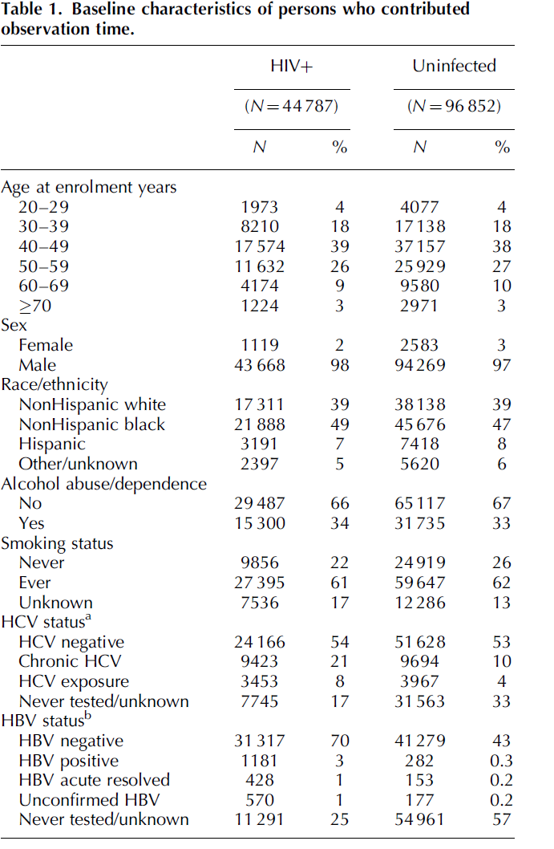

Slide 11
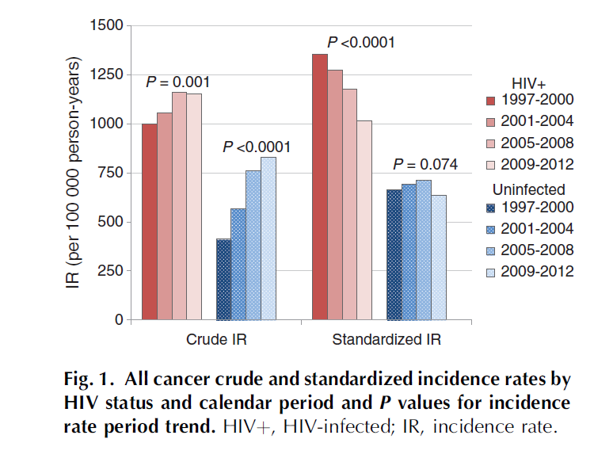

Slide 12
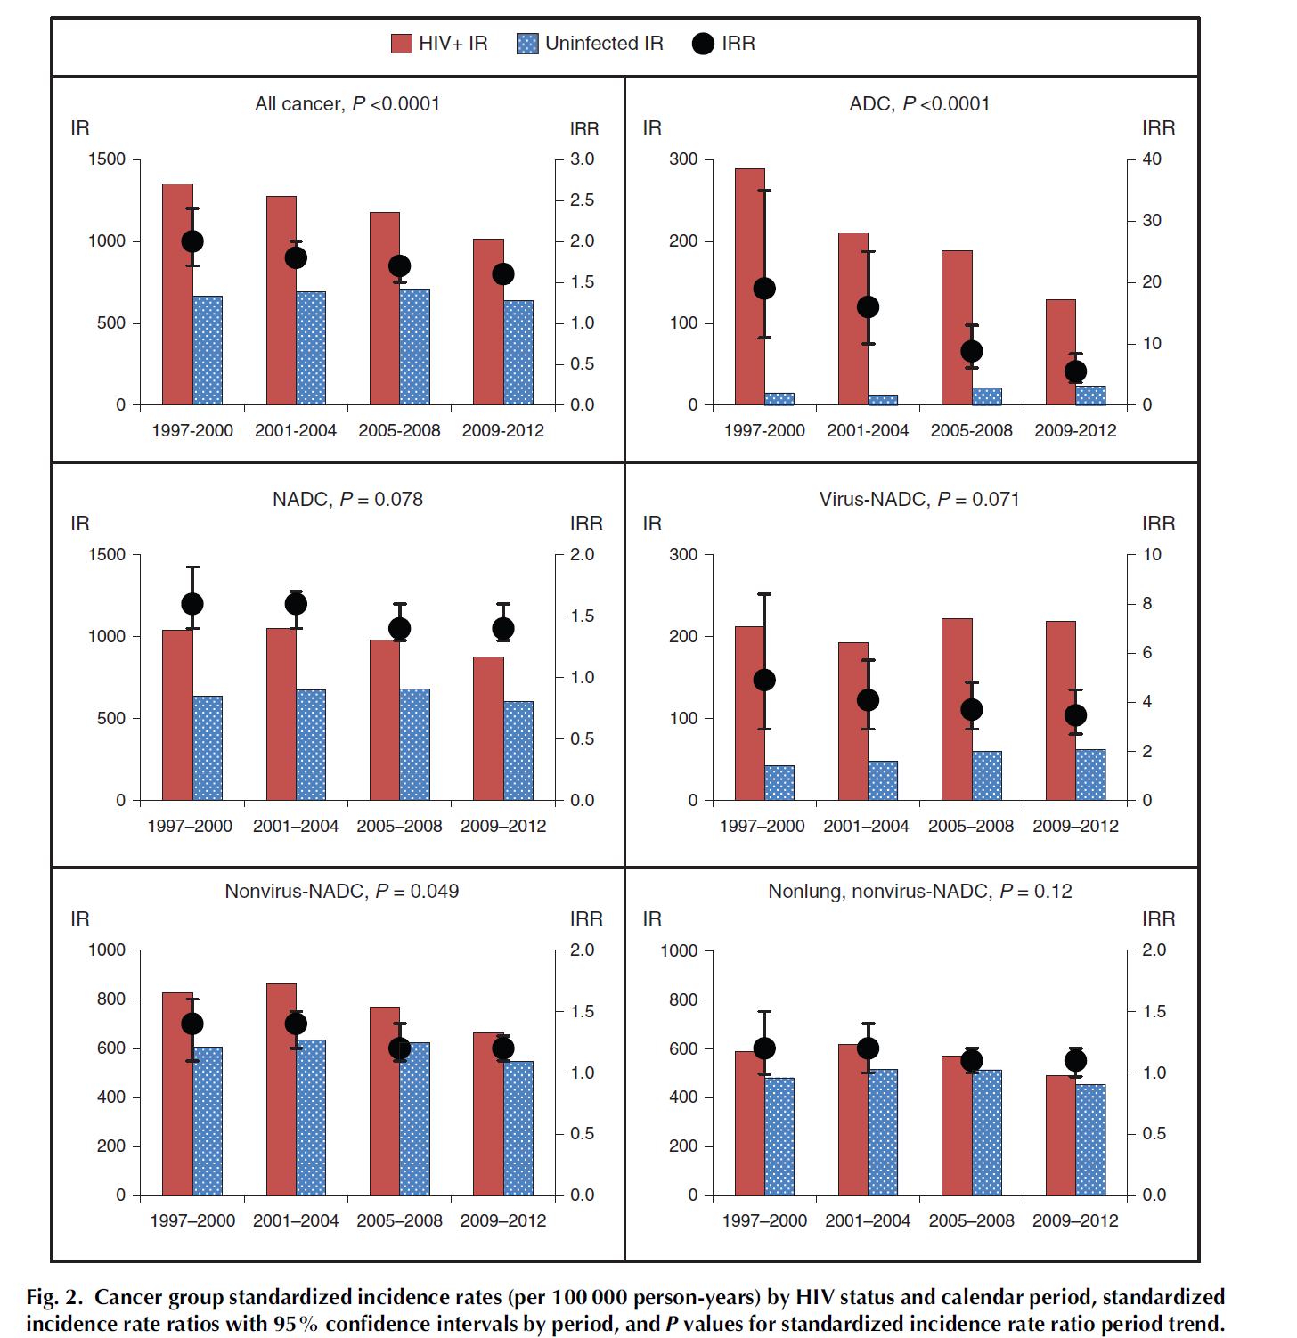

Slide 13
Back up

Slide 14
Original Article Intensified Antituberculosis Therapy in Adults with Tuberculous Meningitis
A. Dorothee Heemskerk, M.D., Nguyen D. Bang, Ph.D., Nguyen T.H. Mai, Ph.D., Tran T.H. Chau, Ph.D., Nguyen H. Phu, Ph.D., Pham P. Loc, M.D., Nguyen V.V. Chau, Ph.D., Tran T. Hien, Ph.D., Nguyen H. Dung, Ph.D., Nguyen T.N. Lan, Ph.D., Nguyen H. Lan, M.D., Nguyen N. Lan, M.D., Le T. Phong, M.D., Nguyen N. Vien, M.D., Nguyen Q. Hien, M.D., Nguyen T.B. Yen, M.D., Dang T.M. Ha, Ph.D., Jeremy N. Day, F.R.C.P., Maxine Caws, Ph.D., Laura Merson, B.S., Tran T.V. Thinh, M.D, Marcel Wolbers, Ph.D., Guy E. Thwaites, F.R.C.P., and Jeremy J. Farrar, F.R.C.P.
N Engl J Med
Volume 374(2):124-134
January 14, 2016

Slide 15
Study Overview
Tuberculous meningitis remains highly lethal.
In this trial, an intensified regimen of levofloxacin and higher-dose rifampin added to standard therapy was compared with standard antituberculosis therapy alone.
The intensified regimen did not result in a higher survival rate.
N Engl J Med
Volume 374(2):124-134
January 14, 2016

Slide 16
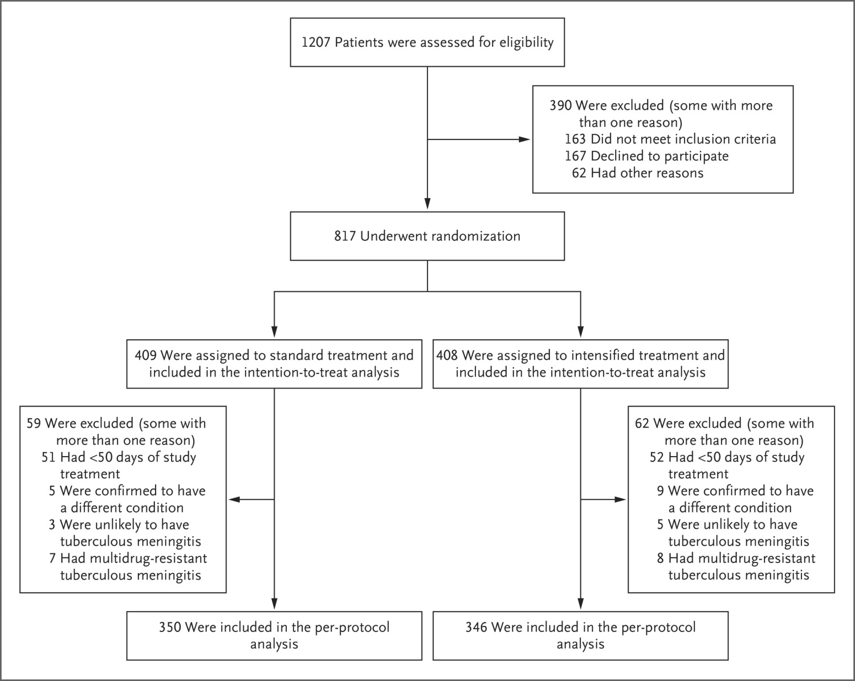
Screening and Randomization.
Heemskerk AD et al. N Engl J Med 2016;374:124-134
Notes:
Figure 1 Screening and Randomization. Among the patients in the intention-to-treat population, in the standard-treatment group, 22 were lost to follow-up, 5 withdrew from the study, 1 went home to die but could not be contacted, 1 died before the study treatment was given, and 6 had their treatment assignment revealed; in the intensified-treatment group, 21 were lost to follow-up, 2 withdrew from the study, 2 withdrew before the study treatment was given, and 3 had their treatment assignment revealed. Among the patients who were confirmed to have a condition other than tuberculous meningitis, in the standard-treatment group, four had cryptococcal meningitis and one had an intracranial tumor; in the intensified-treatment group, seven had cryptococcal meningitis, one had encephalitis caused by herpes simplex virus, and one had eosinophilic meningitis.

Slide 17
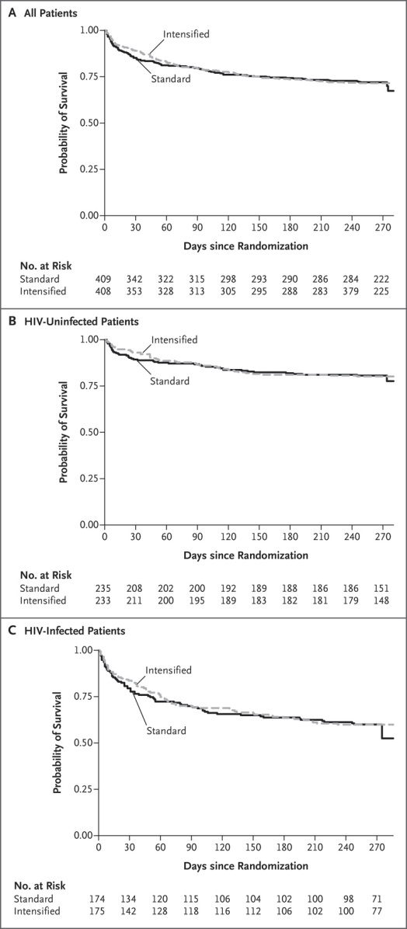
Kaplan–Meier Curves for Overall Survival According to Treatment Group and HIV Infection Status.
Heemskerk AD et al. N Engl J Med 2016;374:124-134
Notes:
Figure 2 Kaplan–Meier Curves for Overall Survival According to Treatment Group and HIV Infection Status. In accordance with the statistical analysis plan, all deaths in the database were included in the final analysis; this included two deaths on days 274 and 275. Because the 9-month follow-up visit was on days 270 through 272 for most patients, the numbers of patients at risk on days 274 and 275 were low, which accounts for the sharp decrease in the Kaplan–Meier curves at the end of the study period.

Slide 18
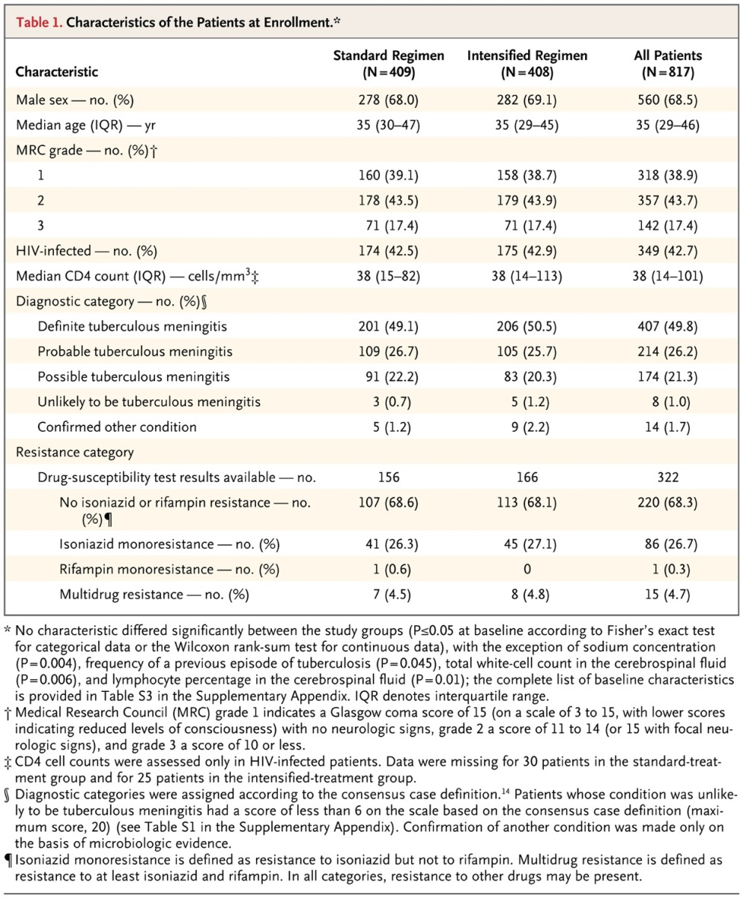
Characteristics of the Patients at Enrollment.
Heemskerk AD et al. N Engl J Med 2016;374:124-134
Notes:
Table 1 Characteristics of the Patients at Enrollment.

Slide 19
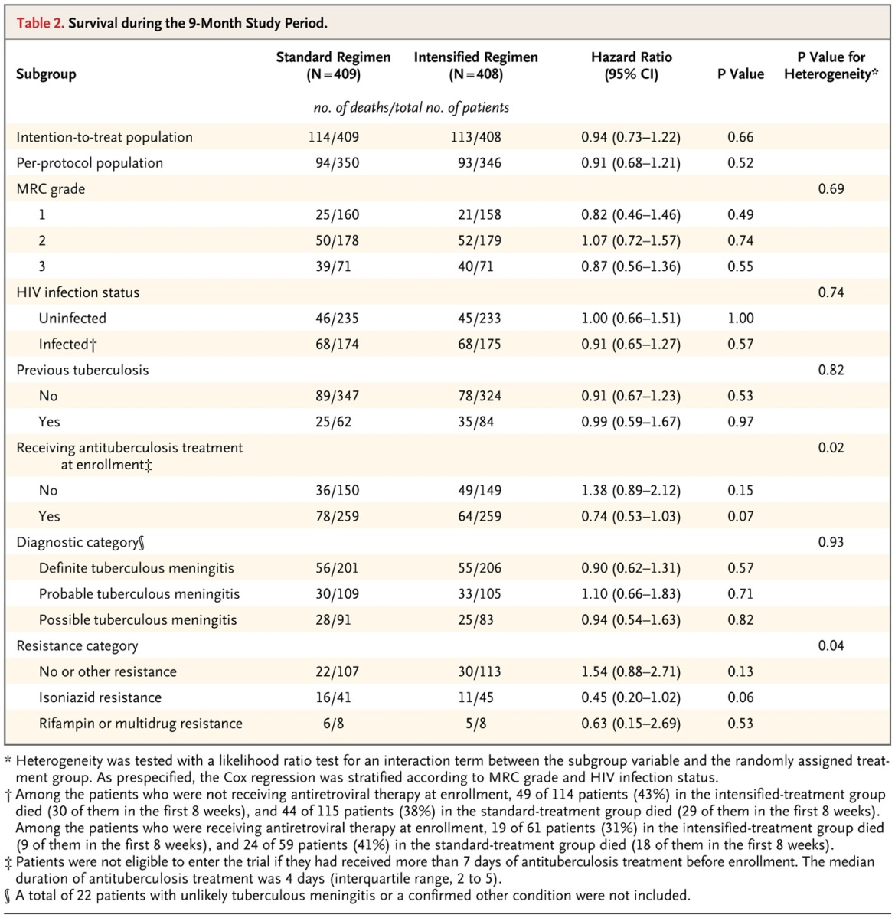
Survival during the 9-Month Study Period.
Heemskerk AD et al. N Engl J Med 2016;374:124-134
Notes:
Table 2 Survival during the 9-Month Study Period.

Slide 20
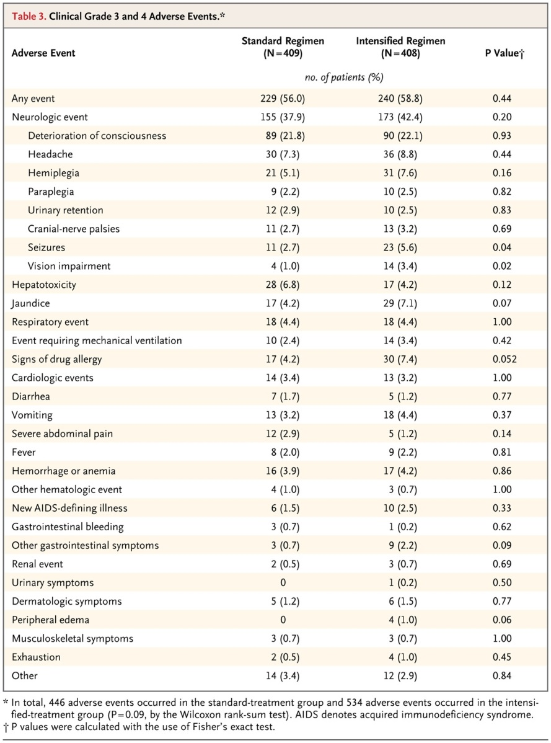
Clinical Grade 3 and 4 Adverse Events.
Heemskerk AD et al. N Engl J Med 2016;374:124-134
Notes:
Table 3 Clinical Grade 3 and 4 Adverse Events.

Slide 21
Conclusions
Intensified antituberculosis treatment was not associated with a higher rate of survival among patients with tuberculous meningitis than standard treatment.
N Engl J Med
Volume 374(2):124-134
January 14, 2016

