Slide 1
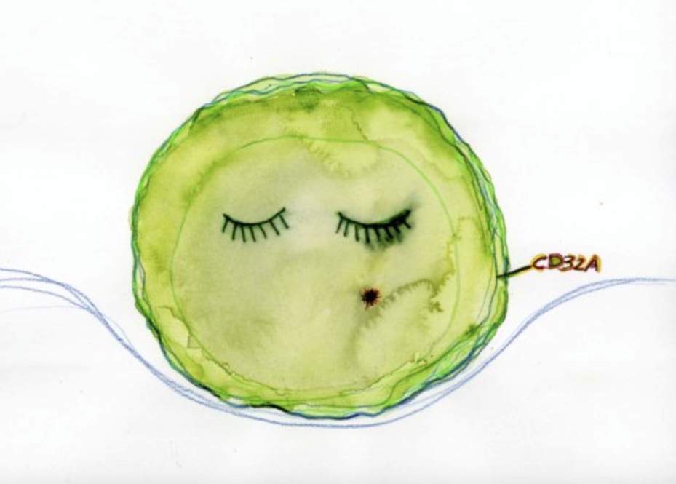
VIROTEAM TABLE RONDE
21-23 Septembre 2017
IMMUNO-VIROLOGIE- Lien avec les comorbidités
Isabelle Pellegrin
Repérer le réservoir pour agir sur le réservoir ?
Descours, Nature 2017
Notes:
The persistence of the HIV reservoir in infected individuals is a major obstacle to the development of a cure for HIV.
Here, using an in vitro model of HIV-infected quiescent CD4 T cells, we reveal a gene expression signature of 103 upregulated genes that are specific for latently infected cells, including genes for 16 transmembrane proteins.
In vitro screening for surface expression in HIV-infected quiescent CD4 T cells shows that the low-affinity receptor for the immunoglobulin G Fc fragment, CD32a, is the most highly induced, with no detectable expression in bystander cells.
Notably, productive HIV-1 infection of T-cell-receptor-stimulated CD4 T cells is not associated with CD32a expression, suggesting that a quiescence-dependent mechanism is required for its induction.
Using blood samples from HIV-1-positive participants receiving suppressive antiretroviral therapy, we identify a subpopulation of 0.012% of CD4 T cells that express CD32a and host up to three copies of HIV DNA per cell. This CD32a+ reservoir was highly enriched in inducible replication-competent proviruses and can be predominant in some participants.
Our discovery that CD32a+ lymphocytes represent the elusive HIV-1 reservoir may lead to insights that will facilitate the specific targeting and elimination of this reservoir.

Slide 2
The gene expression signature of latently HIV-1-infected quiescent CD4 T cells.
CD69-DR-
Illumina
103 genes were exclusively induced in latent XH+ compared to XH− , non-infected controls or bystander cells
Enrichment of genes involved in regulating CK production and inflammatory responses.
16 encode cell surface TM proteins → selected for in vitro validation as cell surface markers of latent infection
Descours, Nature 2017
Notes:
the gene expression profiles of the XH+subset from four donors clustered together and away from the XH−, X and non-infected CD4 T-cell profiles. This result indicates that XH+subsets from different donors share a signature that distinguishes them from the other subsets and that HIV infection shapes the transcriptional landscape of its resting host.
We identified differentially expressed genes, particularly those specifically regulated in the XH+subset, but not in bystander cells Fig. 1d).
→ revealed 111 differentially expressed genes that are significantly induced in latently infected cells as compared to bystanders (Fig. 1d
); of note, no down-modulated genes were identified.
Among the 111 genes, 103 were exclusively induced in XH+compared to XH−and non-infected controls (Fig. 1e).
Functional network analyses revealed an enrichment of genes involved in regulating cytokine production and inflammatory responses). Among the 103 genes, 16 encode cell surface transmembrane proteins, which we selected for in vitro validation as cell surface markers of latent infection (Fig. 2a).

Slide 3
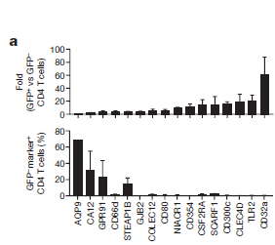
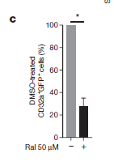
CD32a is specifically induced at the surface of HIV-infected quiescent CD4 T lymphocytes
Gène FCGR2A (spécifique des cellules humaines)
Proteine de surface CD32a = récepteur de basse affinité au fragment Fc des IgG sur les cellules effectrices du système immunitaire
GFP+ vs GHP- (FC)
CD4T
GFP+ vs GHP- (FC)
CD4T
GFP+ CD4T
GHP- markers
CD4T (%)
CD4+CD32a
Selective induction of CD32a after HIV infection of resting CD4 T cells Infection.
Level of CD4 T cells expressing CD32a = 90% were GFP+ and thus were infected with recombinant HIV virions.
Treatment with the RAL before infection prevented CD32a expression by infected resting CD4 T cells → importance of the integration step in CD32a induction.
Descours, Nature 2017
Descours, Nature 2017
Notes:
CD32a is specifically induced at the surface of HIV-infected quiescent CD4 T lymphocytes.
a, Sixteen genes encoding cell surface proteins were selected among the 103 candidates differentially expressed between XH+
and XH− or non-infected CD4 T cells. Their expression at the surface of infected and exposed uninfected total CD4 T cells was then
screened by flow cytometry in 2–6 HIV-negative controls. Results are represented as fold increase of each marker expression in infected versus exposed uninfected total CD4 T cells. Isotype control was used to define threshold of positivity.
b, PBMCs from three HIV-negative controls were prepared as shown in Fig. 1a, and CD32a expression assessed in HLA-DR-negative CD4 T cells. Left, representative dot plot of CD32a expression on non-infected and infected resting CD4 T cells. Right, percentage of GFP expression by CD32a−or CD32a+cells (n=3 HIV-negative controls).
c, Experiment performed as in b, but with cells that were treated with RAL or DMSO before infection.
d, CD32a expression was assessed on PHA–IL-2-stimulated cells treated with VLP-Vpx or untreated. Results are presented as the percentage of CD32a expression among GFP−or GFP+CD4 T cells
We therefore next investigated CD32a expression in vitro, as described in Fig. 1a, using PBMCs from 2–6 additional individuals not infected with HIV. The results were analysed in the subset of quiescent cells that did not express the marker of activation HLA-DR. In each donor, we confirmed the selective induction of CD32a after HIV infection of resting CD4 T cells (Fig. 2b, left panel). Furthermore, when resting CD4 T cells expressing CD32a were analysed for their infection level, we found that 90% were GFP+ and thus were infected with recombinant HIV virions (Fig. 2b, right panel). Interestingly, treatment with the integrase inhibitor raltegravir (RAL) before infection prevented CD32a expression by infected resting CD4 T cells (Fig. 2c), which highlights the importance of the integration step in CD32a induction. We next determined whether productive HIV-1 infection recapitulates the CD32a induction phenotype. PBMCs from 2–3 HIV-uninfected individuals either received no stimulation or were Stimulated with phytohaemagglutinin (PHA) and interleukin 2 (IL-2) and then mock- or VLP-Vpx-treated prior to infection with HIV. FACS analyses revealed that productive infection of stimulated CD4 T cells was not associated with a significant CD32a induction, as compared to resting CD4 T cells (Fig. 2d). These experiments demonstrate that CD32a is a highly specific marker of HIV-1-infected resting CD4 T cells in vitro.

Slide 4
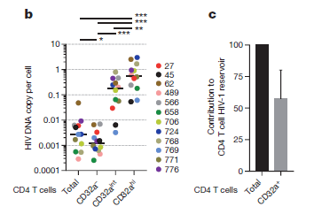
CD32a identifies CD4 T-cell reservoir harbouring inducible replication-competent HIV-1 in ART-treated participants.
12 patients VVIH
CD32a−, CD32a^{int}, CD32a^{hi} CD4 T cells were assessed for infection frequency (total HIV-1 DNA)
Correlation between CD32a expression and viral DNA levels
The contribution of CD32a+ population to the total CD4 T-cell reservoir ranges from 26.8% to 86.3%, as measured by total viral DNA
Descours, Nature 2017
Notes:
Efforts towards the development of therapies aimed at directly targeting and eliminating the reservoir of HIV-1-infected T cells have been impaired by the lack of a specific marker to distinguish the cells from their non-infected counterparts.
On the basis of our in vitro results, we reasoned that the cell surface marker CD32a would allow us to sort reservoir cells in anti-retroviral therapy (ART)-treated participants.
CD32a immunostaining of CD4 T cells isolated from 12 participants (Supplementary Table 3) shows a continuum of expression.
We therefore separated CD4 T lymphocyte subsets with negative (CD32a−), intermediate (CD32aint) and high (CD32ahi) expression levels, as compared to staining with control isotype (Fig. 3a, Extended Data Fig. 2). FACS-sorted total, CD32a−, CD32aint and CD32ahi CD4 T cells were assessed for infection frequency, as measured by total HIV-1 DNA and absolute cell number (β -globin normalization) (Fig. 3b).
Notably, infection frequencies correlated with CD32a expression, as increased viral DNA content was observed in total, CD32a−, CD32aint- and CD32ahi-expressing CD4 T cells (median of 0.003, 0.001, 0.17 and 0.56 HIV-1 DNA copies per cell, respectively) (Fig. 3b; Supplementary Table 4). Averages of 633-fold and 1,024-fold enrichment of HIV DNA copies per cell was observed in CD32ahi CD4 T cells, as compared to total and CD32a− CD4 T cells, respectively ( Fig. 3b; Supplementary Table 4). The observed enrichment is independent of the time of infection and duration of treatment (Supplementary Tables 3, 4).
Depending on the participants, the contribution of CD32a+ population to the total CD4 T-cell reservoir ranges from 26.8% to 86.3%, as measured by total viral DNA (Fig. 3c). These results validate CD32a as a cell surface marker of the CD4 T cell HIV reservoir in HIV-infected virally suppressed participants.
We next investigated whether CD32a+ CD4 T cells contain an inducible replication-competent provirus. We performed a quantitative viral outgrowth assay (qVOA) and calculated the infectious unit per million cells (IUPM) in total and CD32a+ CD4 T cells. As previously reported15, IUPM ranged from 2.2 to 5.7 in total CD4 T cells (Table 1). Notably, IUPM measured in CD32a+ CD4 T cells isolated from four participants ranged from 2,158 to 16,422 (Table 1). Thus, up to 3,000-fold enrichment in inducible replication-competent provirus is observed in CD32a+ as compared to total CD4 T cells (Fig. 3d). Todetermine further the contribution of CD32a+ CD4 T lymphocytes to the inducible viral reservoir in ART-treated participants, CD32a− CD4 T cells were sorted from three aviraemic participants and viral production was measured using HIV Gag p24 ultrasensitive ELISA detection after in vitro T-cell receptor stimulation (using anti-CD2, anti-CD3 and anti-CD28 beads and IL-2). For all tested participants, activation of total CD4 T cells resulted in virus production and spreading in cultures (Fig. 3e). No virus production was observed when the cells were not activated (data not shown). By contrast, depletion of CD32a+ CD4 T cells (median of 500 cells) resulted in marked delay in virus production and spreading (Fig. 3e). qVOA performed using CD32a− and total CD4 T cells isolated from one participant showed a tenfold reduction of IUPM in the former (Extended Data Fig. 3), reinforcing the contribution of CD32a+ CD4 T cells to the inducible viral reservoir contained in total CD4 T cells. These experiments show that CD32a+ CD4 T cells greatly contribute to the pool of HIV-infected CD4 T cells that harbour inducible replication-competent proviruses.

Slide 5
CD32a is a marker of a CD4 T-cell HIV reservoir harbouring replication-competent proviruses
CD32a fulfils the necessary criteria of a biomarker for HIV-persistent CD4 T cells
CD32a+ CD4 T cells make up a substantial part of the pool of CD4 lymphocytes containing inducible replication-competent proviruses
CD32a+ CD4 T cells from ART-treated participants gives a nearly pure population of latent-infected cells
to study viral and cellular diversity of the HIV reservoir at the single-cell level.
to determine the distribution of defective, replication-competent and inducible viruses within this population of reservoir cells.
Important questions about the functional significance of CD32a expression on reservoir cells.
The Fc region of HIV-1 Env-specific broadly neutralizing antibodies is required for their antiviral activity and antibody-dependent cellular cytotoxicity (ADCC) has a role in this process
CD32a expression helps to explain that combination of ART and broadly neutralizing antibodies reduces cell-associated HIV-1 DNA and prolonged viral control?
CD32a expression is part of a cellular response to viral infection or is induced by the virus?
Developing strategies aimed at targeting and eliminating the CD32a+ CD4 T cell HIV reservoir may establish the basis for a ‘direct kill’ as an alternative and or complementary approach toward a HIV cure.
Notes:
Altogether, our experiments show that CD32a fulfils the necessary criteria of a biomarker for HIV-persistent CD4 T cells. Although CD32a does not stain the entire CD4 T-cell reservoir, qVOA and viral induction assays demonstrate that CD32a+ CD4 T cells make up a substantial part of the pool of CD4 lymphocytes containing inducible replication-competent proviruses. Accordingly, we observed correlation between IUPM of total CD4 T cells and HIV DNA copy per cell in CD32a+ CD4 T cells, as well as between IUPM and infection frequencies of CD32a+ CD4 T-cells (data not shown). As sorting of CD32a CD4 T cells from ART-treated participants gives a nearly pure population of infected cells (average of 0.9 HIV DNA copy per cell with median of 0.5), it would be possible to study viral and cellular diversity of the HIV reservoir at the single-cell level. An exciting future direction is to determine the distribution of defective, replication-competent and inducible viruses16,17 within this population of reservoir cells. Our findings also raise important questions about the functional significance of CD32a expression on reservoir cells. The Fc region of HIV-1 Env-specific broadly neutralizing antibodies is required for their antiviral activity18 and antibody-dependent cellular cytotoxicity has a role in this process19. It will thus be interesting to determine whether CD32a expression helps to explain the recent findings that combination of ART and broadly neutralizing antibodies reduces cell-associated HIV-1 DNA and prolonged viral control20. It will also be of interest to determine whether CD32a expression is part of a cellular response to viral infection or is induced by the virus. Most importantly, developing strategies aimed at targeting and eliminating the CD32a+ CD4 T cell HIV reservoir may establish the basis for a ‘direct kill’ as an alternative
and or complementary approach toward a HIV cure.

Slide 6
CD4+/CD8+ ratio restoration in long-term treated HIV-1-infected individuals Fabienne Cabya, writing committee of the CD4+/CD8+ Ratio Working Group of the French Hospital Database on HIV (FHDH-ANRS CO4)
OBJECTIFS
Proportion de patients avec un ratio >1 sous traitement efficace
Délai pour récupérer ce ratio >1
Facteurs associés à cette restauration immunitaire.
PATIENTS (36642 FHDH)
10012 patients traités en première ligne (2000-2010) avec un contrôle virologique (<500 copies) dans les 9 mois suivants la mise sous traitement et un ratio CD4/CD8 <1 à J0
Age médian : 39 (32-46)
médiane de charge virale = 4,7 log10 copies/ml
nadir médian des CD4+ = 237 mm3
Médiane CD8+ = 826/mm3
Ratio CD4/CD8 = 0,26 (0,15-0,40), 59% des patients avec ratio < 0,3
RESULTATS
Probabilité d’obtenir un ratio CD4/CD8 >1 à 5 ans du contrôle virologique = 23 % (30 % à 8 ans).
Population non VIH (HEXA cohorte)
Strindhall et al 2017
Ratio >1 / 60 ans: 85%
pas d’association avec survie à 5 ans
Ratio >1 / 20-59 ans: 92%
Ratio >1 / 60-94 ans: 84%
AIDS 2017, 31:1685–1695
Notes:
Le ratio CD4/CD8 est considéré comme un marqueur de restauration immunitaire reflétant l’activation et l’inflammation résiduelles. Sa persistance à un niveau faible (<0,3) chez des patients sous traitement, avec une charge virale contrôlée est associée au le risque de la survenue de pathologies non liés au Sida (cancer et autres morbidités), par rapport à un niveau supérieur à 0,45. Ce ratio apparait comme un marqueur prédictif du déficit immunitaire bien meilleur que le taux de CD4, même ajusté sur le niveau de la charge virale.
Malgré l’efficacité des traitements anti-rétroviraux, 80% des patients maintiennent un ratio inversé (<1). L’objectif de cette étude réalisée au sein de la base FHDH était de déterminer, la proportion de patients avec un ratio >1 sous traitement efficace, le délai pour récupérer ce ratio >1, ainsi que les facteurs associés à cette restauration immunitaire. Les 10012 patients inclus étaient des patients traités en première ligne entre janvier 2000 et décembre 2010 avec un contrôle virologique (<500 copies) dans le 9 mois suivants la mise sous traitement et un ratio CD4/CD8 <1. A l’initiation du traitement, la médiane de charge virale était à 4,7 log10 copies/ml, le nadir médian des CD4 à 237 mm3, le taux médian de CD8 à 826/mm3 et le ratio CD4/CD8 à 0,26 (0,15-0,40). A l’initiation, 59% des patients avaient un ratio inférieur à 0,3. La probabilité d’obtenir un ratio CD4/CD8 >1 était de 23 % à 5 ans du contrôle virologique, et de 30 % à 8 ans. Cette probabilité était de 17% chez les patients au stade Sida et de 45% chez les patients avec un taux de CD4 supérieur à 500/mm3. Les principaux facteurs associés à la restauration immunitaire (ratio >1) étaient le traitement initié au cours de la primo-infection par le VIH quel que soit le nombre de CD4, un taux de CD4 >500/mm3 en phase chronique, un taux plus faible de CD8 à l’initiation en phase chronique, et un traitement initié plus récemment en 2009-2010, notamment avec un traitement par comportant un inhibiteur d’intégrase et aussi un délai plus court d’obtention du contrôle virologique. Ces résultats sont concordants avec l’introduction en 2008 de cette nouvelle classe connue pour avoir une activité antirétrovirale rapide et importante. N’oublions pas que ce ratio CD4/CD8 >1, marqueur de la restauration immunitaire est sous la double dépendance de la récupération des lymphocytes CD4 mais aussi de la normalisation des lymphocytes CD8 liée à la réplication résiduelle du VIH, à la translocation microbienne et aux co-infections chroniques (CMV, VHC…)

Slide 7
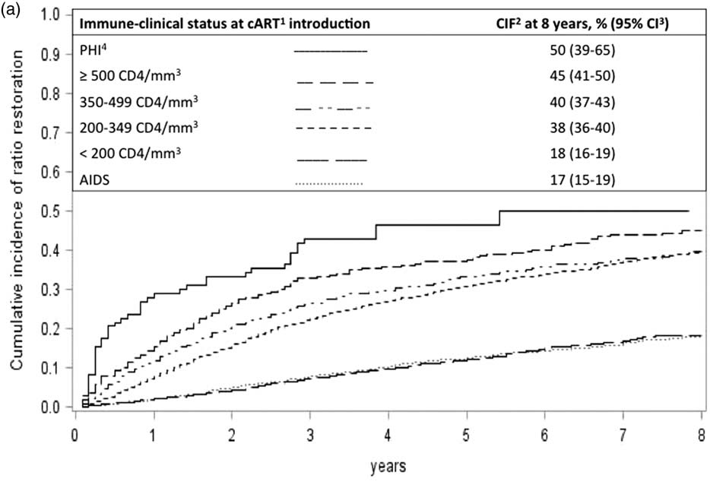
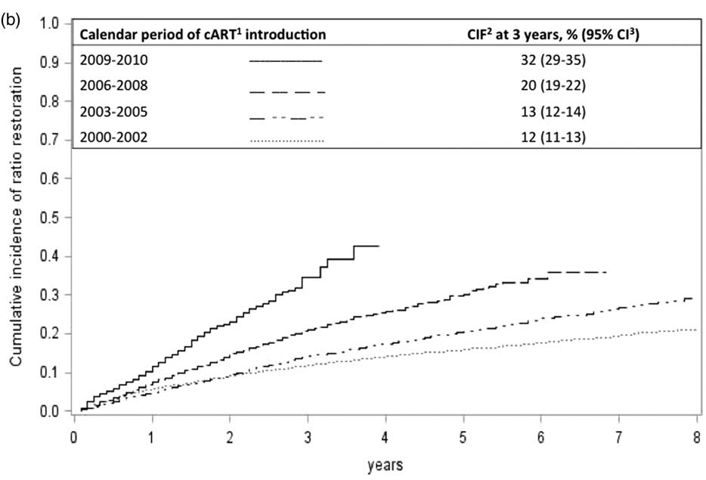
CD4+/CD8+ ratio restoration in long-term treated HIV-1-infected individuals
Principaux facteurs associés à la restauration immunitaire (ratio >1)
CDC: 17% chez les patients au stade Sida
traitement initié au cours de la PIV, quel que soit le nombre de CD4: 46% à 5 ans
taux de CD4 >500/mm3 en phase chronique: 37%
Taux plus faible de CD8 à l’initiation en phase chronique
traitement initié plus récemment en 2009-2010 (inhibiteur d’intégrase > NNRTI > IP)
délai plus court d’obtention du contrôle virologique
Ratio CD4/CD8 >1, marqueur de la restauration immunitaire : double dépendance
restauration des CD4+ ET normalisation des CD8+ (activation immune résiduelle... réplication résiduelle du VIH, translocation microbienne, co-infections chroniques (
Lien avec l’incidence des comorbidités?
AIDS 2017, 31:1685–1695

Slide 8
étude ciadis Chronic Immune Activation anD Immuno-Senescence Association avec la survenue des comorbidités non liées au VIH et à la mortalité A. Ozanne, P.ierre Duffau, E. Lazaro, C. Cazanave, S. Lawson-Ayayi, F. Bonnet, P. Blanco, L. Wittkop, I. Pellegrin for the CIADIS sub-study in the ANRS CO3 Aquitaine cohort study group
Sous-étude de la cohorte ANRS CO3 Aquitaine (N=1010 patients)
Notes:
Afin de répondre à cet objectif, les données de l’étude CIADIS sont utilisées.
Alors CIADIS est une sous-étude de la cohorte ANRS CO3 Aquitaine qui s’intéresse à la participation de l’activation immunitaire, de l’inflammation et de l’immunosénescence aux co-morbidités non liées au VIH
1010 patients ont été inclus dans cette étude avec environ 60% qui ne présentent aucune co-morbidité à l’inclusion.
Le fait que ces participants soient également inclus dans la cohorte ANRS CO3 Aquitaine nous permet d’avoir les données de suivi des patients.

Slide 9
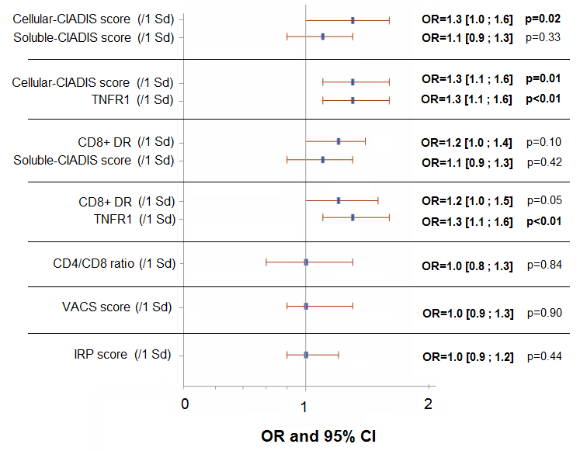
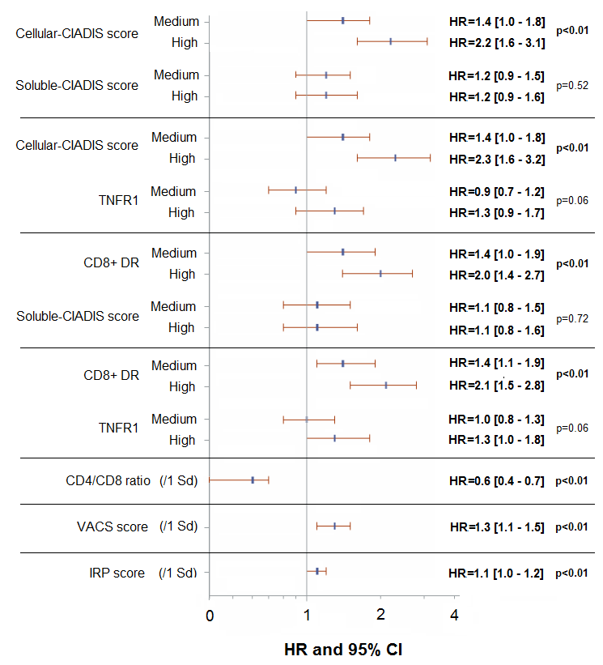
CIADIS (Chronic Immune Activation & ImmunoSenescence)
Multivariable logistic regression models of the association between CIADIS markers, CIADIS scores and having at least 3 non-HIV related comorbidities
Cox proportional hazards models of the association between CIADIS scores and the development of the first non-HIV related comorbidities at 3 years of follow-up
Overall population (N=828)
Duffau, Pellegrin et al AIDS 2017 submitted

