Slide 1
complications
Jean-Luc Meynard
Viroteam 2017

Slide 2
NEAT 022: Switch From Boosted PI to DTG in Suppressed Pts With High CV Risk
International, randomized, open-label phase IV study
Primary endpoints at Wk 48: proportion with HIV RNA < 50 copies/mL (ITT), change in total plasma cholesterol
Wk 48
Wk 96
Immediate switch to DTG + 2 NRTIs†
(n = 205)
Pts with stable HIV-1 RNA
< 50 c/mL on PI/RTV + 2 NRTIs,
high CV risk,* no resistance mutations, no VF
(N = 415)
Continue
PI/RTV + 2 NRTIs†
(n = 210)
Deferred switch to DTG + 2 NRTIs†
*> 50 yrs of age and/or Framingham risk score > 10% at 10 yrs. †NRTIs to remain the same throughout study.
Baseline NRTI backbones: FTC/TDF, 64.8%; ABC/3TC, 31.3%
Gatell JM et al. IAS 2017. Abstract TUAB0102. ClinicalTrials.gov. NCT02098837.
Slide credit: clinicaloptions.com
Notes:
3TC, lamivudine; ABC, abacavir; CV, cardiovascular; DTG, dolutegravir; ITT, intent to treat; RTV, ritonavir; VF, virologic failure.

Slide 3
NEAT 022: Key Findings
Switching to DTG noninferior to continuing boosted PI through Wk 48
Switching to DTG associated with improved lipid profile vs continuing boosted PI through Wk 48
100
93.1
95.2
DTG + 2 NRTIs PI/RTV + 2 NRTIs
10
DTG + 2 NRTIs PI/RTV + 2 NRTIs
P = .286
80
5
4.2
2.5
Treatment difference: -2.1% (95% CI: -6.6% to 2.4%)
0.7
0.5
2.0
1.1
0.4
60
0
ITT Population (%)
-5
40
Mean Change
From BL to Wk 48 (%)
-10
-8.7
-7.7
-7.0
20
-11.3
P < .001
2.0
0.5
4.9
4.4
-15
P < .001
P < .001
0
P < .001
Virologic Success*
Virologic Nonresonse
No Virologic Data
-20
-18.4
*HIV-1 RNA < 50 copies/mL.
-25
P < .001
TC
Non–HDL -C
TG
LDL-C
HDL-C
TC/HDL Ratio
No emergent resistance in pts with VF
No significant differences in grade 3/4 AEs, serious AEs, AE-related d/c
Gatell JM, et al. IAS 2017. Abstract TUAB0102. Reproduced with permission.
Slide credit: clinicaloptions.com
Notes:
AE, adverse event; BL, baseline; CV, cardiovascular; d/c, discontinuation; DTG, dolutegravir; HDL-C, high density lipoprotein cholesterol; ITT, intent to treat; LDL-C, low density lipoprotein cholesterol; RTV, ritonavir; TC, total cholesterol; TG, triglycerides; VF, virologic failure.

Slide 4
ANRS CO4 Substudy: ART and Fracture Risk
Observational case-control study evaluating the risk of low-energy fracture associated with ART in HIV-infected pts 2000-2010
Cases were pts experiencing low-energy osteoporotic fracture (n = 254); controls were randomly selected from database (n = 376)
No evidence of increased fracture risk with TDF or PIs
ARV | Adjusted Fracture OR by Conditional Logistic Regression Models 1-3 (95% CI)
 | 1: By Cumulative Exposure | 2: By Any Exposure | 3: By Exposure Variable*
TDF | 1.03 (0.86-1.24) | 1.04 (0.54-2.02) | 1.24 (0.69-2.24)
ATV | 1.43 (1.01-2.02) | 1.62 (0.85-3.08) | 1.39 (0.99-1.94)
Any PI | 1.01 (0.92-1.11) | 0.98 (0.73-1.31) | 1.10 (0.58-2.08)
3TC | 0.83 (0.73-0.95) | 1.24 (0.53-2.92) | 1.24 (0.52-2.98)
ABC | 0.99 (0.87-1.13) | 1.41 (0.81-2.45) | 1.40 (0.80-2.43)
EFV | 0.81 (0.69-0.95) | 0.84 (0.51-1.40) | 0.82 (0.70-0.96)
Adjusted for transmission group, prior AIDS-defining event, location, BMI, smoker status, alcohol consumption, prior systemic glucocorticoid, period of enrolment. *Variable with lowest Akaike criterion value (best goodness of fit) for each ARV; exposure Y/N for all ARVs except EFV, ATV, DRV, FPV-APV, or FTC with cumulative duration of exposure.
Costagliola D, et al. IAS 2017. Abstract WEAB0103.
Slide credit: clinicaloptions.com
Notes:
3TC, lamivudine; ABC, abacavir; APV, amprenavir; ATV, atazanavir; BMI, body mass index; DRV, darunavir; EFV, efavirenz; FPV, fosamprenavir; FTC, emtricitabine; OR, odds ratio; TDF, tenofovir disoproxil fumarate.
Low-energy fracture: fracture occurring after traumatic events of low intensity (eg, a fall from standing height). Possible osteoporotic sites: vertebra, hip, wrist, humerus upper end, femur lower end, tibia upper end, simultaneous fractures of 3 ribs.

Slide 5
ZEST: Zoledronic Acid vs TDF Switching to Improve BMD in Pts Receiving TDF-Based ART
Randomized study comparing switch to non–TDF-based ART vs continuing TDF-based ART + zoledronic acid* (5 mg IV at Mos 0 and 12) in pts with low BMD† and virologic suppression on TDF-based ART (N = 87)
Lumbar Spine BMD Change at 24 Mos‡
Outcome, 24 Mos | Continue TDF + ZOL (n = 43) | TDF Switch (n = 42) | P Value
Femoral neck BMD ∆ from BL, % | 4.1 | 2.1 | .03
Total hip BMD ∆ from BL, % | 4.6 | 2.6 | .009
Fractures (events), % | 2 | 17 | .03
Fractures (pts), % | 2 | 10 | .20
Mean eGFR ∆ | -6.0 | 3.3 | .003
Continue TDF + ZOL TDF switch
8
7.4
6.1
6
P < .001
P < .001
Change in BMD From BL (%)
4
2
2.9
2.9
0
0
12
24
Mos
*Calcium and vitamin D supplementation (as indicated) were also provided. †T-score ≤ -1.0 at spine (L1-L4) or left femoral neck by DXA. ‡Primary endpoint, ITT population.
Potential limitations: study conducted before TAF available; possible AE concerns with long-term use of bisphosphonates
Hoy J, et al. IAS 2017. Abstract WEAB0106LB. Reproduced with permission.
Slide credit: clinicaloptions.com
Notes:
BL, baseline; BMD, bone mineral density; DXA, dual-energy x-ray absorptiometry; ITT, intent to treat; TDF, tenofovir disoproxil fumarate; ZOL, zoledronic acid.

Slide 6
NA-ACCORD: Smoking, HTN, Cholesterol Primary Drivers to MI Risk in HIV Infection
Retrospective meta-analysis of pts with validated MI events from 7 clinical cohorts within NA-ACCORD from 1/2000 to 12/2013 (N = 29,515)^{[1]}
Population attributable fraction: proportion of MIs avoidable by prevention of modifiable HIV-related and traditional MI risk factors
347 pts (1.2%) had type 1 MI due to plaque rupture
Sensitivity analysis added for 16,687 pts (57%) with BMI data, 227 had type 1 MI
~ 40% MI reduction achievable through prevention of smoking, elevated TC, or HTN, regardless of BMI
Adjusted Population Attributable Fractions for MI,*^{[1]} % |  | MI | BMI Subgroup
Traditional MI risk factors | Smoking | 38† | 36
 | Elevated TC | 43† | 39†
 | HTN | 41† | 39†
 | All 3 (smoking, TC, HTN) | 86
HIV-related MI risk factors | DM | 2 | 4
 | CKD | 3 | 3
 | CD4+ cell count | 10† | 14†
 | VL | 6 | 8
 | AIDS | 2 | -1
 | HCV coinfection | 8† | 14†
*Adjusted for age, sex, race, and all listed risk factors. †P < .05
In separate study (D:A:D), smoking cessation reduced overall cancer rate after 1 yr, except lung cancer (rate high even after > 5 yrs)^{[2]}
1. Althoff KN, et al. CROI 2017. Abstract 130. 2. Shepherd L, et al. CROI 2017. Abstract 131.
Slide credit: clinicaloptions.com
Notes:
BMI, body mass index; CKD, chronic kidney disease; DM, diabetes mellitus; HCV, hepatitis C virus; HTN, hypertension; MI, myocardial infarction; TC, total cholesterol; VL, viral load.
This is a retrospective meta-analysis of NA-ACCORD involving another important collection of data from a long-followed cohort. This analysis looked at the roles of smoking, high blood pressure, and cholesterol, which are the traditional risk factors for MI, in people with HIV infection. I think this analysis confirmed, in a way that is actually helpful in counseling patients, that those 3 factors are strongly associated with risk for the development of a traditional MI, specifically type 1 MIs, which are traditional plaque-rupture MIs.
They found that if you got someone to stop smoking or if you controlled their cholesterol or you got their hypertension controlled, you achieved about a 40% MI reduction by each of those interventions. If you could do all 3, you got an 86% reduction in MI risk.
So, I think emphasizing traditional risk factor management is really important for people with HIV. Similarly, a separate study from the D:A:D: showed that if people stopped smoking, their overall cancer rate was significantly reduced after 1 year, except for lung cancer where the door may already be closed on mitigating that outcome.

Slide 7
Original Article Enhanced Prophylaxis plus Antiretroviral Therapy for Advanced HIV Infection in Africa
James Hakim, F.R.C.P., Victor Musiime, Ph.D., Alex J. Szubert, M.Sc., Jane Mallewa, M.D., Abraham Siika, M.Med., Clara Agutu, M.B., Ch.B., M.P.H., Simon Walker, M.Sc., Sarah L. Pett, Ph.D., Mutsa Bwakura-Dangarembizi, M.Med., Abbas Lugemwa, M.D., Symon Kaunda, M.B., Ch.B., Mercy Karoney, M.Sc., Godfrey Musoro, M.Sc., Sheila Kabahenda, M.B., Ch.B., Kusum Nathoo, M.B., Ch.B., Kathryn Maitland, Ph.D., Anna Griffiths, Ph.D., Margaret J. Thomason, Ph.D., Cissy Kityo, M.Sc., Peter Mugyenyi, Ph.D., Andrew J. Prendergast, D.Phil., A. Sarah Walker, Ph.D., Diana M. Gibb, M.D., for the REALITY Trial Team
N Engl J Med
Volume 377(3):233-245
July 20, 2017

Slide 8
REALITY: Enhanced OI Prophylaxis at ART Initiation in Immunocompromised Pts
Prospective, randomized trial conducted in Zimbabwe, Malawi, Uganda, and Kenya
Primary endpoint: mortality at 24 wks
Additional randomizations
conducted in factorial fashion*
ART-naive HIV-infected adults
and children older than 5 yrs of age with CD4+ cell counts < 100 cells/mm³
(N = 1805)
Enhanced Prophylaxis initiated at time of ART†
(n = 906)
Standard Prophylaxis
initiated at time of ART‡
(n = 899)
*Raltegravir added to ART for 12 wks; food supplementation for 12 wks.
†Cotrimoxazole, isoniazid/vitamin B6 300/25 mg/day for 12 wks (IPT), fluconazole 100 mg/day for 12 wks, azithromycin 500 mg/day for 5 days, albendazole 400 mg (single dose).
‡Cotrimoxazole, IPT added after 12 wks (except in Malawi).
In both prophylaxis regimens, cotrimoxazole and IPT given at half doses if younger than 12 yrs of age.
Hakim J, et al. AIDS 2016. Abstract FRAB0101LB.
Slide credit: clinicaloptions.com
Notes:
ART, antiretroviral therapy; IPT, isoniazid preventive therapy; OI, opportunistic infection.
For more information about this study, go to http://www.clinicaloptions.com/HIV/Conference%20Coverage/AIDS%202016/Highlights/Capsules/FRAB0101LB.aspx

Slide 9
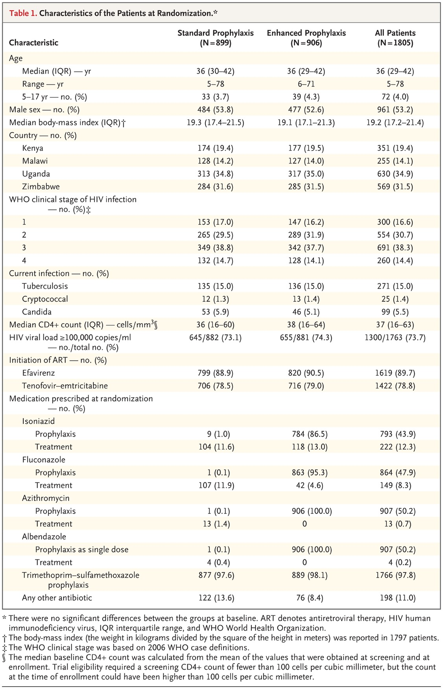
Characteristics of the Patients at Randomization.
Hakim J et al. N Engl J Med 2017;377:233-245
Notes:
Table 1 Characteristics of the Patients at Randomization.

Slide 10
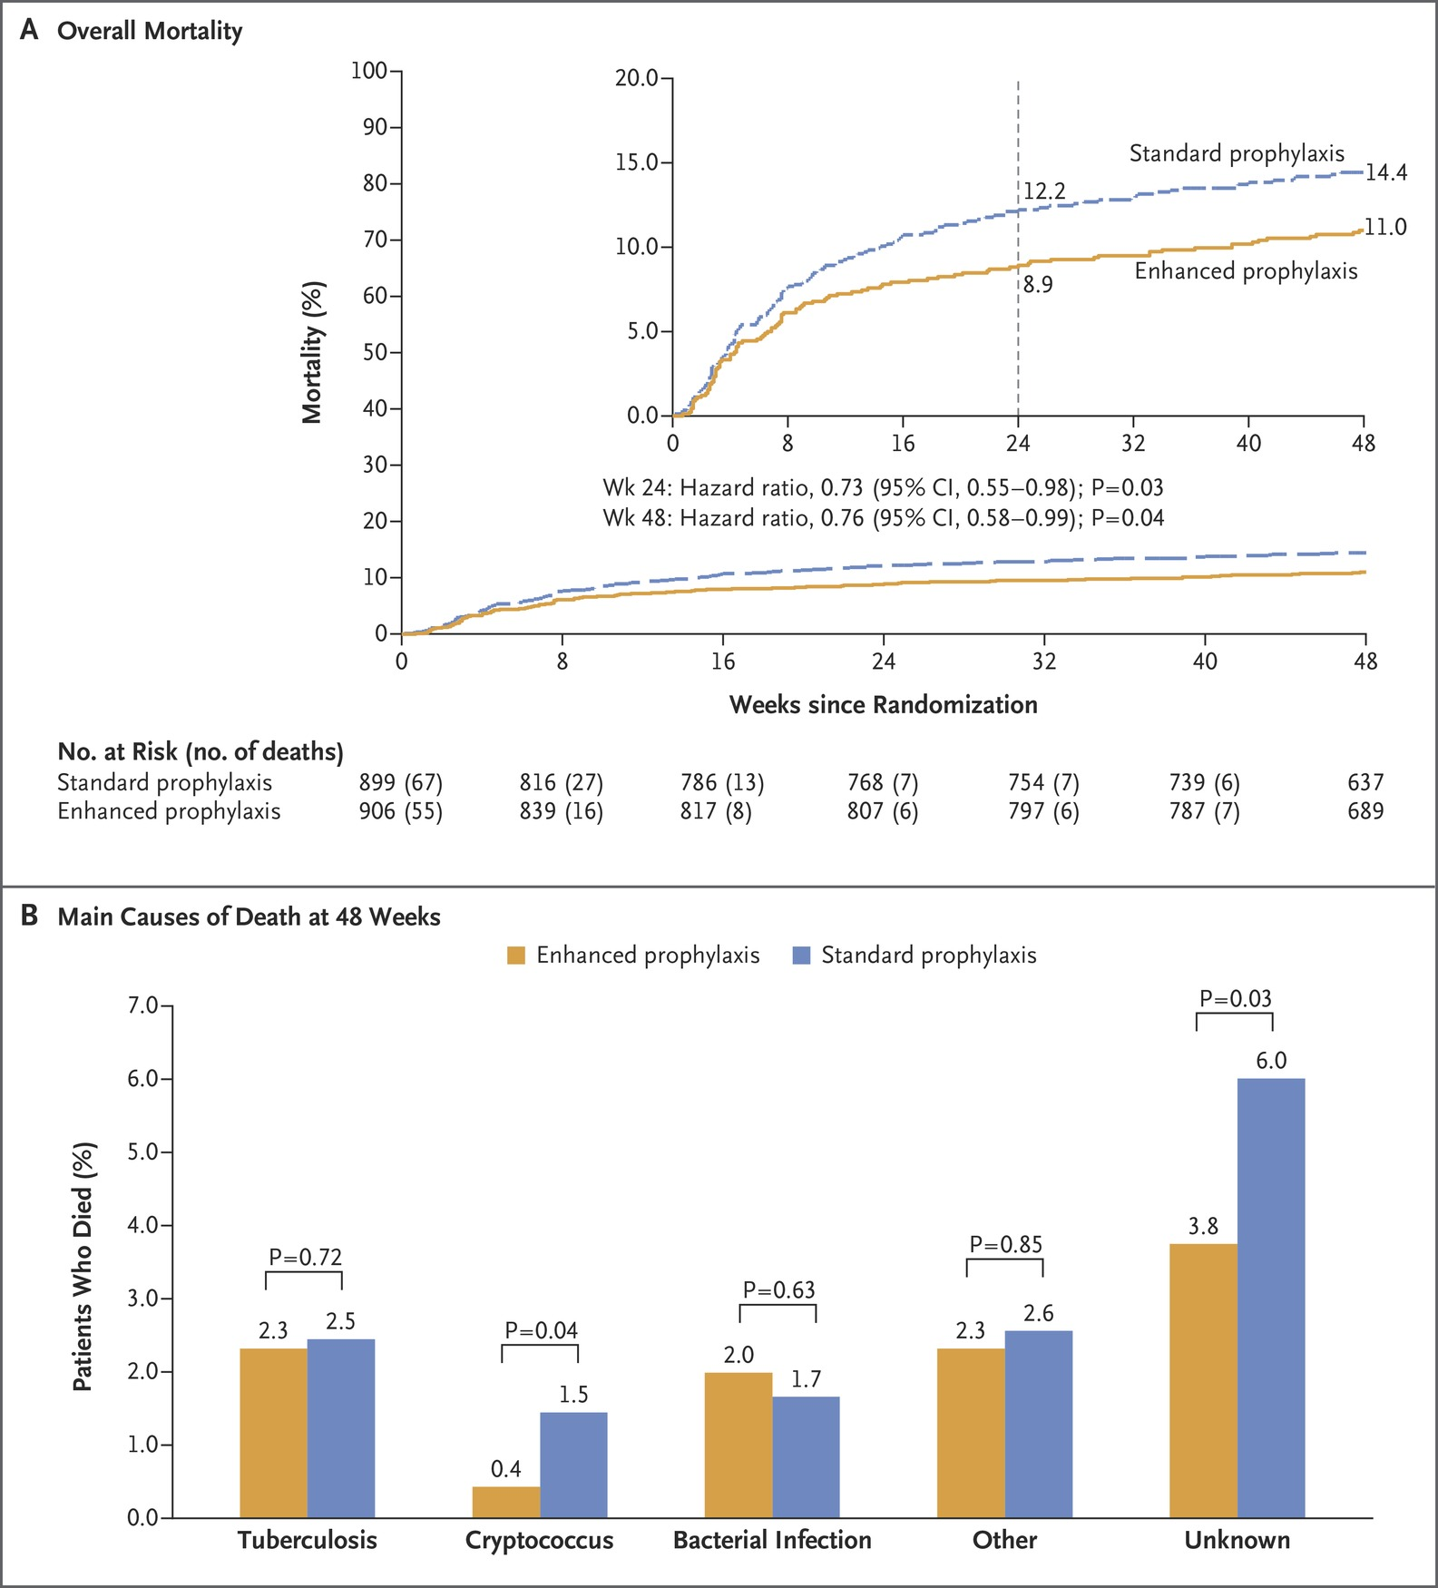
Overall Mortality and Cause of Death at 48 Weeks.
Hakim J et al. N Engl J Med 2017;377:233-245
Notes:
Figure 2 Overall Mortality and Cause of Death at 48 Weeks. Panel A shows the results of a Kaplan–Meier analysis of death over 48 weeks in the enhanced-prophylaxis group and the standard-prophylaxis group. The inset shows the same data on an expanded y axis, with Kaplan–Meier estimates of mortality at 24 and 48 weeks. Panel B shows the predominant causes of death in the two groups over 48 weeks.

Slide 11
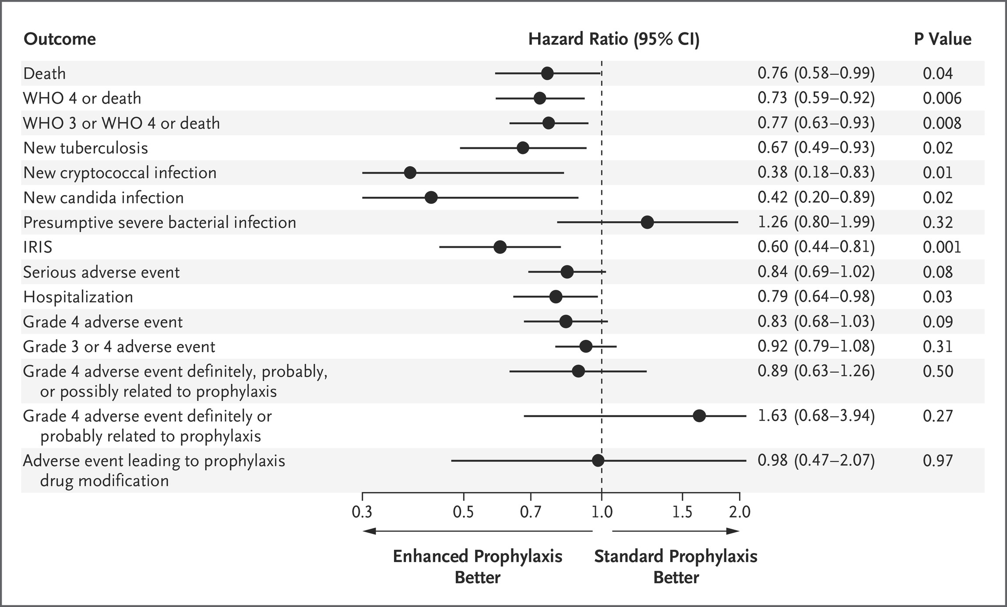
Secondary and Other Outcomes at 48 Weeks.
Hakim J et al. N Engl J Med 2017;377:233-245
Notes:
Figure 3 Secondary and Other Outcomes at 48 Weeks. Secondary outcomes included death, new tuberculosis, new cryptococcal infection, new candida infection, presumptive severe bacterial infection, serious adverse event, hospitalization, grade 4 adverse event, and adverse event leading to prophylaxis drug modification. IRIS denotes immune reconstitution inflammatory syndrome, and WHO World Health Organization.

Slide 12
Conclusions
Among HIV-infected patients with advanced immunosuppression, enhanced antimicrobial prophylaxis combined with ART resulted in reduced rates of death at both 24 weeks and 48 weeks without compromising viral suppression or increasing toxic effects.

Slide 13
Incidental lung cancers and positive computed tomography images in people living with HIV
Lung cancer screening with low-dose computed tomography (LDCT) of high-risk groups in the general population is recommended by several authorities. This may not be feasible in people living with HIV (PLWHIV) due to higher prevalence of nodules. We therefore assessed the prevalence of positive computed tomography (CT) images and lung cancers in PLWHIV.
The Copenhagen comorbidity in HIV infection (COCOMO) study is an observational, longitudinal cohort study. Single-round LDCT was performed with subsequent clinical follow-up (NCT02382822).
Outcomes included histology-proven lung cancer identified by LDCT and positive CT images (noncalcified nodules) in the entire cohort and in the high-risk group (>50 years of age and >30 pack-years). We also assessed the procedures and adverse events, and clinical factors associated with a positive CT image.
Ronit A , AIDS 2017

Slide 14
Incidental lung cancers and positive computed tomography images in people living with HIV
LDCT was performed in 901 patients, including 113 at high risk for lung cancer. A positive image was found in 28 (3.1% of the entire cohort and 9.7% of the high-risk group). Nine patients (all in the high-risk group) had invasive procedures undertaken with no serious adverse events. Lung cancer (stages IA, IIA, and IIIA) was diagnosed in three patients from the high-risk group (2.7%). CD4þ cell count less than 500 cells/ml and CD4þ nadir less than 200 cells/ml were each independently associated with increased odds of a positive image odds ratio 2.32 [95% confidence interval: 1.01– 5.13, P¼0.04] and odds ratio 2.63 [95% confidence interval: 1.13–6.66, P¼0.03].
Randomized LDCT screening trials in PLWHIV are nonexistent, but these findings are comparable with screening rounds from the general population in terms of prevalence of lung cancer and positive CT images

Slide 15
Metabolic syndrome and obesity are the cornerstones of liver fibrosis in HIV-monoinfected patients: results of the METAFIB study
AIDS 2017

Slide 16
Objectives
To assess the impact of MetS on the proportion and severity of liver fibrosis in HIV-monoinfected patients

Slide 17
Methods
Exposed – nonexposed cohort of HIV1- monoinfected patients
without excessive alcohol consumption, HBV/HCV coinfections or
other causes of chronic liver disease
Exposure defined as the presence of MetS (IDF criteria)
Patients nonexposed to MetS matched to exposed patients,
on age, sex and duration of HIV
Liver fibrosis: liver stiffness measurement (LSM,Fibroscan)
Insulin resistance: HOMA-index and leptin/adiponectin
Circulating inflammatory markers:
Adipokines: leptin (fat mass), adiponectin, IL6, usCRP
Macrophage activation: sCD163 and CD14

Slide 18
Results
Number of screened patients:
n = 478
Number of included patients:
N=468
(246 MetS+, 222 MetS-)
63 patients with invalid results
(19 failures and 44 unreliable results)
Number of patients with valid LSM:
N=405
(203 MetS+, 202 MetS-)

Slide 19
Prevalence of liver fibrosis

Slide 21
Discussion
Liver fibrosis assessment based on noninvasive marker (fibroscan)
No liver histology
No analysis of liver steatosis and NASH

Slide 22
Study population (1)
 | Study population n=405 | Patients with MetS, n=203 | Patients without MetS, n=202 | P value
Mean age, years, (SD) | 53 (9) | 54 (9) | 52 (8) | 0.02
Males, n (%) | 359 (89) | 183 (90) | 176 (87) | 0.4
Mean BMI, kg/m², (SD) | 24.6 (5.3) | 26.0 (4.7) | 23.2 (5.5) | 0.0001
Obesity: BMI ≥30kg/m² n (%) | 34 (8.4) | 27 (13.3) | 7 (3.5) | 0.0001
Type 2 Diabetes (n=404), n (%) | 33 (8.2) | 31 (15.3) | 2 (1.0) | 0.0001
Duration of HIV infection (years) | 17.0 (7.0) | 16.9 (6.8) | 17.0 (7.3) | 0.9
CD4 cells count (per mm³) | 617 (257) | 628 (239) | 607 (273) | 0.2
HIV1-VL<20 copies/mL (n,%) | 323 (79.8) | 160 (78.8) | 163 (80.7) | 0.7
Metabolic parameters
HOMA score ≥2.5 (n,%), | 116 (29) | 99 (49) | 17 (8.5) | 0.0001
HDL-cholesterol (mmol/L) | 1.21 (0.37) | 1.06 (0.30) | 1.36 (0.37) | 0.0001
LDL-cholesterol (mmol/L) | 2.95 (1.04) | 2.80 (1.25) | 3.11 (0.74) | 0.0001
Triglycerides (mmol/L) | 1.89 (1.78) | 2.40 (1.65) | 1.37 (1.75) | 0.0001
Glucose (mmol/L) | 5.47 (1.20) | 5.85 (1.48) | 5.09 (0.64) | 0.0001

Slide 23
Study population (2)
 | Study population n=405 | Patients with MetS, n=203 | Patients without MetS, n=202 | P value
Hepatic parameters
AST (IU/L) | 29 (20) | 31 (19) | 27 (20) | 0.0001
ALT (IU/L) | 34 (27) | 41 (34) | 28 (15) | 0.0001
GGT (IU/L) | 52 (52) | 62 (64) | 42 (33) | 0.0001
Serum inflammatory markers | n=396 | n=199 | n=197
Hs CRP (mg/L) | 3.50 (4.94) | 3.69 (4.88) | 3.32 (5.01 | 0.07
Hs IL-6 (pg/mL) | 2.22 (4.33) | 2.16 (3.40) | 2.28 (5.12) | 0.4
Leptin (ng/mL) | 7.99 (11.48) | 10.52 (13.19) | 5.44 (8.76) | 0.0001
Total adiponectin (µg/mL) | 4.39 (2.83) | 3.36 (2.27) | 5.44 (2.95) | 0.0001
HMW adiponectin (µg/mL) | 2.13 (1.95) | 1.39 (1.44) | 2.87 (2.12) | 0.0001
Leptin/adiponectin ratio | 2.56 (4.76) | 3.92 (6.16) | 1.19 (1.87) | 0.0001
sCD14 (ng/mL) | 2116.14 | 2204.3 (736.0) | 2027.1 (1019.3) | 0.0001
sCD163 (ng/mL) | 711.03 (293.82) | 778.1 (298.6) | 643.3 (273.4) | 0.0001

