Slide 1
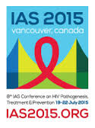
Past, present & future for HIV self-testing
Cheryl Johnson
WHO HIV Dept. Geneva
19 July 2014
No conflict of interest
Notes:
Thank you so much

Slide 2
Why talk about HIVST?
UNAIDS “90-90-90”
Notes:
Many discussions have already taken place this week and will continue to take place this week, about the UN 90’90’90 goals.
In terms of testing and self-testing the focus is on the 1st 90, diagnosing 90% of people with HIV.
Many have described this first 90 as the most difficult of all the 90s—as it is estimated that just under half of all people with HIV do not know their status. Presently, we are facing many obstacles to closing this testing gap, which Rachel has touched on, including limited and diminishing resources, reaching underserved populations, poor quality testing with reports of misdiagnosis as high as 10%, and many people continuing to test late and link to ART late.
To reach the 1st 90 there will be a need for more testing that is both strategic and focused, new approaches to reach those with HIV and undiagnosed and that overcome social, individual, structural and health system barriers and that are designed with linkage to prevention, care and treatment in mind.
Also HIV self-testing is increasingly seen as an option as RDTs are widely used and treatment is widely available.
It is within this context we are discussing HIV self-testing

Slide 3
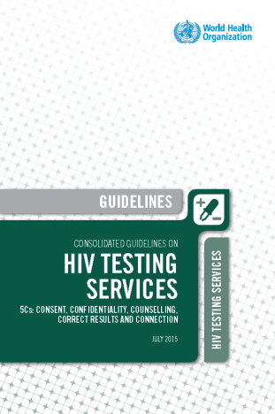
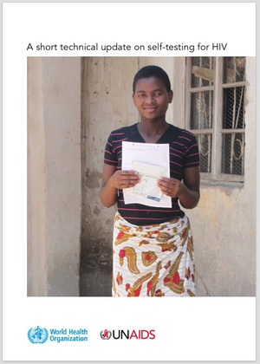
Current WHO guidance on HIVST
Many models, priorities and policy issues, and evidence gaps
Outlines the issues & technical considerations for HIVST & encourages countries to conduct demonstration projects
Normative guidance on HIVST is planned for 2016
Most current information available on HIVST.org
WHO 2015 GL: http://apps.who.int/iris/bitstream/10665/179870/1/9789241508926_eng.pdf?ua=1&ua=1
Notes:
So in the new consolidated guidelines on HIV testing services provides technical considerations and a framework for implementing self-testing and encourages countries to conduct demonstration projects.
WHO currently is planning to develop specific guidance on HIVST in 2016.
What I will share with you is a quick background on HIVST, what we know and don’t know and what direction we are going with HIVST.

Slide 4
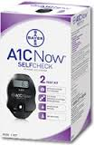
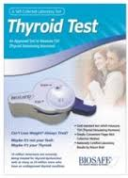
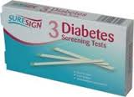
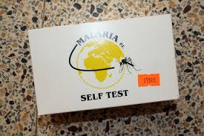
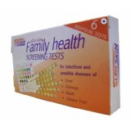
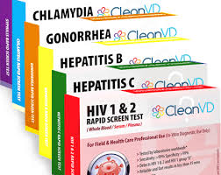
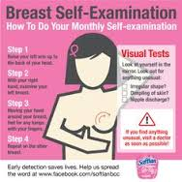
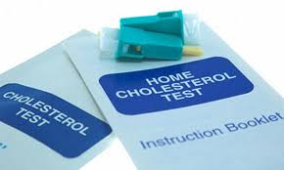
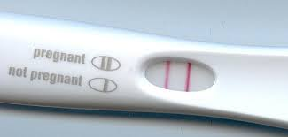
What is self-testing?
Collects
Performs
Interprets
Notes:
In general self-testing describes a process when someone collects his or her specimen, performs a test and interprets his or her test result.
Self-testing is not new. In fact for self-testing for HIV the idea emerged in the mid-1980s very early on in the epidemic; and we have learned from many settings that health workers (including many of the people in this room) have informally self-tested for HIV for sometime.
And many other people have used a self-tested with many of the other widely available self-tests for various conditions, infections, and chronic diseases, many with life altering and potentially devastating implications.
diabetes/glucose monitoring,
pregnancy,
glaucoma,
bowel cancer,
colon cancer,
breast cancer & testicular cancer screening,
urinary tract & liver function,
malaria,
STIs,
HIV.

Slide 5
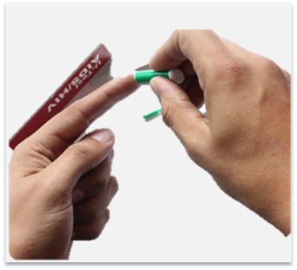
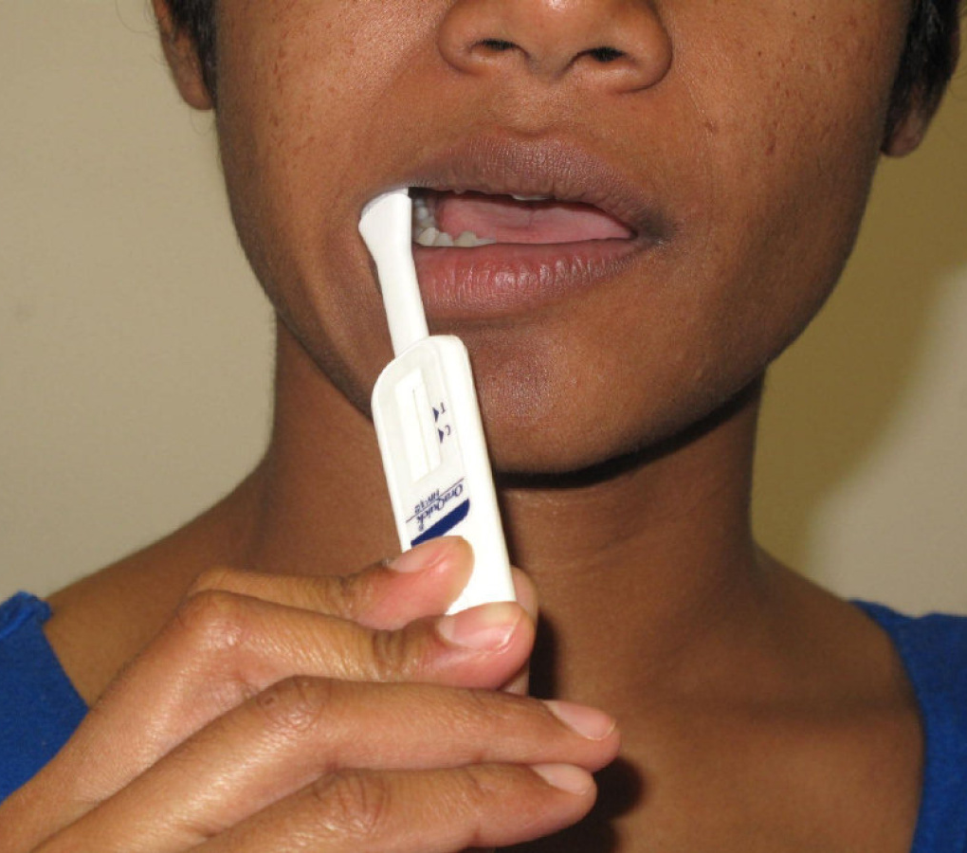
What is HIV Self-Testing (HIVST)?
Reactive results need confirmation by health provider
Notes:
A key aspect of HIV self-testing is that like many self-tests it does not provide a diagnosis. All reactive test results need further testing by health provider according to a national validated algorithm.

Slide 6
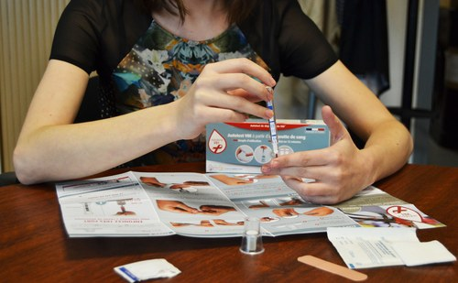
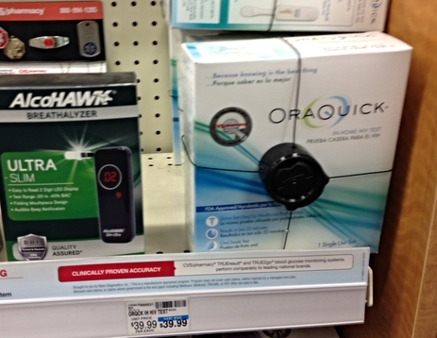
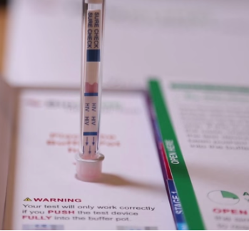
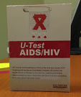
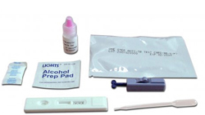
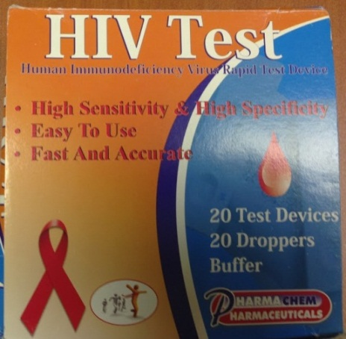
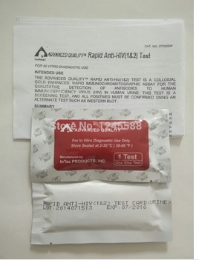
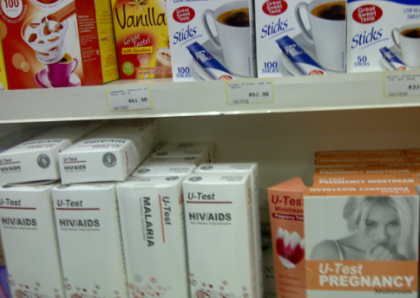
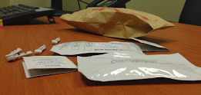
Available Formally
…& Informally
Credits: David Stanton, Vincent Wong, Cheryl Johnson, Matthew Rosenthal
Notes:
Over the years HIV self-testing has become increasingly available in many different settings both informally and formally.

Slide 7
Current Policy Environment
Policies & Product(s) Licensed & Registered | Policies Explicitly Allowing HIVST | Policies Under Development | HIVST Available Informally+ | HIVST Explicitly Illegal
USA 2012 | Australia | South Africa* | China | Botswana
UK 2015 | Kenya | Zimbabwe | Namibia | Germany
 | Hong Kong SAR | Malawi | South Africa
 | South Africa* | Zambia | Russia
 | France° | Brazil | Tanzania
 |  | Peru | Nigeria
 |  | Thailand
Slide based on formal and anecdotal reporting, informal sale in different countries may be under-estimated.
*South Africa allows HIVST kits to be sold through venues, except pharmacies. This policy is currently being reviewed
°Policy and product registration is planned for Sept. 2015
Notes:
As you can see there are a number of country policies on HIVST but at different stages
1988 – HIVST 1st proposed, application to USFDA rejected, concerns lack of ART & RDTs, fear potential suicide/self-harm
1990s –2000s—RDTs & treatment become increasingly available
1997—Germany bans HIVST kits
1999—Netherlands introduces HIVST kits
2000—HIVST kits for sale in South Africa
2005—US FDA lifts ban on HIVST kits
HIVST kits in Hong Kong & Macau
2008—Kenya includes HIVST in national guidelines
2010—South Africa policy states HIVST cannot be sold in pharmacies
2012—US FDA approves the first HIV self-test kit
2013—1st WHO international HIVST consult
Botswana bans HIVST kits
USAID Namibia report identifies 6 HIVST kits being sold
2014—UK & Australia legalize HIVST
2015—France legalizes HIVST
3 HIVST kits are CE marked for sale in Europe
Plans to develop WHO guidelines on HIVST announced
3 trial results anticipated to be released this fall

Slide 8
Products with regulatory approvals
Product (supplier) | Specimen | Business Objectives | Regulatory Status | Other RDTs from Manufacturer
Autotest VIH (AAZ, France)+ | Whole Blood | Sell in France, other EU countries, & Africa | CE marked | SureCheck HIV-1/2
Biosure HIV Self Test (Biosure, UK) | Whole Blood | Sell in UK, & Europe, international roll out planned | CE marked | SureCheck HIV-1/2
OraQuick In-Home HIV Test (OraSure Technologies, USA) | Oral Fluid | Sell in USA, Europe, Latin America, Africa | FDA, CE marked | OraQuick ADVANCE HIV-1/2 OraQuick HIV ½ Rapid test OraQuick HCV Rapid test
As of yet, no WHO prequalified RDTs for HIVST —work is underway provide clear guidance on steps to be taken.
+ HIVST kit are anticipated to be available in France starting Sept 2015.
Notes:
Currently there are 3 products with either FDA or CE mark – and there are a number of other products are currently being developed
All these products now are 2nd generation tests. Underscoring that self-testing is an innovation in the use of an older product. The market for HIVST today is about oral fluid and whole blood, but it wont be the market forever. And the products are improving with more stable read windows, fewer components, integrated buffer systems, molecular detection etc.

Slide 9
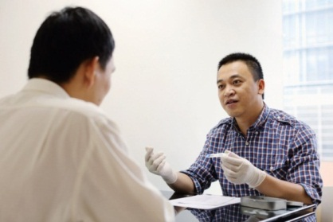
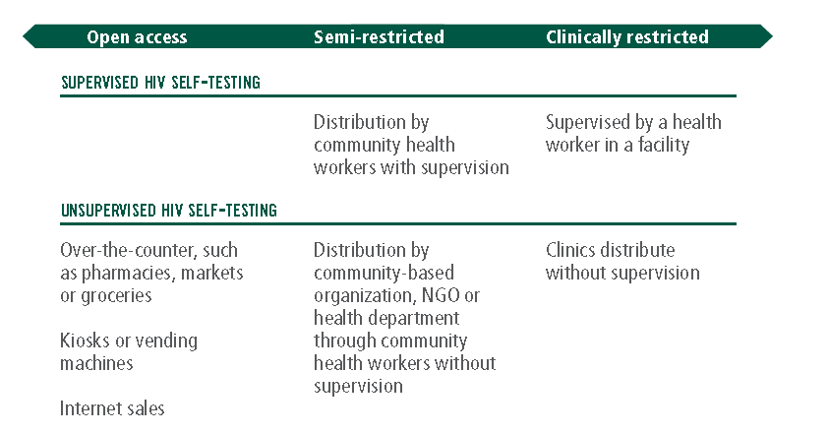
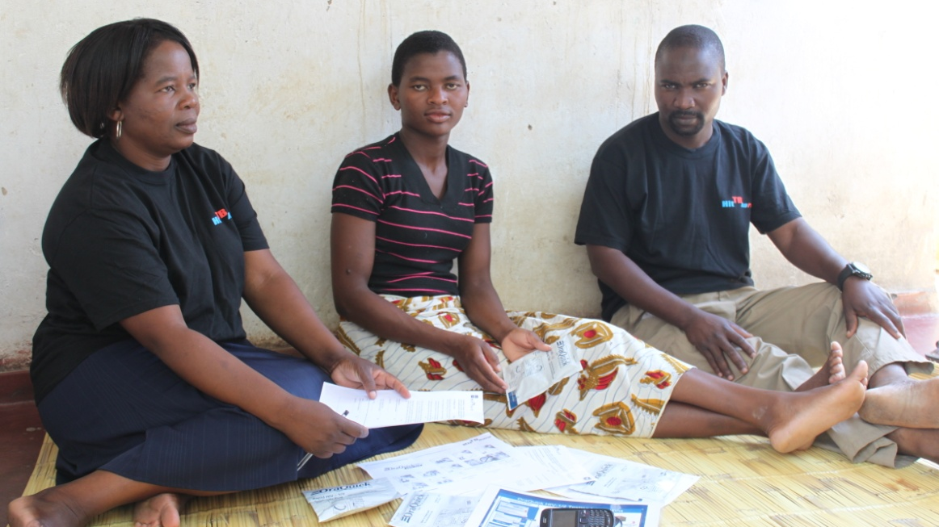
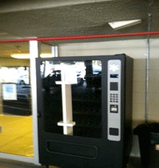
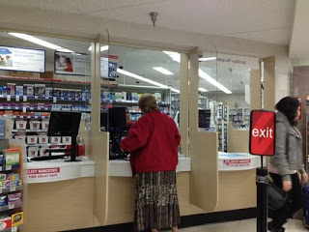
Many Possible Models
Source: WHO 2015
Notes:
There are many approaches to HIV self-testing that are currently being explored with different levels of support and access. Ranging from open access over the counter, on the internet, vending machines to assistance from community health worker or connected to a existing facility or programme
Smart vending machines voucher programmes ^{1,2} –partnering with bathhouses & gyms in USA
Pharmacies & key populations in Kenya³
Via Internet & e-commerce sites in China⁴ & USA⁵
Youth & adolescent HIV testing programmes? ⁶
Couples and partner HTS & providing HIVST kit in PMTCT settings to reach male partners^{6,7}
Kiosks, SMS, tablets and smartphone assisted HIVST^{8,9,10,11,12}

Slide 10
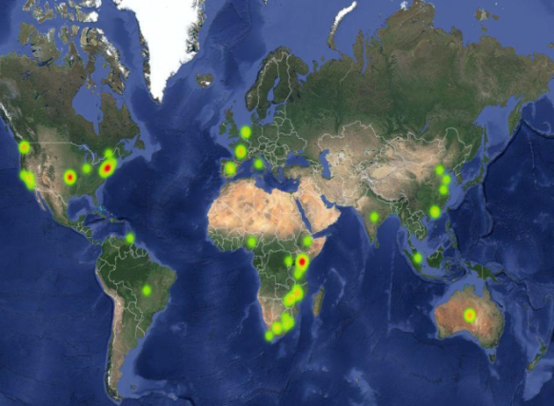
What we know?
HIVST.org

Slide 11
Acceptability & Willingness
Source: 1 www.hivst.org , Evidence Map, accessed 1 July 2015 – 42 reporting studies
Notes:
42 studies on willingness and acceptability.

Slide 12
Uptake Amongst All Residents in Malawi
Since HIVST Made Available
Highest uptake among adolescents
76% in months 1-12
74% in months 13-24
44% first-time testers
~90% returned kits with self-completed questionnaire
Year 1
Women
Year 2
Men
Months
16-19
20-29
30-39
40-49
50+
Age Group (years)
Source: Choko et al forthcoming 2015
Notes:
In some settings uptake is high, particularly among young people (16-19) and a way to get first time testers

Slide 13
Accuracy can be good, but not always
Important to consider within the bigger picture
Sensitivity (n=6)
Specificity (n=7)
Red= fingerstick whole blood
Black = oral fluid
Notes:
Accuracy can be good, especially within supervised HIVST
Sensitivity ≥ 91.7% & specificity ≥ 97.9%^{1,2}
But, can be poor—especially with inappropriate products, poor or no instructions-for-use & without support—or when people with HIV using ART check their status--particularly with oral fluid-based HIV RDTs^{7,10}
Also like all testing accuracy depends on the prevalence of the population testing—this highlights the need for additional confirmatory testing under all (even ideal) circumstances.
But as Jared Baetan has pointed out is that we need to weigh in the context of a bigger picture and compare the sensitivity of a HIV self-test to the sensitivity of 0 and nothing at all.

Slide 14
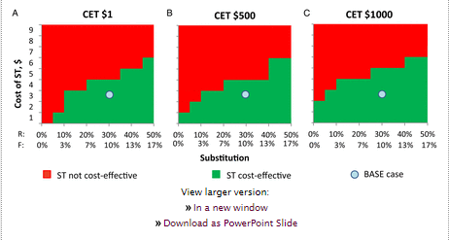
HIVST may be cost-effective
In Zimbabwe, US $ 3 HIVST kit would save 75 million & avert ~7000 DALYs over 20 yrs.
Willingness to Pay varies greatly among Key Populations
Studies, n=8
50
40
15
16
18
7
1.6
9
1
1
Source: Cambiano et al. 2015, Figueroa et al. 2015
Notes:
HIVST in the USA costs $40 and in Namibia cost is $4-12, on Internet kits for HIVST retail under $1
Cost of HIVST in research also varies, $3 in Malawi and $11 in Kenya.
In Zimbabwe, a US $ 3 HIVST kit would result in saving 75 million, while averting around 7000 disability-adjusted life-years over 20 years.
There may be segmented market possibilities as well: might be worth a mention that there may be segmented market possibilities: a targeted public option; a private sector option; a subsidized private sector option (not unlike condoms..). it likely won't be a one-size fits all in every country.

Slide 15
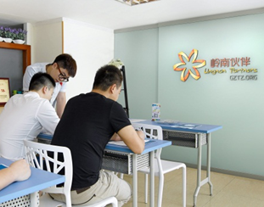
Linkage
Evidence is limited, but promising^{1,2}
Especially when coupled with a proactive approach (e.g. home-based ART initiation)
80-100% of MSM report they would link to further testing and care, if they had a reactive self-test result³
Higher ART among Home Self-test Clusters than Facility-based
MacPherson 2014 (Malawi)
Parent Trial
Participants
Home-Based Test
Home Group
or Home Option
(8,194)
Facility-Based Test
Facility Group
or Facility-Based
(8,466)
181
63
Participants initiating ART
Participants initiating ART
Participants not initiating ART
Participants not initiating ART
8,013
8,403
Source: 1 MacPherson 2014; 2 Choko 2014; 3. Figueroa et al. 2015
Notes:
There is limited evidence, but one compelling trial did demonstrate that with a proactive approach of using home-based ART there was an increase in linkage.
While there is a research gap, this may not be a deal breaker; a lot of other self diagnostics exist (preg tests, diabetic monitoring etc) without worrying too much about linkage. However, systems should be integrated to allow and support linkage (e.g. OraQuick) - call in lines, counselor referrals, instructions that include benefits of early tx, etc.

Slide 16
Adverse Events
No serious adverse events for self-testing for multiple diseases and conditions, including HIV, reported in published literature^{1.}
Monitoring and reporting systems are few, important to develop and implement such systems.
Some potential issues identified so far:
Verbal confrontations² or participant’s plan to coercively test someone³ ;
Couples report that discordant self-test result can be challenging^{5,6} and though few emerging reports of IPV—but primarily among couples with a history of IPV⁴.
In Blantyre, ~3% of people felt coerced/persuaded—however nearly all said they would recommend HIVST to others^{4,5,6}.
Source: 1 Brown et al 2014; 2 Carballo-Dieguez 2012: 3 Katz 2012; 4 Desmond 2014: 5. Kumwenda 2014; 6 Choko 2015
Notes:
Adverse events while no published reports of serious adverse events, there are some reports emerging though few. However, the monitoring and reporting systems need to be implemented to assess this.

Slide 17
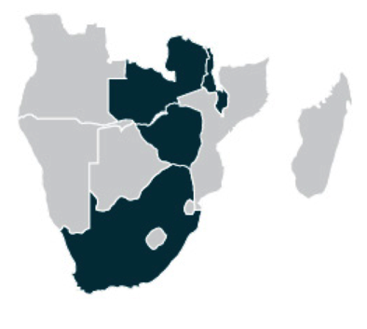
PSI/UNITAID STAR Project Catalysing HIVST in Southern Africa
Implementation-research Partnership Tackling Market Barriers by:
Multiple sites, models, & populations
Normalizing HIVST in Southern Africa
Providing evidence for scale-up
Developing WHO Guidelines
Encouraging policy change
Enabling the regulatory environment
Shaping market to reduce barriers & increase entry of low-cost HIVST products available for purchase & on recommended diagnostic commodities list
Countries
Malawi
Zambia
Zimbabwe
Source: WHO, 2015 http://www.who.int/hiv/mediacentre/news/unitaid_hiv-self-testing/en/
Notes:
So what’s next –WHO and partners part of the UNITAID STAR project will be starting the largest study on HIV self-testing very soon. This project will be conducting implementation science that will fill in knowledge gaps, inform guideline development and policy change and shape the market so that low cost products can become widely available.
But while I am highlighting this I also want to give a shout out the expert level meeting we had yesterday where we heard a lot of positive and promising results. All this work and collaborating together will be critical for WHO guidance and filling knowledge gaps.

Slide 18
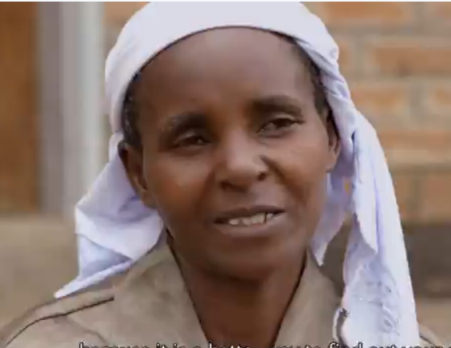
So what do people say about (HIVST)?
Notes:
Click centre image for video link

Slide 19
Conclusions
Current HIV testing services are not enough to get to 90.
Self-testing is not new.
Additional tool to create demand for, not substitute, HIV testing services.
Public health response lags behind public demand—and we need to catch up.
WHO guidance on the way
Get going!
Think big. We need visionaries & champions; we need to stimulate technological advances, better tests & innovations in implementation
Notes:
Current HIV testing services not enough to get to 90. HIVST may be valuable for reaching 1st 90 as a way to create demand for not substitute of HIV testing.
Self-testing is not new.
Public health response lags behind public demand—and we need to catch up. Please like and informal and formal use appears to be increasing. So what can we do about this:
1. WHO guidance is on the way !
2. Get going! Use what we have today and urgently work toward quality assured, WHO PQed, low cost products for resource limited settings & pops who can benefit most.
3. Think big. We need visionaries & champions, to stimulate technological advances, better tests & innovations in implementation

Slide 20
Acknowledgments
IAS organizers, amazing team at the WHO & all colleagues leading the way in HIV self-testing
Rachel Baggaley, Carmen Figueroa, Thilagawthi Deivanayagam, WHO HIV Dept, Geneva, Switzerland
Elizabeth Corbett and Augustine Choko, London School of Hygiene and Tropical Medicine, MLW, Wellcome Trust, Blantyre, Malawi
Frederic Seghers, Clinton Health Access Initiative
Anita Sands and Irena Prat WHO EMP, Geneva, Switzerland
Francois Venter, WITS RHI, Johannesburg, South Africa
Vincent Wong USAID, Washington DC, USA
Notes:
Thank you so much for your time.

