Slide 1




Effectiveness of conditional cash transfers to increase retention in care and adherence to PMTCT services: A randomized controlled trial
M. Yotebieng, H. Thirumurthy, K.E. Moracco, B. Kawende, J.L. Chalachala, L.K. Wenzi, N.L.R. Ravelomanana, A. Edmonds, D. Thompson, E. Okitolonda, F. Behets
R01 HD075171

Slide 2
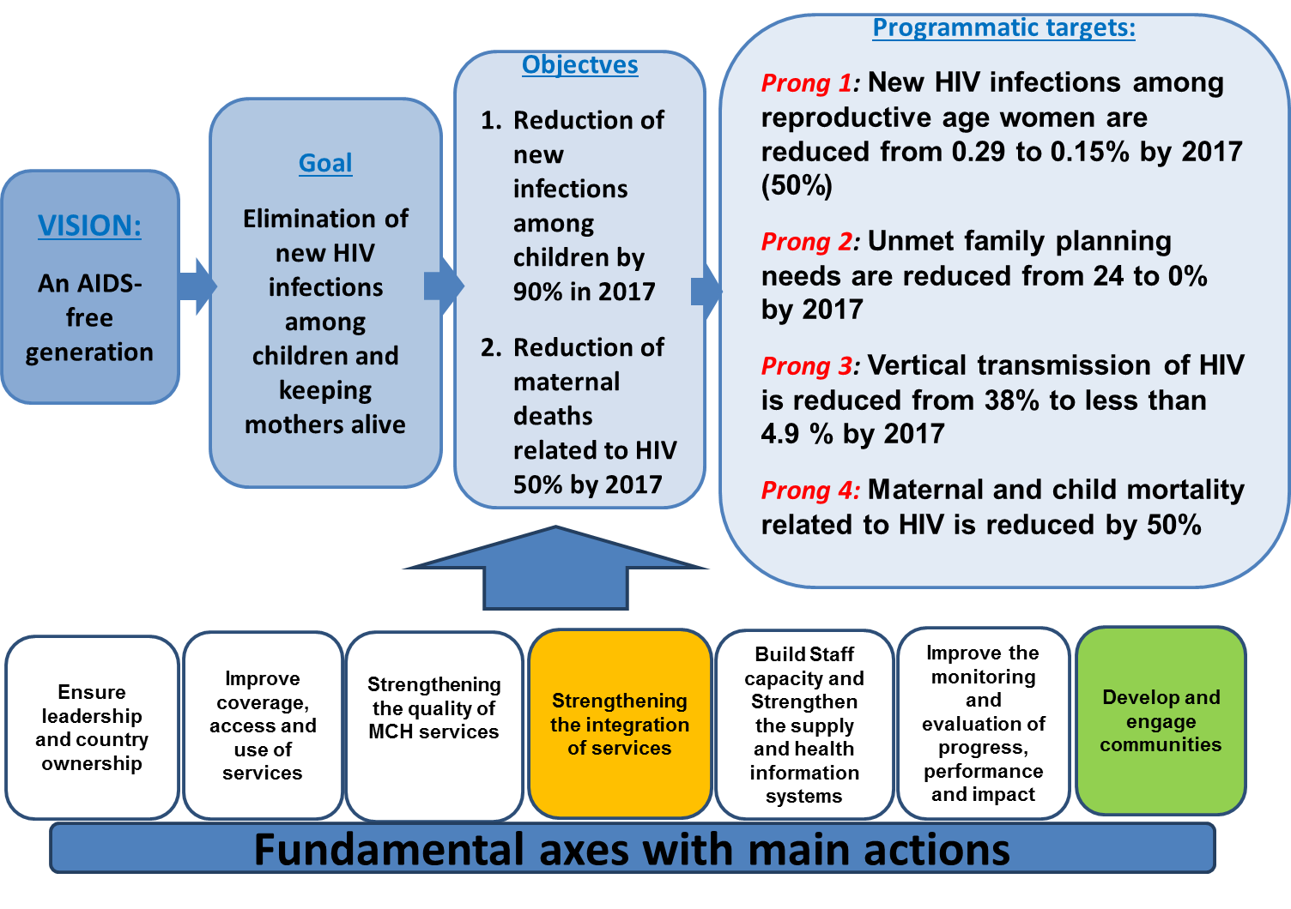
DRC’s STRATEGIES TO ELIMATE MOTHER-TO-CHILD TRANSMISSION OF HIV
Source: National AIDS Program
Notes:
The Global Plan towards the elimination of new HIV infections among children by 2015 and keeping their mothers alive (Global Plan) aimed at reducing MTCT by 90% and HIV-related maternal death by 50% starting in 2009.

Slide 3
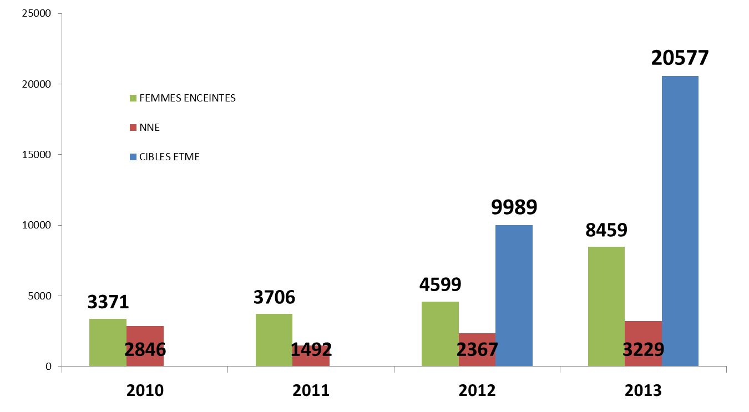
Number of pregnant women and infants initiated on ARV in DRC: 2010-2013
Pregnant women
Infants
eMTCT targets
Source: National AIDS Program, Progress report 2014
Notes:
How is DRC doing?
Maximizing the maternal health and infant HIV-free survival benefits of PMTCT requires high uptake of antiretroviral (80% with option B/B+ and more for Option A, but as you can see from this chart in DRC in 2013, just over 40% of HIV pregnant women received ARV for their own health or for PMTCT

Slide 4
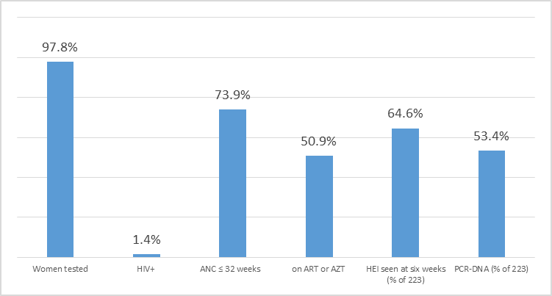
Retention along the PMTCT cascade among 52,364 pregnant women in 36 maternal and child health clinics in Kinshasa: Jan-Dec. 2011
Notes:
Maximizing the maternal health and infant HIV-free survival benefits of PMTCT requires high adherence to a continuum of services referred to as the PMTCT cascade. But as the data on this figure illustrate, the acceptance of HIV testing is relatively high in Kinshasa, over a quarter of women register late at ANC, and for various reasons, just about half are initiated on ARV before delivery, and just 2/3 of children born to those mothers who are documented to have given birth are seen at six months. Thus the need for novel strategies to improve uptake and retention of PMTCT services

Slide 5
Methods
Study Objectives
  Evaluate the effect of conditional cash transfer on adherence to the PMTCT cascade and uptake of PMTCT interventions through delivery and the infant’s six week visit.
Eligibility criteria
  < 32 weeks pregnant
  Newly diagnosed with HIV
  Intent to stay in Kinshasa through at least six weeks postpartum
Notes:
This study was design to evaluate whether provision of small and increasing cash incentive, on the condition that participant attend clinics visits and accept available HIV services will improve uptake and adhere to PMTCT through six week postpartum
The study was conducted in Kinshasa, DRC
Participants were elibible if they were; < 32 weeks pregnant, newly diagnosed with HIV and intend to stay in Kinshasa through six week post partum

Slide 6
Methods
  Intervention
    After randomization (28-32 weeks)
    $5 at the first visit after randomization
    Escalating incentive: $1 + the amount paid at the last visit at subsequent visits
    Median incentive paid: $26 (IQR: $18-$35)
  Primary outcomes
    Retention in care: known to be receiving HIV care at 6 weeks postpartum
    Adherence: attended all scheduled clinic visits and acceptance of proposed services through 6 weeks
Notes:
Following randomization, participants received $5 at their next visit, and at each subsequent visit, if they adhered to conditionalities, $1 was added to the amount paid at the last visit. If they did not adhere, they were »reset » and received the initial amount of $5 at their next visit, if they were adherent.

Slide 7
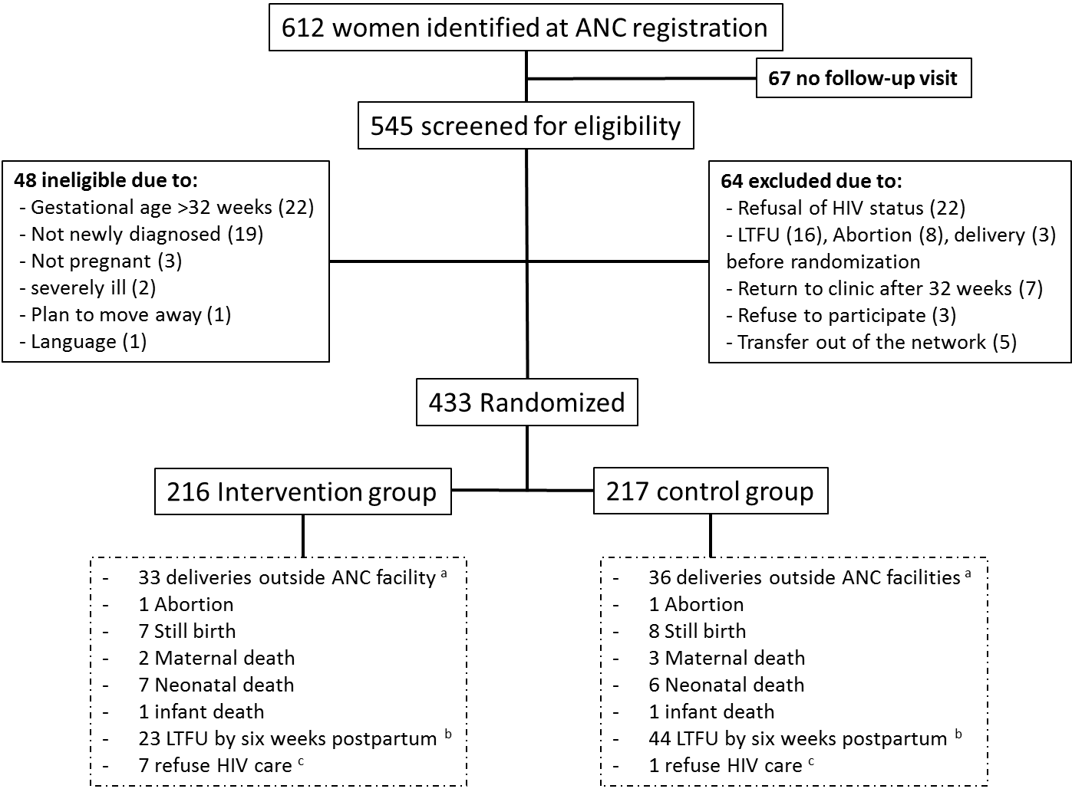
Results: Participants
Notes:
Between April 2013 and August 2014, 612 potential participants were identified, 545 were screened, and 433 were enrolled and randomized.

Slide 8
Retention and adherence at six weeks
Retention in care
Adherence
Intervention
Control
PR = 0.70 (95%CI 0.50, 0.99)
PR = 1.32 (95%CI 1.13, 1.55)
Notes:
At six weeks post-partum, 19% of participants in the intervention group and 28% in the control group were no longer in care (PR 0.70; 95%CI 0.50-0.99). The proportion of participants who attended all clinic visits and accepted proposed services was higher in the intervention group than the control group (68.5% vs. 52.1%; PR 1.32; 95% CI 1.13-1.54).

Slide 9
Loss to follow-up
LTFU before delivery
LTFU at six week
Intervention
Control
PR = 0.50 (95CI% 0.26, 0.98)
PR = 0.53 (95CI% 0.33, 0.84)
Notes:
Similarly, the intervention group had lower LTFU than the control group 5.6% vs. 10.7% at delivery and 11.1% vs 20.3% at six weeks PP; (RR 0.53; 95% CI 0.33, 0.84).

Slide 10
Conclusions
Modest economic incentives were effective in improving PMTCT programmatic outcomes
  Reduction of non-retention by -30%(CI 95%: -50%, -1%)
  Increase adherence to full PMTCT services by 32% (CI 95%: 13%, 55%)
  Reduction of loss to follow-up by -47% (CI 95%: -67%, -16%)
This research contributes to growing evidence that economic incentives are effective in achieving improve health care behaviors in low-income countries

Slide 11
Acknowledgements
Profs. Okitolonda, Behets,
Wembodinga,
Moracco, Thirumurthy,
Drs. Kawende, Chalachala,
Wenzi, Ravelomanana,
Edmonds, Kiketa
Mmes. Thompson, Chalachala, Matadi, Mindia, Nlandu, Salisbury,
Mr. Kihuma, Kleckner
Administrative teams at
KSPH, UNC, OSU
PEPFAR Implementing partners
EGPAF, ICAP
Participants
90 MCH clinics
UNC
OSU
KSPH
Catholic Health Board
Salvation Army
National AIDS Program
Ministry of Health
CDC
PEPFAR
NIH R01 HD075171

Slide 12
Notes:
Fiche de suivi des conditionalites

Slide 13
Subgroups Analyses
 | Risk Ratio (95% CI)
 | Unadjusted ª | Adjusted ^{b}
 | Remain in care ^{c}
Early ANC visit
< 20 weeks | 0.76 (0.33, 1.77) | 0.79 (0.34, 1.82)
>= 20 weeks | 0.69 (0.47, 1.01) | 0.70 (0.48, 1.02)
HIV disclosure to anyone
Yes | 1.05 (0.54, 2.05) | 1.00 (0.52, 1.90)
No | 0.60 (0.40, 0.91) | 0.62 (0.41, 0.93)
Wealth quintile ^{f}
Fifth | 1.10 (0.51, 2.36) | 1.26 (0.69, 2.66)
Fourth | 0.72 (0.35, 1.46) | 0.73 (0.36, 1.50)
Third | 0.89 (0.41, 1.91) | 0.86 (0.40, 1.86)
Second | 0.41 (0.17, 0.97) | 0.41 (0.17, 0.97)
first | 0.54 (0.23, 1.30) | 0.47 (0.20, 1.08)
Primiparous
Yes | 2.31 (0.68, 7.82) | 2.02 (0.57, 7.20)
No | 0.61 (0.42, 0.89) | 0.63 (0.43, 0.91)
Walk to clinic
Yes | 0.53 (0.32, 0.90) | 0.54 (0.32, 0.92)
No | 0.89 (0.56, 1.42) | 0.90 (0.56, 1.44)

