Slide 1
Biomedical Prevention: Contrasting Implementation Challenges
Francois Venter
Wits Reproductive Health & HIV Research Institute (RHI)
IAS Conference on HIV Pathogenesis, Treatment and Prevention 2015

Slide 2
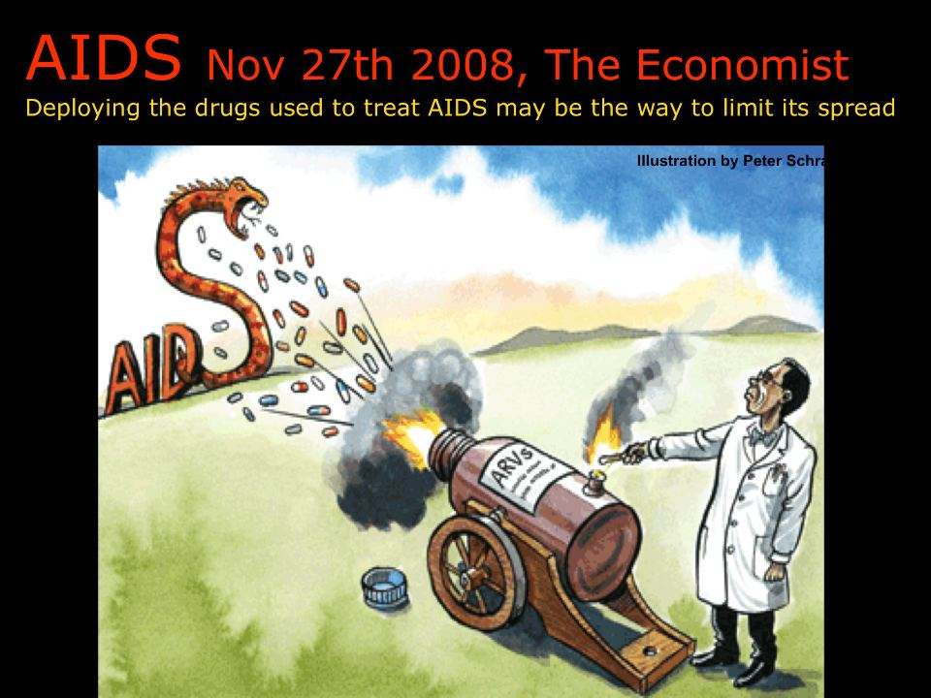
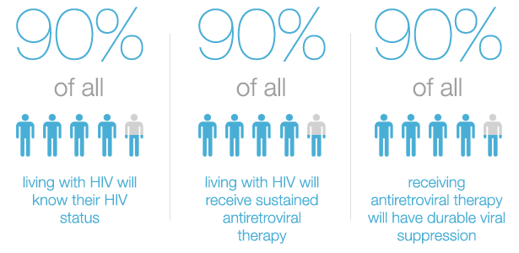
“Test & Treat / offer” vs other biological prevention
Notes:
Note re nomenclature; that Im a skeptic on both; clinician dragged into HIV prevention world

Slide 3
Acknowledgements
RHI: Helen Rees, Eugene Sickle, Michelle Moorhouse, Sinead Delaney-Moretlwe, Vivian Black, Brian Williams, Robyn Eackle, Mohammed Majam, Maria Sibanyoni
DoH: Yogan Pillay, Aaron Motsoaledi, Precious Matsotso, Zuki Panini
WHO: Marco Vitoria, Rachel Baggaley, Cheryl Johnson
University Liverpool: Andrew Hill
AVAC: Mitchel Warren
UCT: Andrew Boulle (UCT), Lee Johnson (UCT), Gary Maartens (UCT)
i-Base: Polly Claydon, Simon Collins
University British Columbia: Julio Montaner
NHLS: Wendy Stevens, Lesley Scott, Lynsey Stewart
Whitman College :Jennifer Cohen
MSF: Tom Ellman, Jen Cohn, Bella Hwang
Gorundup/TAC: Nathan Geffen, Vuyiseka Dubula
SAHCS: Lauren Jankelowitz, Francesca Conradie
HE²RO: Sydney Rosen, Gesine Meyer-Rath, Matt Fox
Amfar: Brian Honermann
Aspen: Stavros Nicolaou
UCSF: Tim Lane
Wits: Jeff Wing, Sarah Stacey
Imperial College London: Andrew Phillips, Sarah Fidler
University Washington: Connie Cellum, Jaered Baeten
Other: Tim Farley, Bill Coleman, Elizabeth Wallis, Louise Kuhn, Lynn Morris
Declarations: Research and other support (current, anticipated): PEPFAR, Bill and Melinda Gates Foundation, Gilead, Mylan, ViiV. Boards, speaking honoraria, conference attendance (all <$2000): Mylan, Gilead, Aspen, Merk, Viiv/GSK, Abbot
Notes:
Does not mean endorsement

Slide 4
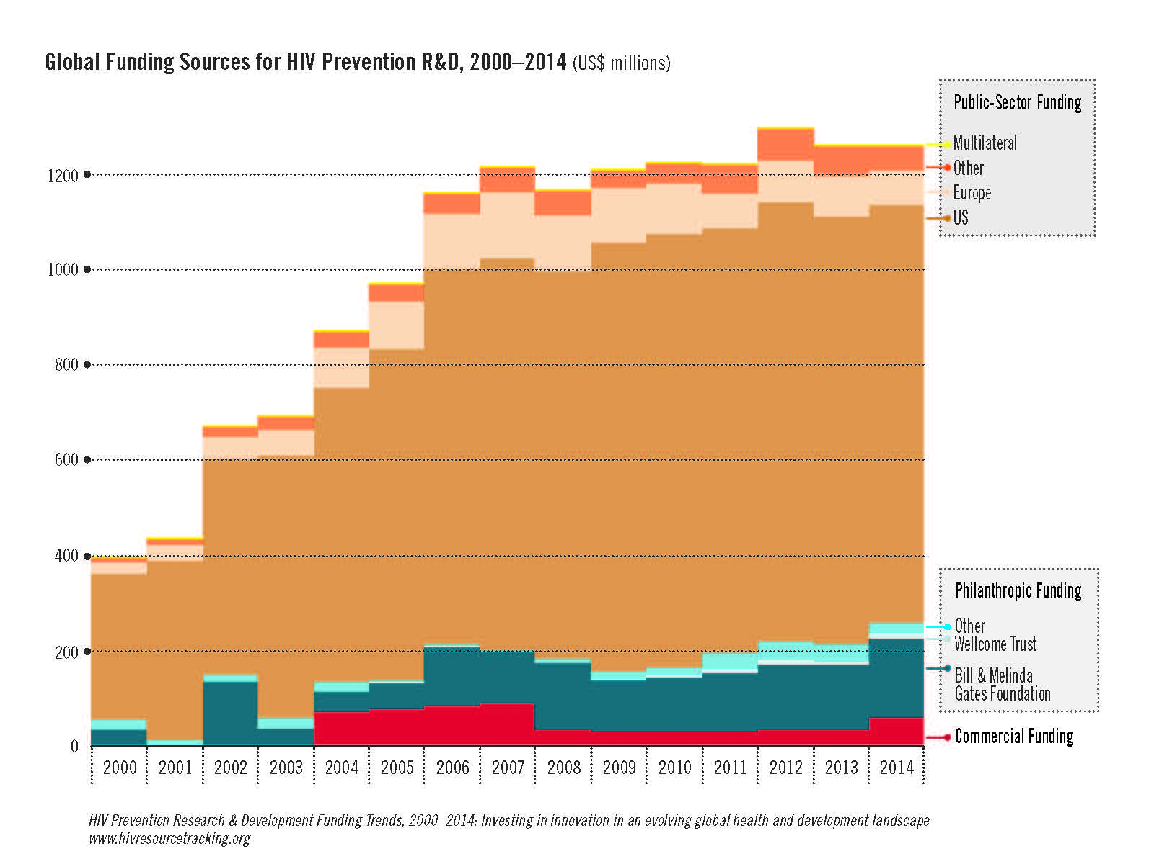
Thanks: Mitchell Warren, AVAC

Slide 5
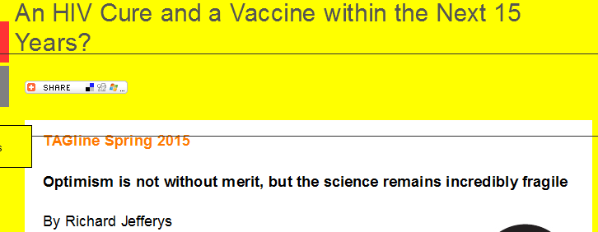
So what do we have in the bag?
T&T (including PMTCT and children)
Post Exposure Prophylaxis (PEP)
Pre-exposure prophylaxis (PrEP)
Male circumcision
Condoms
Needle exchange
Behaviour change
(New microbicides)
(Vaccines)
(Cure)
Notes:
– make point re condoms, nneedles, adherence vs prescriptive moralistic

Slide 6
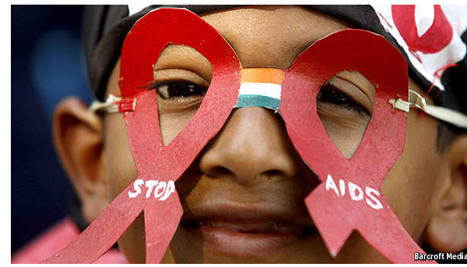
Lets start with ‘’treatment for prevention” (T&T)
Theoretical and observational data been around for a while
Notes:
Taking a quick history tour

Slide 7
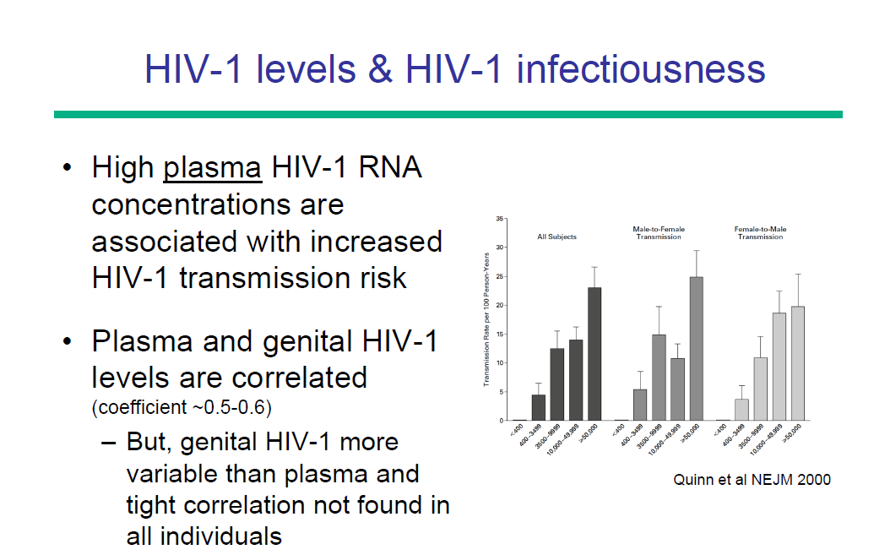
Thanks Connie Cellum
Notes:
Also in PMTCT, PEP

Slide 8
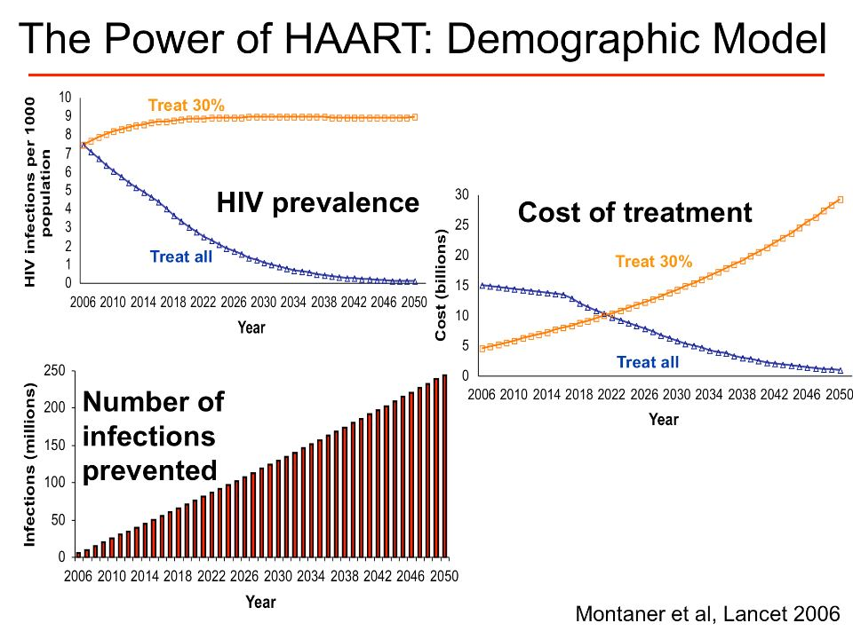

Slide 9
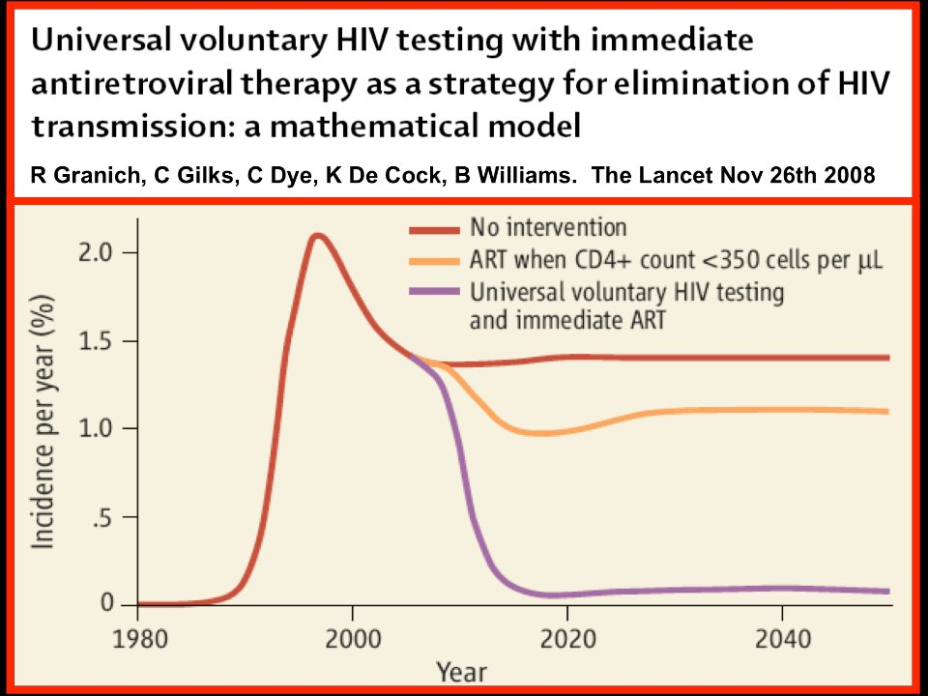

Slide 10
Observational studies followed…

Slide 11
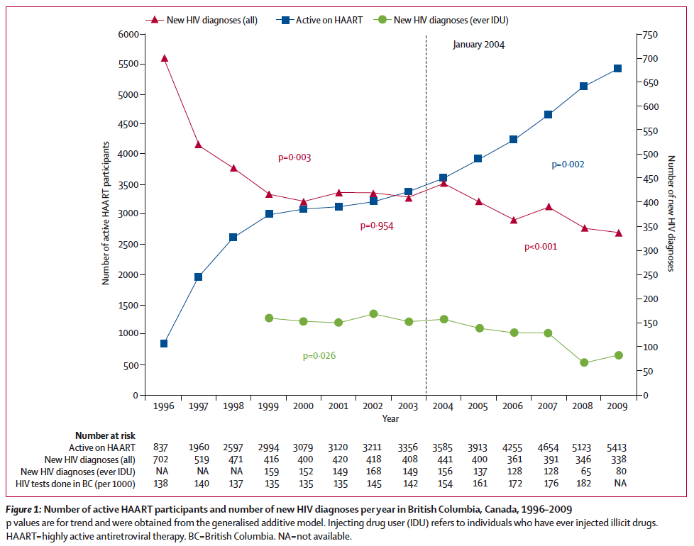

Slide 12
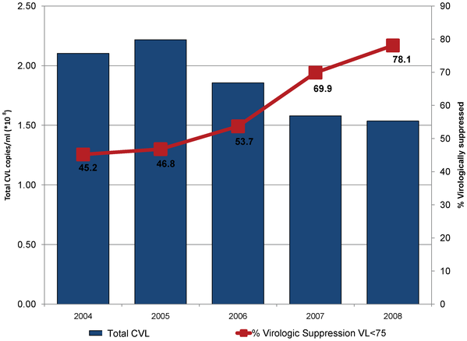
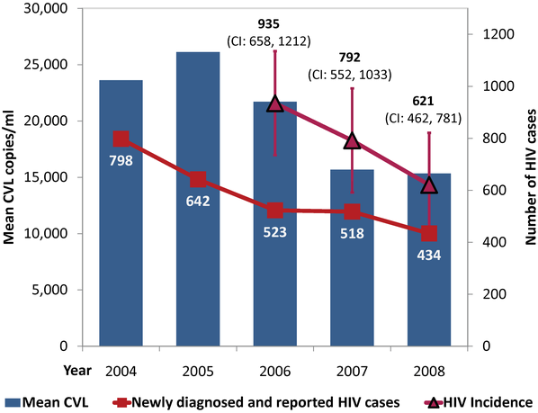
Viral Load and New HIV Cases in San Francisco
n=12,512 unduplicated HIV-positive individuals.
Das M,, et al. Decreases in Community Viral Load Are Accompanied by Reductions in New HIV Infections in San Francisco. PLoS ONE 2010
Notes:
Slide: Reductions in HIV RNA, Newly Diagnosed and Reported Cases in SF (2004-2008)
Das and colleagues used San Francisco’s HIV/AIDS surveillance system to examine the trends in community HIV RNA levels from 2004 to 2008. Mean community HIV RNA levels was calculated as the mean of the most recent HIV RNA level of all reported HIV-positive individuals in a particular community.¹
Community HIV RNA levels decreased from 2004 to 2008 and were accompanied by decreases in new HIV diagnoses from 798 (2004) to 434 (2008). The decrease in community HIV RNA level was significantly associated with the decrease in new HIV cases from 2004–2008 (P=0.002).¹
These results suggest that wide-scale antiretroviral therapy could reduce HIV transmission at the population level.¹
Reference
Das M, Chu PL, Santos G-M, et al. Decreases in community viral load are accompanied by reductions in new HIV infections in San Francisco. PLoS ONE. 2010;5:e11068.

Slide 13
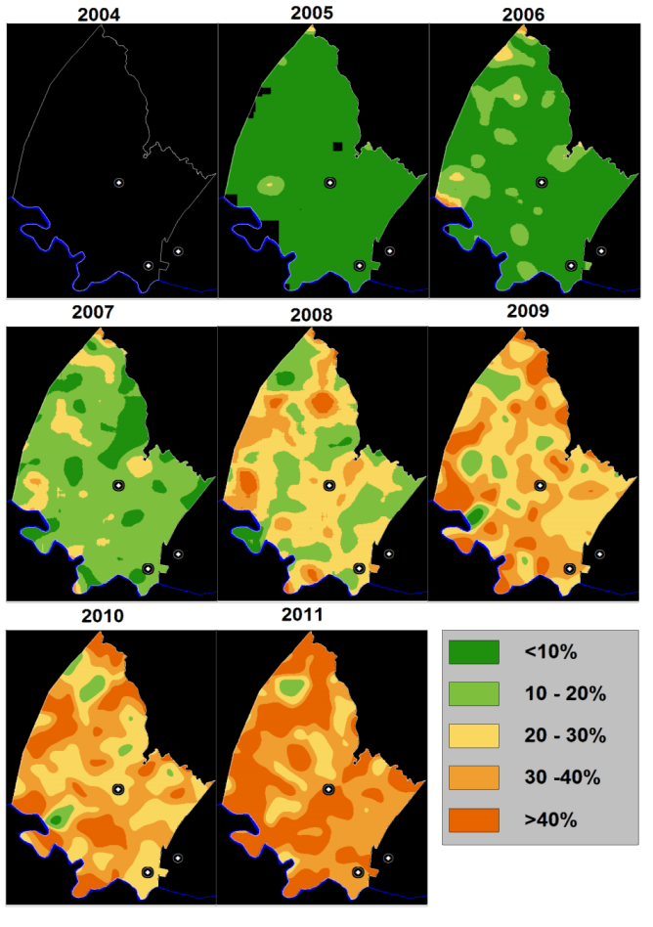
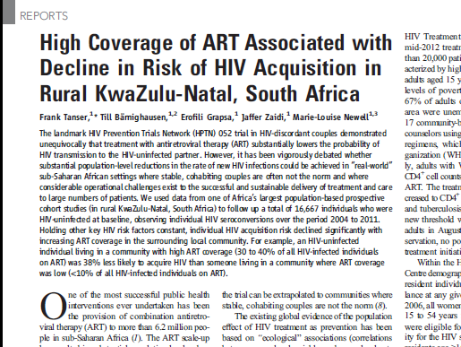
ART coverage significantly decreased individual risk, KwaZulu Natal, South Africa (2004-11)
Africa Centre longitudinal surveillance cohort with community and individual data
Between 2004 and 2011, 1395 HIV seroconversions and over 53,042 person-years of observation (crude HIV incidence rate of 2.63 (95% C.I. 2.50 to 2.77) per 100 person-years
Every % point increase in ART coverage among all HIV+ adults in a community, was associated with a 1.7% decline in the hazard of HIV acquisition (p <0.001)
Maps showing the estimated percentage of HIV⁺ adults
(≥15 years of age) on ART across the Africa Centre’s
surveillance area (2004 to 2011)

Slide 14


Is sex safe? HPTN 052
  HR = 0.37 or 96.3% reduction in transmission
%
Deferred
Immediate

Slide 15
Is sex safe? HPTN 052
And confirmed in Partners study
  HR = 0.37 or 96.3% reduction in transmission
%
Deferred
Immediate

Slide 16
Thorn in T&T side: Individual benefit
Conflicting observational studies
052 not convincing re individual data
Notes:
Gazzard: Expensive public health ‘’adventure’’

Slide 17
START and Temprano fixed this
Thanks: Simon Collins

Slide 18
START and Temprano fixed this
David Barr: “It’s easy to say that we always knew the answer… we would have a very different answer if we lived in the d4T or AZT era…”
Thanks: Simon Collins

Slide 19
START and Temprano fixed this
Thanks: Simon Collins

Slide 20
Programmes are starting to improve

Slide 21
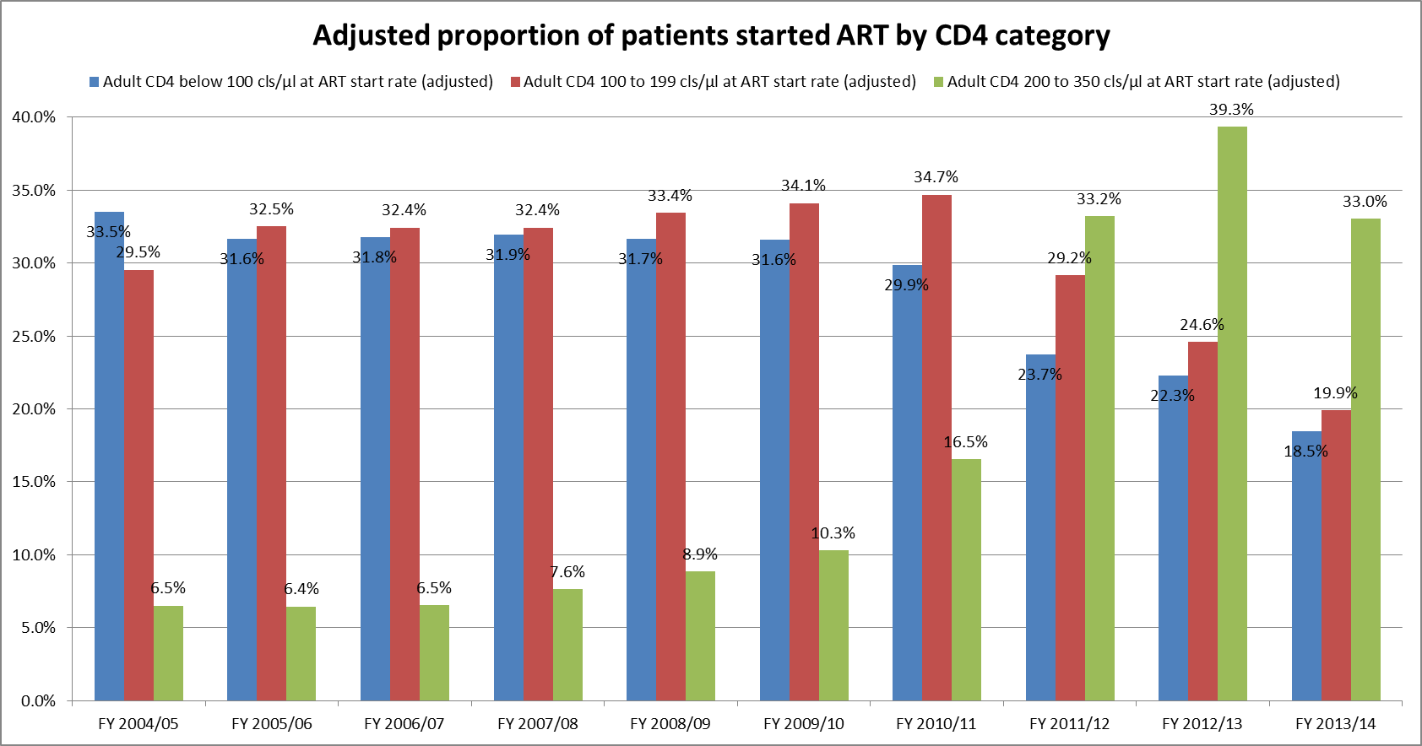

Changing disease severity over time
Thanks: Andrew Boulle
Source: Consolidated National report covering monthly and quarterly ART data to end March 2014

Slide 22

Life expectancy
Near-normal expectancy for adults starting ART above 200 cells/µL;
Currently updating this analysis
Johnson et al, PLoS Med 2013

Slide 23

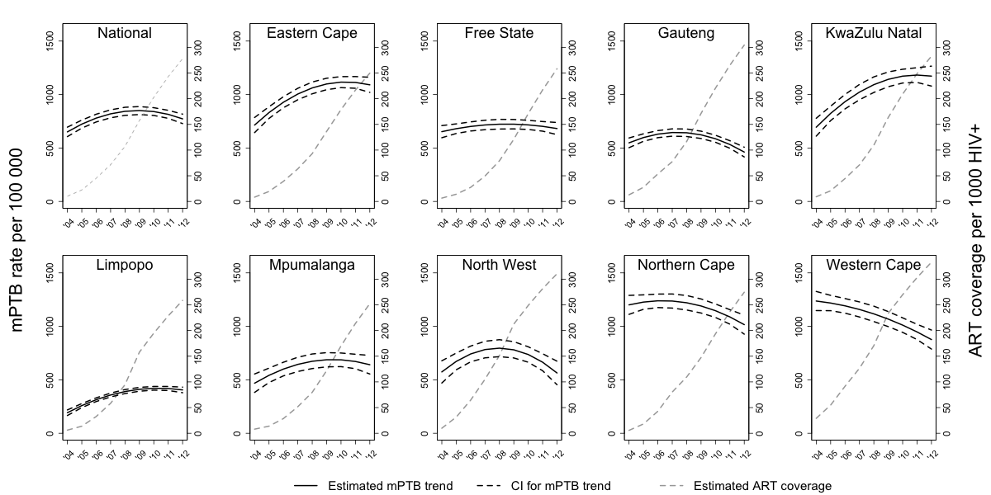
~4 YEAR LAG BETWEEN SCALE UP OF ART AND DECLINE IN MTB INCIDENCE
Figure 1: Incidence of microbiologically-confirmed pulmonary tuberculosis (per 100,000 population) and antiretroviral treatment coverage rates in HIV-infected individuals nationally in South Africa nationally and provincially from 2004 to 2012
The solid black line represents the estimated trend in PTB incidence per 100,000 population over the study period and the dotted black line the corresponding 95% confidence interval. The overlaid dotted grey line is the ART coverage per 1000 HIV positive individuals based on data from the ASSA 2008 model.
Nanoo A, Izu A, Ismail, NA, Ihekweazu C, Abubakar I, Mametja D, Madhi SAM. 2015. Nationwide and regional decline in incidence of microbiologically-confirmed pulmonary tuberculosis in South Africa: a time series analysis from 2004 to 2012. The Lancet Infectious Diseases, In press

Slide 24



Huge expansion of T&T projects
MAXART (Swaziland)
SEARCH (Kenya, Uganda)
Africa Centre/ANRS (South Africa)
POPART (Zambia, South Africa)
HPTN 065 (USA)
BCPP (Botswana)

Slide 25
Huge expansion of T&T projects
MAXART (Swaziland)
SEARCH (Kenya, Uganda)
Africa Centre/ANRS (South Africa)
POPART (Zambia, South Africa)
HPTN 065 (USA)
BCPP (Botswana)
“That’s over a million participants!”- Tim Maestro, FHI 360

Slide 26
So, problem solved.

Slide 27
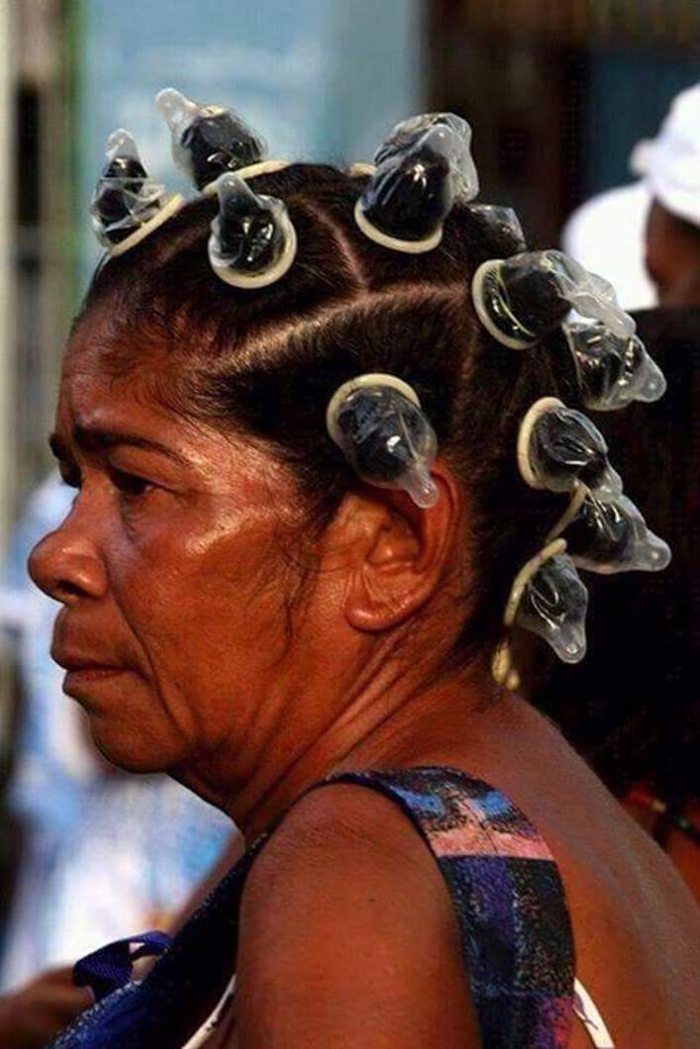
So what do we have in the bag?
T&T
Post Exposure Prophylaxis (PEP)
Pre-exposure prophylaxis (PrEP)
Male circumcision
Condoms
Needle exchange
(New microbicides)
(Vaccines)
(behavioural change)
Notes:
– make point re condoms, nneedles, adherence vs prescriptive moralistic

Slide 28
NB: Usually exist in context of care
PrEP, vaccines, microbicide ring…
Cost
Inconvenience
Side effects
Stigma

Slide 29
PrEP

Slide 30

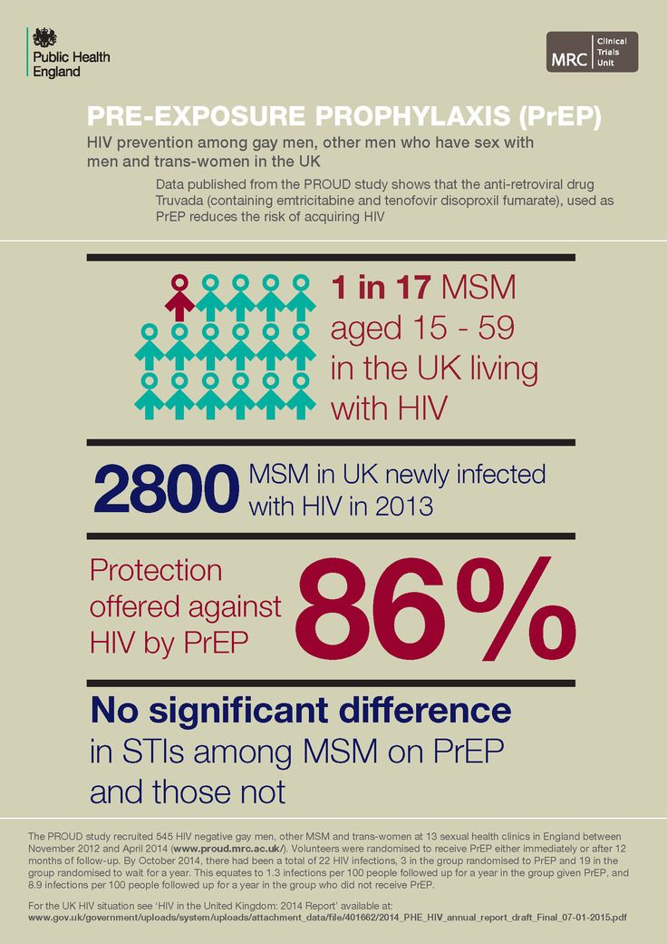

Slide 31
PrEP
“Risk compensation” – debunked; condoms not enough
Resistance not an issue; ?toxicity monitoring

Slide 32

$$$$$
And coverage very limited

Slide 33
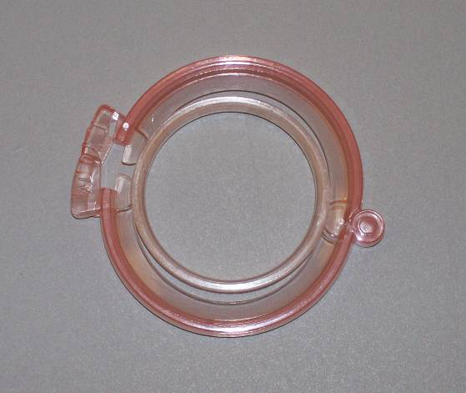
Male circumcision
10 years since Orange Farm – 60% reduction
Sustained reduction, protection in women
2014 - 14 priority African countries: 3.3 million men circumcised (22% increase on 2013; 750% increase from 2010)
Links men to services
Source: Mitchell Warren, AVAC; Tim Farley

Slide 34
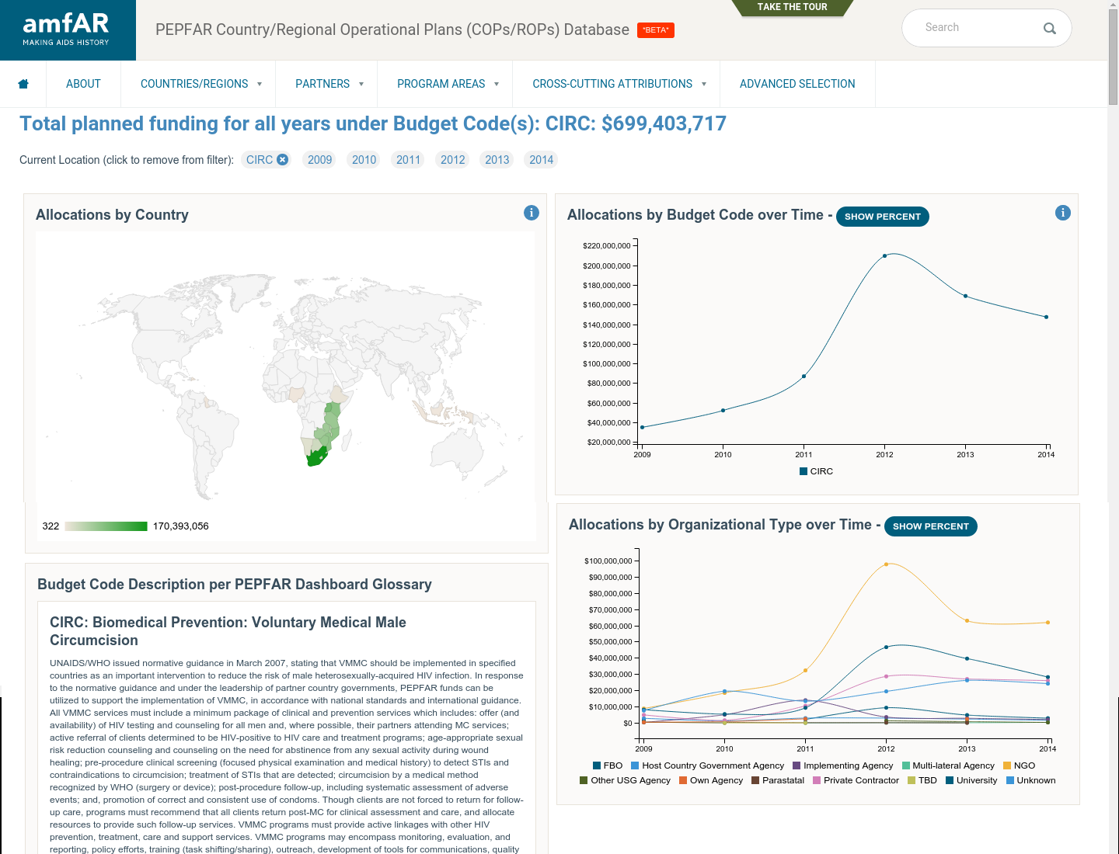
Thanks: Brian Honermann, AMFAR

Slide 35
Let’s do a thought-experiment…
Pretend you are: A cold-hearted public health official
“Let’s dump prevention: lets aggressively test, and give them the best treatment, in the best system”
“Why prevent when its so much easier to treat?”

Slide 36
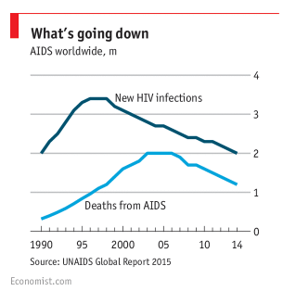

Slide 37
Does this make sense?
Fits current health model – just need to expand HIV testing, tinker with existing services
No money on dubious behaviour change
No more complicated vertical programmes
No more x to stop y HIV infections
No more political problems: Gay men, sex workers, IDU’s, adolescent sex education

Slide 38
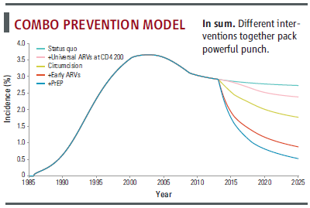
Greatest impact with implementing effective strategies together
From Cohen Science 2011, model from Cremin and Hallett
HIV/AIDS Department

Slide 40
For T&T to work, need suppression

Slide 41
Achilles heel of test & treat
Retention retention retention
Health system – unfriendly, unreliable
Reliance on global manufacturing and API

Slide 42
Thanks: Andrew Hill

Slide 43

Target 3 – Percentage of HIV+ People with HIV RNA suppression
- Results
Code: MOAD01, MOAD0102
Title: 90-90-90: Delivering on the Targets
Date: Monday, 20 July 2015
Time: 16:30-18:00
Room: Ballroom C-D
20%
Notes:
REDRAW – 90% threshold of treated patients

Slide 44
Figures
Figure 1. Average retention at specified time points, by region*
* Note: Y axis starts at 40%
Fox MP, Rosen S, Retention of Adult Patients on Antiretroviral Therapy in Low- and Middle-Income Countries: Systematic Review and Meta-analysis 2008-2013, J Acquir Immune Defic Syndr. 2015 May

Slide 45
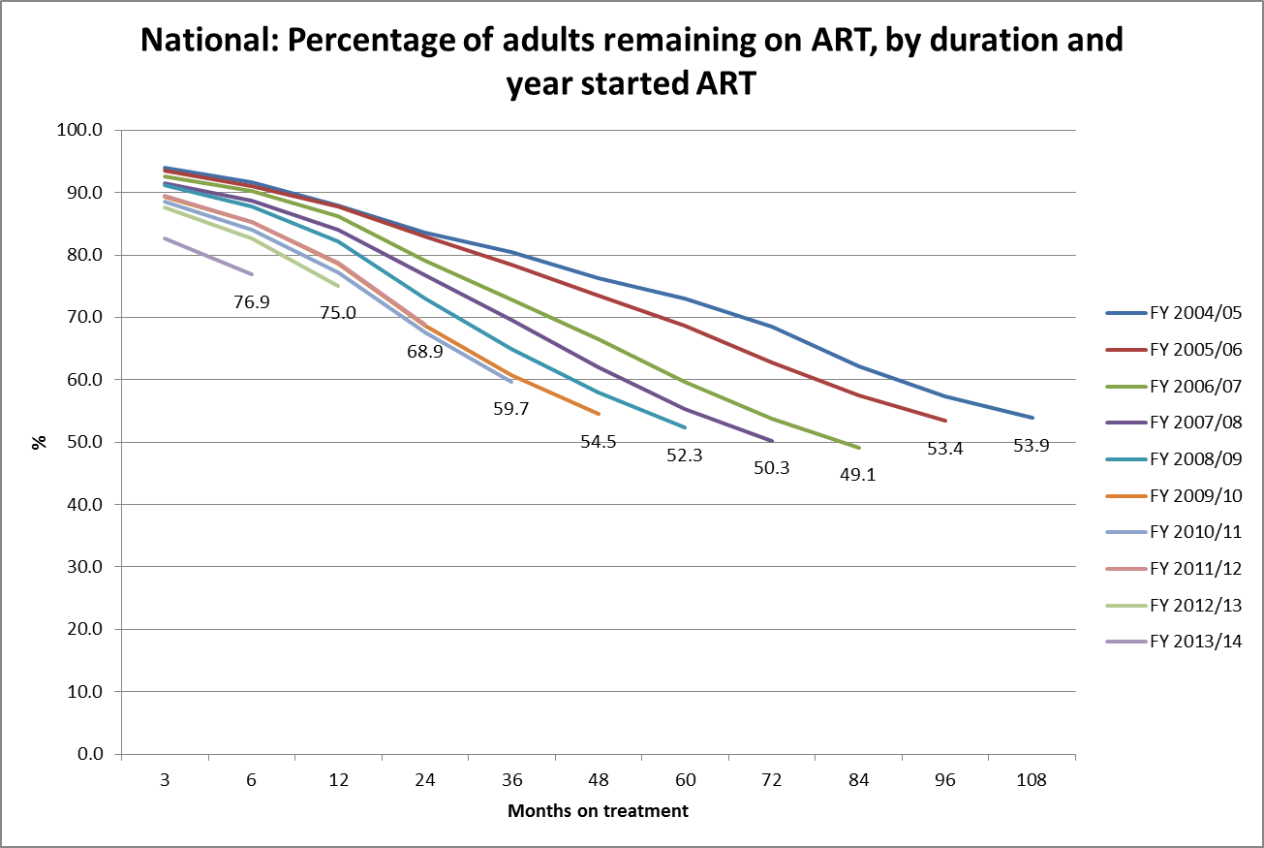

Retention in care
Source: Consolidated National report covering monthly and quarterly ART data to end March 2014
Thanks: Andrew Boulle

Slide 46
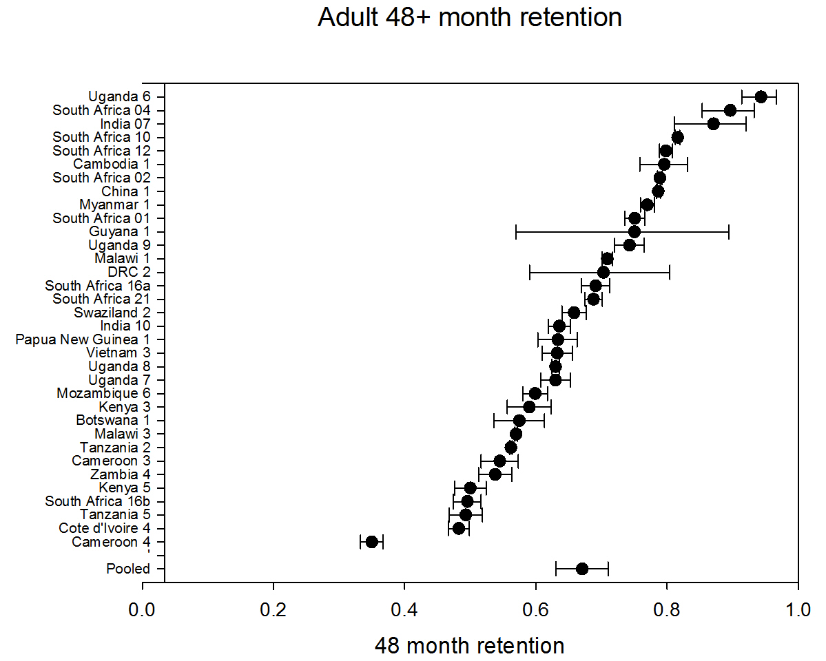
Figure of 48 month retention includes 48 month retention (sometimes interpolated) for all cohorts reporting beyond 48 months
Notes:
Huge disparity – health systems, M&E

Slide 47
Treatment for life
Thanks: Julie Fox, Guys

Slide 48

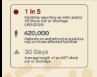
Your life is in the hand of (an often unreliable) distributor
And it is an international problem….

Slide 49
And you rely on raw chemicals…
Thanks: Stavros Nicolau
Can (and should) Africa make its own medicines? BMJ 2015 – 80% generics from India
Notes:
30 million people is a massive ndertaking never done before by generics; will we have enough TDF

Slide 50
Money IS short
More scrutiny against impact

Slide 52
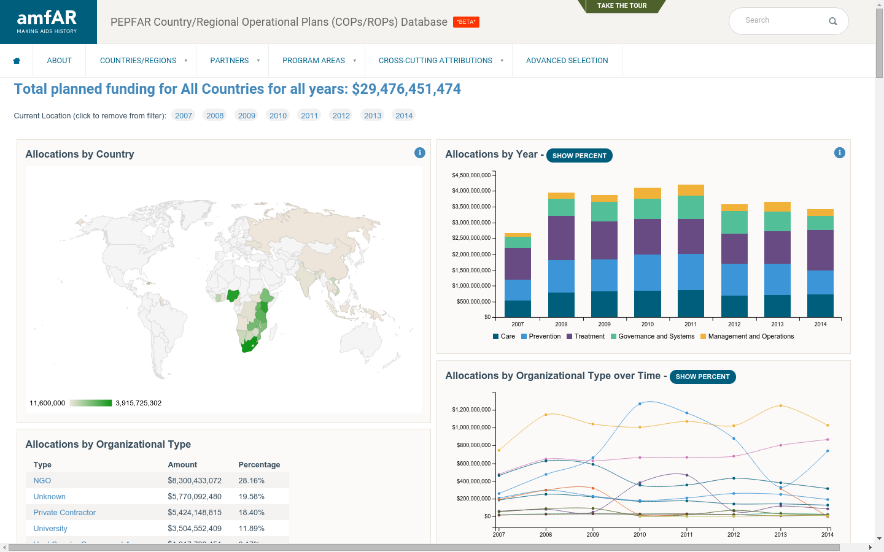
Pepfar data
Thank to Brian Honermann, Amfar

Slide 53
Rich countries too
Thanks: Andrew Hill

Slide 54
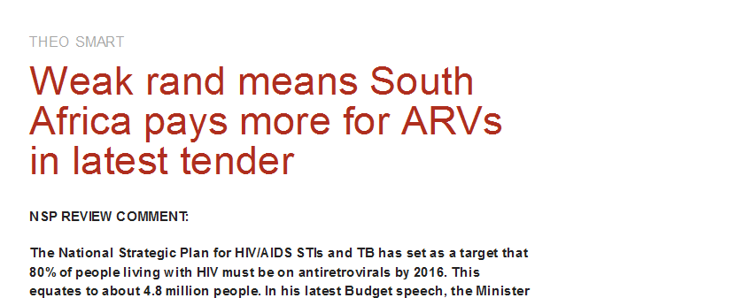
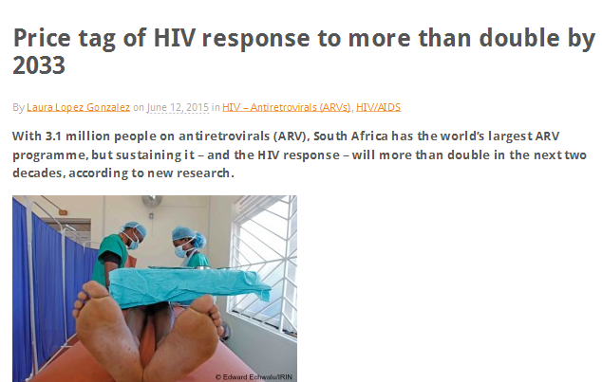

Slide 55

Stigma and systems
Uptake of prevention interventions
HIV testing
Adherence
Re-entry into systems

Slide 56

The 2014 South African PLHIV Stigma Index Research Report

Slide 57

BHIVA 2015, activist conversation on Grindr

Slide 58
Stigma can apply to HIV prevention programmes too
Feature of many behaviour change programmes
Obsessed with sexual partnering – concurrency, sugar daddies, marriage, abstinence, ‘faithfulness’, ‘’4 c’’

Slide 59
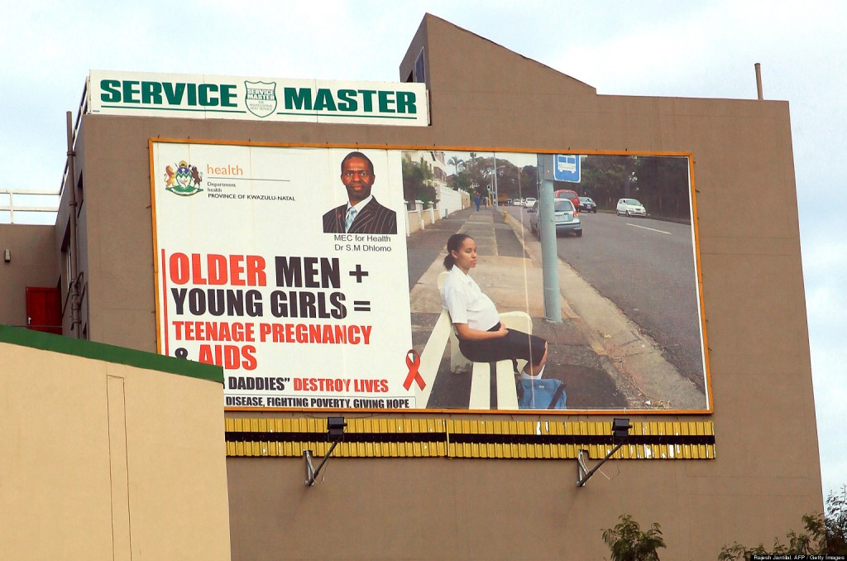
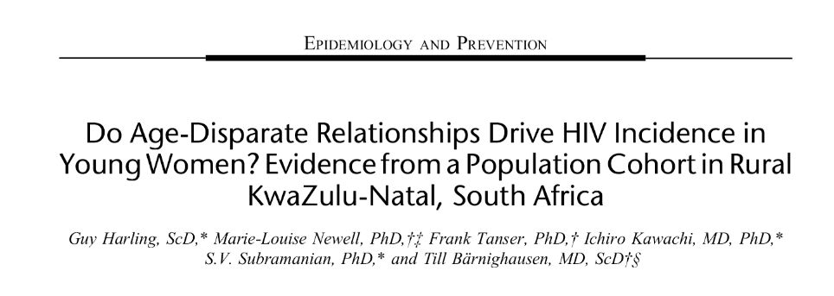
Stigma can apply to HIV prevention programmes too
Feature of many behaviour change programmes
Obsessed with sexual partnering – concurrency, sugar daddies, marriage, abstinence, ‘faithfulness’, ‘’4 c’’

Slide 60
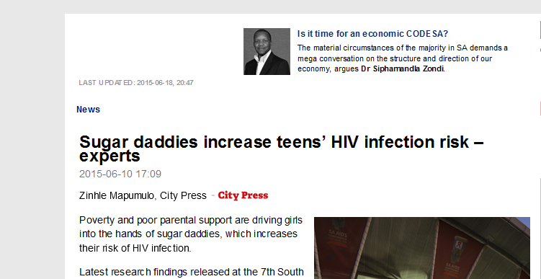
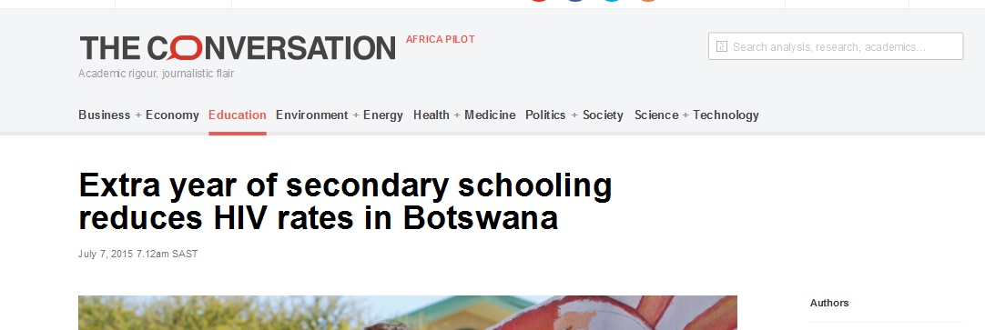
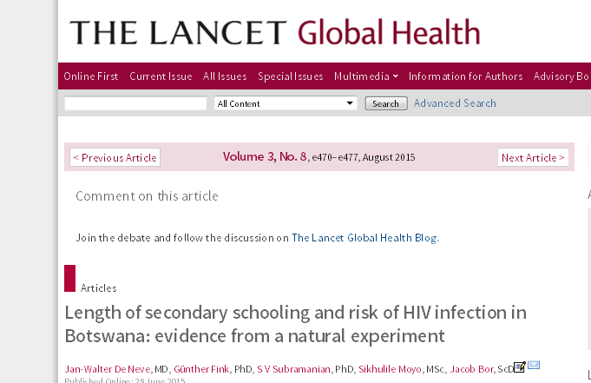
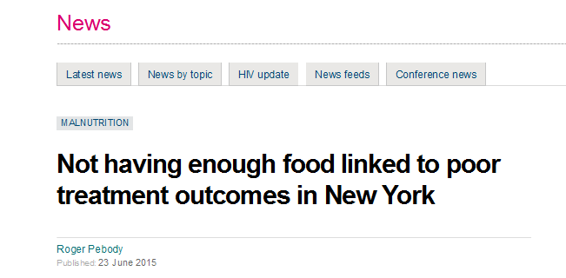
Less morality… more accountability
More services.

Slide 61
Being HIV-positive is NOT easy
Stigma
My life …
  Mercy of manufacturing
  At mercy of donor and government priority shifts
  Interacting with an unfriendly health system - out of pocket costs
  Violence still in many communities

Slide 62
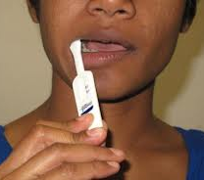
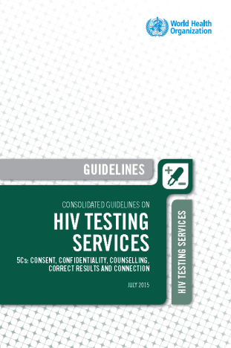
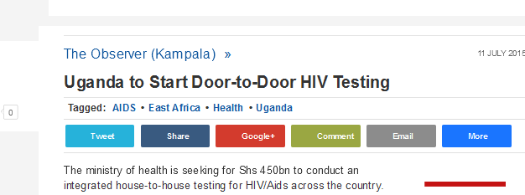
Testing, testing…
First 90 possibly the hardest
Innovative operational testing strategies needed beyond:
  Facility based testing
  Community based testing
  ? Self testing ?workplaces ?key populations ?schools
Thanks WHO: Cheryl Johnson/Rachel Baggaley

Slide 63








South Africa’s Investment Case –
What are the country’s
“best buys” for HIV and TB?
Gesine Meyer-Rath^{1,2}, Calvin Chiu¹, Leigh Johnson³, Kathryn Schnippel⁴, Teresa Guthrie⁵, Sarah Magni⁶, Yogan Pillay⁷, Fareed Abdullah⁸, Eva Kiwango⁹
on behalf of the Investment Case Task Team and Steering Committee
¹ Health Economics and Epidemiology Research Office (HE²RO), University of the Witwatersrand/ Boston University
² Center for Global Health and Development, Department of International Health, Boston University
³ Centre for Infectious Disease Epidemiology and Research (CIDER), University of Cape Town
⁴ Right to Care
⁵ Guthrie Consult
⁶ Anansi Health Consulting
⁷ National Department of Health
⁸ South African National AIDS Council
⁹ UNAIDS South Africa

Slide 64
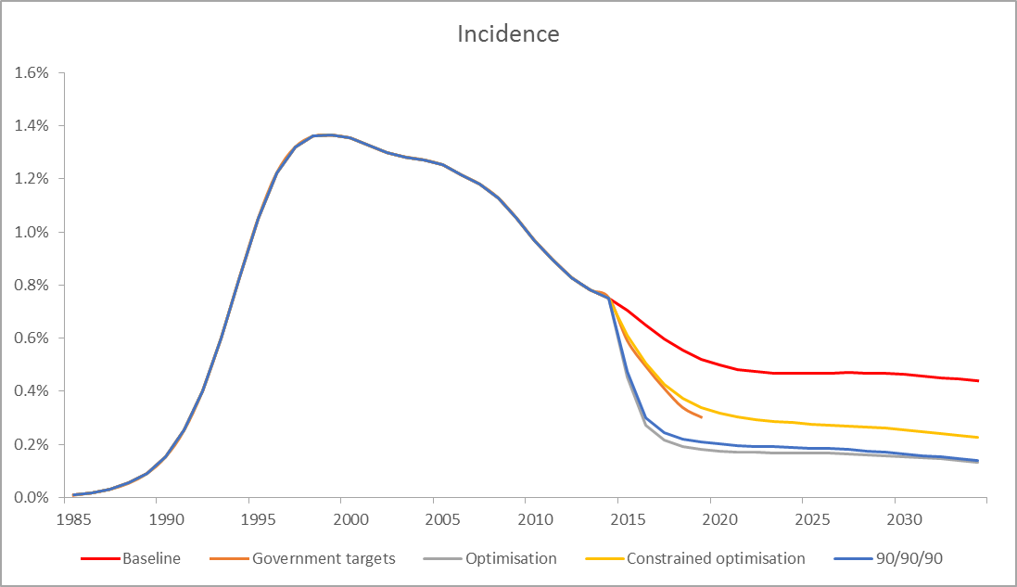
South Africa has passed peak incidence- the choice is how rapidly to further reduce it going forward
The introduction of ART has already done much to reduce incidence
Currently, 2/3 funded
Regardless of what is spent, HIV will not (quite) be eliminated by 2030
NSP: 50% reduction in 2012 incidence by 2016
UNAIDS: Elimination (=Incidence <0.1%)

Slide 65
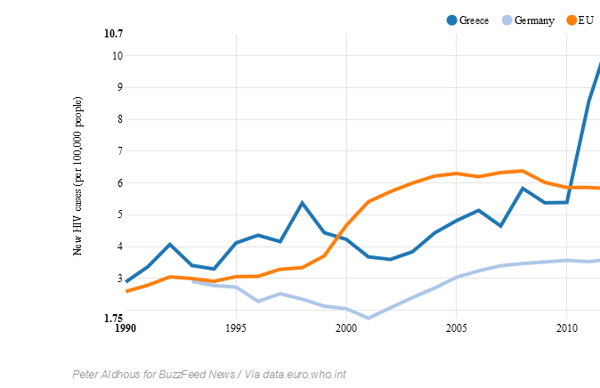
But money makes a difference…

Slide 66



SAHMS-FSW HIV prevalence estimates
Thanks: Tim Lane, UCSF
Notes:
Confirm the extraordinarily high burden of disease-

Slide 67
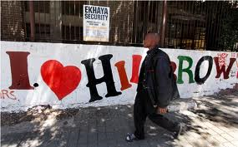
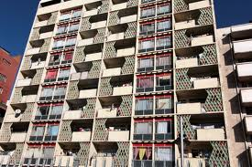
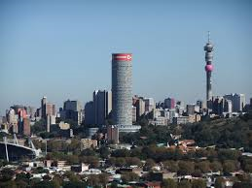
TAPS Demonstration Project
Expanded use of ARV for Treatment And Prevention for female Sex workers in South Africa
Investigators: Robyn Eakle, Gabriela Gomez, Francois Venter, Helen Rees

Slide 68
Haven’t lost a single patient

Slide 69
“They are so nice to us. They treat us like white people.”

Slide 70
Challenges specific to T&T
Retention and tracking programmes need priority
Return into care HAS to be made easier
Need easier, cheaper, more robust first line
Adherence interventions - crisis

Slide 71
Challenges specific to prevention
Access needs to be easier
Behaviour changes IF you provide good services
$$$ (and challenge wasted money)

Slide 72
Conclusions: Challenges to both
Addressing poverty and social access probably far more important that CD4 thresholds, new-fangled prevention tech
HIV testing
Friendlier services

