Slide 1
Sustained viral suppression in persons living with HIV/AIDS receiving HAART in Peru
P. Caballero ^{1,2}, C.M. Da Silva ³, M. Da Cruz ⁴
¹Universidad Nacional Mayor de San Marcos, Instituto de Medicina Tropical, Lima, Peru.
²Instituto Nacional de Salud, Lima, Peru.
³Fiocruz, Department of Epidemiology and Quantitative Methods, ENSP Sergio Arouca, Rio de Janeiro, Brazil,
⁴Fiocruz, Department of Endemias Samuel Pessoa, ENSP Sergio Arouca, Rio de Janeiro, Brazil.

Slide 2
CONFLICT OF INTEREST DISCLOSURE
The authors declare no conflict of interest.

Slide 3
Peru: The National HAART Program
Decentralized system
Launched in 2004
Ministry of Health
Uninsured persons
25 Regions
Public and private (non- profit) clinics
Health Information System
Public financing (100%)

Slide 4
OBJECTIVES
Analyze the frequency and duration of viral suppression in the first cohort of people living with HIV/AIDS (PLWHA) under treatment in Peru.
Identify the proportion of patients who linked to the program and achieved viral suppression (viral load ≤ 400).
Analyze the duration of the sustained viral suppression and its relationship with demographic variables and indicators of virological and immune response.

Slide 5
METHODS
Retrospective observational cohort study in adult patients with HIV-AIDS who linked to antiretroviral treatment program between April 2004 and December 2006 with follow-up until December 31, 2012

Slide 6
METHODS
Inclusion criteria:
Adult patients ≥18 years
Men and women
HIV diagnosis confirmed
Accessed through the Ministry of Health´s Program
All cities
Laboratory data and variables registered in NetLab
Exclusion criteria:
Social Security´s patients
Not registered cases / incomplete records

Slide 7
Definitions
Patients under treatment who achieved "viral suppression" are referred to as “Responders". And the group that never reached this state is called "non-Responders".
For purposes of the study, a patient receiving HAART has "sustained viral suppression" when achieved viral load ≤ 400 copies/ml and maintains this value over time with a variable duration.
It is called “interruption of viral suppression” if the patient has viral load > 400 copies / ml.
Notes:
Note that this is not “virologic failure”. This is the first interruption of viral suppression in patients under treatment, considering as a threshold 400 copies.

Slide 8
National Lab Reporting System:
All communicable diseases under public health surveillance.
This system works through the Internet, has electronic reporting of results and a database.
Health professionals have a username and password provided by the INS.
https://www.netlab.ins.gob.pe/FrmNewLogin.aspx
Notes:
El Netlab es un sistema modular integrado que usa el sistema operativo de Windows, una administración de tipo MS SQL 2000 y aplicaciones que usan la plataforma ASP.NET. Tiene tres componentes principales: (1) un componente de registro para ingreso de datos de muestras biológicas y resultados de las pruebas de laboratorio; (2) un componente de reporte para comunicar los resultados de laboratorio a diferentes usuarios; y (3) un componente educacional
El Instituto Nacional de Salud ha adquirido un certificado digital para el servidor de datos del Sistema NETLAB. El certificado digital asegura que la información que visualizan los usuarios en sus computadoras, procede del servidor de datos del Sistema NETLAB y que no puede ser vista ni consultada por otras personas. Esta garantía de que los resultados no han sido modificados desde su emisión desde el servidor de datos de NETLAB hasta su consulta por parte del usuario, la otorga la empresa certificadora Signature Trust (DST). Por tanto, la base de datos del NETLAB tiene control de calidad para los datos necesarios para el estudio.

Slide 9
STATISTIC ANALYSIS
Survival analysis (Kaplan-Meier) was applied in Responders patients to study the duration of viral suppression and its relationship with the independent variables.
Cumulative survival rate was analyzed in Responders.
The findings were evaluated by Cox proportional hazards and Schoenfeld residuals.
R Software was used, version 3.0.3, survival package.
Notes:
Survival time was measured between the first control with undetectable viral load until the presence of the first interruption of viral suppression. Persons lost to follow up and those without interruption of viral suppression were censored. Cumulative survival rate was analyzed. This value indicates the probability that a patient "survive with viral suppression" after a certain period of time (until the end of the interval).

Slide 10
PLWHA accessed to HAART Program
PERU 2004-2006
N=6,289 (100%)
Pre HAART evaluation /no treatment
N=1147 (18%)
PLWHA linked to care (At least 2 viral load measurements registered )
N=5142 (82%)
NON- RESPONDERS: Never achieved viral suppression
612 (12%)
RESPONDERS: achieved viral suppression 04/2004-12/2012
N=4530 (88%)
Notes:
During the study period a total of 6289 PLWHA had access to health care settings for pre HAART evaluation. Only 5142 linked to care and received HAART. Of these patients, a total of 4530 achieved viral suppression for variable time, and are called RESPONDERS. 612 patients never achieved viral suppression and are NON-RESPONDERS.

Slide 11
RESULTS: Cumulative Survival Rate
Notes:
This value indicates the probability that a patient "survive with viral suppression" after a certain period of time (until the end of the interval).
Este valor indica la probabilidad que un paciente “sobreviva con supresión viral” transcurrido un cierto período de tiempo (hasta el final del intervalo).

Slide 12
SUSTAINED VIRAL SUPPRESSION IN RESPONDERS (N=4530)
4530
4194
1969
3719
3256
2901
2506
1 YEAR
2 YEARS
3 YEARS
4 YEARS
5 YEARS
6 YEARS
Notes:
In each period (one year interval) patients with interruption of viral suppression and those lost to follow up were eliminated.

Slide 13
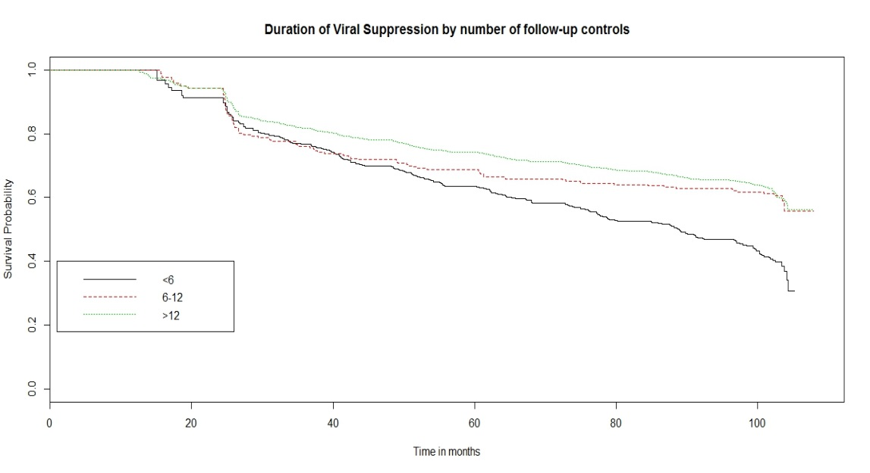
KAPLAN MEIER CURVES

Slide 14
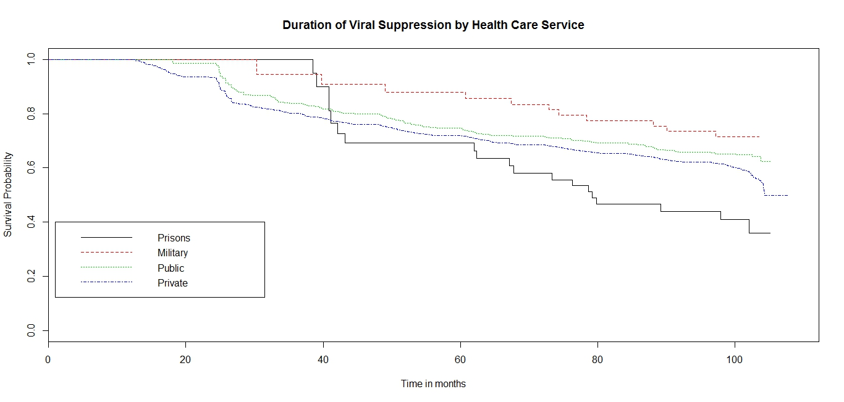

Slide 15
Cox Proportional Hazard
Notes:
According to adjusted Cox models, there is lower risk for interruption of viral suppression in patients with the following characteristics: men, ratio CD4maximun/baseline > 1, CD4nadir between 200- 350 or >350 and patients linked to public or private health care facilities.
In addition, there is higher risk in younger patients between 18-29 or 30-39 years old at the beginning of treatment.

Slide 16
CONCLUSIONS
This is the first Peruvian national study with preliminary information about the continuum of care for PLWHA.
Sustained viral suppression is presented as a convenient program indicator, feasible and useful.
This indicator can help program managers in monitoring treatment response and also the engagement in care.
Notes:
(pacientes recluidos en cárceles vs enrolados en instituciones privadas; pacientes atendidos en la Costa vs atendidos en la Sierra).

