Slide 1
High rates of non-reactive HIV serology after antiretroviral treatment initiated in acute HIV infection
J.L.K. Fletcher, S. Pinyakorn, M. de Souza, S. Akapirat, R. Trichavaroj, T. Pankam, E. Kroon, D. Colby, P. Prueksakaew, D. Suttichom, J.H. Kim, P. Phanuphak, N. Phanuphak, J. Ananworanich, The SEARCH010/RV254 Study Group
IAS 2015, Abstract WEAB0102

Slide 2
Conflicts
None to declare

Slide 3
Background
Revision of guidelines to allow initiation of combination antiretroviral therapy (cART) for all HIV-infected individuals
preservation the CD4⁺ T cell population
restriction of seeding of the viral reservoir
curtailment of opportunity for viral evolution
Patients with rapid suppression of HIV viraemia may represent attractive candidates for future cure research
Incomplete maturation of serological responses may be a marker of low HIV viral burden
Notes:
Newer guidelines based on lower drug toxicity and recognition of effects of uncontrolled viraemia non-AIDS-defining conditions.
- “allow” as evidence lower for CD4+ >500 and differing risk:benefit (drug adherence/toxicity) etc….
Rare cases of seronegative HIV-1 infection associated with lack of cytotoxic T lymphocyte response?
Note occasional previous reports of seroreversion/non-conversion are based on older assays
Does the subset of perinatally HIV-exposed but uninfected children who subsequently serorevert tell us anything?

Slide 4
Study Methods
Prospective cohort study launched in April 2009 in Bangkok, Thailand recruiting subjects with acute HIV infection (AHI)
Individuals presenting for voluntary HIV counseling and testing considered to have AHI if:
4th generation IA reactive and 2nd generation EIA non-reactive
4th generation IA non-reactive with detectable nucleic acid testing
Enrollees offered immediate initiation of cART
Notes:
- 9 of 271 subjects not considered in this analysis because: 2 declined to initiate immediate ARV; 1 was unable to initiate immediate ARV; 6 are non-Thais
- Note briefly randomisation to HAART (177; 68%) or megaHAART (85; 32%)

Slide 5
Study Methods (cont.)
Clinical interview
Blood draw for HIV-specific, pre-cART assays
2nd generation EIA (2G)
Genetic Systems rLAV EIA (Bio-Rad)
Avioq HIV-1 Microelisa (Avioq)
3rd generation EIA (3G)
Genscreen HIV 1/2 (Bio-Rad)
4th generation EI (4G)
AxSYM HIV antigen/antibody Combo (Abbott)
HIV Combi Assay (Roche)
ARCHITECT HIV antigen/antibody Combo (Abbott)
p24, Western blot (WB)
Performed at baseline, week 12 and week 24
Notes:
- Clinical interview = to establish dates of possible HIV exposure; describe calculation of estimated exposure date
- Need to justify equivalency between different assays
- Note: from 30 March 2013 to 01 August 2013, no 2G assay was used – all subjects screened with Bio-Rad Genscreen HIV 1/2

Slide 6
Study Population
271 subjects enrolled during April 2009 to May 2015 from 139,397 samples screened
3 did not initiate cART during AHI; 6 participants were not Thai
Characteristic | N = 262
Median age, years (IQR) | 27 (23 – 32)
Male, n(%) | 251 (96)
Men who have sex with men, n(%) | 245 (94)
Bachelor degree or higher, n(%) | 160 (61)
Median income, USD/month (IQR) | 1,061 (606 – 2,121)
Median duration of infection, days (IQR) | 18 (14 – 25)
Median time from infection to ARV initiation, days (IQR) | 19 (14 – 25)
Median CD4⁺ T cell count, cells/μL (IQR) | 380 (273 - 505)
Median HIV-RNA, log₁₀ copies/ml (IQR) | 5.78 (5.18 – 6.61)

Slide 7
Study Population (cont.)
Baseline staging | N = 262
Fiebig Stage n, (%)
I [RNA+, p24-, HIV IgM-] | 41 (15.7)
II [RNA+, p24+, HIV IgM-] | 72 (27.5)
III [RNA+, HIV IgM+, HIV IgG-] | 106 (40.5)
IV [RNA+, HIV IgM+, HIV IgG+, WB indeterminate] | 26 (9.9)
V [RNA+, HIV IgM+, HIV IgG+, WB+ without p31] | 17 (6.5)
Notes:
Fiebig stages consistent with revised figures [i.e. same as for plenary session]

Slide 8
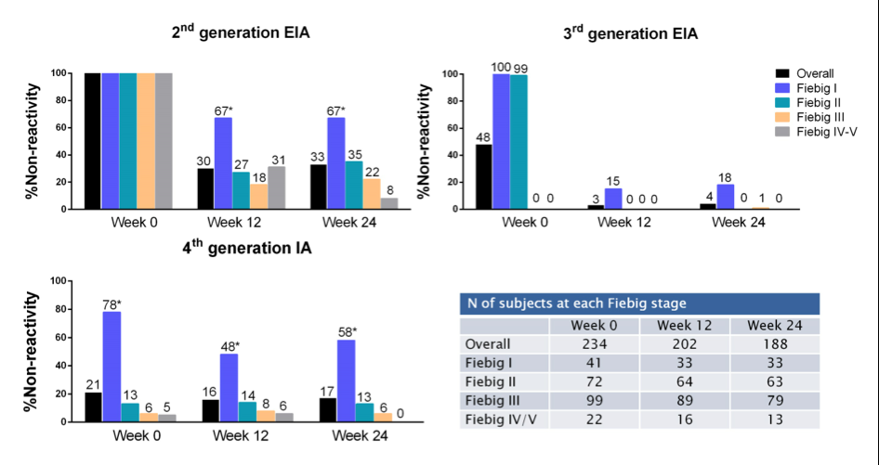
Non-reactivity to HIV enzyme immunoassay
* %non-reactivity is significantly higher in Fiebig 1
than other Fiebig stages, p=<0.05
Notes:
- Amongst all subjects who demonstrated a non-reactive 2nd generation EIA result at their baseline visit
- Need to explain discrepancy in number of baseline 4th gen negative subjects vs number of Fiebig 1 + 2 enrolled (a number of subjects who do not fit classical Fiebig staging patterns; discuss with Mark; this in addition to unavailability of assays to determine IgM vs IgG reactivity suggests time to move to 4thG staging, which has better resolution for the very earliest stages of infection anyway)

Slide 9
Predictors of week 24 2G non-reactivity
Predictors | Univariate |  | Multivariate
 | Odds Ratio (95%CI) | p-values | Adjusted Odds Ratio (95%CI) | p-values
Age | 0.99 (0.95 – 1.03) | 0.57
Sex
Male | Ref.
Female | 2.59 (0.76 – 8.86) | 0.13
Days since infection | 0.99 (0.95 – 1.02) | 0.43
Treatment
HAART | Ref.
MegaHAART | 1.73 (0.94 – 3.20) | 0.08
CD4 T cells
< 350 | Ref. |  | Ref.
≥ 350 | 3.10 (1.61 – 6.00) | 0.001 | 2.21 (1.06 – 4.61) | 0.03
HIV RNA (log10copies/mL)
≥5 | Ref. |  | Ref.
< 5 | 6.59 (3.12 – 13.91) | <0.001 | 3.96 (1.77 – 8.89) | 0.001
Fiebig stage
I-II | 3.48 (1.81 – 6.68) | <0.001 | 2.76 (1.36 – 5.60) | 0.005
III-V | Ref. |  | Ref.

Slide 10
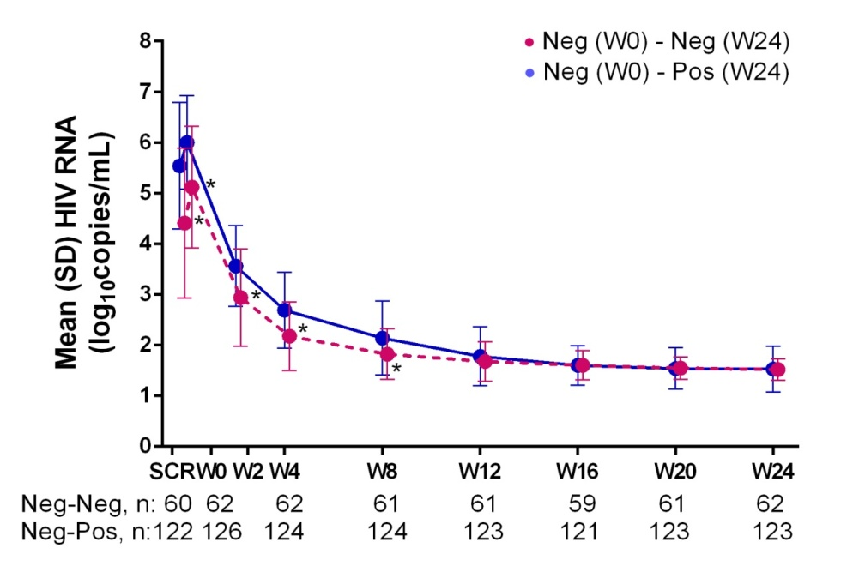
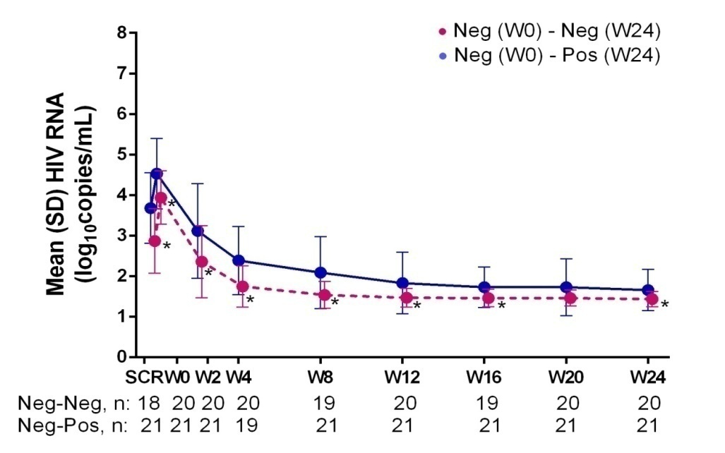
Association with HIV-RNA AUC_{0-24wk}
Plasma viral load by 2G EIA reactivity
Plasma viral load by 4G IA reactivity
p<0.0001
p<0.004
Notes:
This is a univariate analysis. This association disappears in multivariate analysis (discuss with Meaw).

Slide 11
Conclusions
One third of subjects initiating cART in AHI maintain non-reactivity to 2G EIA at 6 months
Approximately 20% of this group are also non-reactive by 4G IA
Low viral load prior to cART initiation predicts non-reactivity to 2G EIA
Serologically non-reactive subjects may represent for a population of interest for research into potential HIV cure strategies

Slide 12
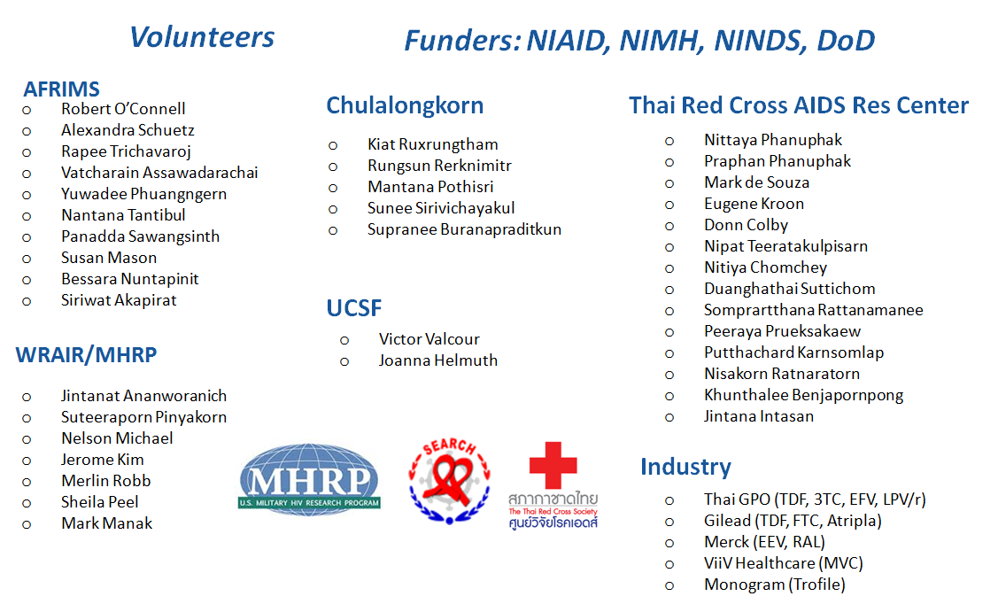
Acknowledgements

