Slide 1
Advancing HIV Vaccines into Efficacy studies: the time is now
Glenda Gray

Slide 2
What we need to end AIDS: controlling viremia
Innovations in the management of HIV that will impact on community viral load and infectiousness: prevention of secondary transmission
New classes of Drugs
FDCs, long acting ARVS & child friendly formulations
Point of care viral load & CD4 monitoring
Innovations in Prevention that will be required when secondary transmission is not averted
HIV Vaccines & other immune based strategies
Microbicide development & long acting ARVS for PrEP
HIV Cure: to enable control by eliminating viremia in those infected
Immunological & Drug Based Strategies aimed at the latent reservoir
Transmission occurs sub-clinically
Gray, G et al Plos Biol, in press 2015

Slide 3
“Ultimately, we believe, the only guarantee of a sustained end of the AIDS
pandemic lies in a combination of non-vaccine prevention methods and
the development and deployment of a safe and effective HIV vaccine.”

Slide 4
Challenges for making HIV vaccines
Scientific: highly variable virus that integrates into host genome, rapidly establishing latency, evading both humoral & cellular responses

Slide 5
Limited financial Investment from Private Sector & LMIC countries
Limited pharmaceutical support
Donaldson E, et al, HIVR4P 2014

Slide 6
This has resulted in only 4 vaccine concepts that have been tested in 6 efficacy trials in 30 years

Slide 7
Clinical HIV-1 Vaccine Efficacy Trials (Barouch & Michael, 2013)
Study/ location | Vaccine/s | Risk Group/HIV incidence | Result
1. Vax003 Thailand | AIDSVAX B/E gp120 in alum | IDUs 3.4% | No VE
1. Vax004 US/Europe | AIDSVAX B/B gp120 in alum | MSM/high risk women 2.6% | No VE
2. HVTN 502 Americas STEP | MRKAd5 HIV-1 gag/pol/nef | MSM/high risk women 3% | Halted for futility; early transient increased infection in vaccinees
2. HVTN 503 RSA Phambili | MRKAd5 HIV-1 gag/pol/nef | Heterosexual men & women 3.7% | No VE; late increased HIV infection in unblinded male vaccinees
3. RV144 Thailand | ALVAC-HIV vCP1521, AIDSVAX B/E rgp120 in alum | Heterosexual men and women with variable risk 0.28% | 31.2% VE @ 42/12; 60% VE @ 12/12
4. HVTN 505 | DNA(gag/pol/nef/env) rAD5gag/pol/env (A,B,C) | Circumcised MSM Ad5 neg 1.8% | Halted at interim analysis for futility

Slide 8
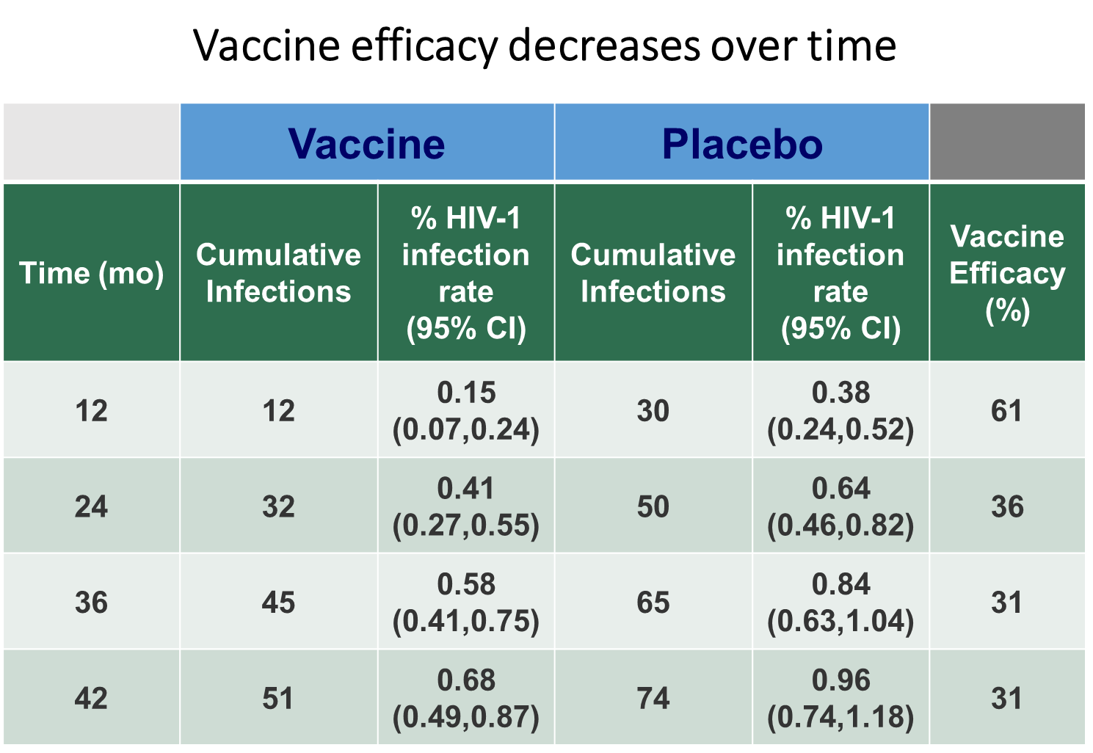
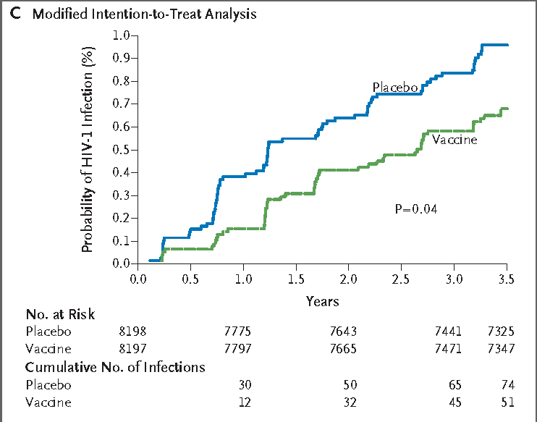
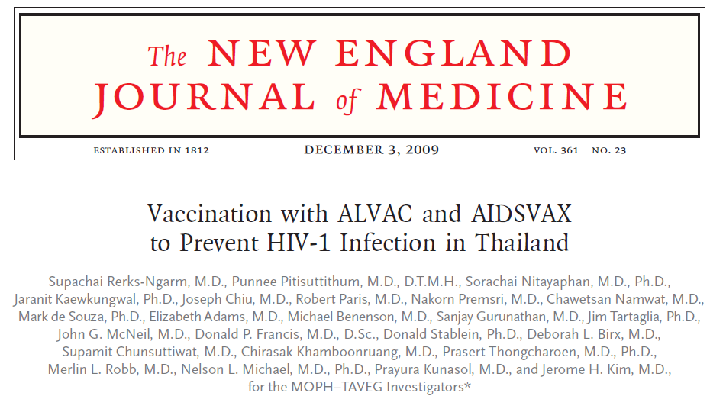
Thai Trial (RV144) Primary Results
1.0
Modified Intention-to-Treat Analysis*
0.9
0.8
Placebo
0.7
0.6
Vaccine
Probability of HIV Infection (%)
0.5
0.4
0.3
0.2
0.1
0.0
0.0
0.5
1.0
1.5
2.0
2.5
3.0
3.5
Years
125 HIV infections in 16395 subjects

Slide 9

Kinetics of Vaccine-Induced Immune Response and
Vaccine Protection Based on RV144
Limited/No Vaccine
Protection
Waning Vaccine
Protection
Good Vaccine
Protection
T-cells
Levels
Poor Ab Response,
T-cells
Ab
0
1
3
6
9
12
Months
Pox
Pox
Pox + Env
protein
Pox + Env
protein
Pox + Env
protein
AIDS Vaccine Conference 2009, Bangkok

Slide 10
Key correlates that emerged from RV144 that appeared to be related to Vaccine Efficacy (Haynes, 2012)
VE
The binding of IgG antibodies to the V1V2 region of gp 120
The binding of plasma IgA to env
The avidity of IgG antibodies for env
VE
Antibody Dependent Cellular Cytotoxicity (ADCC)
Neutralising Antibodies to vaccine antigen
The magnitude of CD4 T cells specific for HIV-1 env
In vaccinees with low plasma IgA responses

Slide 11
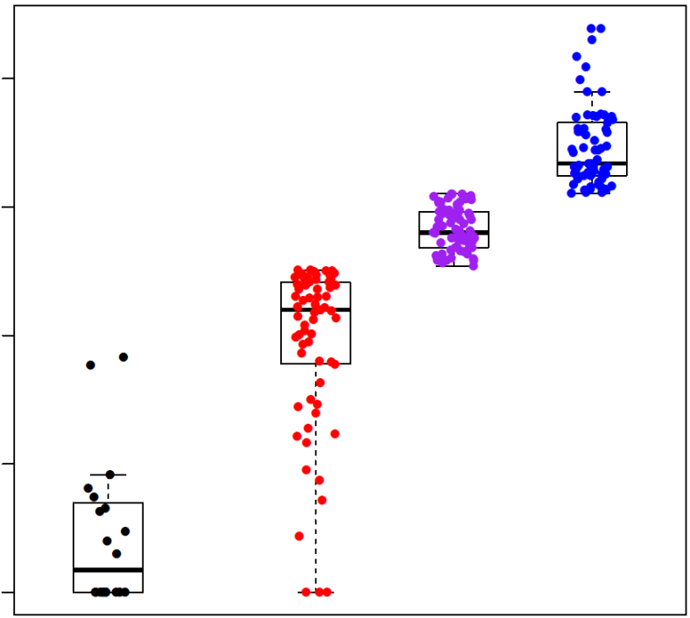


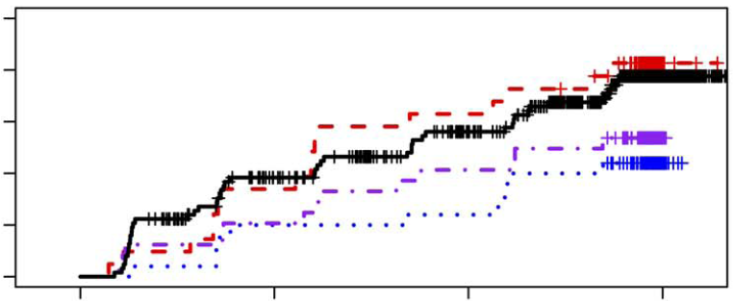
Association between V1V2 antibodies and HIV acquisition in RV144 is critical to VE
A
10000
B
0.010
Placebo
Low
Medium
High
1000
0.008
100
0.006
MFI
Probability of Infection
0.004
10
0.002
0.000
0
0
12
24
36
Uninfected
Placebo
Low
Medium
High
Time since Week 26 visit (months)
Uninfected Vaccine

Slide 12
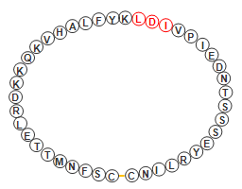
V1/V2 IgG Correlate of Risk
V2 Specific mAbs were isolated and characterized that involve position 169 in the V2 loop (Liao et al. Immunity 2013).
Virus sieve analysis in the V2 loop at position 169 (Rolland et al. Nature 2012).
V2 Loop Crown
181
169
α4β7 binding motif
60% of clade C isolates have lysine at position 169 vs 10% of clade B isolates
Flanks

Slide 13
lack of a direct correlation between neutralising antibodies and HIV-1 acquisition
Even at peak antibody response, none of the sera from the vaccinees neutralised a panel of 20 contemporaneous isolates of HIV-1 circulating in Thailand during the course of the trial…..

Slide 14
Post RV144 world: conceptual summary of the correlates work
Non neutralising antibodies with antibody functions such as ADCC, ADCP & virion capture, as well as polyfunctional CD4 T cell responses were associated with VE
Neutralisation was not the mechanism that protected against HIV acquisition
Strategies that build on these concepts have formed the basis of the efficacy studies taken forward

Slide 15
Besides non neutralising HIV vaccine approaches….other things were happening in the neutralising space

Slide 16
Immunogen design to induce neutralisation
Advances in B cell technology have enabled the field to identify and isolate broadly neutralising antibodies from persons with chronic HIV infection
Passive transfer of these BNABS have demonstrated protection in NHPs from experimental challenge
Opening up a new vaccine approach either utilising these BNABS as passive immunisation or to form the basis of new immunogen design

Slide 17
This leads us to evaluate 3 strategies to advance HIV immunization
Efficacy Studies
P5 “Clade C” approach using ALVAC & gp120/MF59
(HVTN 702)
Multi-clade approach using rAd26/MVA/gp140 trimer
Neutralising antibody approaches

Slide 18








2010 Formation of the P5 Partnership
Purpose:
To build on RV144 data and ultimately license a pox-protein based HIV vaccine with the potential for broad and timely public health impact.
  Strategy:
  Continue to build public-private partnerships critical for success.
  Work with host countries to support a flexible regulatory strategy in target populations and regions.
  Generate and incorporate knowledge from the assessment of next-generation vaccine concepts.

Slide 19
The Strategy for the ALVAC/Protein
Phase 3 Program
Construction of Bivalent Subtype C gp120/MF59
Construction of ALVAC-HIV-C
(vCP2438)
Booster at
12 months
Optimize regimen by increasing potency and durability

Slide 20
HVTN Strategy for the Phase 3 Program
HVTN 097
HVTN 100
HVTN 702
Designed to evaluate RV144 vaccine regimen in RSA and compare immunogenicity to that in Thailand
A standard phase 1 trial of the clade C products to decide whether to proceed to phase 3
A Classic phase 3 RCT assessing efficacy and safety aimed at licensure
Notes:
Add HVTN in the title?
I think this slide would be better if the protocol number was shown horizontally as well.

Slide 21
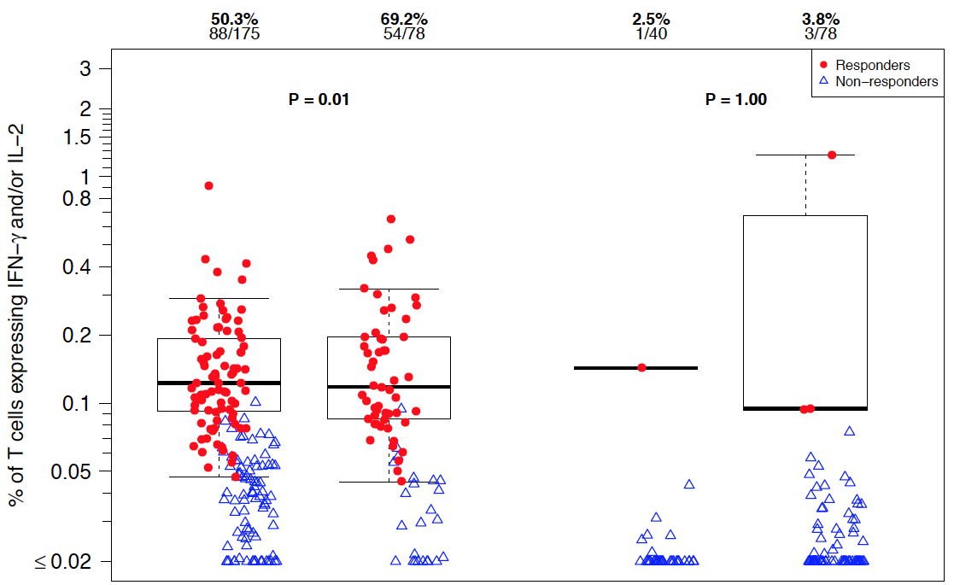
Peak CD4⁺ T Cell Response Rates and
Magnitudes are Higher in Prevalence in 097 vs. RV144
50.3% 69.2% 2.5% 3.8%
88/175 54/78 1/40 3/78
Response rate:
RV144
HVTN 097
RV144
HVTN 097
92TH023-ENV
LAI-GAG
Gray G HIVR4P, 2014

Slide 22
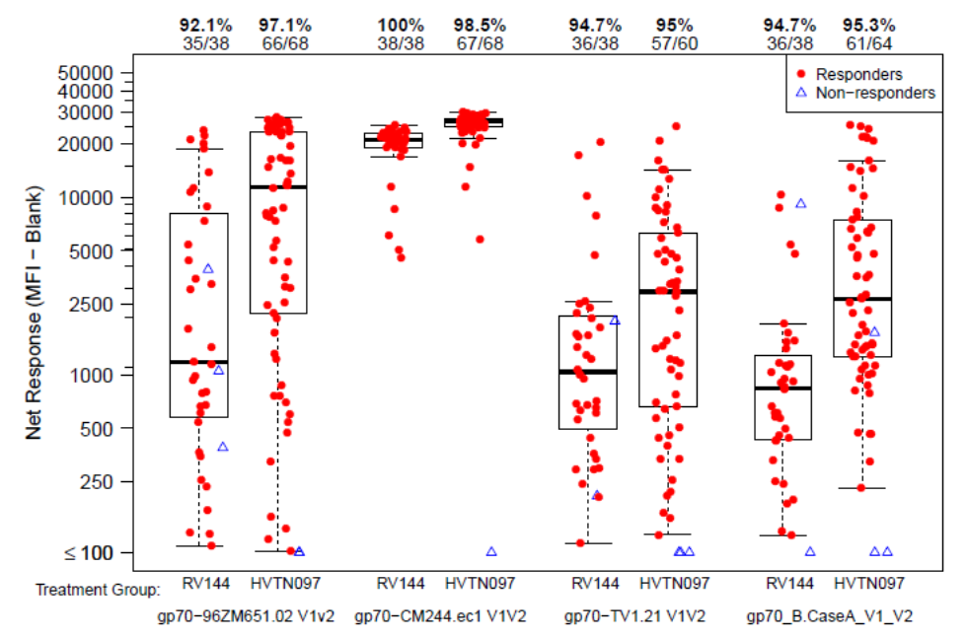
Comparison of V1V2 IgG responses between 097 and RV144
Gray G HIVR4P, 2014

Slide 23
Study Schema: HVTN 100
N (total 252) | Primary Vaccine Regimen |  |  |  | Booster
 | Month 0 | Month 1 | Month 3 | Month 6 | Month 12
210 | ALVAC-HIV (vCP2438) | ALVAC-HIV (vCP2438) | ALVAC-HIV+ Bivalent Subtype C gp120/MF59® | ALVAC-HIV+ Bivalent Subtype C gp120/MF59® | ALVAC-HIV+ Bivalent Subtype C gp120/MF59®
42 | Placebo | Placebo | Placebo + Placebo | Placebo + Placebo | Placebo + Placebo
Products:
ALVAC-HIV (vCP2438) expressing HIV-1 env (clade C gp120), clade B (gp41), gag (clade B) & protease (clade B) (Dose: >1 X 10⁶ CCID₅₀)
Bivalent subtype C gp120/MF59 containing 100mcg TV1.Cgp120 & 100mcg 1086.Cgp120
Immunogenicity evaluation to be applied to this study to inform advancement into phase 3: study fully enrolled in RSA

Slide 25
Go/No-Go Criteria:
HVTN 100 Must Meet all of the Following Conditions to advance to HVTN 702
Parameters to be assessed
Prevalence of Binding Antibodies to clade C gp120 antigens in the vaccine that approach 90%
Prevalence of V1V2 antibodies to clade C gp70 scaffold antigens of >57% at week 28
CD4+ T cell responses to HIV env of ~60%
The above immune responses would, based upon RV 144 predict a VE=50% @ 2 years

Slide 26
Study Schema: HVTN 702
N (total 5400) | Primary Vaccine Regimen |  |  |  | Booster
 | Month 0 | Month 1 | Month 3 | Month 6 | Month 12
2700 | ALVAC-HIV (vCP2438) | ALVAC-HIV (vCP2438) | ALVAC-HIV+ Bivalent Subtype C gp120/MF59® | ALVAC-HIV+ Bivalent Subtype C gp120/MF59® | ALVAC-HIV+ Bivalent Subtype C gp120/MF59®
2700 | Placebo | Placebo | Placebo + Placebo | Placebo + Placebo | Placebo + Placebo
Estimated Total Study duration 72 months:
Stage 1: 60 months-18 months for enrolment, 24 months of follow-up for HIV-1 uninfected individuals, 18 months follow up for HIV-1 infected individuals)
Stage 2: an additional 12 months of follow up for uninfected individuals

Slide 27
3 strategies to advance immunization
Efficacy Studies
P5 “Clade C” approach using ALVAC & gp120/MF59
(HVTN 702)
Multi-clade approach using rAd26/MVA/gp140 trimer
Neutralising antibody approaches

Slide 28

HIV vaccine research program:
Janssen and Collaborators
BIDMC
Harvard
MHRP
IAVI
Ragon
NIAID/HVTN

Slide 29
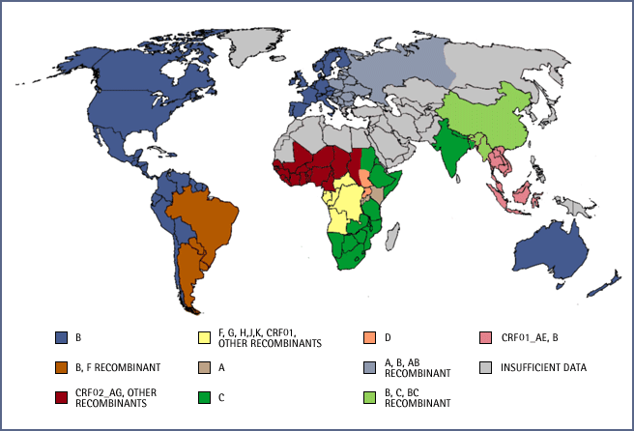

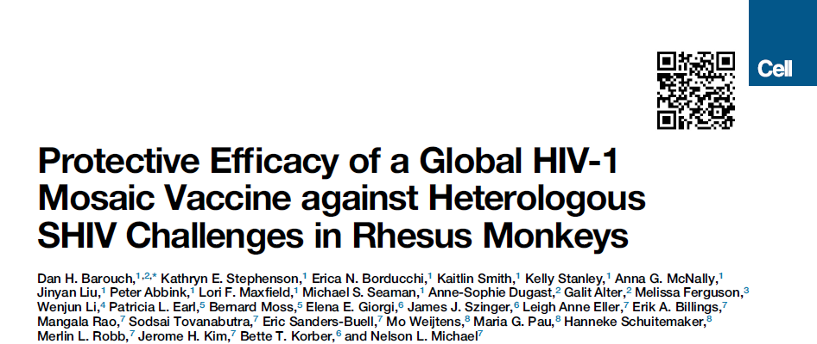
HIV Vaccine Aiming at Protection Against all Clades of HIV-1
Different HIV-1 clades dominate in different geographic regions
Adolescents (11-17 years) /Adults (18-65 years) in endemic countries and populations at risk in Western world
1
2
3
Potent priming Vectors
Mosaic inserts for global coverage
Trimeric env protein for improved humoral immunity
Low seroprevalent Ad26
Ad26.HIV-Gag-Pol
Ad26.HIV-Env
(MVA.HIV-Gag-Pol-Env)
Dan H Barouch et al, 2013
Dan H Barouch et al., 2010

Slide 30


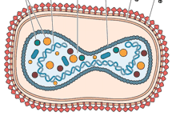
A prime-boost vaccine regimen aiming at global coverage starting 2017-2021
Prime
Boost
Ad26 Mosaic vectors
gag-pol-env
Ad26 Mosaic vectors
gag-pol-env
Soluble trimer gp140 env protein
+/-
or
Ad26 Mosaic vectors
gag-pol-env
MVA Mosaic vectors
gag-pol-env
Soluble trimer gp140 env protein
+/-
prime
prime
boost
boost
months
0
3
6
12
Regimen to be selected after Phase 1/2a

Slide 31
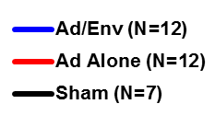
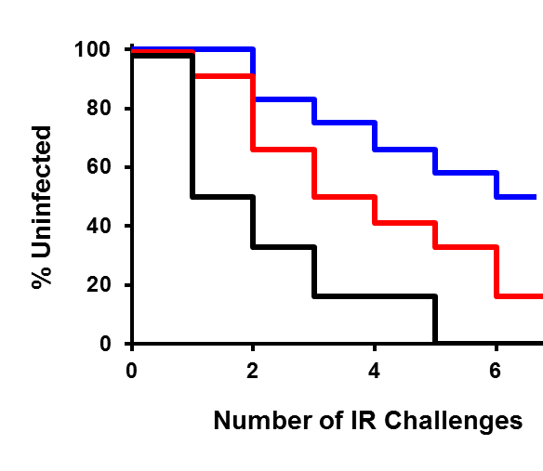
Ad26/Env SIV Vaccines Partially Protect Against IR SIVmac251 Challenges in Rhesus Monkeys
90% reduction of per exposure acquisition risk for Ad/Env (P=0.001)
50% (6 of 12) show complete protection for Ad/Env (P=0.01)
32 rhesus monkeys
  Ad26/Env (N=12)
  Ad26/Ad35 (N=12)
  Sham (N=7)
Repetitive, intrarectal, heterologous SIVmac251 challenges
Correlates of protection
  ELISA P < 0.0001
  Ab Funct P = 0.004
  NAb P = NS
Barouch et al. Science 2015

Slide 32
3 strategies to advance immunization
Efficacy Studies
P5 “Clade C” approach using ALVAC & gp120/MF59
(HVTN 702)
Multi-clade approach using rAd26/MVA/gp140 trimer
Neutralising antibody approaches

Slide 33
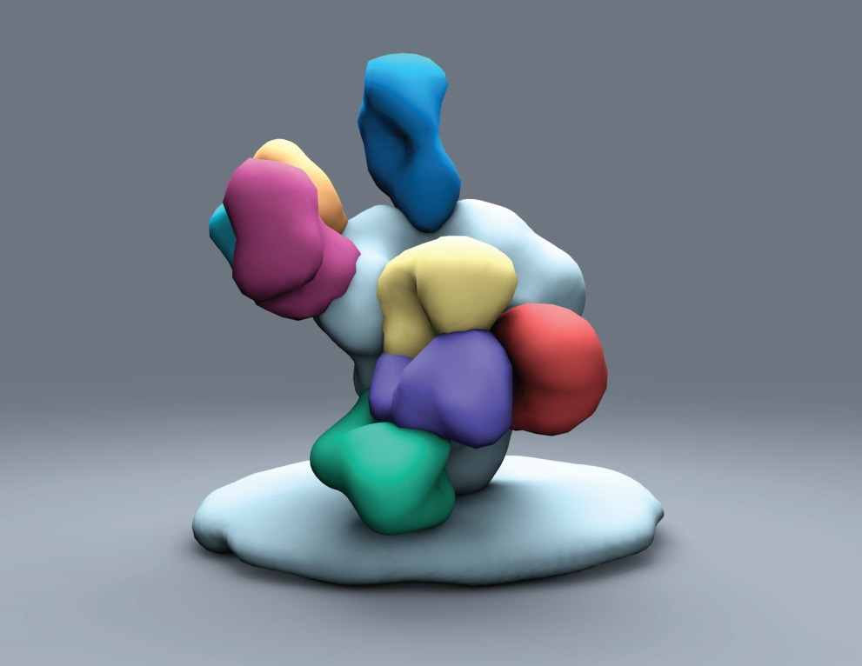
Neutralising Ab to HIV-1
V3-glycan
V1V2-glycan
V1V2-Glycan – bind to trimer cap
V3-glycan, N332 supersite
gp41 MPER – near mebrante
gp120/41 interface – bind to parts of both gp120 and gp41
CD4 binding site of gp120 – where the virus attaches to CD4
CD4 binding site
gp120/41
interface
gp41 MPER
Only antibodies that have advanced to the clinic (VRC01, 3BNC117)
Christina Corbaci, Andrew Ward,

Slide 34
Use of HIV Antibodies in Prevention
Can mAb prevent infection in high risk adults (Antibody Mediated Prevention)
Can mAb protect infants during childbirth and breastfeeding
Can we use it as a topical microbicide?
What level of antibody is needed (ug/ml) to protect
How long will the antibody work (weeks, months?)
Cocktails to increase breadth vs potency
Notes:
34

Slide 35
All the NHP studies are with cell free virus, in humans we know that there is cell associated sexual and breast milk HIV transmission

Slide 36
Neutralising Ab to HIV-1
V3-glycan
V1V2-glycan
V1V2-Glycan – bind to trimer cap
CD4 binding site of gp120 – where the virus attaches to CD4
CD4 binding site
gp120/41
interface
gp41 MPER
Only antibodies that have advanced to the clinic (VRC01, 3BNC117)
Christina Corbaci, Andrew Ward,

Slide 37
Neutralisation Activity of VRC01
Virus clade | Number of viruses | IC₅₀ < 50 µg/mL | IC50 < 1 µg/mL
A | 22 | 100% | 95%
B | 49 | 96% | 80%
C | 38 | 87% | 66%
D | 8 | 88% | 50%
CrRF01_AE | 18 | 89% | 61%
CRF02_AG | 16 | 81% | 56%
G | 10 | 90% | 90%
CRF07_BC | 11 | 100% | 45%
Other | 18 | 83% | 78%
Total | 190 | 91% | 72%

Slide 38
VRC01 Protects against Mucosal
SHIV-Challenge in Non-human Primates
20 mg/kg infusion of VRC01: Challenge with SHIV SF162P3
RECTAL CHALLENGE
VAGINAL CHALLENGE
4/4 protected
4/4 protected
0/4 protected
1/4 protected
Pegu et al. Science Transl Med (2014)
Ko et al. Nature (2014)
Rudicell et al. J Virol (2014)
Notes:
Figure legend :
Plasma concentration of VRC01 IgG1 and infection status after passive transfer of VRC01 IgG1. The plasma concentration of VRC01 IgG1 was measured by a RSC3-based ELISA in animals at different time points after the administration of VRC01 IgG1 to male (A, top panel) or female (B, top panel) rhesus macaques. The percentage of animals remaining uninfected as determined by a real time PCR assay for detecting plasma viremia after either rectal (A, bottom panel) or vaginal (B, bottom panel) challenge with a single high dose of SHIV SF162P3 (300 TCID50) at day 2 post transfer of either a control or VRC01 IgG1 antibody. * denotes a statistical significant difference between the VRC01 and control groups using the log-rank statistical test.

Slide 39
Passive Antibody Prevention
NHP studies tell us that physiologically achievable levels of Ab could prevent HIV-1 infection:
But no direct proof in humans
Need to Learn from Proof of Concept in Humans and understand the mechanism in which bNABs protect against infection
Antibody Mediated Prevention trial (HVTN/HPTN) in MSM (clade B) & heterosexual women (clade C) starting in 2016

Slide 40




Slide 41

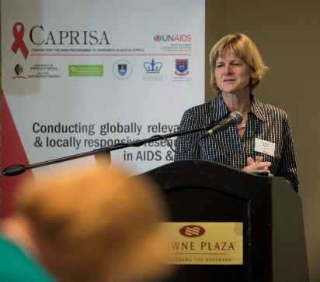
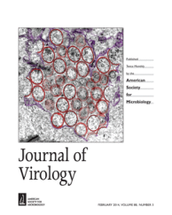
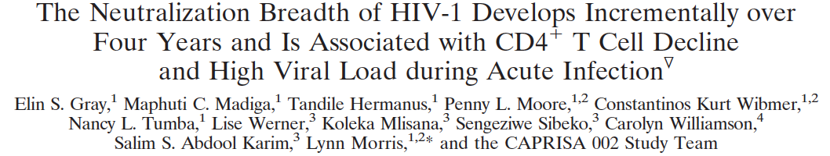
Preventing HIV infection in women by passive immunisation with CAP256-VRC26.25
SA team identified a potent V1V2 BNab in patient- CAPRISA 256
Y
From an acute infection cohort where approximately 7 participants developed antibody responses able to neutralize >40% of circulating viruses

Slide 42
Breadth and potency of CAP256-VRC26.25 and other selected bNAbs against HIV-1 clade C isolates
Increasing potency
Data show IC₅₀ neutralization titers of a clade C virus panel (n=54) assessed by TZM-bl pseudovirus assay. Each dot shows the value for a single virus. Bars indicate median value of viruses that are neutralized.
Nicole Doria-Rose, John Mascola, VRC
Notes:
Shows exceptional potency

Slide 43
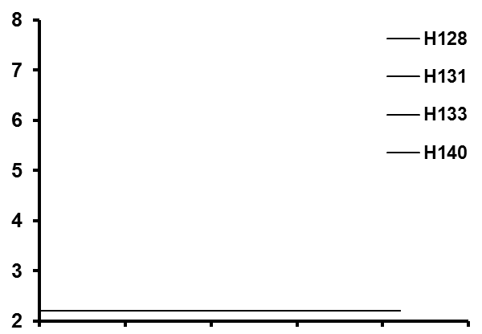

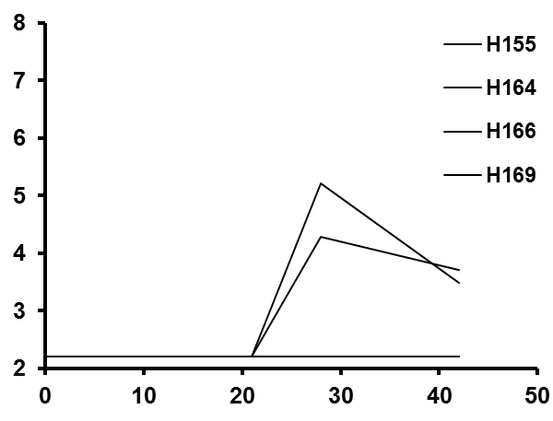
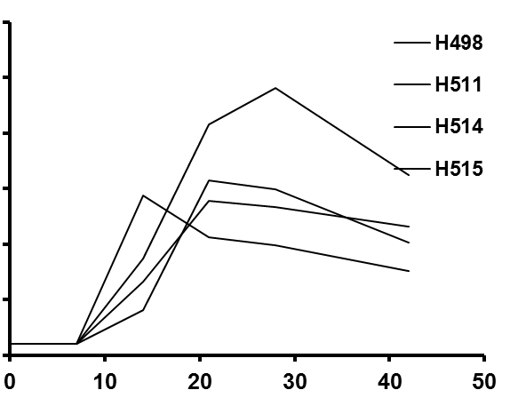
Prophylactic efficacy of CAP256.VRC26.25.LS against high-dose IR SHIV-325C challenge in Rhesus monkeys
2 mg/kg
0.4 mg/kg
Log RNA Copies/ml
0.08 mg/kg
Sham
Log RNA Copies/ml
Days Following Challenge
Source: Dan Barouch

Slide 44
The critical link between AMP & immunogen design will be in defining the levels of neutralisation required to achieve protection and will set the standard for developing immunogens that achieve these levels of antibodies

Slide 45
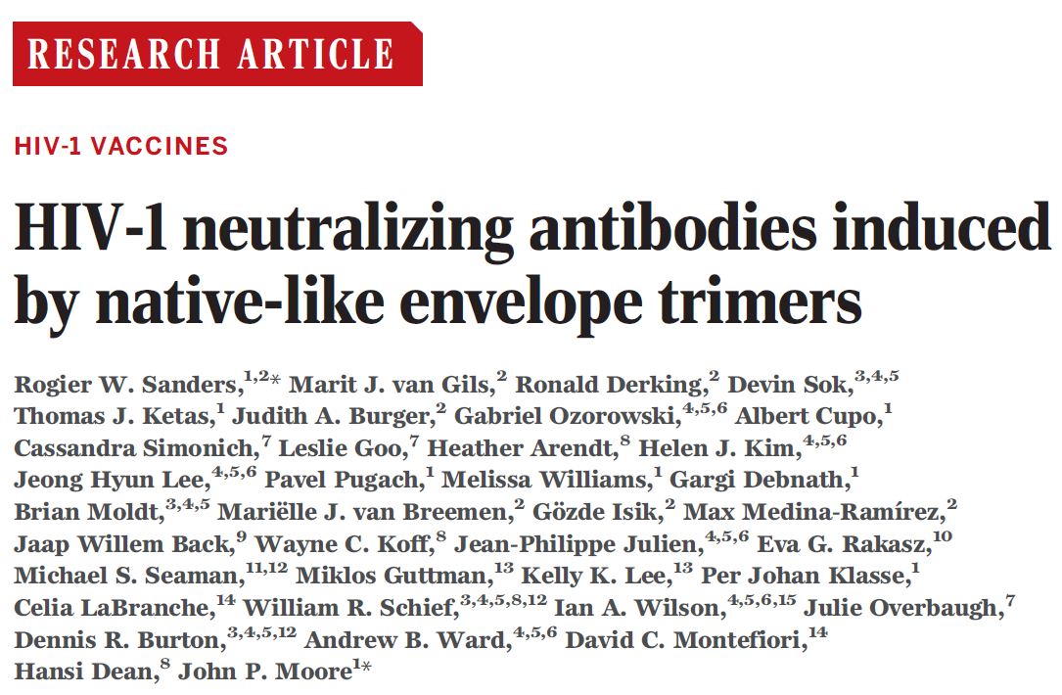
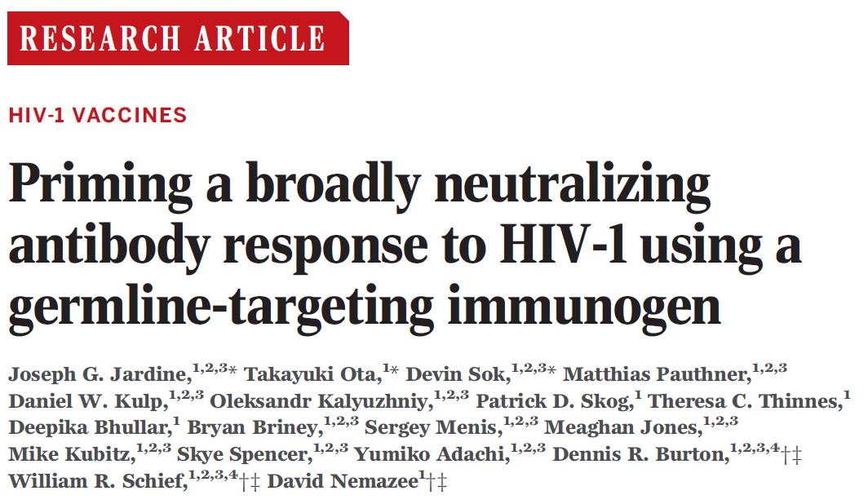



Slide 46
Develop highly effective strategies to reduce HIV acquisition e.g HIV vaccine, or novel ways to administer broadly reactive neutralizing antibodies
Develop long acting pre exposure prophylaxis strategies that can be used topically or systemically for both men & women
Deliver ARV Treatment "en masse" including implementing highly effective programs to eliminate mother to child transmission

Slide 47
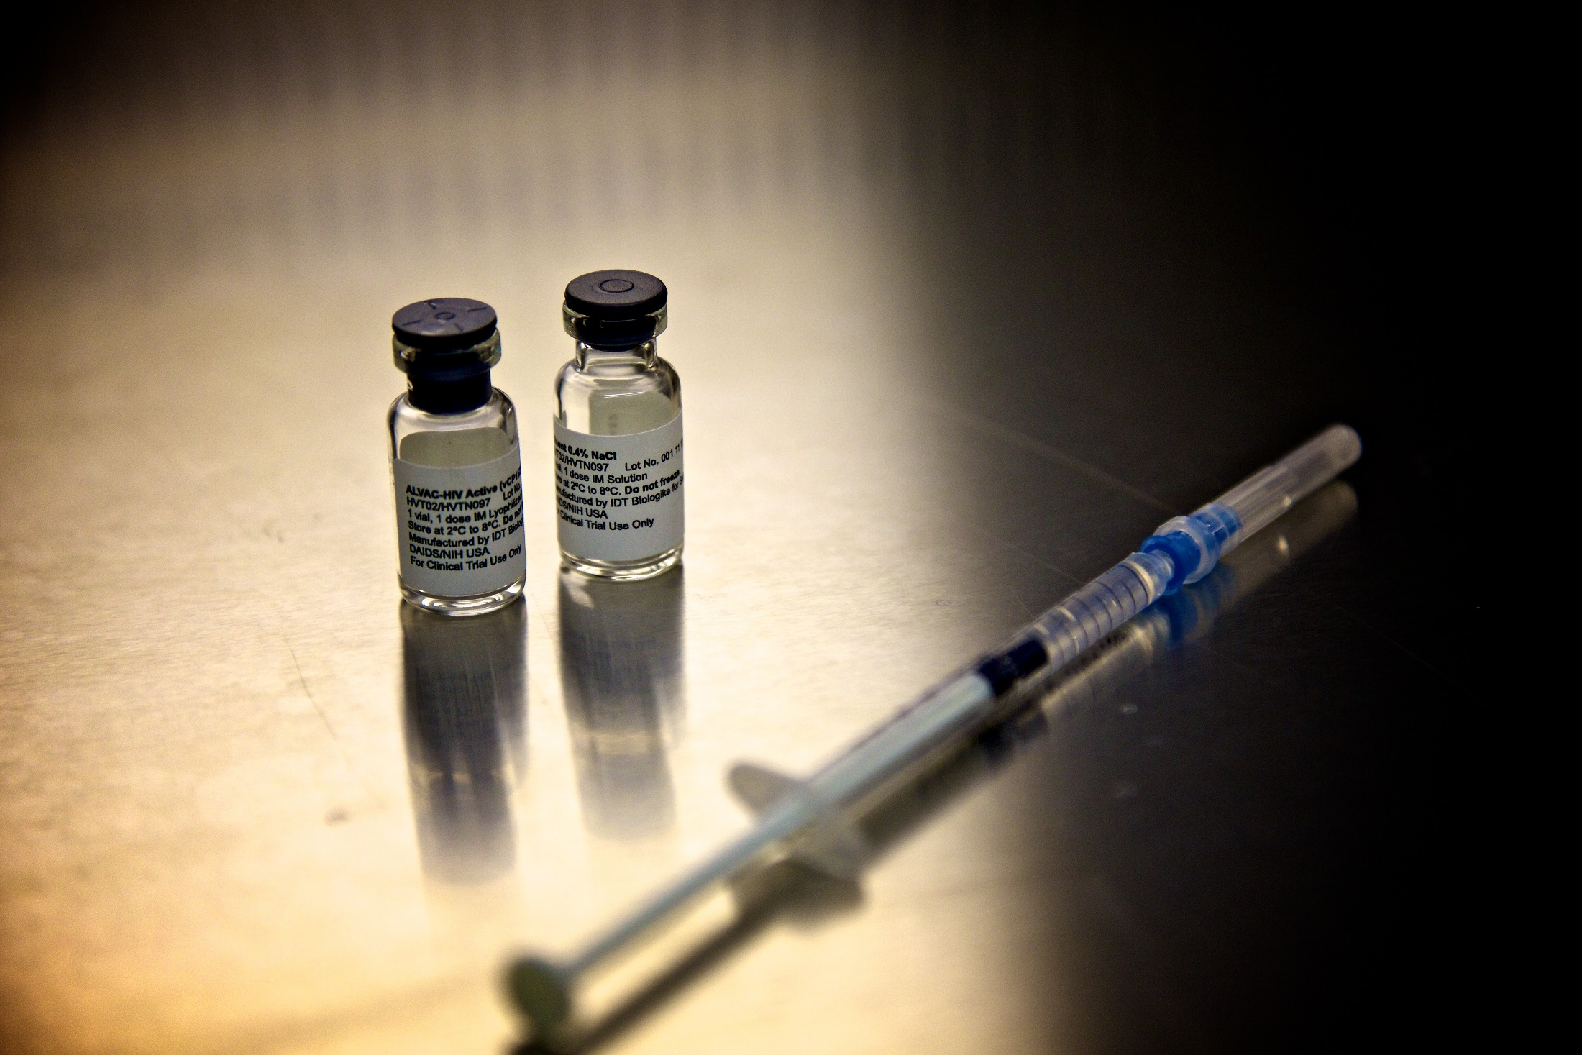
What we need to remember
Notes:
The size, cost and logistic complexity of HIV-1 efficacy trials are substantial
We need to mobilise other organisations and governments to support HIV vaccine development and testing
We also need multiple distinct vaccine candidates: 1) novel env immunogens aimed at eliciting broadly neutralising antibodies and 2) new vaccine approaches to optimise non neutralising antibodies that may be associated with protection, 3) global antigen development to address global diversity
Need new scientists, new early stage investigators and we need them from the developing world
Expand the preclinical efficacy studies, stringent SIV & SHIV challenge studies,
We have our work cut out: let the work begin!

Slide 48
Acknowledgements
J&J/Janssen
Dan Barouch
Nelson Michael
Frank Tomaka
CAPRISA/NICD
Salim Abdool Karim
Lynn Morris
Penny Moore
Quarraisha Abdool Karim
IAS
Ken Mayer
HVTN
Larry Corey
VRC
John Mascola
Barney Graham
& Funders:
NIAID/BMGF/SAMRC

