Slide 1
Assessing the HIV Care Continuum in CCASAnet: progress in clinical retention, ART use, and viral suppression
July 22, 2015
Peter F. Rebeiro, PhD, MHS
On behalf of: Carina Cesar, Bryan E. Shepherd, Raquel B. De Boni, Claudia Cortés, Fernanda Rodriguez, Pablo Belaunzarán-Zamudio, Jean W. Pape, Denis Padgett, Daniel Hoces, Catherine C. McGowan, and Pedro Cahn
of the Caribbean, Central and South America network for HIV epidemiology (CCASAnet)

Slide 2
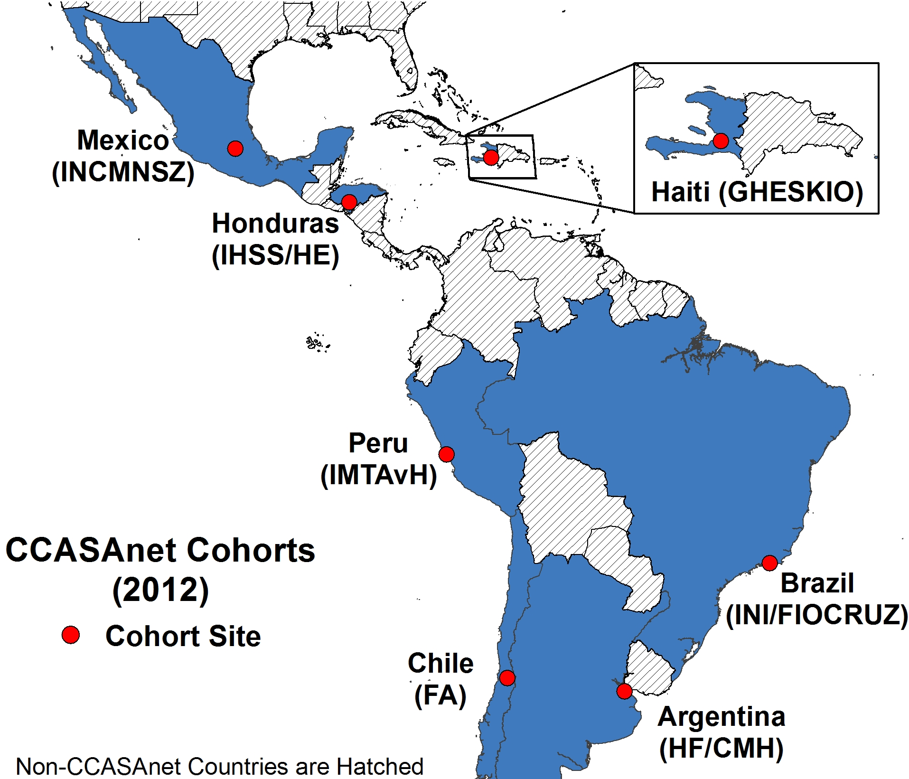
Notes:
cohortname | Freq. Percent Cum.
------------+-----------------------------------
Argentina | 3,740 19.89 19.89
Brazil | 3,085 16.41 36.31
Chile | 1,984 10.55 46.86
Haiti | 6,036 32.11 78.97
Honduras | 825 4.39 83.36
Mexico | 833 4.43 87.79
Peru | 2,296 12.21 100.00
------------+-----------------------------------
Total | 18,799 100.00

Slide 3
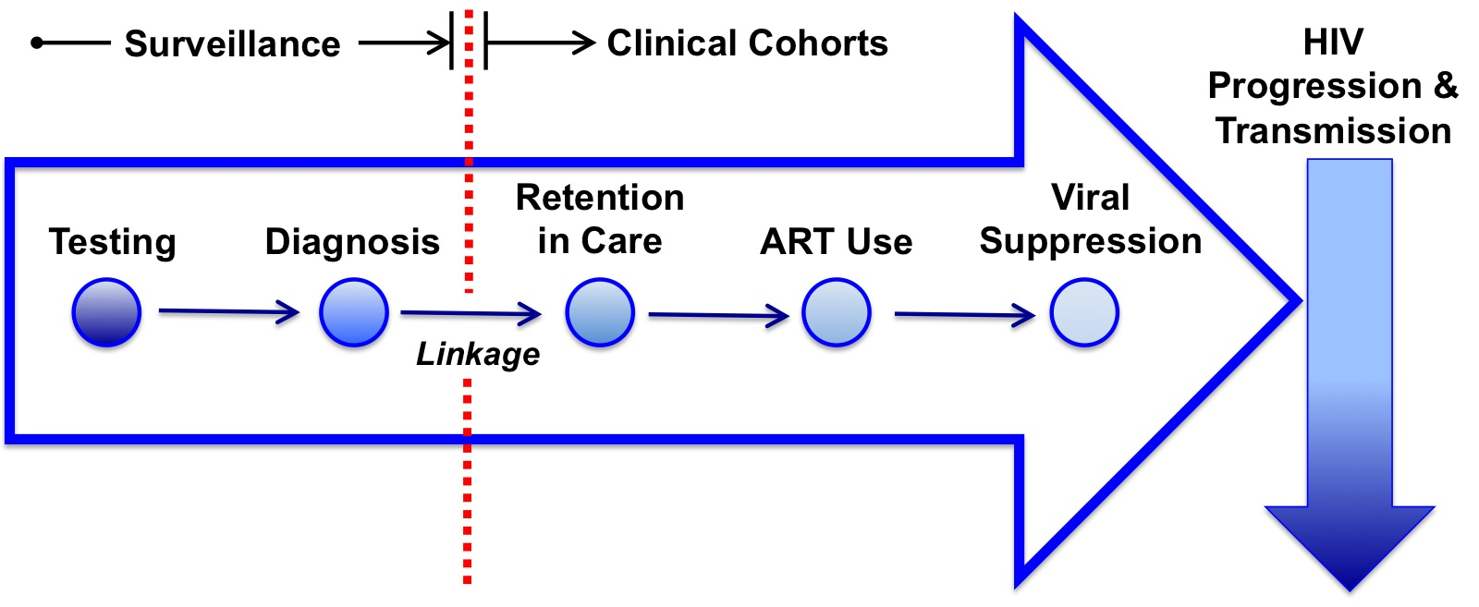
Adapted from Ford MA, and Spicer CM. Monitoring HIV care in the United States: indicators and data systems. National Academies Press; 2012.
1. Retention: ≥2 HIV primary care encounters per year, >90 days apart (US Institute of Medicine)
2. ART use: ART during the year, among those with ≥1 HIV primary care visit during the year (US Department of Health and Human Services)
3. Viral suppression: HIV-1 RNA <200 copies/mL at the last measurement in the year, among those with ≥1 HIV primary care visit during the year (US Department of Health and Human Services)
Notes:
cohortname | Freq. Percent Cum.
------------+-----------------------------------
Argentina | 3,740 19.89 19.89
Brazil | 3,085 16.41 36.31
Chile | 1,984 10.55 46.86
Haiti | 6,036 32.11 78.97
Honduras | 825 4.39 83.36
Mexico | 833 4.43 87.79
Peru | 2,296 12.21 100.00
------------+-----------------------------------
Total | 18,799 100.00

Slide 4
CD4 and VL used as proxies for clinic visit in Argentina and Peru
Haiti excluded from ART outcome, ART use was cohort inclusion criterion
Haiti excluded from viral suppression outcome, VL monitoring not available
Modified Poisson regression with Generalized Estimating Equations (GEE) to account for multiple outcomes per individual
Restricted cubic splines to allow non-linear relationships between age, year of assessment, and outcomes

Slide 5
Characteristics of individuals in CCASAnet contributing to analyses of HIV Care Continuum indicators from 2003 through 2012
Characteristic | Total for Retentionª | Not Retainedª | Retainedª | p-value*
 | (N=18,799)
Total | 89,557 | 23,869 | 65,688
Age (Years) | 36.1 (30.0, 43.0) | 35.2 (29.3, 41.7) | 36.4 (30.3, 43.5) | 0.21
Sex
Male | 56,725 | 15,321 (27.0) | 41,404 (73.0) | Ref.
Female | 32,832 | 8,548 (26.0) | 24,284 (74.0) | 0.24
HIV Risk Factor
MSM | 25,553 | 7,515 (29.4) | 18,038 (70.6) | Ref.
IDU | 1,555 | 820 (52.7) | 735 (47.3) | <0.01
Hetero | 28,938 | 9,454 (32.7) | 19,484 (67.3) | <0.01
Other/Unk. | 33,511 | 6,080 (18.1) | 27,431 (81.9) | <0.01
Country
Argentina^{d} | 18,878 | 7,598 (40.2) | 11,280 (59.8) | Ref.
Brazil | 17,399 | 4,922 (28.3) | 12,477 (71.7) | <0.01
Chile | 11,938 | 2,723 (22.8) | 9,215 (77.2) | <0.01
Haiti^{e} | 4,279 | 1,027 (24.0) | 3,252 (76.0) | <0.01
Honduras | 23,074 | 3,438 (14.9) | 19,636 (85.1) | <0.01
Mexico | 3,933 | 593 (15.1) | 3,340 (84.9) | <0.01
Peru^{d} | 10,056 | 3,568 (35.5) | 6,488 (64.5) | <0.01
Individual Years in Care | 7 (4, 9) | 7 (4, 9) | 7 (4, 9) | <0.01
US Institute of Medicine retention indicator: individuals with ≥2 HIV primary care encounters per year, >90 days apart
d. Argentina and Peru used laboratory measures (CD4+ counts and HIV-1 RNA measures) as proxies for HIV primary care visits when determining retention status
Notes:
Numbers are presented as Person-years contributed (%) except for Age and Individual Years in Care, which are Median (Interquartile Range)
* Univariate modified Poisson regression with a Generalized Estimating Equation (GEE) to account for within-individuals clustering of outcomes; p-value for age is for the Wald chi-square test when modeling age using a restricted cubic spline with 4 knots.

Slide 7
Characteristics of individuals in CCASAnet contributing to analyses of HIV Care Continuum indicators from 2003 through 2012
Characteristic | Total for ART^{b} | Not on ART^{b} | On ART^{b} | p-value*
 | (N=14,380)
Total | 68,877 | 11,565 | 57,312
Age (Years) | 35 (29.1, 41.9) | 32.5 (27.1, 39.3) | 35.5 (29.6, 42.4) | <0.01
Sex
Male | 49,101 | 8,119 (16.5) | 40,982 (83.5) | Ref.
Female | 19,776 | 3,446 (17.4) | 16,330 (82.6) | 0.7
HIV Risk Factor
MSM | 27,304 | 5,079 (18.6) | 22,225 (81.4) | Ref.
IDU | 1,344 | 203 (15.1) | 1,141 (84.9) | 0.25
Hetero | 29,745 | 4,800 (16.1) | 24,945 (83.9) | 0.17
Other/Unk. | 10,484 | 1,483 (14.2) | 9,001 (85.9) | <0.01
Country
Argentina^{d} | 18,721 | 3,549 (19.0) | 15.172 (81.0) | Ref.
Brazil | 18,318 | 3,253 (17.8) | 15,065 (82.2) | 0.34
Chile | 12,548 | 2,282 (18.2) | 10,266 (81.8) | 0.8
Haiti^{e} | N/A | N/A | N/A
Honduras | 3,012 | 234 (7.8) | 2,778 (92.2) | <0.01
Mexico | 4,711 | 459 (9.7) | 4,252 (90.3) | <0.01
Peru^{d} | 11,567 | 1,788 (15.5) | 9,779 (84.5) | <0.01
Individual Years in Care | 8 (5, 10) | 6 (3, 8) | 8 (5, 10) | <0.01
b. cART was defined as regimens of ≥3 active antiretroviral agents (including triple-nucleoside regimens); US Department of Health and Human Services ART indicator: number of individuals prescribed ART during the year, among those with ≥1 HIV primary care visit during the year
e. Haiti did not contribute to the assessment of ART use due to receipt of ART being an inclusion criterion of the clinical cohort; Haiti did not contribute to the assessment of viral suppression due to a lack of universal HIV-1 RNA testing within the clinical cohort
Notes:
Numbers are presented as Person-years contributed (%) except for Age and Individual Years in Care, which are Median (Interquartile Range)
* Univariate modified Poisson regression with a Generalized Estimating Equation (GEE) to account for within-individuals clustering of outcomes; p-value for age is for the Wald chi-square test when modeling age using a restricted cubic spline with 4 knots.

Slide 9
Characteristics of individuals in CCASAnet contributing to analyses of HIV Care Continuum indicators from 2003 through 2012
Characteristic | Total for Viral Suppression^{c} | No Viral Suppression^{c} | Viral Suppression^{c} | p-value*
 | (N=13,330)
Total | 60,640 | 17,708 | 42,932
Age (Years) | 35.3 (29.3, 42.1) | 33.4 (27.6, 40.2) | 35.9 (30.0, 42.9) | <0.01
Sex
Male | 43,474 | 12,357 (28.4) | 31,117 (71.6) | Ref.
Female | 17,166 | 5,351 (31.2) | 11,815 (68.8) | 0.11
HIV Risk Factor
MSM | 24,026 | 6,970 (29.0) | 17,056 (71.0) | Ref.
IDU | 1,191 | 340 (28.6) | 851 (71.5) | 0.96
Hetero | 25,965 | 7,988 (30.8) | 17,977 (69.2) | 0.56
Other/Unk. | 9,458 | 2,410 (25.5) | 7,048 (74.5) | <0.01
Country
Argentina^{d} | 17,282 | 5,127 (29.7) | 12,155 (70.3) | Ref.
Brazil | 17,167 | 5,215 (30.4) | 11,952 (69.6) | 0.78
Chile | 10,116 | 2,618 (25.9) | 7,498 (74.1) | 0.2
Haiti^{e} | N/A | N/A | N/A
Honduras | 1,324 | 167 (12.6) | 1,157 (87.4) | <0.01
Mexico | 4,556 | 778 (17.1) | 3,778 (82.9) | <0.01
Peru^{d} | 10,195 | 3,803 (37.3) | 6,392 (62.7) | <0.01
Individual Years in Care | 7 (5, 10) | 6 (4, 9) | 8 (5, 10) | <0.01
c. US Department of Health and Human Services viral suppression indicator: individuals with plasma HIV-1 RNA <200 copies/mL at the last measurement in the year, among those with ≥1 HIV primary care visit during the year
e. Haiti did not contribute to the assessment of cART use due to receipt of cART being an inclusion criterion of the clinical cohort; Haiti did not contribute to the assessment of viral suppression due to a lack of universal HIV-1 RNA testing within the clinical cohort
Notes:
Numbers are presented as Person-years contributed (%) except for Age and Individual Years in Care, which are Median (Interquartile Range)
* Univariate modified Poisson regression with a Generalized Estimating Equation (GEE) to account for within-individuals clustering of outcomes; p-value for age is for the Wald chi-square test when modeling age using a restricted cubic spline with 4 knots.

Slide 11
Modeled relationships between characteristics of CCASAnet patients and HIV Care Continuum indicators from 2003 through 2012, with 95% Confidence Intervals (95% CI)
Characteristic | Adjusted* RR (95% CI): Retentionª | Adjusted* RR (95% CI): ART use^{b} | Adjusted* RR (95% CI): Viral Suppression^{c}
Age (Years)^{d}
20 | 1.04 (0.99,1.09) | 0.83 (0.78,0.87) | 0.79 (0.75,0.84)
30 | 1.01 (0.98,1.03) | 0.94 (0.91,0.98) | 0.93 (0.90,0.97)
40 | Ref. | Ref. | Ref.
50 | 1.01 (1.00,1.03) | 1.03 (1.01,1.05) | 1.04 (1.02,1.06)
60 | 1.03 (0.98,1.08) | 1.05 (0.99,1.12) | 1.09 (1.03,1.15)
Sex
Male | Ref. | Ref. | Ref.
Female | 0.97 (0.94,0.99) | 0.97 (0.93,1.00) | 0.97 (0.94,1.01)
HIV Risk Factor
MSM | Ref. | Ref. | Ref.
IDU | 0.83 (0.74,0.93) | 1.09 (0.98,1.20) | 1.03 (0.93,1.15)
Hetero | 1.00 (0.97,1.04) | 1.04 (1.01,1.08) | 1.01 (0.97,1.05)
Other/Unk. | 0.97 (0.93,1.02) | 1.05 (1.00,1.10) | 1.03 (0.97,1.08)
Years in Care | 1.02 (1.02,1.02) | 1.05 (1.04,1.05) | 1.06 (1.06,1.07)
Bold estimates are statistically significant, p<0.05
*Fully adjusted models include all terms in table, as well as cohort site and calendar time (modeled with a restricted cubic spline
with 4 knots)
Notes:
a. US Institute of Medicine retention indicator: individuals with ≥2 HIV primary care encounters per year, >90 days apart; Argentina and Peru used laboratory measures (CD4+ counts and HIV-1 RNA measures) as proxies for HIV primary care visits when determining retention status
b. cART was defined as regimens of ≥3 active antiretroviral agents (including triple-nucleoside regimens); US Department of Health and Human Services cART indicator: number of individuals prescribed cART during the year, among those with ≥1 HIV primary care visit during the year; Haiti did not contribute to the assessment of cART use due to receipt of cART being an inclusion criterion of the clinical cohort
c. US Department of Health and Human Services viral suppression indicator: individuals with plasma HIV-1 RNA <200 copies/mL at the last measurement in the year, among those with ≥1 HIV primary care visit during the year; Haiti did not contribute to the assessment of viral suppression due to a lack of universal HIV-1 RNA testing within the clinical cohort
d. Age was modeled using a restricted cubic spline with 4 knots; estimates presented are not age categories, but rather, contrasting comparisons at specific age values (vs. the reference of 40 years old).
MSM: Male Sexual contact with Men
IDU: Injection Drug Use
Hetero: Heterosexual contact

Slide 12
Limitations:
Results within CCASAnet may not be generalizable to HIV population not successfully linked/engaged in care in these countries
Additional research is needed to identify social/contextual/economic impediments to achieving positive Care Continuum outcomes, and their causes, in these settings

Slide 13
Conclusions:
HIV Care Continuum outcomes have improved over time in this cohort
Efforts to improve retention should focus on females and IDUs
Efforts to improve ART use should focus on MSM
Efforts to improve ART use and viral suppression should focus on younger individuals

Slide 14
CCASAnet patients, clinicians, data managers, and investigators
Grant U01-AI069923-09 from the National Institutes of Health, USA
Hospital Fernandez and Centro Médico Huésped, Buenos Aires, Argentina
Instituto Nacional de Infectologia Evandro Chagas, Fundação Oswaldo Cruz, Rio de Janeiro, Brazil
Fundación Arriarán, Santiago, Chile
Le Groupe Haïtien d'Etude du Sarcome de Kaposi et des Infections Opportunistes, Port-au-Prince, Haiti
Instituto Hondureño de Seguridad Social and Hospital Escuela, Tegucigalpa, Honduras
Instituto Nacional de Ciencias Médicas y Nutrición Salvador Zubirán, Mexico City, México
Instituto de Medicina Tropical Alexander von Humboldt, Lima, Perú
CCASAnet Data Coordinating Center, Vanderbilt University School of Medicine, Nashville, TN, USA

Slide 15
Thank you!
Questions?

