Slide 1
HIV Transmitted Drug Resistance Declined from 2009 to 2014 among acutely infected MSM in Bangkok, Thailand
Donn Colby, Nittaya Phanuphak, Sunee Sirivichayakul, Peeriya Prueksakaew, Putthachard Saengtawan, Rapee Trichavaroj, Trevor Crowell, Jerome Kim, Jintanat Ananworanich, Praphan Phanuphak on behalf of the RV254/SEARCH010 Study Group
Abstract WEAB0104

Slide 2
RV254/SEARCH 010 Cohort
Opened to enrollment in April 2009
Patients with acute HIV infection (Fiebig I-V)
Median 18 days from HIV exposure to starting ART
93% male, 5% female, 2 % transgender women
92% MSM/TGW

Slide 3
Methods
All patients (n=233) recruited into the RV254/SEARCH010 cohort from April 2009 through December 2014 were included in the analysis
Baseline genotype testing prior to initiating ART (median 18 days after HIV infection)
First 66 pts: TRUGENE HIV-1 (Siemens Healthcare Diagnostics, Australia)
Remainder: validated in-house method at Chulalongkorn University Hospital.
Mutations categorized following WHO surveillance drug resistance mutation (SDRM) list (Bennett, PloS One, 2009)
Change in prevalence over time was assessed by chi-square test for trend
Time periods were combined into 2-year blocks for analysis.

Slide 4
Results: cohort characteristics
Characteristics | (n=229)*
Age, years, median (IQR) | 28 | (23 – 32)
Male, n(%) | 218 | 95%
Risk group, MSM n(%) | 211 | 92%
Duration since HIV exposure, median (IQR) days | 18 | (14 – 24)
Sexual partners past 30 days, median (range) | 2 | (1 – 20)
Recreational drug use in the past 30 days, n(%) | 51 | 22%
HIV RNA, Median (IQR) | 5.8 | (5.2 – 6.8)
CD4, Median (IQR) | 354 | (265 – 490)
Subtype CRF01_AE, , n(%), (n=211) | 170 | 80.6%
*n=234 in cohort, 2 samples inadequate blood volume, 2 samples unable to amplify

Slide 5
Results: drug mutations
SDRMs | Prevalence (%) | 95% CI
Any SDRM | 7.0 | 4.0 – 11.1
NRTI | 2.6 | 1.0 – 5.6
NNRTI | 2.2 | 0.7 – 5.0
PI | 3.6 | 1.5 -6.9

Slide 6
Results: drug mutations
 | SDRM | n | %
NRTI (n=228) | M41L | 2 | 0.9
 | D67N | 1 | 0.4
 | L74I | 1 | 0.4
 | T215F | 1 | 0.4
 | T215E | 1 | 0.4
NNRTI (n=228) | K103N | 3 | 1.3
 | Y181C | 2 | 0.9
 | G109A | 1 | 0.4
PI (n=225) | L23I | 1 | 0.4
 | M46I | 3 | 1.3
 | M46L | 1 | 0.4
 | F53Y | 1 | 0.4
 | G73S | 1 | 0.4
 | V82A | 1 | 0.4

Slide 7
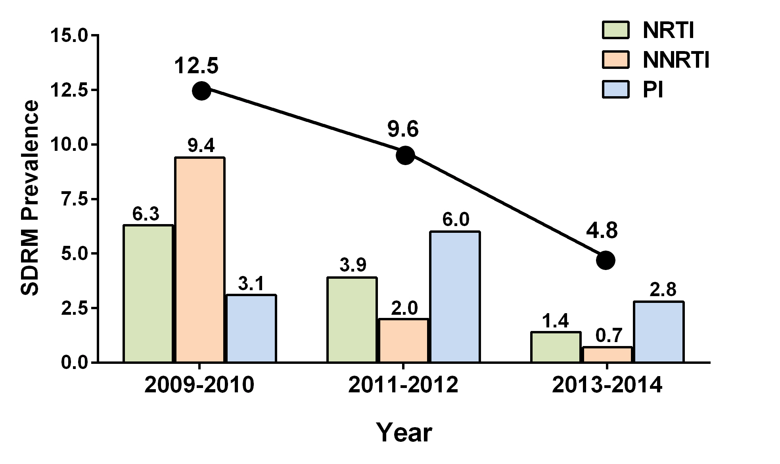
Trend in TDR over time
 | Overall | 2009 - 10 | 2011 - 12 | 2013 - 14 | P*
N enrolled | 229 | 32 | 52 | 145
Any resistance, n(%) | 16 (7.0) | 4 (12.5) | 5 (9.6) | 7 (4.8) | 0.08
NRTI | 6 (2.6) | 2 (6.3) | 2 (3.9) | 2 (1.4) | 0.09
NNRTI | 5 (2.2) | 3 (9.4) | 1 (2.0) | 1 (0.7) | 0.005
PI | 8 (3.6) | 1 (3.1) | 3 (6.0) | 4 (2.8) | 0.64

Slide 8
Conclusions
TDR appears to be declining among MSM newly infected with HIV in Bangkok
Especially NRTI and NNRTI mutations
Trend in PI mutations is less clear
TDR may also be low in other populations in Thailand that have lower HIV prevalence and incidence
The overall TDR rate in 2013-14 was 4.8%
Consistent with other reports for TDR in SE Asia (2.9%) and less than Europe/NA (9-11%) (Rhee, PLoS, 2015)
Meets WHO definition of “low-level” HIV TDR
NNRTI continue to be effective as first-line ART in Thailand
Genotype screening for all new ART patients in Bangkok may not be necessary, but surveillance should continue to monitor for any changes

Slide 9
THANK YOU

Slide 10
Acknowledgements: RV254/SEARCH Study
AFRIMS
Thai Red Cross AIDS Res Center
Volunteers
Funders: NIAID, NIMH, NINDS, DoD, amfAR
Chulalongkorn
Robert O’Connell
Alexandra Schuetz
Rapee Trichavaroj
Vatcharain Assawadarachai
Yuwadee Phuangngern
Wiriya Rutvisuttinunt
Nantana Tantibul
Panadda Sawangsinth
Susan Mason
Bessara Nuntapinit
Siriwat Akapirat
Kiat Ruxrungtham
Rungsun Rerknimitr
Sukalya Lerdlum
Mantana pothisri
Phandee Wattanaboonyongcharoen
Ponlapat Rojnuckarin
Sopark Manasnayakorn
Sunee Sirivichayakul
Supranee Buranapraditkun
Suteeraporn Pinyakorn
Nittaya Phanuphak
Praphan Phanuphak
Mark de Souza
Frits van Griensven
James Fletcher
Eugene Kroon
Nipat Teeratakulpisarn
Donn Colby
Nitiya Chomchey
Duanghathai Suttichom
Somprartthana Rattanamanee
Peeraya Mungu
Putthachard Saengtawan
Tippawan Pankam
NIAID/NCI
WRAIR/MHRP
Irini Sereti
Daniel Douek
Eli Boritz
Mary Marovich
Frank Maldarelli
Nelson Michael
Jerome Kim
Merlin Robb
Jintanat Ananworanich
Silvia Kim
Sodsai Tovanabutra
Sheila Peel
Mark Manak
Linda Jagodzinski
Mike Eller
Leigh Ann Eller
Hendrik Streeck
Diane Bolton
Shelly Krebs
Bonnie Slike
Lisa Reilly
Leidos-NCI Frederick
UCSF
Yale
Jacob Estes
Claire Deleage
Jeff Lifson
Robin Dewar
Adam Rupert
Victor Valcour
U Hawaii
Serena Spudich
VGTI
Industry
Lishomwa Ndhlovu
Nicolas Chomont (U Montreal)
Rafick Sekaly (Case Western)
Elias Haddad
Lydie Trautmann
Thai GPO (TDF, 3TC, EFV, LPV/r)
Gilead (TDF, FTC, Atripla)
Merck (EEV, RAL)
ViiV Healthcare (MVC)
Monogram (Trofile)
UT Galveston
UMN
Netanya Sandler
Timothy Schacker

