Slide 1
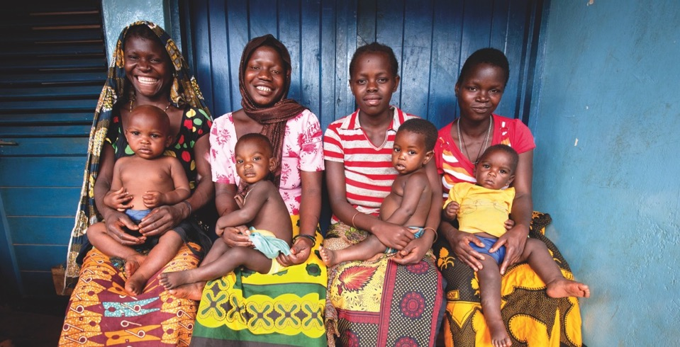
Improving Early ANC Attendance: Project ACCLAIM
Mary Pat Kieffer, Godfrey Woelk, Daphne Mpofu, Rebecca Cathcart and the ACCLAIM Study Group

Slide 2
Disclosure
This work was supported by Grant Agreement GLAcc/cc/Fund 52304/15247/0200 from the Department of Foreign Affairs, Trade and Development Canada (DFATD).
Its contents are solely the responsibility of the authors and do not necessarily represent the official views of DFATD.

Slide 3
Background
PMTCT programming at facility level has not effectively addressed community level barriers that limit demand
Little evidence of successful community interventions in the literature that address demand and uptake of PMTCT services
PMTCT performance may be improved with innovative interventions that address community norms, including harmful gender norms, barriers to positive health behaviors and health-seeking behaviors for all women
For successful implementation of Option B+ and with Test and Treat on the horizon, new approaches to community engagement are urgently needed

Slide 4

ACCLAIM = Advancing Community Level Action in Maternal and child health and PMTCT
Goal: To increase community demand, uptake, and retention in MCH/PMTCT services toward elimination of pediatric HIV
Cluster randomized trial
45 population clusters
Intervention period: 18 months
Levels of intervention:
  Community Leaders:
  Empowerment and Action
  Community Members:
  Opening the public dialogue
  Individuals:
  Information and attitudes
UGANDA
ZIMBABWE
SWAZILAND

Slide 5
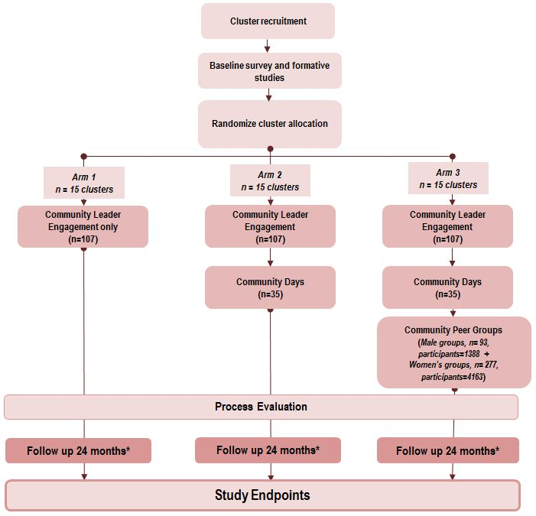
Study Design
Follow up 18 months
Follow up 18 months
Follow up 18 months
Notes:
Three arms: 1: CL only, 2: CL plus CD; 3: CL, CD and groups

Slide 6

Endpoints
Primary endpoint:
  Early Infant Diagnosis Visit at 6-8 weeks of age
Secondary endpoints:
ANC attendance < 20 weeks
4 ANC visits
Male partner testing
Women retested before delivery
Facility delivery
ARV uptake for women and exposed infants
Notes:
‘Difference in differences’ design, compares differences before and after across the 3 arms
No control arm due to cost; all arms compared to ‘pre-intervention’

Slide 7

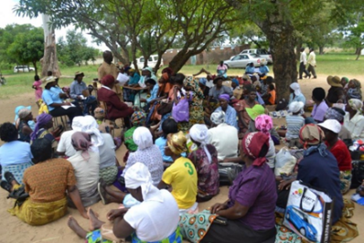
Community Leader Engagement
Leaders chosen by community in each of the 45 clusters
Participate in 5-day Community Leaders Institute
Use MCH and PMTCT data to develop Community Action Plans with community stakeholders to address barriers to ANC and PMTCT
Use dialogues to conduct community advocacy to:
  Encourage families to protect the life of the child and mother
  Emphasize early ANC visits and facility delivery

Slide 8
Baseline Data
Community Knowledge, Attitudes, Practices and Behaviors (KAPB) survey conducted at baseline
  Community aware of need for early ANC, but actual practice was poor
 | Percent agreeing with: “A woman should go to first ANC as soon as she realizes she is pregnant” (KAPB data) | ANC attendance ≤12 weeks (Facility data) | Average GA at 1st ANC (Facility data)
Swaziland | 41% | 12% | 20 weeks
Uganda | 21% | 16% | 22 weeks
Zimbabwe | 24% | 3% | 24 weeks

Slide 9
Methodology
Each ACCLAIM cluster includes health facilities that offer ANC and PMTCT
Data on Gestational Age (GA) at first ANC visit were collected retrospectively from ANC registers in health facilities within the ACCLAIM clusters
  Health workers estimated GA by palpation
  Pregnancies too small to palpate were coded as being 10 weeks GA
Baseline data were collected for the quarter prior to interventions and compared to one year later
Results are presented for all 45 clusters for first 12 months of implementation

Slide 10
Preliminary Results at Facility Level
Women attending ANC before 20 weeks increased from 45% to 51%
Change in Gestational Age at First Antenatal Care Visit, 45 Clusters, Swaziland, Uganda and Zimbabwe
 | Gestational age at first ANC |  | Total
 | <=20 weeks | 21+ weeks
Baseline | 2245 (45%) | 2785 (55%) | 5030 (100%)
12 months post-implementation | 2905 (51%) | 2819 (49%) | 5724 (100%)
 | p = 0.0001

Slide 12
Increase in 1st ANC Attendance ≤12 Weeks GA, by country
45 ACCLAIM Clusters, Zimbabwe, Swaziland and Uganda, 2013-2015
  Intervention begins
Note: Implementation began later in Uganda

Slide 13
Comparison of ACCLAIM vs. non-ACCLAIM in Zimbabwe
Gestational Age at 1st ANC: ≤20 weeks and ≤12 weeks
EGPAF-supported sites, 2013-2015

Slide 14

Conclusion
Preliminary results suggest that community leader training and engagement is associated with a positive trend of earlier 1st ANC attendance
Further results from the study will track further progress on study outcomes as all three community interventions are rolled out

Slide 15
Acknowledgements
ACCLAIM Country Teams in Swaziland, Uganda and Zimbabwe
Community Leaders and Peer Facilitators

