Slide 1
Retaining mother-baby-pairs in care and treatment: the mothers2mothers Mentor Mother Model
mothers2mothers
K. Schmitz, E. Scheepers, E. Okonji, V. Kawooya

Slide 2
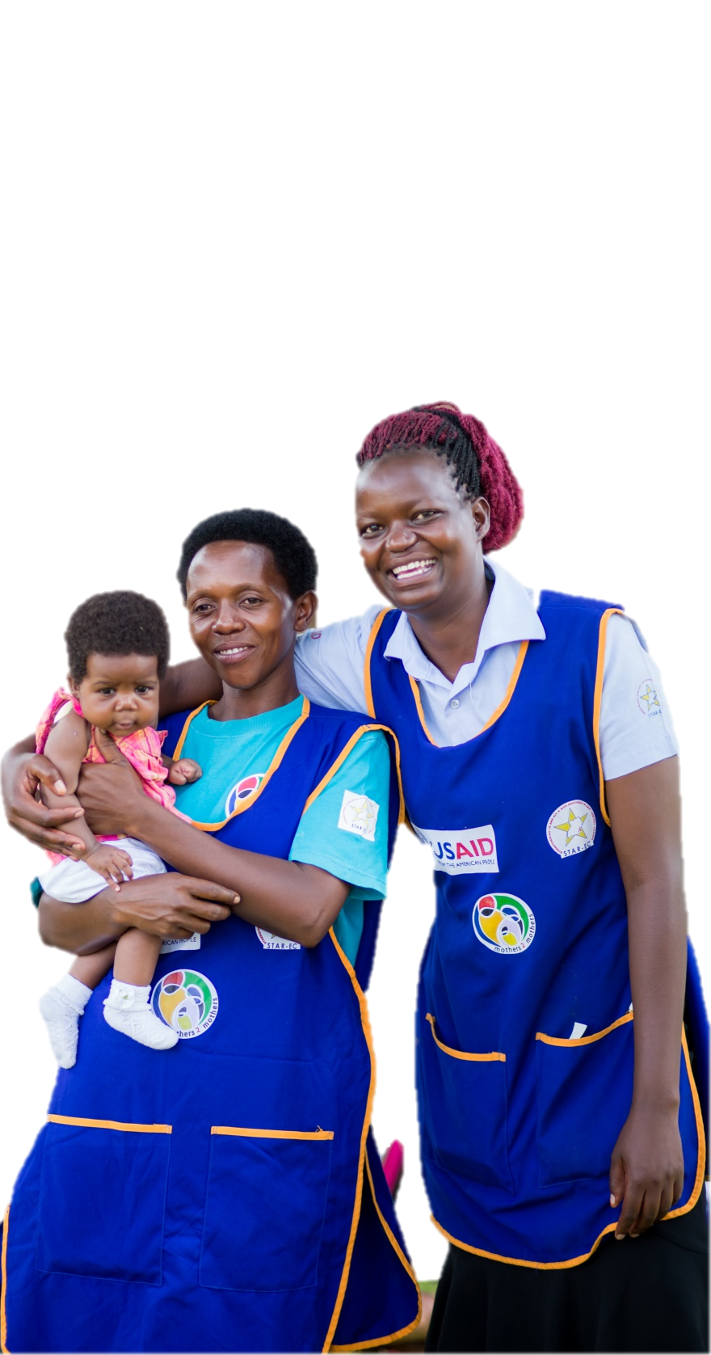
This Presentation
The mothers2mothers Mentor Mother Model
Evaluation Methodology
Results and Conclusion
Ongoing m2m Programme Innovation
Acknowledgements

Slide 3
The m2m Mentor Mother Model

Slide 4
A Peer-Mentor Approach
A peer education and psychosocial support programme
Operating in six Option B+ countries in Africa
m2m Mentor Mothers are women living with HIV who have recently experienced PMTCT
Trained and employed to support other mothers and their families through the same process

Slide 5
Ongoing and New Challenges
Lifelong ART and Option B+
Treatment-as-Prevention
Retaining clients in care and treatment during lengthy periods of breastfeeding
Paediatric care and treatment

Slide 6
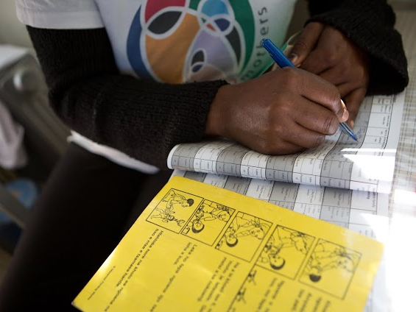
External Evaluation
of the m2m Mentor Mother Model
as implemented under the USAID-funded JSI Research & Training Institute Inc’s STAR-EC Programme in Uganda
(2014)

Slide 7
To investigate whether maternal and infant PMTCT outcomes and maternal psychosocial well-being outcomes were associated with exposure to m2m Mentor Mothers
Purpose

Slide 8
Methods
A quasi-experimental matched area comparison design in 31 intervention facilities and 31 matched control facilities
PMTCT outcomes measured retrospectively among 2,282 mother-baby-pairs
Facility-based Psychosocial Wellbeing surveys in the same intervention and control facilities, using standardised questionnaires among 796 pregnant women and new mothers
Propensity Score Matching was used to investigate the net effect attributable to the m2m standard-of-care

Slide 9
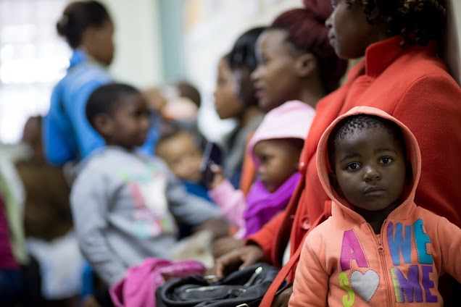
Results

Slide 10
PMTCT Outcome Indicator | Average effects among matched exposed subjects in m2m sites | Average effects among matched unexposed subjects in control sites | Net effect (Percentage Points) | P-Value
Percentage of HIV-positive women who disclosed their HIV status to their partners | 82.1% | 68.9% | 13.2 | <0.001
Receipt of ARVs /ART for PMTCT among HIV-positive pregnant women | 91.8% | 95.1% | -3.3 | <0.001
ANC attendance at least 4 times during previous pregnancy among HIV-positive women | 49.3% | 39.7% | 9.6 | <0.001
Delivery by skilled health personnel in past 12 months among HIV-positive women | 87.1% | 75.8% | 11.3 | <0.001
Exclusive breastfeeding among HIV-positive mothers | 90.1% | 55.9% | 34.2 | <0.001
Percentage of HIV-positive women who used a family planning method appropriate for their needs. | 63.2% | 38.0% | 25.2 | <0.001
Retention in care among HIV-positive women 12 months after ART initiation | 90.9% | 63.6% | 27.3 | <0.001
Receipt of Nevirapine suspension at birth by HIV-exposed babies (ART prophylaxis for PMTCT) | 86.0% | 59.0% | 27 | <0.001
Percentage of HIV-exposed children who were given a PCR test at 6 weeks after birth | 71.5% | 45.8% | 25.8 | <0.001
Percentage of HIV-exposed children who were given an HIV test 6 weeks after cessation of breast feeding | 60.5% | 31.4% | 29.4 | <0.001
Percentage of HIV-exposed children who were given an HIV test 18 months after delivery | 60.2% | 18.1% | 42.1 | <0.001
Linkage of HIV-positive babies to pediatric ART | 60.9% | 27.8% | 33 | <0.001

Slide 11
Psychosocial Wellbeing Outcome Indicators | Average effects among matched exposed subjects in m2m sites | Average effects among matched unexposed subjects in control sites | Net effect (Percentage Points) | P-Value
Experience of social support | 80.1% | 71.7% | 8.4 | 0.003
Demonstrates Coping Self-Efficacy | 86.6% | 64.5% | 22.1 | <0.001
Demonstrates Coping Behaviour | 69.4% | 56.9% | 12.5 | <0.001
Demonstrates HIV Disclosure and Safer Sex Self-Efficacy | 71.7% | 50.7% | 21 | <0.001
Did not experience Depression | 83.3% | 78.1% | 5.2 | 0.028
Experience of Good relationship with health worker | 95.2% | 86.0% | 9.2 | <0.001
Experience of Good relationship with partner | 72.2% | 58.3% | 13.9 | <0.001
Demonstrates HIV Treatment Adherence Self-efficacy (HIV-ASES) | 97.7% | 97.4% | 0.3 | 0.395
Demonstrates coping with stigma | 40.2% | 31.2% | 9 | 0.006
Demonstrates no experience of internalized stigma | 99.5% | 97.9% | 1.6 | 0.025
Accurate HIV Knowledge | 87.1% | 81.8% | 5.3 | 0.015
Positive Gender attitudes | 44.7% | 36.5% | 8.2 | 0.01

Slide 12
Conclusion

Slide 13
The m2m Mentor Mother Model
A simple, scalable, adaptable and sustainable model of peer education and psychosocial support
Addresses the challenges facing HIV-positive pregnant women and mothers
The evidence shows that m2m's psychosocial peer support
Improves uptake of PMTCT services
helps HIV-positive pregnant women and new mothers and their families cope more effectively with HIV and enhances their psychosocial wellbeing.
Integration of peer education and psychosocial support into clinical PMTCT standard-of-care is recommended.

Slide 14
Ongoing m2m Programme Innovation
Integrated Community- and Facility-based Standard-of-Care
Integrated PMTCT-ECD services
Enhanced Programme Model transitioning into an RMNCH-Programme
Adolescent Health
Improved systems to support enhanced, integrated service delivery - mHealth

Slide 15
m2m Mentor Mothers m2m Marjorie Mbule, Sarah Auma, Emeka Okonji, Ewa Skowronska, Anne Schley, Stephano Sandfolo, Mitch Besser Implementing Partners JSI Research & Training Institute Inc. STAR-EC programme - Denis C. Businge, Samson Kironde and the Uganda Ministry of Health - Dr Linda Kisakye. External Evaluators Dr. Charlotte Muheki Zikusooka (Principal Investigator) Dr. Daniel Kibuuka-Musoke (Co-Principal Investigator) John Baptist Bwanika (Statistician) Dr. Dickens Akena (Psychiatry Specialist) Acknowledgements

Slide 16
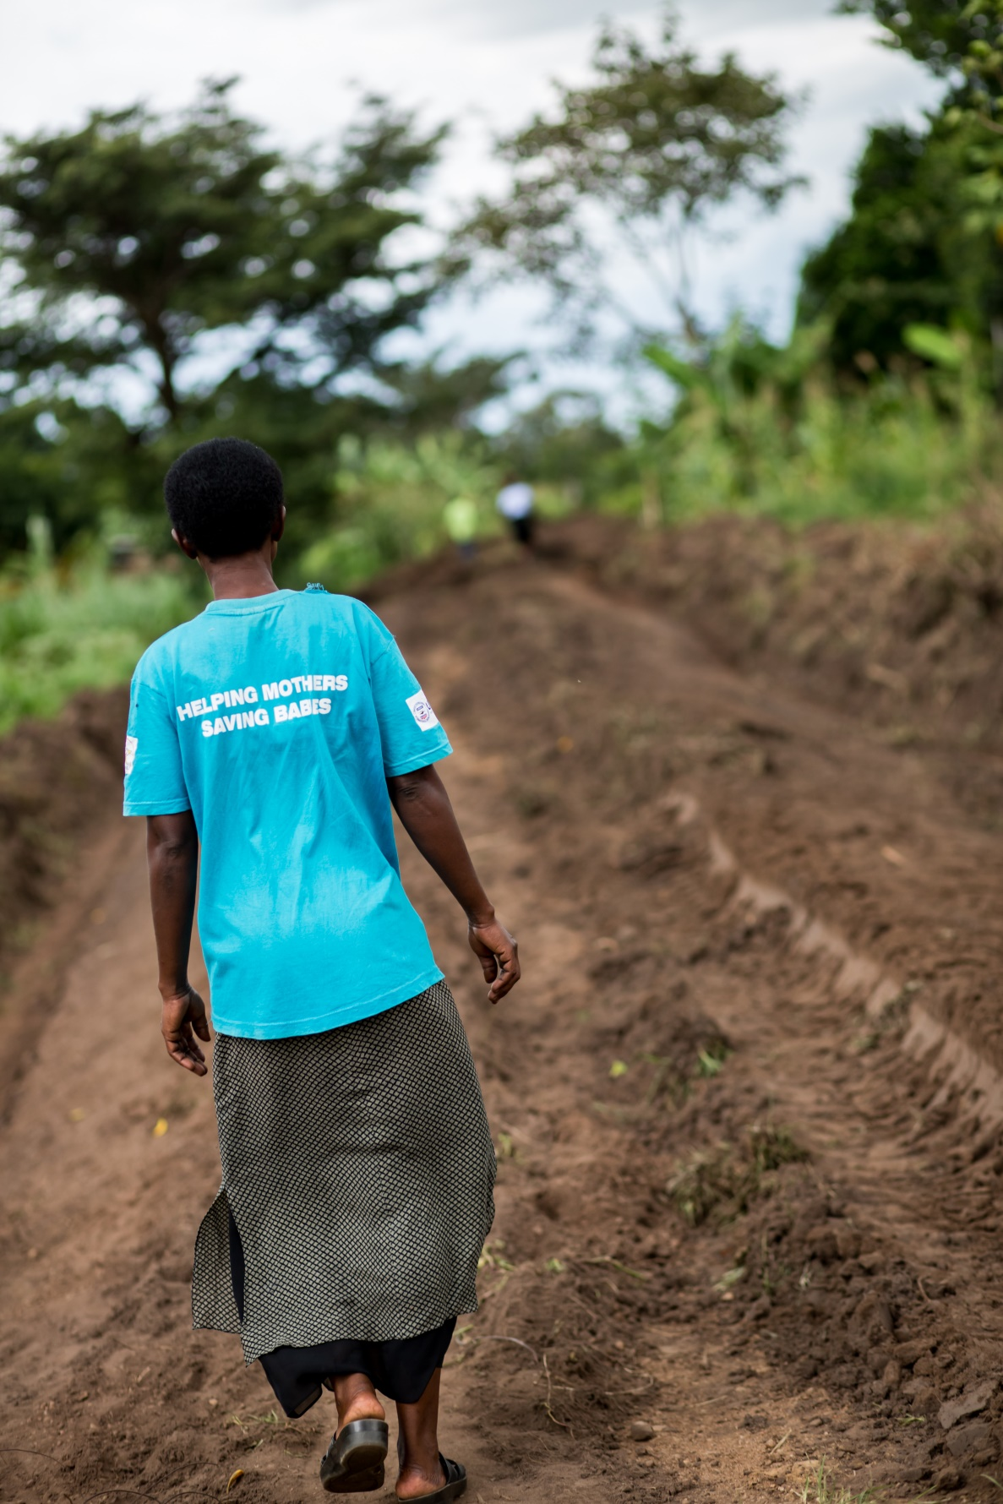
Our Key Donors

