Slide 1


From Care to Cure
Nicolas Chomont, PhD
Assistant Professor, Université de Montréal and Centre de Recherche du CHUM
Notes:
Thank you very much. I want to start by thanking IAS for the invitation. It is a great pleasure to be here and a true honour to address this audience.

Slide 2
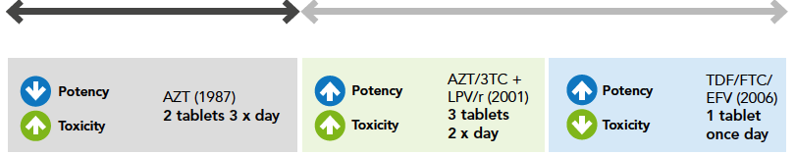
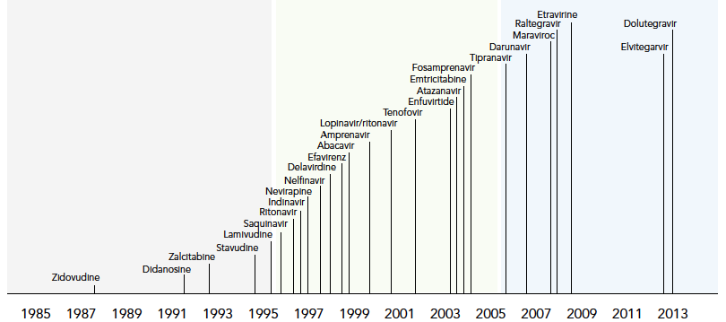
Smarter and better HIV treatment options are available
Era before ART
Era of ART
Source: UNAIDS, gap report
Notes:
Since the discovery of the virus in 1983, Treatments for HIV infection have dramatically improved in terms of efficacy and tolerability. The implementation of triple therapy in 1996 has increased the potency of HIV treatments and reduced their toxicity. More recently, novel antiretroviral drugs such as integrase inhibitors have been added to this arsenal and have further improved treatments for HIV infection.

Slide 3
The success of ART
Expected survival of a 20-year-old person living with HIV in a high income country
Era before ART
Era of ART
Source: UNAIDS, gap report. Adapted from Lohse et al, 2007; Hoog et al. 2008; May et al, 2011; Hogg et al. 2013
Notes:
This scientific success has translated into clinical benefits: Antiretroviral therapy has saved the lives of many people living with HIV during the past 20 years.
Whereas the expected survival of a 20 years old person living with HIV was only 8 years in the mid 90s’, this number has increased dramatically since the beginning of the century. Today, the life expectancy of an individual living with HIV in a high income country is close to the one of uninfected people. This clearly demonstrates the success of ART.

Slide 4
Why do we need a cure?
Notes:
Therefore, why do we need to do better than ART. Why do we need a cure?

Slide 5
Stigmatization
Criminalization
Toxicity of ART
HIV
Access to ART
Economic burden of ART
Notes:
Although ART can dramatically reduce the amount of HIV in the body of infected people, the virus persists at low levels. Because of HIV persistence, stigmatization and criminalization remains. The use of ART may have long-term toxicity. In addition, access to ART for everyone is a formidable challenge. Finally, the financial burden associated with ART represents another argument to find a cure for HIV infection.

Slide 6
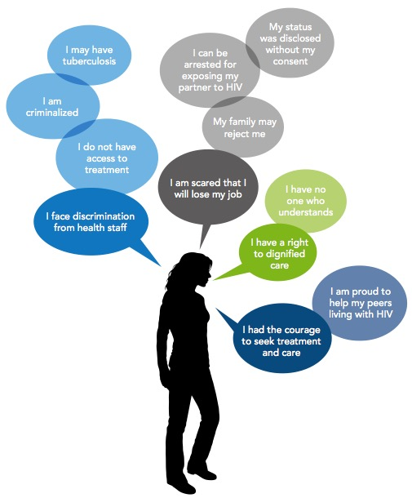
I. Criminalization/Stigmatization
I am a person living with HIV. I face these issues:
Source: UNAIDS, gap report.
Notes:
People living with HIV are still criminalized in a large number of countries. In addition, people living with HIV are still stigmatized, and may be rejected by the family and or their colleagues at work.

Slide 7

II. Access to ART
28.6 million people need ART in low- and middle income countries
Despite considerable progress, only 11.7 million people (41%) receive ART
Access to treatment for all is a formidable challenge

Slide 8
III. Toxicity of ART
ART needs to be administered indefinitely
Antiretroviral drugs may induce:
  Bone toxicity
  Cardiovascular risk
  Hepatotoxicity
  Renal toxicity
Long term effects of ART (>20 years) are largely unknown
A. Carr et al. AIDS 2009

Slide 9
IV. Economic burden of HIV: The example of Canada
It is estimated that 3,070 people contracted HIV in Canada in 2009
 | Total cost | Cost per person | Percentage of total
Health Care | $768,120,000 | $250,000 | 19%
Labour Productivity | $2,083,190,000 | $670,000 | 52%
Quality of life | $1,180,180,000 | $380,000 | 29%
Total | $4,031,490,000 | $1,300,000 | 100%
HIV still generates enormous costs for Canada in terms of human suffering, job loss and its related economic impact, and financial burden on our health care system
Source: Kingston-Riechers, Canadian AIDS Society, 2011
Notes:
For those who have access to HAART, living with HIV generates life-time expenses that creates an additional economic burden. This table indicates the Lifetime Economic Loss Attributed to All Those Who Tested Positive in Canada in 2009.
The net present value of treating individuals with new HIV infections will be about $768 million over their remaining lifetimes.
The net present value of productivity losses associated with new HIV infections will be about $2 billions and it is estimated that the lost of quality of life attributable to HIV generates another financial loss of more that 1 billion.
Overall, the economic impact of 3,070 new HIV infections in 2009 has a lifetime cost of $4 billions. This is another argument in favour of finding a cure for HIV infection.

Slide 10
Stigmatization
Criminalization
Toxicity of ART
HIV
Access to ART
Economic burden of ART
Notes:
A cure for HIV that would eliminate all trace of remaining virus would allow people living with HIV and AIDS to enjoy a life free or antiretroviral drugs and would eliminate all these

Slide 11
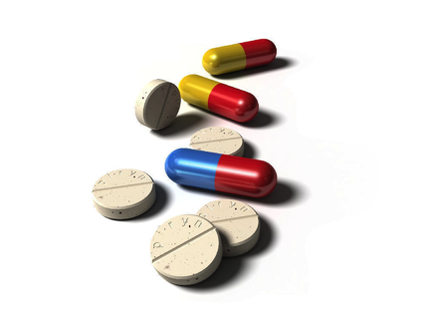
ART does not eradicate HIV
ART
Circulating virus
Time
HIV persists during ART
Notes:
Antiretroviral therapy reduces the amount of circulating virus to undetectable levels by conventional viral load tests. However, whenever treatment is interrupted, HIV rapidly comes back, indicating that even if it was invisible for months of years, HIV persists during ART.

Slide 12
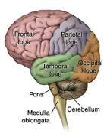

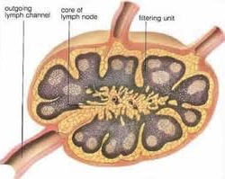
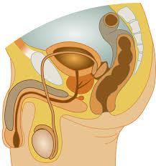
Where does HIV hide?
TW Chun et al. J Infect Dis 2008; S. Yukl et al. J Infect Dis 2010; M. Churchill et al. Annals Neur 2010; C. Fletcher et al. PNAS 2014; M. Perreau et al. J Exp Med 2013
Notes:
In addition to cells in the circulating blood, Its is now well established that HIV persists in several organs in people who have been receiving ART for several years. The genetic material of the virus, as well as viral particles have been detected in many tissues including the brain, lymph nodes, genital tract and gut.

Slide 13
Mechanisms of HIV persistence
“Active reservoir”
“Latent reservoir”
Residual
replication
T cell
survival
T cell
proliferation
D. Finzi et al. Science 1997; J. Wong et al. Science 1997; TW Chun et al. PNAS 1997; S. Palmer et al. PNAS 2008;
N. Chomont et al. Nat Med 2009; M. Buzon et al. Nat Med 2010; H. Hatano et al. J Infect Dis 2013; C. Fletcher et al. PNAS 2014.
Notes:
At the cellular level, HIV mainly persists in CD4+ T cells. There are several mechanisms by which HIV maintains its reservoir.
First residual levels of replication, particularly in tissues in which antiretroviral drugs may to reach their optimal concentrations, may continuously replenish a pool of cells that are actively replicating the virus. The proportion of individuals on ART in which this mechanisms occurs is still unclear.
In contrast, a small pool of latently infected cells, which means a small number of ells in which the virus remains silent during ART, can be detected in all individuals on suppressive therapy. The latent reservoir is made of cells that are long lived as well as cells that slowly divide, thereby maintaining the size of the latent reservoir for long periods of time.

Slide 14


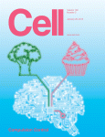
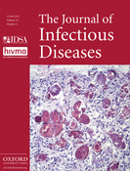
Proliferation as a mechanism of persistence
Notes:
As I briefly mentioned earlier, in addition to T cell survival, proliferation of infected cells is another mechanism by which HIV persists during ART. Several important studies published this year

Slide 15
Diversity of CD4 T cells
Naïve
Memory
“Stem cell” memory
Central
memory
Transitional
memory
Effector
memory
Terminally differentiated
Ag
IFN-γ
IL-2
Apoptosis
Survival
Activation
Self renewal
F. Sallusto et al. Nature 1999; C. Riou et al. J Exp Med. 2007; R. Ahmed et al. Nat. Rev Immunol 2009; L. Gattinoni et al. Nat Med 2011 ; D. Farber et al. Nat. Rev Immunol 2014
Notes:
The diversity of the mechanisms by which HIV persists reflects the disverity of the CD4+ T cell subpopulations which are endowed with different capacities to produce cytokines, to self renew, to survive and to proliferate. From naïve cells that have not seen their cognate antigen to terminally differentiated cells that are relatively short lived, the CD4 compartment is made of a variety of memory cells that contribute to the persistence of HIV.

Slide 16
Contribution of CD4 T cell subsets to the HIV reservoir
HIV persists in different CD4+ T cell subsets
N. Chomont et al. Nat Med 2009; M. Buzon et al. Nat Med 2014.
Notes:
Indeed, we and others has previoudly shown that several cell subsets contribute to HIV persistence during ART. With Rafick Sekaly, we demonstrated that integrated viral genomes can mostly be detected in cells displaying a central, transitional and effector memory phenotype in individuals on ART. More recently, Maria Buzon and Matthias Lichterfeld identified the newly discovered stem cell memory subset as a preferential niche for HIV during ART. As these stem cell memory cells have a very long half life and can self renew, they may represent a particularly stable reservoir for HIV.

Slide 17
T cell survival as a mechanism of persistence
Short-term
HAART
Long-term
HAART
Long-lived T_{SCM} represent a stable reservoir for HIV during ART
M. Buzon et al. Nat Med 2014; S. Jaafoura et al. Nat Comm 2014
Notes:
Indeed, the contribution of stem cell memory cell seems to increase with the duration of ART, whereas the contribution of the other subsets may gradually diminish. The group of Yassine Taoufik found that the half life of this reservoir appears to be significantly longer that the other cellular reservoirs for HIV.
This illustrates that memory CD4+ T cells that have an enhanced capacity to survive may serve as a long-lived reservoir for HIV.

Slide 18



Barriers to an HIV cure
HIV persistence in tissues
Latently infected cells are rare and undistinguishable from uninfected cells
Latently infected cells are diverse
Eradication strategy should reach tissues
Eradication strategy should be specific
Eradication strategy should target all infected cells
Notes:
As I briefly mentioned earlier, in addition to T cell survival, proliferation of infected cells is another mechanism by which HIV persists during ART. Several important studies published this year

Slide 19
Two types of cure
“Sterilizing” cure
“Functional” cure

Slide 20
Sustained remission off ART is rare but achievable
STOP
< 2months
Boston A
3 months
ART
ART started early in infection
Boston B
8 months
Viral load
Mississippi child
28 months
Limit of detection
Visconti and SPARTAC
Timothy Brown
0
1
2
3
6
7
years
G. Hütter et al. NEJM 2009; D. Persaud et al. NEJM 2013; K. Luzuriaga et al. NEJM 2015; T. Henrich et al. JID 2013; T. Henrich et al. Ann Intern Med 2014; W. Stöhr et al. Plos One 2013; L. Hocqueloux et al. AIDS 2010; A. Saez-Cirion et al. Plos Path 2013; Adapted from J. Cohen, Science 2015.
Notes:
Rebound in viremia typically occurs within 2 months after ART interruption. But there are some exceptions. Timothy Ray Brown aka the “Berlin Patient” received a transplant of stem cells that were protected from HIV infection more than 7 years ago. HIV is still undetectable is his body and he is considered as the first individual who has been cured.
Tim Henrich and Dan Kuritzkes reported 2 cases of bone marrow transplants (although not resistant to HIV) who showed a significant delay in rebound (3 and 8 months).
The Mississippi child who received ART30 hours after birth for up to 18 months did not rebound for almost 28 months.
Finally, rare individuals in the Spartac and Visconti acute infection studies display sustained remission several years after ART cessation.
These 2 studies together with the case of the Mississippi child suggest that initiating ART early after infection may be an important parameter that could lead to control.

Slide 21
Impact of early ART on HIV persistence (RV254)
ART started:
during chronic infection
<25 days after infection
<17 days after infection
Very early ART (<2-3 weeks after infection) dramatically reduces the frequency of cells carrying integrated genomes
J. Ananworanich et al. Plos One 2012; J. Ananworanich et al. Journal of Viral Eradication 2015; C. Vandergeeten, in preparation.

Slide 22
Reservoir after 2 years of ART
Early ART results in a restricted reservoir in all memory subsets
C. Vandergeeten and J. Ananworanich, CROI2013.

Slide 23
Clinical benefits of early ART: Visconti (ANRS)
14 post-treatment controllers from the ANRS/Visconti study
ART started within 10 weeks after primary infection, for a median time of 3 years
Virological control following ART cessation for an average time > 9 years
10
9
Replication competent HIV
2000
ART
10
8
10
7
1500
10
6
CD4+ T cells/mm3
10
5
HIV-1 RNA (copies/ml plasma)
1000
10
4
10
3
500
10
2
10
1
0
10
0
01
02
03
04
05
06
07
08
09
10
Year
Post treatment controllers naturally “control” a reservoir of small magnitude
A. Saez-Cirion et al. PLoS Path 2013

Slide 24
Cure strategies
To limit the establishment of the reservoir
To reduce the size of the reservoir
Early ART
Render uninfected cells resistant to HIV
Deplete infected cells
Flush out the latent reservoir

Slide 25
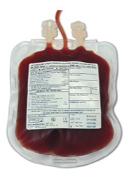
Render uninfected cells resistant to HIV
infusion
leukapheresis
CD4 T cells enrichment
expansion
SB-728 vector
(CCR5 disruption Zn Finger)
Adapted from P. Tebas et al. New. Engl. J. Med. 2014

Slide 26
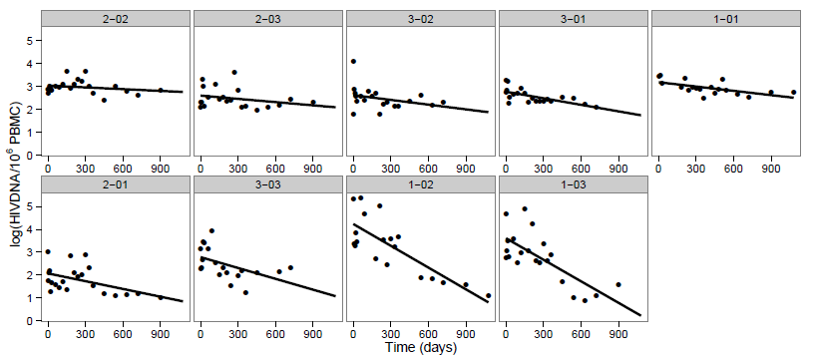
Reservoir decay without ART interruption (902 Trial)
*
*
*
*
*
*
Significant decay of total HIV DNA in 6/9 participants
Sangamo, J. Zeidan and R. Sekaly

Slide 27
T_{SCM} are enriched in CCR5-modified cells
TSCM (cells per µl)
TSCM
T_{SCM} persists after infusion and are more likely to be resistant than the other cell subsets
J. Zeidan and R. Sekaly

Slide 28
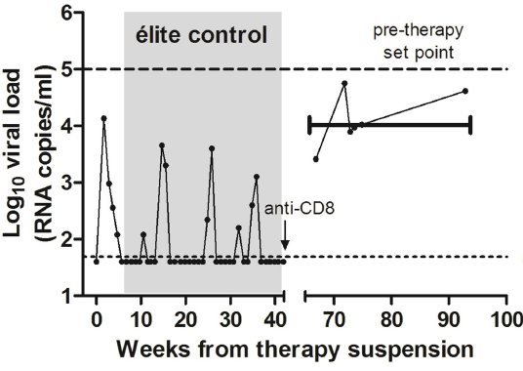
Depleting reservoir cells
Central memory
Transitional memory
Effector
memory
Naive
Apoptosis
Auranofin
CD8 T cell depletion
Non human primate
Non-specific depletion of cells carrying latent virus may lead to control
I. Shytaj et al. J Virol 2015; A. Savarino et al. Retrovirology 2015; B. Chirullo et al. Cell Death Dis 2013.

Slide 29
Flush out the latent reservoir (Shock and kill)
“Latency
reversing agent”
Cytopathic effect
Immune response
ART ART ART ART ART ART ART ART ART ART

Slide 30
Molecular mechanisms of HIV latency
Gamma-c Cytokines:
IL-7
IL-15
Jak/STAT inhibitors
(ruxolitinib)
Bromodomain inhibitors
JQ1
I-BET
HDAC inhibitors
Saha (vorinostat)
Panobinostat
Romidepsin
PKC agonists:
Prostratin
Bryostatin
HIV latency results from multiple mechanisms
D. Richman et al. Science 2009

Slide 31
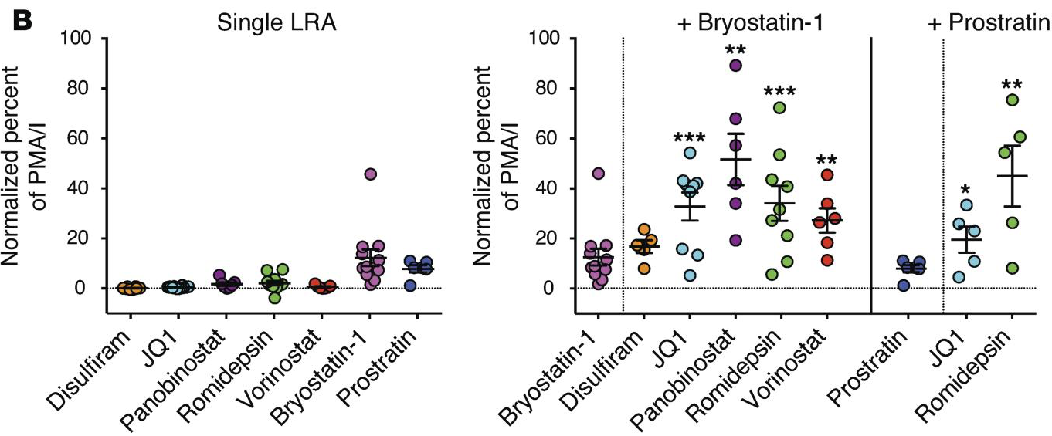
Disrupting latency in vitro
Single
“latency reversing agent”
Combinations of anti-latency drugs induce robust levels of HIV production in latently infected cells
G. Laird et al. J Clin Invest 2015; S. Reuse et al. Plos One 2009

Slide 32
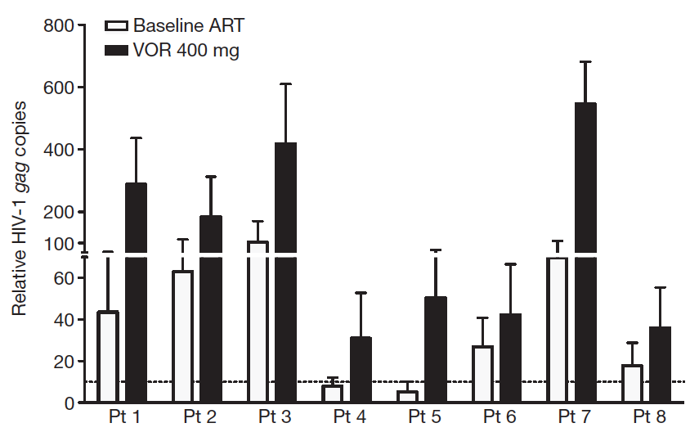
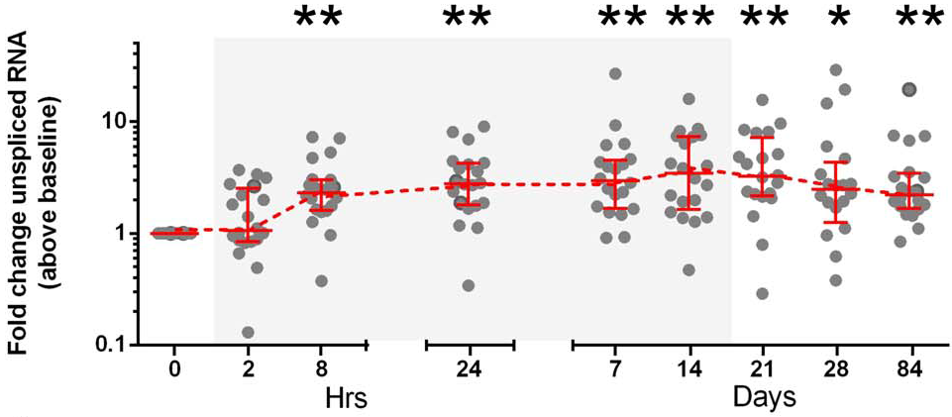
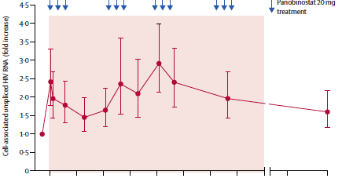
Disrupting latency in vivo
vorinostat – single dose
vorinostat – multiple doses
panobinostat – multiple doses
romidepsin – multiple doses
Anti-latency drugs induce HIV transcription in latently infected cells…
N. Archin et al. Nature 2012; J. Elliott et al. Plos Path 2014; T. Rasmussen et al. Lancet HIV 2014; O. Søgaard et al. in revision

Slide 33
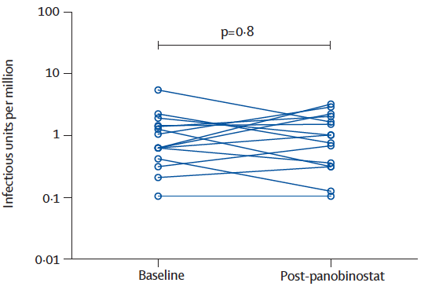
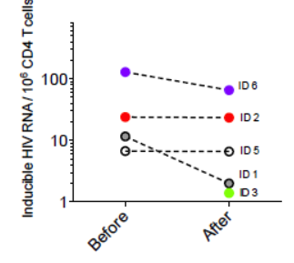
Disrupting latency in vivo
vorinostat – single dose
vorinostat – multiple doses
“no […] substantial reduction in the frequency of replication-competent HIV within resting CD4⁺ T cells”
panobinostat – multiple doses
romidepsin – multiple doses
… but does not significantly reduce the size of the latent reservoir
N. Archin et al. Nature 2012; J. Elliott et al. Plos Path 2014; T. Rasmussen et al. Lancet HIV 2014; O. Søgaard et al. in revision

Slide 34
Cure strategies
To reduce the size of the reservoir
Render uninfected cells resistant to HIV
Deplete infected cells
Flush out the latent reservoir
and facilitate clearance of infected cells
and enhance immune control

Slide 35
TLR7 agonist administration in SIV infected macaques
Plasma SIV RNA
CD8 T cell activation
TLR7 agonist induces viral production and increases CD8 T cell activation
Courtesy of J. Whitney and Gilead

Slide 36
Immune checkpoints and HIV persistence
Immune checkpoints (PD-1, LAG-3, TIGIT, CTLA-4) negatively regulate T cell responses and contribute to immune exhaustion
These molecules can be blocked by antibodies to restore HIV-specific immunity
+
+
-
HIV production
PD-1
Number of immune checkpoints
0
1
2
3
No
Activation
Activation
Activation
+ PD-1
engagement
Immune checkpoints are expressed at the surface of infected cells and inhibit viral reactivation from latency
R. Fromentin et al. in preparation.

Slide 37
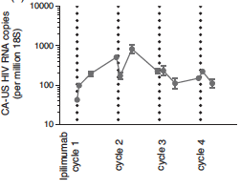
Immune checkpoint blockers
+
-
Persistence
+
Clearance
Anti-PD-1
(pembrolizumab)
Anti-CTLA-4
(ipilimumab)
In vitro and in vivo data suggest that immune checkpoint blockers may display anti-latency activities (+ pro-immune functions)
R. Fromentin et al. in preparation; F. Wightman et al. AIDS 2015.

Slide 38
From Care to Cure
Cure ?
Reactivation + immune boost
(TLR7, PD-1/CTLA-4 antibodies…)
Latent reservoir
Latent reservoir
ART in
acute infection
HIV in tissues
ART optimization
(mega-ART?)
HIV replication
ART
Care

Slide 39







Acknowledgments
Centre de Recherche du
CHUM - U de Montréal
Rémi Fromentin
Marion Pardons
Amélie Pagliuzza
Petronela Ancuta
Mohamed El-Far
Andres Finzi
Daniel Kaufmann
Hugo Soudeyns
Cecile Tremblay
Case Western
Rafick Sekaly
Joumana Zeidan
TRCARC/MHRP
Praphan Phanuphak
Nittaya Phanuphak
James Fletcher
Eugene Kroon
Donn Colby
Jintanat Ananworanich
Lydie Trautmann
Diane Bolton
Jerome Kim
Merlin Robb
Nelson Michael
Southern Research
Deanna Kulpa
VRC
Danny Douek
Eli Boritz
Jason Brenchley
UCSF
Steven Deeks
Hiroyu Hatano
Ma Somsouk
Peter Hunt
Elisabeth Sinclair
Rick Hecht
Rebecca Hoh
Tim Henrich
Satish Pillai
Mike McCune
Doherty Institute
Sharon Lewin
Gabriela Khoury
McGill U Health Center
Jean-Pierre Routy
Institut Pasteur
Asier-Saez-Cirion
Françoise Barré-Sinoussi
Westmead Institute
Sarah Palmer
Eunok Lee
Merck
Daria Hazuda
Mike Miller
Richard Barnard
GSK
Jessica Brehm
David Favre
Emory University
Mirko Paiardini
Guido Silverstri
VGTI Oregon
Afam Okoye
Louis Picker
Aarhus University
Ole Søgaard
Thomas Rasmussen
Martin Tolstrup
Istituto Superiore di Sanità
Andrea Savarino
Iart Shytaj
Harvard University
James Whitney
MIRC
Moti Ramgopal
Brenda Jacobs
Ragon Institute
Matthias Lichterfeld
Xu Yu
ANRS
Livia Pedroza
Anne-Marie-Rey Cuillé
IAS
Anna-Laura Ross
Rosanne Lamplough
Idun Strand
Marjorie Francois
The study participants

