Slide 1
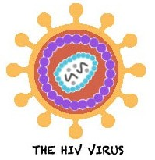




HIV Co-morbidities
In Children and Adolescents
Thanyawee Puthanakit, MD
¹Department of Pediatrics, Faculty of Medicine,
Chulalongkorn University
²HIVNAT, Thai Red Cross AIDS Research Center
Bangkok Thailand

Slide 2
Conflict of interest disclosure
Receive research funding from ViiV Healthcare
and Gilead via HIVNAT, Thai Red Cross AIDS Research Center
No direct financial relationships with any
pharmaceutical organization

Slide 3
Children & Adolescents living with HIV
3.4 million children/adolescents living with HIV¹
  By 2014: 783,000 children on ART
Mixed population of children/adolescents
living with HIV
  Surviving adolescents who started treatment late
  : co-morbidities related to advanced stage HIV
  Aging adolescents who received early treatment : long-term exposure to antiretroviral drugs
¹UNAIDS Report on the Global AIDS Epidemic, 2013.
Notes:
Currently estimated 3.4 million children and adolescents living with HIV.
There are significant progress in access to antiretroviral treatment in the past decade.
By 2014, approximate 800,000 children on ART of which is approximate one-third of children who needed.
Therefore, there are mixed population of children/adolescents living with HIV
First group is surviving adolescents who have slow disease progression who access to ART later in the course of infection: co-morbidities related to severity of HIV itself that destroyed organ function .
Second group is aging adolescents who received treatment early in life with long term exposure to antiretroviral drugs: comorbidities more related to long term ART toxicity.

Slide 4

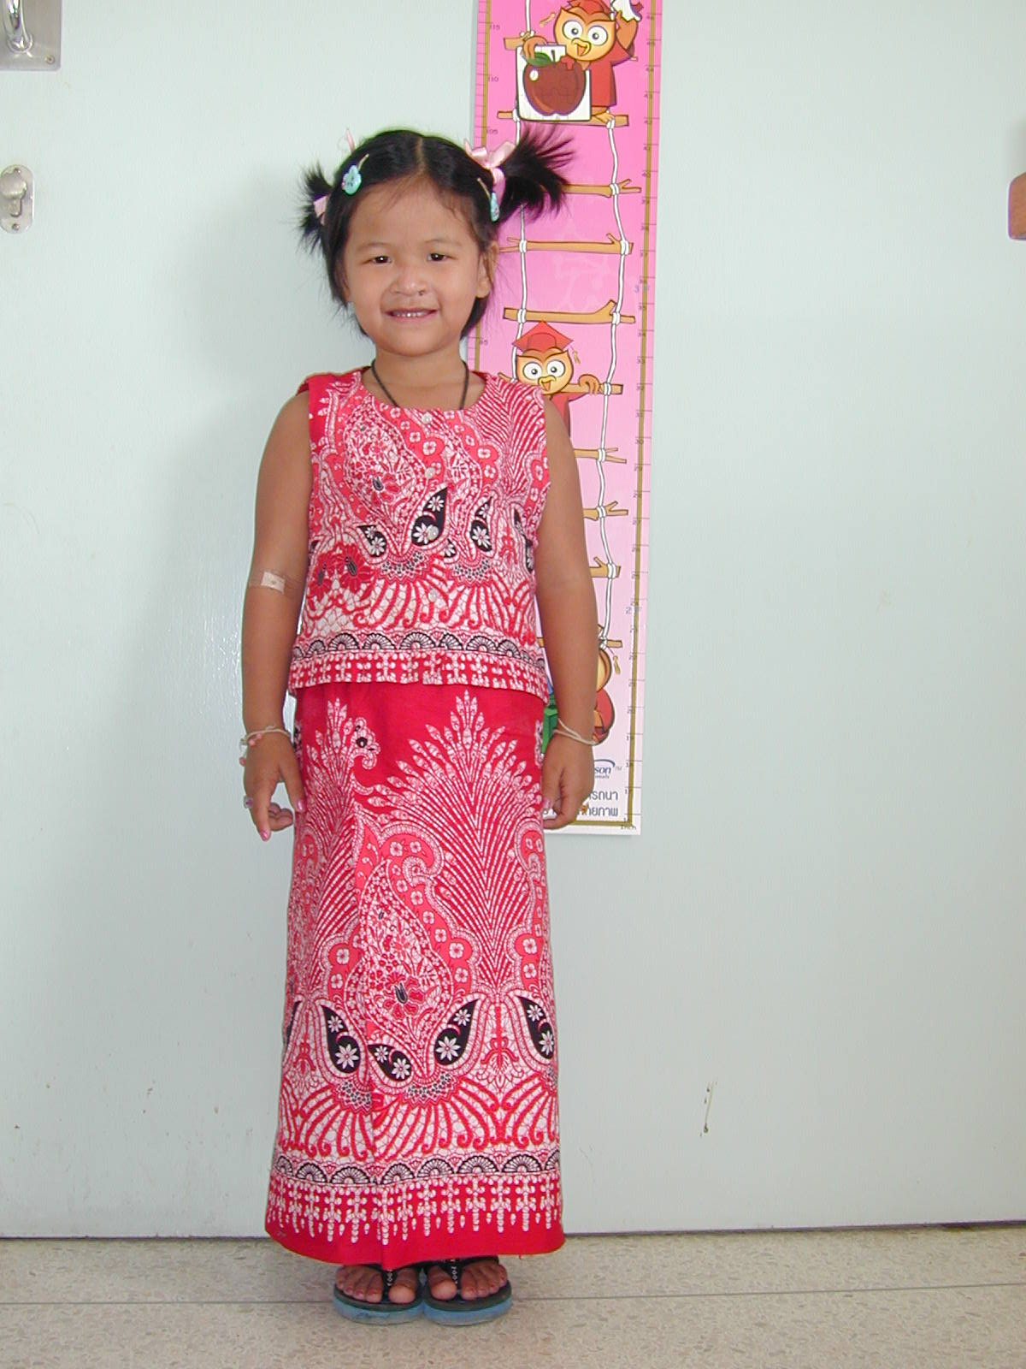
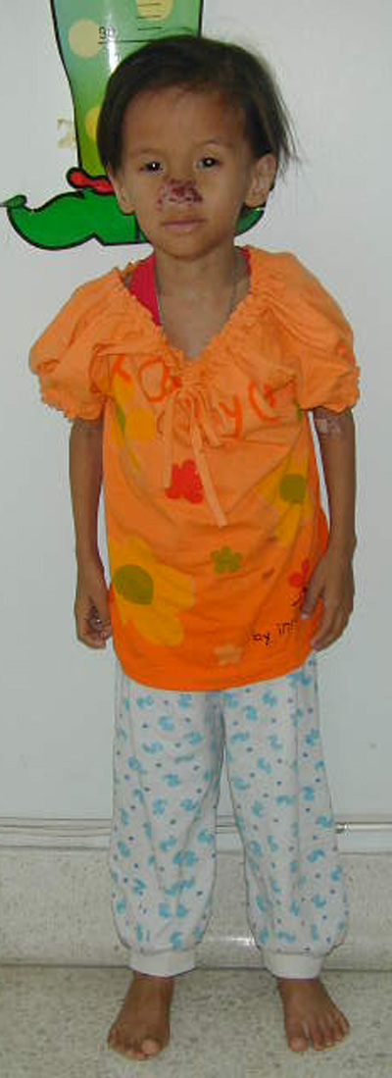
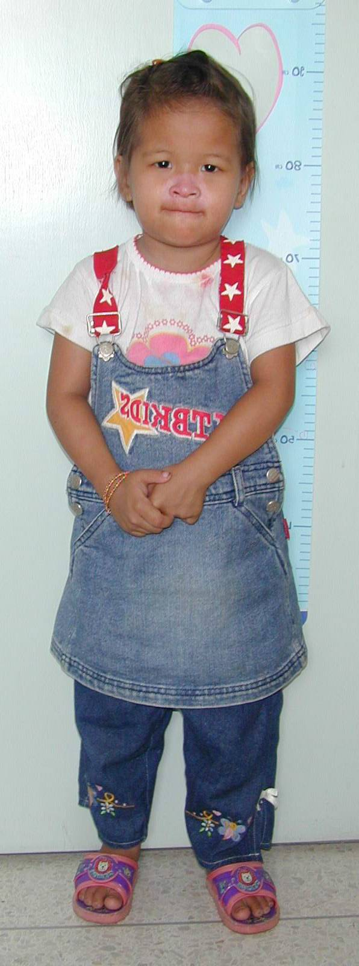

2 mo
18 mo
12 years later
Before
With permission
Notes:
12 years ago, I met this 6 years old HIV-infected girl, she has AIDS symptom and malnutrition.
Before start ART, I have concern about the efficacy of treatment, Immune reconstitution inflammatory syndrome and durability of ART.
She turns out responded to treatment very well. After 2 months of treatment she gained weight and be able to grow up nicely.
Now she is 18 years old, married, has a job at orange orchard.
However, she experienced AIDS symtoms and need a life long ART therapy 40-50 years from now. What is a risk of developing HIV co-morbidities? and how we can minize it.

Slide 5
Pediatric HIV Co-morbidities
Describe pediatric HIV co-morbidities
Needs for pediatric antiretroviral drugs development to minimize HIV co-morbidities
Challenge in integration of screening and management of pediatric HIV co-morbidities in resource-constrained settings
Notes:
I will address the following points
Describe pediatric HIV Co-morbidities
Needs for pediatric ARV development to minimize HIV co-morbidities
Challenge in integration of screening and management esp. in resource constrained settings that use public health approach rather than individualized therapy

Slide 6
Pediatric HIV Co-morbidities
HIV co-morbidities
Opportunistic infection
Chronic inflammation
Chronic lung diseases
Delayed growth, puberty
Antiretroviral toxicity
Dyslipidemia
Renal dysfunction
HIV co-infection
HBV, HCV-Liver cirrhosis
HPV- Anogenital cancer
Psychosocial factors
Mental health
Alcohol, substance abuse
Notes:
HIV co-morbidities are multifactorial;
From HIV itself – From chronic inflammation caused by viral replication or opportunistic infection that leads to cause end organ dysfunction
Such as chronic lung diseases; delayed in growth and puberty
From antiretroviral toxicity – such as dyslipidemia, impaired renal function
From HIV coinfection such as viral hepatitis B or C – can lead to liver cirrhosis or Human papilloma virus infection – related to anogenital cancer
Psychosocial factors that related to or lead to HIV-infection such as mental health problem, alcohol or substance abuse
I would like to spend most of the time discuss co-morbidites that are consequence of HIV/OIs and antiretroviral toxicity.

Slide 7
Pediatrics vs. Adult HIV Co-morbidities
Children/Adolescents Accumulate risk for NCDs Not able to attain milestone | Adult/Elderly Non communicable diseases(NCDs)
Persistent proteinuria Tubular dysfunction | Chronic kidney diseases End stage renal diseases
Dyslipidemia Hypertension, Insulin resistance | Cardiovascular disease events
Impaired peak bone mass Low bone mineral density | Bone Fracture
Developmental delay Impaired cognitive function | HIV associated neurological disorders (HAND), Dementia
Notes:
In Aging HIV infected adult co-morbidities are symptomatic and manifest as a non communicable diseases events.
But among Children and adolescents – co-morbidities are accumulation of risk factors of NCDs which lead to significant problem in years or decades to come or disturb of developmental milestone
For example:
1. Renal problem start with as persistent proteinuria or tubular dysfunction – without intervention – it could lead to chronic kidney diseases or end stage renal diseases
.
2. Cardiovascular diseases risks factors such as hypertension dyslipidemia or insulin resistance are accumulating
For bone health; HIV infection or ARV disturb bone formation and not attain peak bone mass – leave them at risk of bone fracture
5. Or cause in developmental delay or imparied of cognitive function

Slide 8
Non-communicable Diseases
Priority Areas for PLHIV
High Priority | Medium priority | Lower priority
Modification of ARV for prevention NCDs | Screening for renal dysfunction | Screening for cervical cancer
Cardiovascular risk assessments and intervention | Bone Health in Children/Adolescents | HPV vaccine
Growth and Puberty delay in children and adolescents | Screening for HBV, HCV co-infection | HBV vaccine
Mental Health screening and intervention | Obesity reduction | Harm reduction for HBV,HCV in PWID
 | Smoking, Alcohol and Substance abuse
Consultation on chronic comorbidities in PLHIV meeting report; WHO July 2014.
Notes:
In July 2014; WHO convene a consultation meeting among experts to identify priority area of NCDs in people living with HIV
The working group prioritize the conditions to high priority such as modify ARV drugs or treatment strategies to prevent NCDs,
Assessment and intervention for cardiovascular risk,
Growth in children and adolescents, mental health
Medium priority such as renal dysfunction, bone health in children and adolescents.

Slide 9
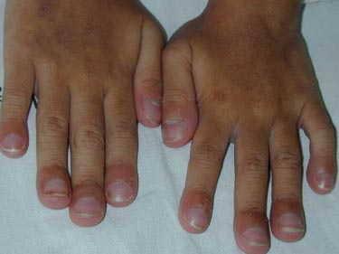
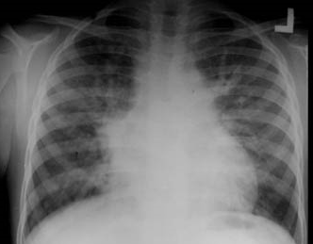
Chronic Lung Disease
Chronic lung disease is common among
HIV-infected adolescents in Asia and Africa
Sign and symptoms
  Chronic cough, recurrent infection
  Clubbing of fingers
  Hypoxia at rest (O₂ sat <92%)
  Hypoxia on exertion(desaturation >5%)
Pathophysiology
  Large airways: Bronchiectasis
  Small airways: Bronchiolitis obliterans
Photo: pedaids.info
Ferrand. Clin Infect Dis 2012;55:145-52.
Notes:
Chronic lung disease are more common in Africa and Asian Children than in Western countries
– Which might explain by repeated infection by virus and bacteria or secondary to immune dysregulaton induced by HIV itself
Study among Zimbabwe HIV-infected long term non progressor presence at median age of 12 years
40% has hypoxia either at rest (13%) on exercise (29%)
Sign and symptoms include chronic cough, recurrent respiratory tract infection, in a child with chronic hypoxia – has clubbing of fingers.
They have hypoxia either at rest (13%) or on exertion (29%).
The involvement on large airway Bronchiectasis: common chest x-ray findings show ring and tramline opacities
The involvement on small airway - bronchiolitis obliterans: wheeze not response to bronchodilator, Chest x-ray: hyperinflation;
These condition some may improve after ART but some not reverse even after immune recovery.

Slide 10
HIV-associated Nephropathy
HIV-associated Cardiomyopathy
Nephropathy¹
Heavy proteinuria and rapid progression to end-stage renal disease
Pathology: Focal segmental glomerulosclerosis and tubulo-interstitial lesions
HAART + ACE-inhibitors²
  80% decrease in proteinuria
  39% complete remission
Cardiomyopathy³
Dyspnea, Heart failure
Echocardiogram
LVEF < -2 Z -score or
LV dimension > 2 Z-score
Prevalence
Pre ART era = 44.3%
HAART era = 3.7%
¹Ray PE. Pediatr Nephrol 2004:19:1075-92.
²Ramsuran D. Pediatr Nephrol 2012;27:821-7.
³Lipshultz SE. JAMA Pediatr. 2013;167:520-527.
Notes:
Nephropathy presented with heavy proteinuria and progression to end-stage renal diseases
The
Compare 3 groups children 7-11 year
HIV on HAART: Mar 2007-Nov 2009 ( N=325) 89% ON HAART
P2C2 (N=70) 17% on HAART – Pulmonary and cardiovascular complications

Slide 11
Poor growth and delayed puberty
Pre-ART: 51% underweight and 48% stunted
2 years after ART: 70% catch-up weight and 61% height
West African cohort
N=2004
ARROW study: Puberty development
2-3 year delays in entering pubertal stage
Continued growth even in late pubertal stage 4-5
Jesson J, et al. Pediatr Infect Dis J 2015 e159. Szubert AJ. AIDS 2015;29:609-18.
Notes:
N =2004 median age start ART 4 years
Pre- ART about half of children has underweight and stunted
Strikingly: the probability of catch-up in growth and puberty is depend on age at start ART -- start @ age < 5 years of age has higher chance to catch up
ARROW cohort show that the age at puberty is delayed
Male G2 12.8 G5 = 16.9 years
Female B2 11.7 Menarche 14.3 and B5 16.1
On average delayed in pubertal stage 2-3 years compare to Black American Children. However they have continue growth in late pubertal stage G4-G5.

Slide 12
Neurodevelopmental outcomes
Mean IQ Score
CDC C HIV HEU HIV HEU Control
PHACS ( N =558)
Mean age 12 years
Thai-PREDICT (N =603)
Mean age 9 years
Smith R. Pediatr Infect Dis J 2012;31:592-8. Puthanakit T. Pediatr Infect Dis 2013; 32:501-8.
Notes:
Neurodeveopmental and cognitive funcition is very important
Since it will effect the ability to taking care of themselves, effect adhrence
And also opportunity @ school and work
The normal fullscale is 100 with SD of 15 point
The study in PHACS cohort in US children showed that HIV-infected children had low IQ, and children who had

Slide 13
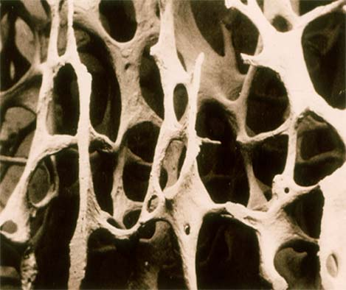
Low bone mineral density before attained peak bone mass
  Peak bone mass achieved by age 20-25 years
Bone mineral density (BMD) Z-score by
Dual-energy x-ray absorptiometry (DXA) at lumbar spine
BMD z-score < -2 ranged from 4-32%
Ongoing research: Effect of calcium, vitamin D supplement
Sudjaritrak T. Puthanakit T. J virus eradicate 2015:1:159-67.
Notes:
Bone health in children and adolescent HIV is unique co-morbidity since the exposure to both HIV and antiretroviral therapy are occurred during established of peak bone mass. It posed a therotical fracture risk when these children are aging.
Bone mineral density assessed by dual energy x-ray absorptiometry or DXA usually performed at lumbar spine, interpret by comparing with age and gender match for BMD Z-score
The cross sectional study among children in middle income countries show prevalence of low BMD in a range form 4-32%

Slide 14
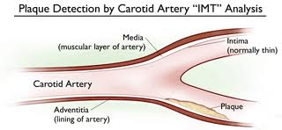
Cardiovascular disease risks
CVD risks score
PHACS: PDAY score > 4 in 12%
Hypertension
Prevalence = 1%
Dyslipidemia
22% had non-HDL cholesterol > 130 mg/dl
Hyperglycemia
Prevalence = 1%
Obesity
Prevalence = 13%
Partel K. Circulation. 2014;129:1204-1212.
Notes:
Pediatric HIV/AIDS cohort study (PHACS)
Assess aggregate atheroscelrotic cardiovascular disease risk scores
“ Pathobiological determinants of athersclerosis in youth (PDAY) for coronary arteries
N = 165 median age = 16 year
Risk factors = hypertension, dyslipidemia, hyperglycemia, obesity, smoking
Risk factors = male, AIDS, boosted PI. --- no significant change in risk score over 4 years
PDAY for carotid ≥2, ≥3, and ≥4 = 24%, 16%, and 12% having CA score
Score predicts coronary a. calcium and carotid artery intima thickness
The cardiovascular event might take years for clinical events, however the assessment of risk score should be done.
Intervention may be needed in case with multiple risk factors.
NOTE:
Chatterton-Kirchmeier S. Pediatr Infect Dis J 2015;34:610-4.
Cohort in Atlanta perinatal: horizaontal AA (60%:40%) 30% had BMI > 25 (which is similar to general AA)
Age 2-17 (> 95percentile) age 18-25 (> 140 or 90 mm Hg) = 20 versus 16% high blood pressure (compare to in general pop 4-5% HT)
High blood pressure: single measurement while Hypertension defined as >= 3 times of high BP
US cohort¹: 20% high BP

Slide 15
Challenge for management of dyslipidemia in pediatric HIV
Different threshold to add pharmacotherapy
  LDL > 190 mg/dl
  LDL > 160 mg/dl plus 2 risk factors
  LDL > 130 mg/dl due to chronic inflammatory disease
Lack of clinical trial data to demonstrate the benefit of statin use in pediatric HIV
  NHLBI recommend – statin in children >10 years of age
Limited ARV drugs choice to substitute
Pediatrics 2008;122: 198-208.
NHLBI Guidelines for cardiovascular and risk reduction in adolescents 2011.
Notes:
Cohort from UK: Rhoads MP JAIDS 2011;57:404-12
Prevalence 0.7%, 2.2% and 10.5% respectively

Slide 16
Co-morbidities related to ART
Metabolic syndrome/ Lipodystrophy – Stavudine
Dyslipidemia – Boosted PI
Insulin resistance –Boosted PI
Renal tubular dysfunction – Tenofovir
Urgent need for development of
low toxicity, potent and affordable
pediatric antiretroviral drugs
Notes:
Up to million children will be on antiretroviral drug start early and life-long
Therefore, there is an urgent need for development of low toxicity, potent and affordable pediatric antiretroviral drugs

Slide 17
Modification of ARV to prevent co-morbidities (I)
Pediatric WHO 2013 | Adult WHO 2013 | Adult DHHS 2015
Age <3 years Lopinavir/r + ABC (AZT)/3TC | Efavirenz+ TDF/3TC | Integrase inhibitors +2NRTI Dolutegravir + ABC/3TC Raltegravir + TDF/FTC or Elvitegravir/COBI + TDF/FTC Protease inhibitors +2NRTI Darunavir/r + TDF/FTC
Age 3-10 years Efavirenz + ABC (AZT)/3TC
Age >10 years Efavirenz + TDF/3TC
 |  | Alternative regimen Efavirenz+ TDF/3TC
Dolutegravir/ABC/3TC is approved for age > 12 years
IMPAACT P1093: Dolutegravir in age 6-12 year
ODYSSEY: Dolutegravir+2NRTI vs standard of care
Raltegravir is approved for age > 2 years
Notes:
The current guideline in pediatric < 3 years using boosted PI → switch to NNRTI
The adolescents using TDF
Increase role of intergrase inhibitors in pediatric population
Dolutegravir has an approved

Slide 18
Modification of ARV to prevent co-morbidities (II)
Tenofovir alafenamide fumarate (TAF)
    Elvitegravir/cobicistat/Emtricitabine/TAF vs Elvitegravir/cobicistat/Emtricitabine/TDF
    Adolescent 12-18 years BW > 35 kg
    Reduce prevalence of proteinuria >2+ (4% vs 21%)
    Reduce rate of BMD decline >4% (7% vs 30%)
TAF/emtricitabine pediatric data include efficacy, dosage and formulation are needed
Sax PE Lancet. 2015;385:2606-15.
Kizito H. 7th international workshop on pediatric HIV 2015– abstract 19.
Notes:
Adolescent 12-18 years BW > 35 kg
2. TAF has more favorable effect on hip an spine BMD
( Mean change -2.8 versus -1.3%, proportion with > 3% bone loss = 26% versus 46%)
However. these findings will translate to clinical significant or not is yet to be seen.
The PK substudy; 90% lower in plasma tenofovir exposure and 4X tenofovir diphospate (active metabolite)
Tenofovir alafenamide
November 2014: elvitegravir 150 mg, cobicistat 150 mg, emtricitabine 200 mg and TAF 10 mg (E/C/F/TAF) ---- action date approx 1 year
April 2015 : emtricitabine and tenofovir alafenamide (200/10 mg and 200/25 mg) (F/TAF)
July 2015: emtricitabine 200 mg /tenofovir alafenamide (TAF) 25 mg / rilpivirine 25 mg (R/F/TAF)
A fourth investigational TAF-based regimen TAF, emtricitabine and cobicistat, and darunavir (D/C/F/TAF)
Elvitegravir/cobistat/emtricitabine/TAF (Study 292-0106) age 12-18 year; reduction in CrClearance
Plan follow up study 6-12 year
Rilpivirine/emtricitabine/TAF : start with 12 years of age and older
Emtricitabine/TAF : consider dose finding in 4 weeks till 6 year
Potential treatment strategies
NRTI-sparing regimen
Elvitegravir +darunavir/ritonavir (PENTA 17)
Dolutegravir + Rilpivirine
Cabotegravir (long acting nanosuspension) + Rilpivirine

Slide 19
HIV service delivery and co-morbidities
  Health care providers knowledge and skills
  Management Algorithms are needed
    Identify patient with high risk of each co-morbidity
    Screening tests to detect early sign and symptoms
    of HIV co-morbidities
    Referral for moderate or severe cases
  Operational research to identify feasible service delivery models for resource-limited settings
  using public health approach are urgently needed.
Notes:
Health care providers prepare for not only OI management, ART but have to incoperate
e.g. calculate creatinine clerance Operational research to identify feasible service delivery models for resource-limited settings requiring a public health approach

Slide 20
Pattern of renal dysfunction in pediatric/adolescent HIV
Proteinuria
% Proportion with Renl Impairment
1
2
3
4
¹Hofer CB. AIDS Research and Human Retroviruses. 2014; 30:966-9. ²Purswani M. Pediatr Nephrol. 2012;27:981-9.
³Deyà-Martínez A. Pediatr Nephrol. 2014;29:1561-6. ⁴ Unpublsihed data from HIVNAT cohort .

Slide 21
Screening for Renal Dysfunction
US Guideline¹
Evaluate renal function with eGFR- twice a year
Evaluate kidney damage with urine analysis-annually
PHACS²: Prevalence of Chronic kidney disease = 4.5%
Almost all case had persistent proteinuria
Only 2 of 20 cases had GFR <60 ml/mm/1.73m²
What is the sensitivity of urine dipstick to detect children and adolescents with renal abnormalities?
1 Lucas GM. CKD-HIV; Clin Infect Dis. 2014;59:e96-138.
2 Purswani M. Pediatr Infect Dis J. 2013;32:495-500.
Notes:
The clinical guideline US adult recommend to evaluate renal function by measure glomerular filtration rate twice a year. And also perform urine analysis looking for evidence of proteinuria annually.
There is no specific guideline in pediatric or adolescents.
However, Data from PHACS cohort in adolescent which find 4.5% prevalence of Chronic kidney disease. Almost all cases had persistent proteinuria and only 10% had GFR less than 60.
Therefore, in resource limited settings, in pediatric population one might routine screen for renal dysfunction with Urine dipstick. And then triage one with proteinuria for further work-up.
Among patient with evidence of proteiuric nephrophathy; consider using medications in a class of angiotensin converting enzyme inhibitors or angiotensin receptor blockers to reduce proteinuria and risk of progression to end stage renal disease.
1. Angiotensin-converting enzyme inhibitors (ACEIs) block conversion of Angiotensin I to angiotensin II
2. Angiotensin receptor blockers (ARBs) ( ---- sartan), interfere with the binding of angiotensin II to angiotensin I receptors
3. Significant proteinuria = >1+ urine strip or protein creatinine ratio > 0.2

Slide 22
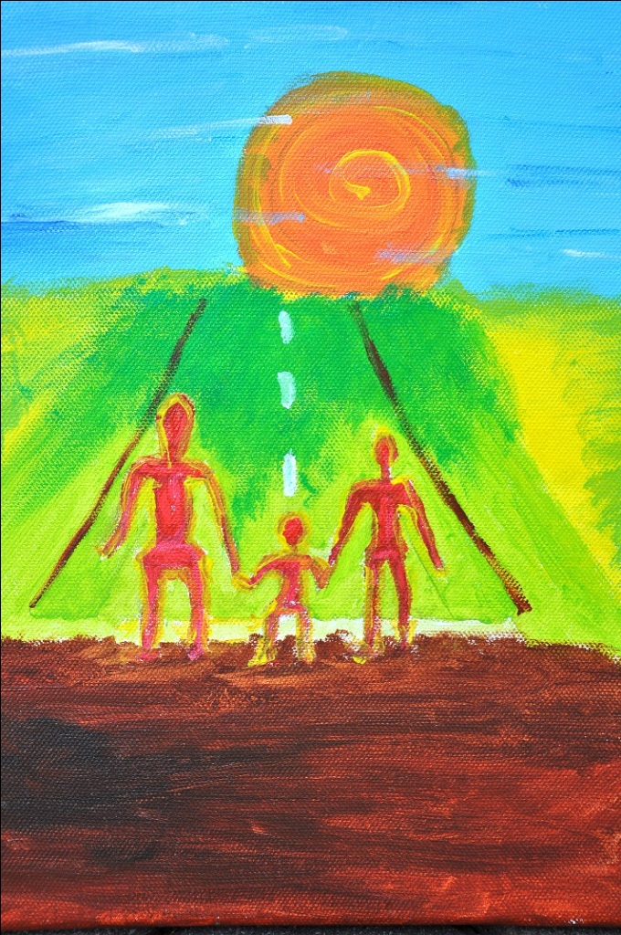
CONCLUSIONS
Pediatric HIV co-morbidities are
changing in the face of ART
Minimize by early treatment
More pediatric ARV with lower
risk of long-term toxicities
Monitoring and management
algorithms are urgently needed
My life
“ For my future, I would like to have family, house, rice farm and money which I earn for a living.”
“I am on the promising way of hope.”
Notes:
HIV comorbidities have change their faces after antiretroviral therapy.
I am optimistic that the HIV co-morbidities or non communicable diseases complications in children and adolescent will be manageable.
With earlier diagnosis and earlier ARV treatment: the incidence of HIV associated nephropathy, cardiomyopathy or severe malnutrition will reduce over time.
With low toxicity maintenance therapy or even pediatric remission in certain subgroup of patient. Will decrease co-morbidity
Meanwhile
Monitoring algorithm to triage high risk of comorditites – public health approach for resource limiting settings need to be developed urgently
Management to modify risk factors should be implement in adolescent and young adult before it is too late
Care provider and Service delivery system need to prepare capability and capacity to cope with this
I would like to end my talk that in the past 15 years we have come so far avert death in pediatric HIV --- I do believe that we will be able to do more and better
to ensure that they will have an opportunity to grow old and live their life normal as everyone here in this room.
We will do our best to make sure that this young man dream will come true “ For my future, I would like to have family, house, rice farm and money which I earn for a living.
I am on the promising way of hope.

Slide 23



Acknowledgements
Johns Hopkins Bloomberg School of Public Health
  Chris Beyrer Kenrad Nelson Andrea Ruff Craig Hendrix
Research Institute of Health Science, Chiang Mai University
Virat Sirisanthana Thira Sirisanthana
Linda Aurpibul Tavitiya Sudjaritrak
HIVNAT, Thai Red Cross AIDS Research Center
Praphan Phanuphak, Kiat ruxrungtham
Jintanat Ananworanich, Torsak Bunupuradah
Faculty of Medicine, Chulalongkorn University
Chitsanu Pancharoen, Suvaporn Anugulruengkitt
Special thanks for colleagues who support for presentation preparation
  Annette Sohn Carlo Quinto George Siberry Linda-Gail Bekker

