Slide 1
New Directions in the 2015 Consolidated ARV Guidelines Update Meg Doherty, MD, PhD, MPH 19 July 2015 WHO Satellite Vancouver – IAS 2015

Slide 2
Objectives of Presentation
2015 ARV Guidelines update - why now?
Overview of Evidence Base
New directions in guidance

Slide 3
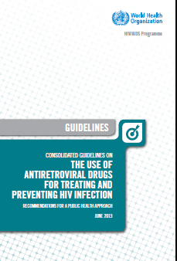
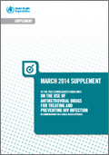
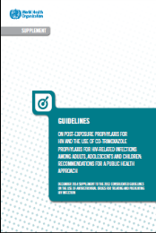
Why do we need 2015 ARV guidelines?
New Science
Early treatment trials starting to report (TEMPRANO, START)
Data on safety of key ARVs in specific populations
New Commodities
New ARVs at new doses & formulations (INI, low dose EFV, DVR/r FDC)
Treatment optimisation for children and adolescents (pellets, new strategies)
New Technologies
Balance of POC versus standard CD4, VL and EID platforms
Rethink Service Delivery Models
Preparation for greater numbers on ARV; improve linkage, referral, adherence approaches; Enhance efficiency and maintain quality

Slide 4
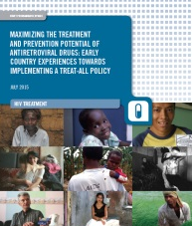
2015 ARV : Timeline
Evidence retrieval:
Systematic reviews
Values and preferences
Community consultations
Modelling
Dec 2014 – May 2015
Key recommendations
preview
July 19 2015
Launch Full Updated 2015 Consolidated ARV Guidelines
Dec 1 2015
Core group
July 23-24 2015
Supplement launch WAD
Dec 1 2014
GDG
Clinical/
Operational
June 1-5 2015
June 16-19 2015
Launch Interim Guidelines on when to start and pre-exposure prophylaxis
Sept -Oct 2015
Core group
Oct 20-21 2014
Sep
Oct
Jan
Oct
Apr
Jan
Dec
Nov
Feb
May
Mar
Jun
Aug
Jul
Sep
Nov
Dec

Slide 5
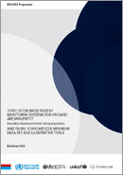
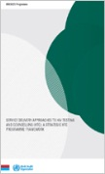
WHO Consolidated ARV Guidelines
WHAT TO DO?
When to start
What to use for children, adolescents, pregnant women
How to monitor
Co-infections
HIV and MH & NCDs
PrEP
Operational & Service Delivery
Clinical
HOW TO DO IT WELL?
Care Packages (Differentiated /Adaptive Care)
Linkages, Retention, Adherence
Quality of care
Diagnostics
Supply chain
Programmatic Prioritization
HOW TO DECIDE?
Approaches to prioritization & sequencing
Tool kits for country adaptation and implementation

Slide 6
2015 ARV Guidelines Process
SYSTEMATIC REVIEWS
GREY LITERATURE
2013
RECOMMENDATIONS
QUALITY
OF
EVIDENCE
MODELLING
(HIV MC, IeDEA)
QUALITATIVE DATA REVIEWS
SURVEY OF ARV & LAB USE
(AMDS, GARPr)
QUALITY (GNP+ FORUM)
VALUES
&
PREFERENCES
FEASIBILITY
&
COST
DRUG COSTING
(GPRM, AMDS)
COMMUNITY & HCW CONSULTATIONS
PROGRAMME MANAGERS SURVEY (KIT)
Notes:
The key elements of the WHO guidelines development process and in particular the development of recommendations involves a synthesis from three key areas the formal assessment of evidence and ranking of its quality based on systematic reviews; an assessment of feasibility and cost with modelling and costing models, and preferences and values from community or health care workers perspective
ADD in EXISTING GUIDELINES

Slide 7
Overview of when to start ART studies
1995-2005
2005-2010
2010-2013
2015
Several ACTG and CPCRA studies (early Post HAART Era): ART initiation CD4 < 200 cells/mm³ - Impact on AIDS mortality and major OIs incidence
TEMPRANO and START studies: (ART initiation at CD4 > 500 cells/mm³) impact on severe HIV morbidity & disease progression, without increase in severe adverse events
Observational studies (ART initiation at CD4 > 350 cells/mm³ ) impact on mortality, dz progression & non-AIDS events
CIPRA and SMART studies (ART initiation at CD4 ≤ 350 cells/mm³) Impact on HIV mortality, dz progression, & co-morbidities (TB)
HPTN 052: reduction of HIV transmission among HIV serodiscordant couples and risk of TB in adults (impact on HIV incidence)

Slide 8
ART eligibility: 5 policy scenarios
Estimated millions of people eligible for ART (2014)
30 m.
36.9 m.
1
2
3
4
5
CD4 ≤ 200
CD4 ≤ 350
CD4 ≤ 350
+ TasP
CD4 ≤ 500
All HIV+
Recommended
since 2003
Recommended
since 2010
Incremental approach 2012
+ indications for ART at any CD4
Treat ALL
2013 guidelines
2015 guidelines

Slide 9
Target population | WHAT IS EXPECTED IN 2015 ART GUIDELINES?
Adults | ART initiation at any CD4
 | As a priority, ART initiation if WHO clinical stage III/IV or CD4 ≤ 350
Pregnant/BF women | ARV initiation at any CD4 and continued lifelong (Option B+)
Adolescents (10-19 year old) | ART initiation at any CD4
 | As a priority, ART initiation if WHO clinical stage III/IV or CD4 ≤ 350
Children | ART initiation at any CD4 if 1-10 years-old
 | ART initiation at any CD4 if < 1 year-old
 | As a priority, ART initiation if < 2 years-old or WHO clinical stage III/IV or CD4 < 25% (< 5 years) or ≤ 350 (>5 years)
NEW
REVISED
DIRECTIONS IN WHEN TO START
NEW
DRAFT
NEW

Slide 10
Evidence Summary: When to Start in Adults
Systematic Review of 18 eligible studies (1 RCT and 17 observational cohorts )
Some observational studies reported results from a single cohort (6 studies)
Outcomes reported:
WHEN TO START - EVIDENCE
Mortality
Severe HIV disease
HIV disease progression
AIDS events
Non-AIDS events
Malignancy ( AIDS and non AIDS)
Tuberculosis
HIV transmission
SAE and lab abnormalities
Severe HIV disease or malignancy or mortality (combined outcome)

Slide 11
Evidence Summary: Risk of death, severe HIV disease or HIV disease progression
Clinical trials
Evidence for lower risk of death, severe HIV disease or malignancy compared to those deferring treatment (1 study TEMPRANO)
WHEN TO START - EVIDENCE
Observational studies
Evidence for lower risk of death or progression to AIDS compared to those deferring treatment (2 studies)
CI confidence interval; df, degrees of freedom; IV, inverse variance; RCT, randomised controlled trial

Slide 12
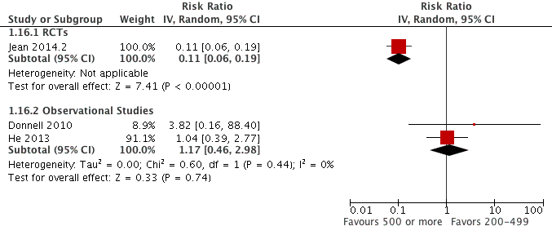
Evidence Summary: Risk of HIV transmission
Clinical Trial (1 RCT)
Evidence for lower risk of HIV transmission compared to those deferring treatment
WHEN TO START - EVIDENCE
Observational studies
Evidence for no significant difference in the risk of HIV transmission between early vs deferred treatment (2 studies)
CI confidence interval; IV, inverse variance; RCT, randomised controlled trial

Slide 13
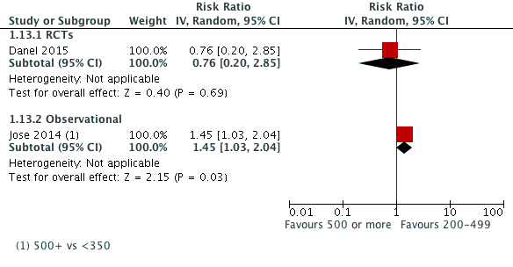
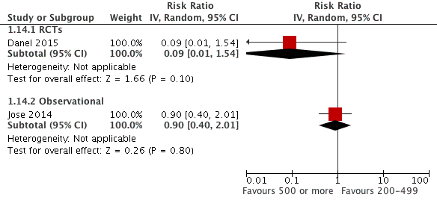
Evidence Summary: Risk of Hepatic & Renal SAE or any grade III/IV SAE
Clinical trial
no increased risk of hepatic and renal SAE between early vs deferred treatment (1 study)
Hepatic SAE
Observational studies
increased risk of hepatic SAE compared to those deferring treatment but no increased risk for renal SAE (1 study)
WHEN TO START EVIDENCE
Renal SAE
Combined
No increased risk of any grade 3 / 4 SAE between early and deferring treatment (2 studies)
Grade 3 / 4 SAEs
CI confidence interval; IV, inverse variance; RCT, randomised controlled trial

Slide 14
When to Start in Adults: Evidence Summary
Systematic review on when to start ART in asymptomatic PLHIV found 1 RCT and 17 cohorts or meta-analyses of cohorts reporting on 8 separate outcomes in patients with <500 CD4 and ≥500 CD4 cells/µL
Clinical benefits of ART initiation over 500 CD4 to all PLHIV compared with < 500 CD4 initiation,
with reduction of severe HIV morbidity, HIV disease progression and HIV transmission,
without increase in grade III/IV adverse events.
WHEN TO START - EVIDENCE

Slide 15
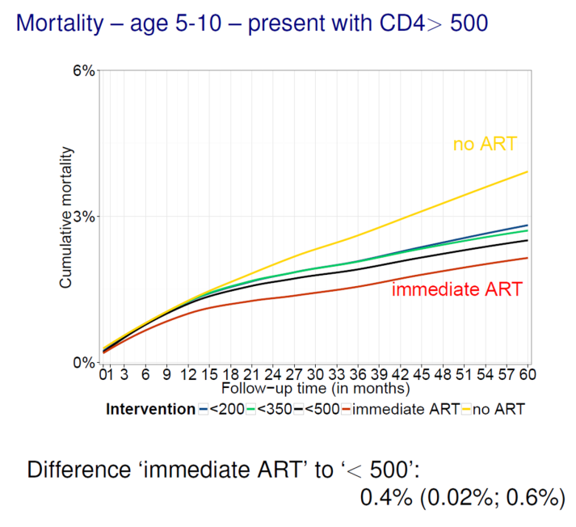
Evidence for Children & Adolescents
Lack of direct evidence in support of earlier initiation (particularly for horizontally infected adolescents)¹
Indirect evidence suggests reduction in mortality and improvement in growth (particularly in children 5-10 years with CD4 >500)²
A growing body of evidence demonstrates the positive impact of ART on growth³, neurodevelopment⁴, immunological recovery⁵ and in preventing pubertal delays⁶
Gains appear to be limited for vertically infected adolescents^{2,5}
WHEN TO START - EVIDENCE
References:
1. Sigfried et al 2014
2. IeDea network 2015
3. McGrath et al 2011
4. Laughton et al 2012
5. Picat et al 2013
6. Szubert et al 2015

Slide 16
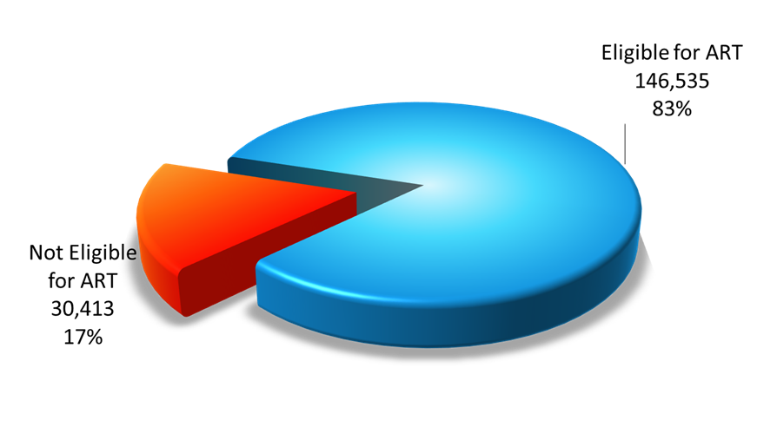
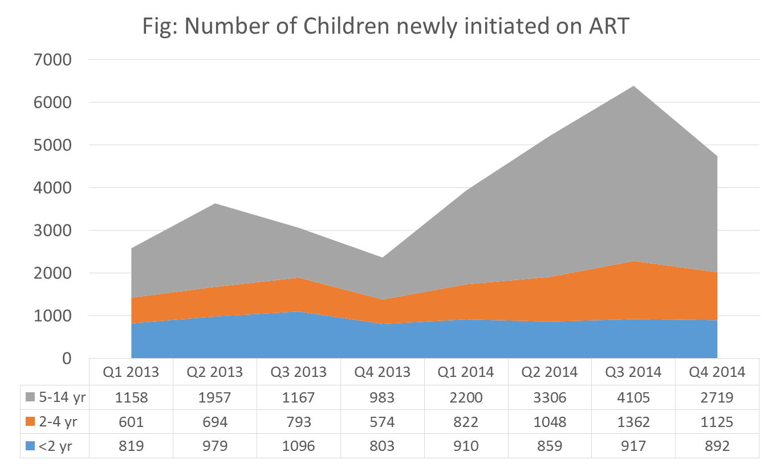
Programmatic Rationale Children and Adolescents
Only ~20% are not eligible based on existing criteria
Eliminates the need for determining CD4 count to initiate ART
Avoids delaying ART in settings without access to CD4 testing.
Simplifies paediatric treatment and facilitate expansion of paediatric ART (task-shifting and decentralization)
Improves retention in care compared to pre-ART
WHEN TO START - EVIDENCE
Need adherence support (particularly in adolescents), careful planning, strengthening laboratory services and improvement of procurements and supply of key commodities
Source: Uganda National programme - Rapid assessment May 2015

Slide 17
Community – led Global Consultation:
AFROCAB
Acceptability of Earlier Initiation of ART
24 workshops, 8 countries, 8 sub populations, 206 people living with HIV, 74 service providers.
Earlier initiation was deemed acceptable, specific considerations were highlighted
Collaborative decision-making with the ultimate decision to initiate ART being client-driven
The requirement for comprehensive and accurate information to ensure an informed decision as well as readiness
Initiating ART is relatively easy however maintaining adherence is challenging
Stigma and discrimination were uniformly raised as fundamental concerns by all and seen to constrain treatment access and adherence
ACCEPTABILITY
Notes:
Apart of a renewed focus on acceptability – a community led consultation was undertaken on 2 critical question with minimal published acceptability literature
Countries included: Zambia, Kenya, India, Indonesia, Portugal, Ukraine, Peru and Zimbabwe
These included: Adolescents/Young people, Adults, Parents/Caregivers, People who use drugs, Sex Workers, Men who have Sex with Men, Transgender persons and Service Providers.
Findings were presented to the guideline development group in June 2015 to inform acceptability consideration in the decision making process.

Slide 18
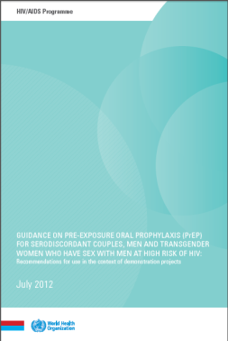
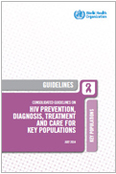
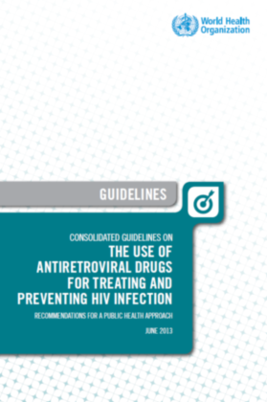
WHO guidance on PrEP: 2012 ─ 2015
2012
Guidance for MSM & Serodiscordant Couples in the context of demonstration projects to encourage countries to conduct such demonstration projects
2014
Consolidated Key Populations Guidelines - Recommendation for MSM
Among men who have sex with men, PrEP is recommended as an additional HIV prevention choice within a comprehensive HIV prevention package
2015
Oral PrEP (containing TDF) should be offered as an additional prevention choice for people at substantial risk of HIV infection as part of combination prevention approaches
Not population specific
Significant HIV risk means HIV incidence > 3 per 100 py

Slide 19
Overall evidence for PrEP: July 2015
Study
Effect size (CI)
IPERGAY – on demand Truvada
(MSM – France & Canada)
86% (39; 99)
PROUD – daily oral Truvada
(MSM – United Kingdom)
86% (62; 96)
Partners PrEP – daily Truvada
(Discordant couples – Kenya, Uganda)
75% (55; 87)
Partners PrEP – daily oral Tenofovir
(Discordant couples – Kenya, Uganda)
67% (44; 81)
Oral PrEP
TDF2 – daily Truvada
(Heterosexuals men and women- Botswana)
62% (22; 84)
iPrEx – daily Truvada
(MSM - America’s, Thailand, South Africa)
44% (15; 63)
FEMPrEP – daily Truvada
(Women – Kenya, South Africa, Tanzania)
6% (-52; 41)
MTN003/VOICE – daily Truvada
(Women – South Africa, Uganda, Zimbabwe)
-4% (-49; 27)
MTN003/VOICE – daily Viread
(Women - South Africa, Uganda, Zimbabwe)
-49% (-129; 3)
CAPRISA 004 – coital Tenofovir gel
(Women – South Africa)
39% (6; 60)
Topical PrEP
MTN003/VOICE – daily Tenofovir gel
(Women – South Africa, Uganda, Zimbabwe)
15% (-21; 40)
FACTS 001– coital Tenofovir gel
(Women – South Africa)
0% (-40, 30)
 |  |  |  |  |  | -130 |  | -60 |  | -40 |  | -20 |  | 0 |  | 20 |  | 40 |  | 60 |  | 80 |  | 100
Effectiveness (%)

Slide 20
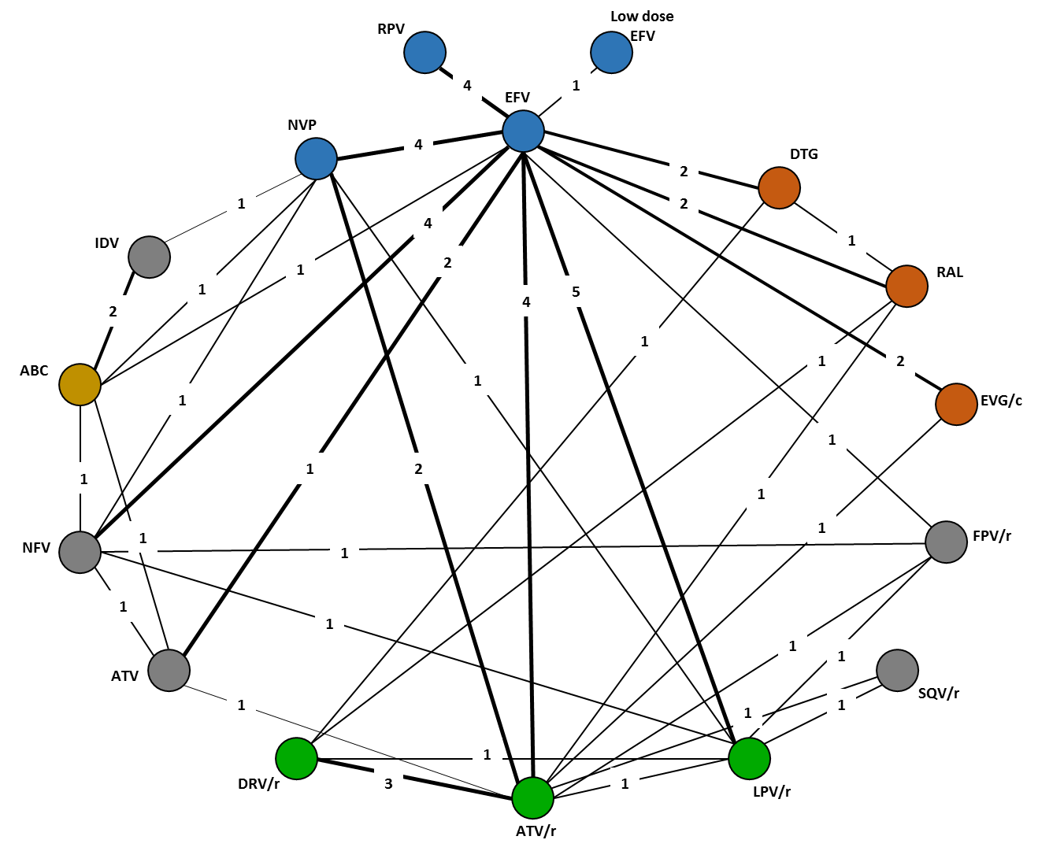
What to use in first line ARV Therapy
systematic review using a comparative pairwise and network meta-analysis evaluated 76 trials for direct and indirect evidence
35,270 patients randomized to 171 treatment arms
Direct evidence for comparative efficacy and safety of INSTIs compared to EFV was obtained from 6 RCTs
SINGLE, PROTOCOL 004, GS 102 study, GS 104 study, SPRING-1 and STARTMRK.
The evidence on low dose EFV (EFV 400) came from ENCORE 1.
Edward Mills, Steve Kanters, M. Eugenia Socias, For WHO ARV GDG, June 1-5 2015

Slide 21
Directions of the Systematic Review
Edward Mills, Steve Kanters, M. Eugenia Socias, For WHO ARV GDG, June 1-5 2015
All treatment regimens are comparable with respect to mortality or AIDS defining illnesses.
Evidence that DTG and EFV400 superior with respect CD4 recovery at 24, 48 and 96 weeks
INSTIs (DTG > RAL) are more effective than EFV and other regimens for viral suppression at 24, 48 and 96 weeks.
All treatments tend to be comparable in terms of emergent serious adverse events, with exception of NVP (elevated risk)
Limitation: Minimal data on DTG + TDF + XTC (SPRING-2)
Notes:
The systematic review using a comparative pairwise and network meta-analysis evaluated 76 trials for direct and indirect evidence (35,270 patients randomized to 171 treatment arms)
Direct evidence for comparative efficacy and safety of INSTIs compared to EFV was obtained from 6 RCTs
SINGLE, PROTOCOL 004, GS 102 study, GS 104 study, SPRING-1 and STARTMRK.
The evidence on low dose EFV (EFV 400) came from ENCORE 1.
A total of 14 ‘endonodal’ trials were included as well as 19 trials with differences in backbones

Slide 22
What will be new in the 2015 ARV guidelines?
Treat all (at any CD4) - people living with HIV across all ages
The sickest remain a priority (symptomatic disease and CD4< 350)
New age band for Adolescents (age 10-19)
Option B not taken forward; Option B+ as the new standard
Placement of INSTIs (DTG) and dose reduction options in 1st and 2nd line therapy
PrEP recommended as an additional prevention choice for all people at substantial risk of HIV infection (> 3% incidence)

Slide 23
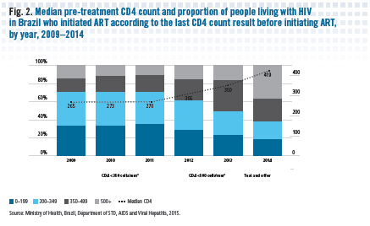
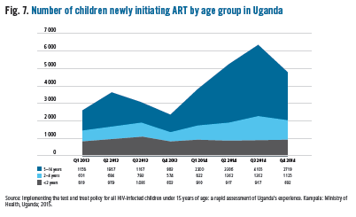
Countries are leading the way
Examples from five countries implementing Treat All or Treating All in specific populations:
Uganda started to treat all children < 15 years in 2014
Seen increase in overall number children on ART
Retention at 12 m similar; VLS = 84%
Brazil has been treating all for one year
Leading to increase in median CD4 at ART initiation (265 to 419)
Similar retention and VLS at 12 months (81% for CD4 > 500)

Slide 24
Acknowledgements
Special thanks to all the external experts who contributed as members of the Guideline Development Groups, and to those who contributed to the GRADE systematic reviews and supporting evidence which informed the guidelines process.
Core Group Co-Chairs
Wafaa El-Sadr (ICAP and Columbia University;USA)
Yogan Pillay (SA MoH)
Guideline Development Group
Co-Chairs
Elaine Abrams (ICAP, and Columbia University, USA)
Serge Eholie (ANEPA/Treichville Hospital, Abidjan, Côte d’Ivoire)
Anthony Harries (the Union; UK)
Fabio Mesquita (Brazil MOH)
WHO Department
Gottfried Hirnschall
Andrew Ball
Rachel Baggaley
Rachel Beanland
Marco Vitoria
Martina Penazzato
Shaffiq Essajee
Nathan Ford
Eyerusalem Kebede Negussie
Alice Armstrong
Francoise Renaud
Bob Grant (consultant)
Michelle Rodolph
Annabel Baddeley, Alberto Mattelli,
Haile Getahun
Other Contributors
Temprano, START research teams
The University of California, San Francisco University of Basel
Global Evaluation Service (GES)
The HIV Modelling Consortium
AFROCAB, APN+, AHF Ukraine, ICW, Vialibre, Pangaea
The Global Network of People living with HIV/AIDS
Avenir Health
CDC
PEPFAR
Bill and Melinda Gates Foundation
Notes:
And finally with thanks to colleagues and co-chairs of the GDGS, WHO staff, and external partners for systematic reviews, community consultations, modelling

Slide 25
WHO ARV Guidelines Evolution 2002 to 2015
Topic | 2002 | 2003 | 2006 | 2010 | 2013 | 2015
When to start | CD4 ≤200 | CD4 ≤ 200 | CD4 ≤ 200 Consider 350 - CD4 ≤ 350 for TB | CD4 ≤ 350 -Regardless CD4 for TB and HBV | CD4 ≤ 500 - Regardless CD4 for TB, HBV PW and SDC - CD4 ≤ 350 as priority | Towards Treat All Adolescents age band
1st Line ART | 8 options - AZT preferred | 4 options - AZT preferred | 8 options - AZT or TDF preferred - d4T dose reduction | 6 options & FDCs - AZT or TDF preferred - d4T phase out | 1 preferred option & FDCs TDF and EFV preferred across all pops | Continue with FDC and harmonization across age bands
2nd Line ART | Boosted and non-boosted PIs | Boosted PIs -IDV/r LPV/r, SQV/r | Boosted PI - ATV/r, DRV/r, FPV/r LPV/r, SQV/r | Boosted PI - Heat stable FDC: ATV/r, LPV/r | Boosted PIs Heat stable FDC: ATV/r, LPV/r | Greater number of options
3rd Line ART | None | None | None | DRV/r, RAL, ETV | DRV/r, RAL, ETV | Encourage HIV DR to guide
Viral Load Testing | No | No (Desirable) | Yes (Tertiary centers) | Yes (Phase in approach) | Yes (preferred for monitoring, use of PoC, DBS) | Support for scale up of VL using all technologies
Earlier initiation
Simpler treatment
Less toxic, more robust regimens
Better and simpler monitoringz

