Slide 1
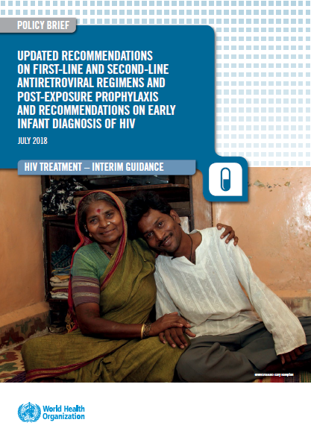



Updated WHO Treatment Guidelines &
Data from other cohorts and regions to guide decisions around the use of DTG
Meg Doherty MD MPH PhD
24 July 2018
WHO HQ

Slide 2
New findings informed DTG safety profile among women of child bearing potential
NIH‐funded study identified a potential safety concern and reported it to the World Health Organization (WHO) and ViiV Healthcare.
Observational study in Botswana, found 4 cases of neural tube defects out of 426 women who became pregnant while taking DTG.
This rate of approximately 0.9% compares to a 0.1% risk of neural tube defects in infants born to women taking other antiretroviral medicines at the time of conception.

Slide 3
Drug Safety Alert vs. Policy Guidelines
DOCUMENT | CARACTHERITICS | EXAMPLES
DRUG SAFETY ALERTS | Drug centered, more restrictive, consider major clinical scenarios | WHO (EMP), FDA, EMA, PEPFAR, SAHCS, ViiV, Brazilian MoH
GUIDELINES | Patient centered, consider a clinical and programmatic aspects in decision making | WHO (HIV), CDC, DHHS, BHIVA

Slide 4
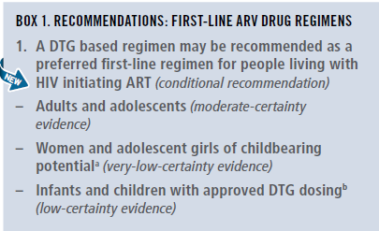
New recommendations first-line ARV regimens

Slide 5
Safety and Efficacy of DTG and EFV600 in 1st line ART
(summary 2018 WHO Sys Review & NMA)
major outcomes | DTG vs EFV₆₀₀ | _{QUALITY OF EVIDENCE}
Viral suppression (96 weeks) | DTG better | moderate
Treatment discontinuation | DTG better | high
CD4 recovery (96 weeks) | DTG better | moderate
Mortality | comparable | low
AIDS progression | comparable | low
SAE | comparable | low
Reference: Steve Kanters, For WHO ARV GDG, 16-18 May 2018
WHO, 2018
Notes:
Evidence: The NMA showed that DTG, was superior to EFV in terms of viral suppression, CD4 recovery and treatment discontinuation. EFV400 was better than EFV 600 in terms of CD4 recovery and treatment discontinuation, but comparable in terms of viral supression. DTG was betetr than EFV400 in terms of viral suppression and treatment discontinuation. All regimens were comparable in terms of mortality, disease progression and occurrence of SAE. The quality for this evidence was rated according GRADE methodology.
Research gaps: There are concerns on NTD potential risk with DTG if used in the early pregnancy and during the preconception period.

Slide 6
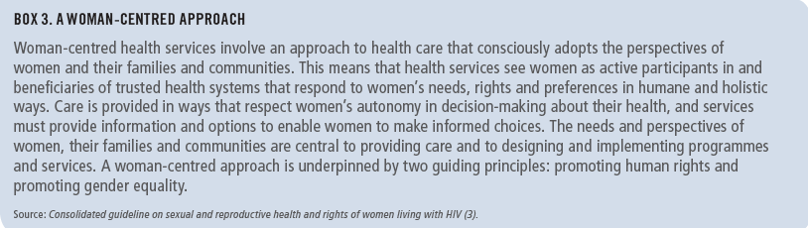
Note of caution for using DTG in women and adolescent girls of childbearing potential
Exposure to DTG at the time of conception may be associated with NTD risk among infants.
DTG appears to be safe when started after the period of risk of neural tube defects (ie, up to 8 weeks after conception).
Adolescent girls and women of childbearing potential who do not currently want to become pregnant can receive DTG together with consistent contraception (hormonal contraception and DTG have no reported or expected drug–drug interactions).
An EFV-based regimen is a safe and effective first-line regimen and can be used among women of childbearing potential during the period of potential risk for developing NTDs.
National programmes should consider the balance of benefits and risks when selecting the optimal ARV regimen for women and adolescent girls of childbearing potential (fertility levels, contraceptive availability and coverage, pretreatment resistance to NNRTIs at the population level, drug availability and the maternal and infant toxicity profile).

Slide 7
DTG 50 mg BID with rifampicin resulted in DTG concentrations similar to DTG 50 mg QD
DTG 50 mg QD
DTG 50 mg BID
DTG 50 mg BID + rifampicin 600 mg QD
7
6
5
4
DTG concentration (µg/mL)
n=11
3
2
1
0
0 4 8 12 16 20 24
Time (hours)
There were no discontinuations from AEs and no Grade ≥3 clinical or laboratory events
*For BID dosing, simulations of the concentrations
after a second dose are provided (dashed lines in figure)
Dooley KE et al. J Acquir Immune Defic Syndr 2013;62:21−27

Slide 8
WHO 2018 recommendations for first-line
Population | Preferred | Alternatives | Special situations
Adult men and adolescent boys | TLDª | TLE600 TLE400 | AZT+3TC+ EFV600^{b} TDF+3TC (or FTC)+PI/r^{c}
Pregnant (from eight weeks after conception) and breastfeeding women and adolescent girls
Women and adolescent girls with effective contraception or not of childbearing potential
Women and adolescent girls of childbearing potential who want to become pregnant and have no effective contraception | TLE600 | TLE400 TDF+3TC (or FTC)+PI/r^{c} | AZT+3TC+ EFV600^{b} TDF+3TC (or FTC)+ RAL
In PLHIV with TB using rifampicin, the dose of DTG needs to be increased to 50 mg twice daily.
NVP may be used in special circumstances where alternative options are not available.
If national prevalence of EFV pretreatment drug resistance exceeds 10% or if no other alternatives are available.
TLD = TDF + 3TC + DTG
TLE = TDF + 3TC (or FTC) + EFV
Notes:
TDF & XTC are currently recommended as the preferred NRTI backbone for ART initiation
Large clinical evidence and programmatic advantages support the use of DTG as preferred 1st line option for all adults and adolescents with HIV , including women and adolescents girls using consistent and reliable contraception.
Concerns regarding safety of DTG use during periconception period were recently identified, but are based on limited data and has been closely investigated by WHO and other partners.

Slide 9
Preferred and alternative second-line ART regimens for TB and HBV co-infections
Population | Preferred second-line regimen
HIV and TB coinfection | If using rifampicin in TB regimen | Optimized NRTI backbone plus double-dose DTG (that is, DTG 50 mg twice daily) or double-dose LPV/r (that is, LPV/r 800 mg/200 mg twice daily)^{acd}
 | If using rifabutin in TB regimen | Optimized NRTI backbone plus DTG or boosted PI-containing regimens at standard doses ^{ac}
HIV and HBV coinfection | AZT + TDF + 3TC (or FTC) + (DTG or ATV/r or LPV/r) ^{bd}
a If TDF + 3TC (or FTC) was used as the NRTI backbone in the 1st line failing regimen, AZT+3TC should be used in 2nd line and vice-versa.
b DRV/r can be used as an alternative PI option.
c In childbearing age women an adolescent girls, DTG can be used if she is on reliable contraception and fully informed and benefit outweighs the risk.
d Standard LPV dose with an adjusted dose of RTV (that is, LPV400mg/ RTV 400mg twice daily) can be used as alternative options.

Slide 10
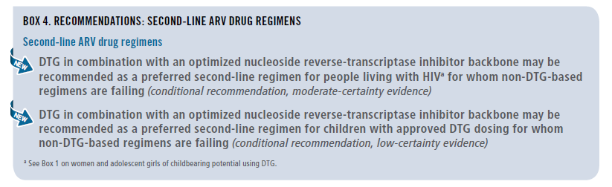
2018 WHO RECOMMENDATIONS: SECOND-LINE ARV DRUG REGIMENS

Slide 11
Preferred and alternative second-line ART regimens for adults, and adolescents (including pregnant / breastfeeding women)
Population | Failing first-line regimen | Preferred second-line regimen | Alternative second-line regimens
Adults and adolescentsª | 2 NRTIs + DTGª | 2 NRTIs^{b} + (ATV/r or LPV/r) | 2 NRTIs^{b} + DRV/r^{b,c}
 | 2 NRTIs^{b} + EFV (or NVP) | 2 NRTIs^{b} + DTG ^{a,b} | 2 NRTIs^{b} + (ATV/r or LPV/r or DRV/r^{c,d})
ª DTG can be offered to women receiving reliable contraception and who are fully informed of the benefits and risks, including the potential risk of neural tube defects (see Box 1 and the section on safety concern about DTG for women and adolescent girls of childbearing potential).
^{b} If ABC + 3TC or TDF + 3TC (or FTC) was used in the failing first-line regimen, AZT + 3TC should be used in second-line ART and vice versa.
^{c} RAL + LPV/r can be used as an alternative second-line regimen for adults and adolescents.
^{d} DRV/r can be used as an alternative PI option.

Slide 12
Sequencing options for preferred first-, second- and third-line ART regimens in adults and adolescents (including pregnant women and women childbearing potential)
Population | 1st line regimens | 2nd line regimens | 3rd line regimens
Adults and adolescents (including pregnant and women of childbearing potential)ª | 2 NRTIs + DTG ^{b} | 2 NRTIs + (ATV/r or LPV/r) | DRV/r ^{e f} + DTG ^{g} ± 1-2 NRTIs (where possible consider optimization using genotyping)
 | 2 NRTIs + EFV | 2 NRTIs + DTG ^{b}
 | 2 NRTIs + LPV/r | 2 NRTIs + DTG ^{c}
 | 2 NRTIs + EFV | 2 NRTIs + DTG ^{d}
a Optimized NRTI backbone should be used: AZT following TDF or ABC failure, and vice-versa.
b In childbearing age women an adolescent girls, DTG can be used in those on reliable contraception and fully informed and benefit outweighs the risk.
c This applies to children for whom approved DTG dosing is available. RAL should remain the preferred 2nd line for those children for whom approved DTG is not available.
d ATV/r or LPV/r should remain the preferred 2nd line for those children for whom approved DTG is not available. This applies to children for whom approved DTG dosing is available.
e In PI-experienced patients, the recommended DRV/r dose should be 600mg/100 mg twice daily.
f DRV/r should not be used in children younger than three years of age.
g DTG based 3rd line following use of INSTI must be administered with DTG BD.

Slide 13
Approach to use of DTG across different guidelines making bodies
ART history | Clinical scenarios | DHHS | BHIVA | WHO
ART naive or on using a non-DTG containing regimen | Early pregnancy
 | Late pregnancy
 | Childbearing age potential, not using contraception
 | Childbearing age potential, using effective/consistent contraception
On DTG containing regimen | Early pregnancy
 | Late pregnancy
 | Childbearing age potential , not using contraception
 | Childbearing age potential, using contraception
* The definition of early pregnancy period varies in different guidelines. DHHS: < 8 weeks from LMP; BHIVA : 1st trimester; WHO: < up to 8 weeks from conception.
Do not initiate DTG/ switch to other effective options
Initiate /continue to DTG or switch to other effective options
initiate/ switch to DTG

Slide 16
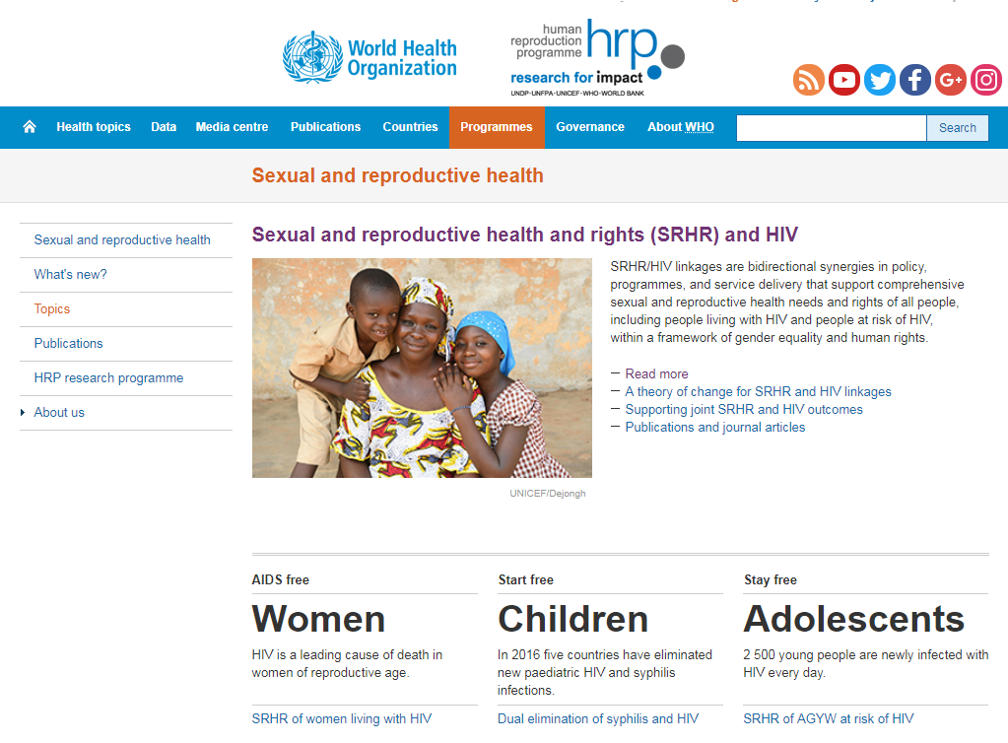
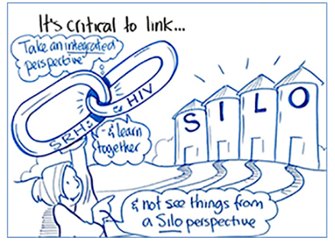
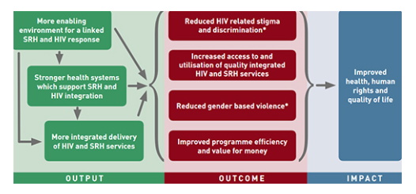
Programmes should strengthen the integration of sexual and reproductive health services within HIV treatment programmes to ensure reliable and consistent access to contraception for women and adolescent girls living with HIV.

Slide 17

Types of Data available
Data from Pharmacovigilence databases
  APR, ,EMA, FDA, WHO VigiBase, WHO/TDR Global repository PV data
Trial Data
Basic Science
Country policy & programmatic data
  Retrospective Cohort
  Prospective data from active surveillance

Slide 18
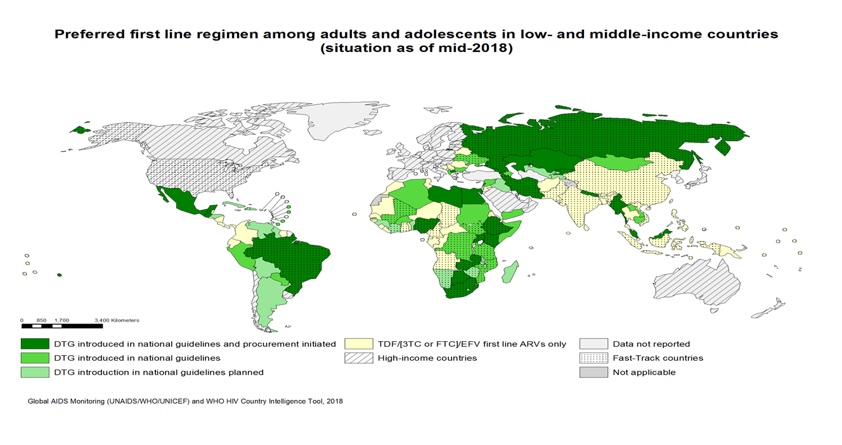
DTG uptake by countries
By July 2018, 71 LMICs (51%) informed that have included or are planning to include DTG in their national guidelines :
  DTG introduced in national guidelines: 26
  DTG introduced in national guidelines and procurement initiated: 24
  DTG introduction in national guidelines planned : 21
Approximately 500 000 PLHIV are using DTG globally
* preliminary data

Slide 19
Botswana, Brazil and Kenya have adopted DTG as preferred 1st line option and have implemented a programmatic transition to DTG
Country | Transition start | PLHIV on DTG | M/F ratio | DTG eligibility criteria |  |  |  |  |  |  |  |  | % of reported DTG adverse events | Major DTG AEs reported (top 3) | DTG monitoring tools |  |  | Use of VL for DTG substitution
 |  |  |  | ART naive | NNRTI intolerance | Stable on ART non EFV regimens | Stable on ART EFV regimen | PW | TB | 2nd line | 3rd line | PEP
 |  |  |  |  |  |  |  |  |  |  |  |  |  |  | Toxicity (PV) | APR | HIVDR
Botswana | May 2016 | 57,000 | 40/60 | ✓ | ✓ | ✗ | ✗ | ✓ | ✓ | ✓ | ✓ | ✓ | 1% | GI symptoms Skin reactions Insomnia | ✗ | ✓ | ✓ | ✓
Brazil | Jan 2017 | 100,000 | 70/30 | ✓ | ✓ | ✓ | ✓ | ✗ | ✗ | ✗ | ✓ | ✗ | 2% | GI symptoms Skin reactions Insomnia | ✓ | ✓ | ✓ | ✓
Kenya | July 2017 | 15,000 | 25/75 | ✗ | ✓ | ✓ | ✗ | ✓ | ✓ | ✗ | ✓ | ✗ | 7% | Headache Abnormal dreams Insomnia | ✓ | ✗ | ✗ | ✓
Source: MoH Botswana, Brazil & Kenya, 2018

Slide 20

DTG transition as 1st line: plans and guidance revision
Information received from 56 Countries
DTG 1st line already rolled out
8 countries
GL revised
5 Countries
GL revision Planned
1 Country
Not DTG as 1st line
22 countries
DTG 1st line Planned
26 countries
No information on revision plan
2 Countries
GL revised
7 Countries
GL revision On-going/Planned
7 Countries
GL revision on hold
5 countries
No information on revision plans
7 Countries
GL: guidelines

Slide 21
Countries Guidance revision on DTG 1st line: WLHIV initiating DTF based regimen
Results from in country discussion on use DTG among Women Child Bearing age (WCAB) in countries that have already revised the GL and with on-going GL revision (17 countries)
WLHIV
WCBA*
PW
ANY contraception→ DTG
No contraception→ NO- DTG
Counselling on risk/benefit and on contraception
a) DTG
b) Preferred NO-DTG but informed choice allowed
All PW →
NO-DTG based regimen
PW identified within 8wk or 1st trim → NO-DTG
PW identified later (>2nd trim) → DTG based regimen
All WCBA
NO-DTG based regimen
Long term contraception→ DTG
No contraception→ NO- DTG
3 countries
13 countries
a) 1 country**
b) 1 country
2 countries**
6 Countries**
7 countries
Preferred NO-DTG based but informed choice allowed
1 country
*Several countries defined WCBA as women 10-49 years old or in pre-menopausal period
** 6 countries recommend Pregnancy test to be performed before starting WCBA on DTG based regimen

Slide 22
Country Challenges post Alert
Contraception:
  Definition of “consistent” or “long term” contraception
  Injectable method have not be considered long term methods in most of the countries
Pregnant women:
  Difficulty to correctly dating the pregnancy in the first trimester
  If using DTG during pregnancy and switching afterwards how to ensure that the switching happen before new pregnancy
  Most countries chose EFV for PW: what about women identified late in pregnancy when DTG could give the higher benefit?
Adolescents girls:
  Group with higher risk of low adherence and low viral suppression
  Group at higher risk of unplanned pregnancies and lower uptake of contraception

Slide 23
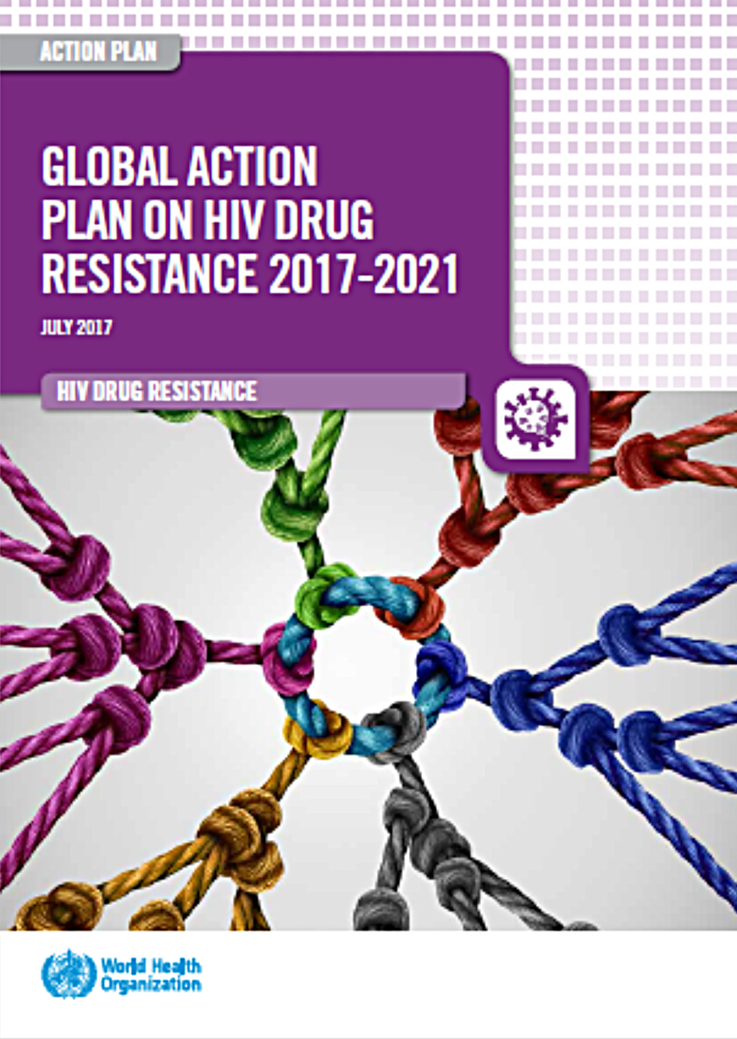
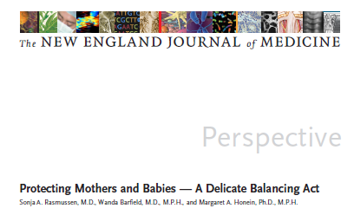
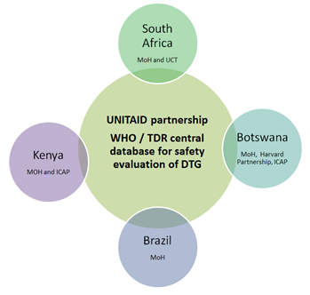
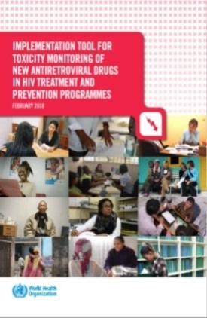
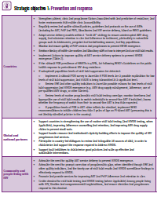
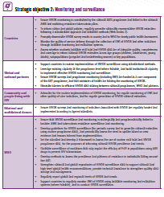
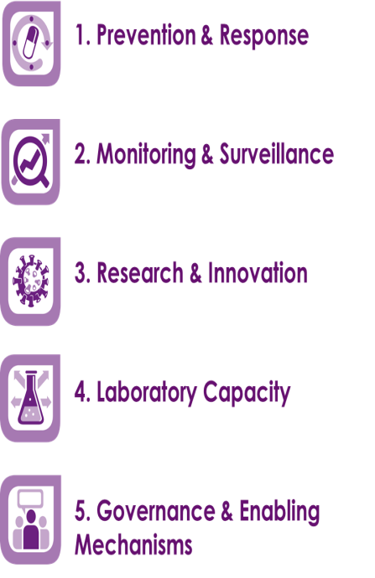
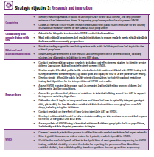
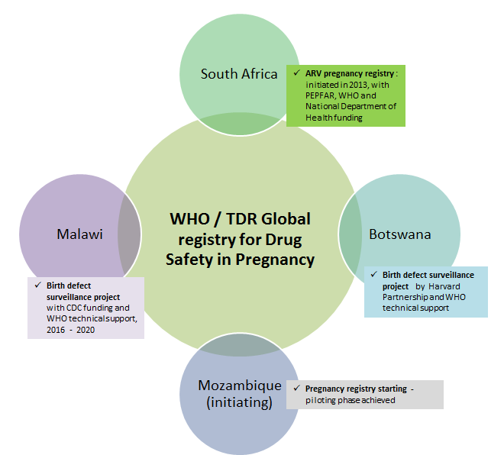
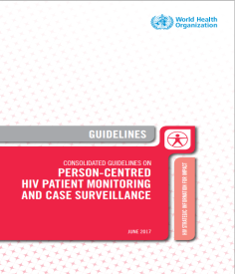
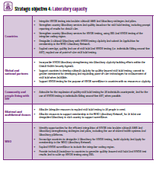
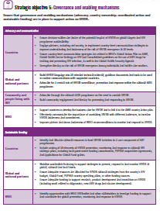
WHO technical support for HIVDR and toxicity monitoring and safe introduction of DTG and other new ARVs
Global Action Plan on HIVDR (2017-2022)
WHO ARV toxicity monitoring implementation tool and training materials
Central DTG toxicity database
Strengthening routine toxicity monitoring via HIV patient monitoring system
Surveillance of drug safety in pregnancy

Slide 24
Timeline to review future data
2018-2019
2018
April
May
June
July
August
September
October
November
December
2019
January
February
March
April
May
18 May WHO DTG safety alert
AIDS 2018
Discussion s
Systematic reviews; review of data with FDA, EMA, APR, ViiV
Global & country discussions, IAS/WHO Meeting
Iterative review by WHO technical and Safety Groups, ASCoMP and partners
GDG Meeting 16-18 May
GDG Meeting TBD
Webex to Countries and to partners
Re-review of guidance
Interim guidance

Slide 25
Conclusions
Faced with an unexpected signal of risk in a high value and much anticipated ARV
WHO along with other regulatory issued drug safety warnings
DTG can be used and WHO emphasizes that women and adolescents of child bearing potential will need informed choices; and use DTG with consistent and reliable contraception
Communities need to be at the table to discuss policy translation at country level
Silver lining is an opportunity for integration and real linkages between HIV and SHR; FP choices need to be available in HIV clinics
WHO with partners committed to collecting and reviewing all data as becomes available to inform and update guidelines

Slide 26

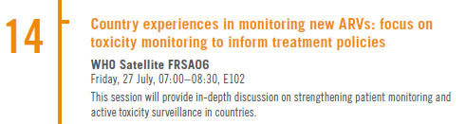
Join us on Friday @ AIDS 2018

Slide 27
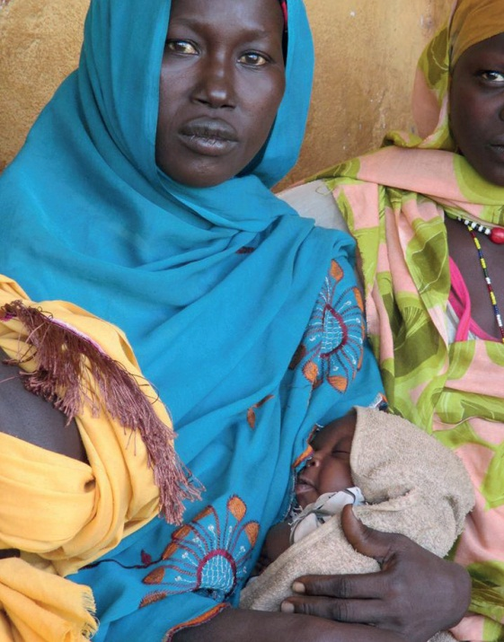
Acknowledgements
Guidelines Development Group members
Lynne Mofenson
Rebecca Zash
WHO Treatment and Care team
Marco Vitoria
Martina Penazzato
Serena Brusamento
Chantal Migone
Nathan Ford
Lara Vojnov
Silvia Bertagnolio
Vindi Singh
Ajay Rangaraj
Anisa Ghadrshenasa
Systematic Review Teams
External Review Group
PEPFAR, Global Fund, Gates, CDC, USAID
ICW, GPN+, APN+, ITPC

