Slide 1
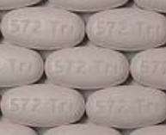
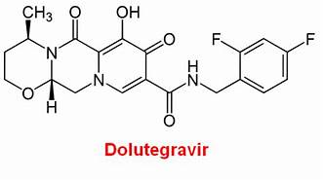
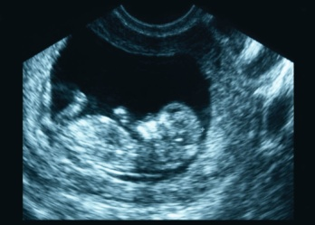
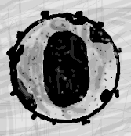
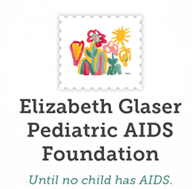

Session - Safety of DTG in Pregnancy: Late Breaking Findings, Interpretations, Implications
July 24 2018
Overview on Safety of HIV Treatment in Pregnancy
Lynne M. Mofenson MD
Senior HIV Technical Advisor
Elizabeth Glaser Pediatric AIDS Foundation

Slide 2
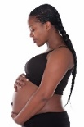


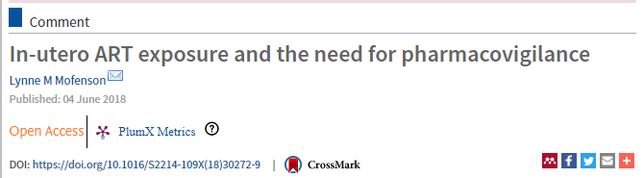

HIV, Pregnancy and ART
HIV is associated with significant morbidity/mortality for the pregnant woman and her fetus/infant – treatment is required for both maternal health and to prevent MTCT
Only limited data on ARVs in pregnancy/lactation; of the 31 approved ARVs, mean lag between approval→any pregnancy data is 5 years (no data 3/7 drugs approved since 2010)
Big unknowns, particularly for newer drugs:
  Pharmacokinetics and safety in pregnancy (and lactation)
  Fetal/infant safety
Unanticipated findings with preconception DTG demonstrate importance of pharmacovigilance when new drugs introduced into adult population

Slide 3
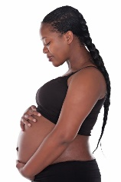

ARVs and Pregnancy
What can we learn from preclinical studies?
Are there differences in pregnancy outcomes between ART regimens?
Why is timing of exposure - critical and often neglected variable - important?
Do birth outcomes vary by timing of ART start?
Are there differences in DTG and EFV started during pregnancy?
Evaluation of safety re: birth defects

Slide 4
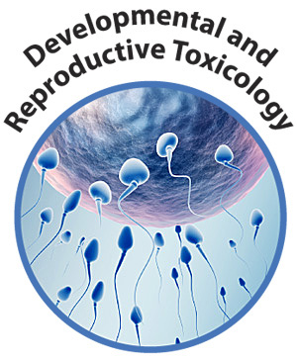

What Can We Learn From
Pre-Clinical Reproductive Toxicology Studies

Slide 5

What is Predictive Value of Pre-Clinical
Animal Studies?
The molecular basis of birth defects with drug exposure is known for only a few drugs
Most human teratogens were first identified by clinical/epidemiologic studies (e.g., thalidomide, diethylstibesterol, valproate)
Animals can be differentially sensitive to drugs:
  Thalidomide was negative in mice/rat embryo-fetal studies and only positive for limb malformation in rabbit studies
  This is why currently FDA requires studies in >2 animal species

Slide 6
What is Predictive Value of Pre-Clinical
Animal Studies?
To date, drugs known to be teratogenic in humans have shown teratogenic activity in mouse, rat or rabbit studies (often retrospectively) (van der Laan JW et al. Reg Toxicol Pharmacol 2012;63:115-23).
However, while negative tests are reassuring, there is no absolute assurance that negative results obtained by testing drugs in these species can definitively predict that an agent will lack teratogenic effects in humans (Ujhazy E et al. Developmental Toxicology: Safety Evaluation of New Drugs 2005)
Similarly, it cannot be said that agents teratogenic in in animals will necessarily produce teratogenic effects in humans at therapeutic dose levels (e.g., EFV and CNS defects in monkeys but not in humans)

Slide 7

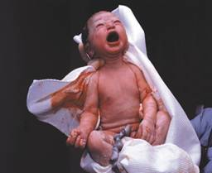

Do Pregnancy Outcomes Vary by ART Regimen?

Slide 8
Do Pregnancy Outcomes Vary By ART Regimen?
Any Adverse/Severe Adverse Outcome By Preconception ART, Botswana
Zash R et al. JAMA Pediatr. 2017;171:e172222
Compared to EFV ART, ↑ aRR of adverse outcomes with other ART regimens
1.15
(1.0-1.3)
1.30
(1.2-1.4)
1.31
(1.1-1.5)
1.21
(1.0-1.5)
1.44
(1.2-1.7)
1.68
(1.4-2.0)
1.58
(1.2-2.1)
1.93
(1.4-2.6)
(PTD, SGA, SB, neonatal death)
(VPTD, VSGA, SB, neonatal death)

Slide 9
Regardless of ART Regimen, Pregnancy Outcomes Were Worse in HIV+ Women On ART than HIV-Uninfected Women
Zash R et al. JAMA Pediatr. 2017;171:e172222
Compared to HIV-uninfected, ↑ aRR of adverse outcomes for HIV+ woman on ART
Any: 1.40
(1.3-1.4)
Severe: 1.50
(1.4-1.6)
(PTD, SGA, SB, neonatal death)
(VPTD, VSGA, SB, neonatal death)

Slide 10
Regardless of ART Regimen, Pregnancy Outcomes Were Worse in HIV+ Women On ART than HIV-Uninfected Women
Zash R et al. JAMA Pediatr. 2017;171:e172222
→EFV-based ART appears safer than NVP or LPV-r-based ART
→But ART - regardless of regimen - does not make pregnancy outcomes among HIV+ women the same
as in HIV-uninfected women
Compared to HIV-uninfected, ↑ aRR of adverse outcomes for HIV+ woman on ART
Any: 1.40
(1.3-1.4)
Severe: 1.50
(1.4-1.6)
(PTD, SGA, SB, neonatal death)
(VPTD, VSGA, SB, neonatal death)

Slide 11

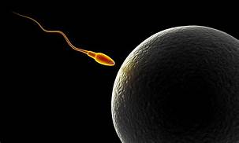
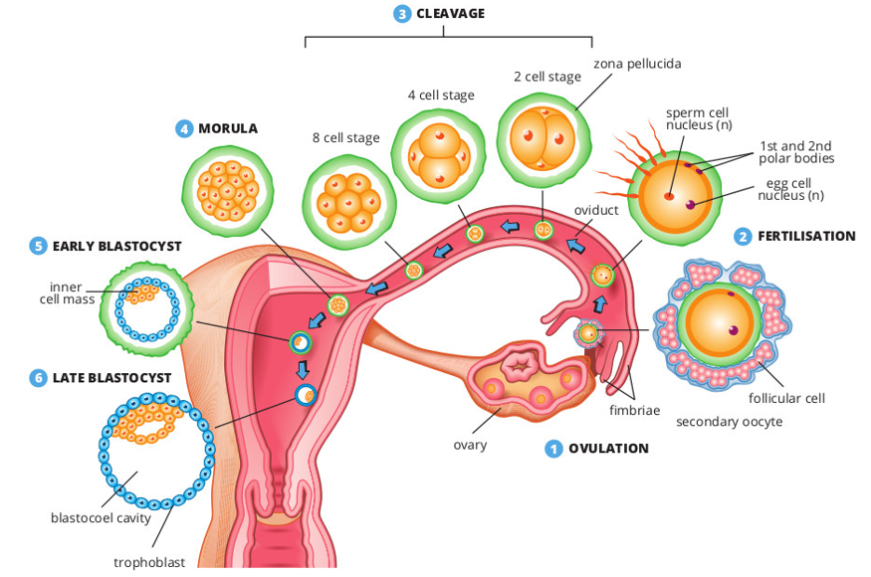
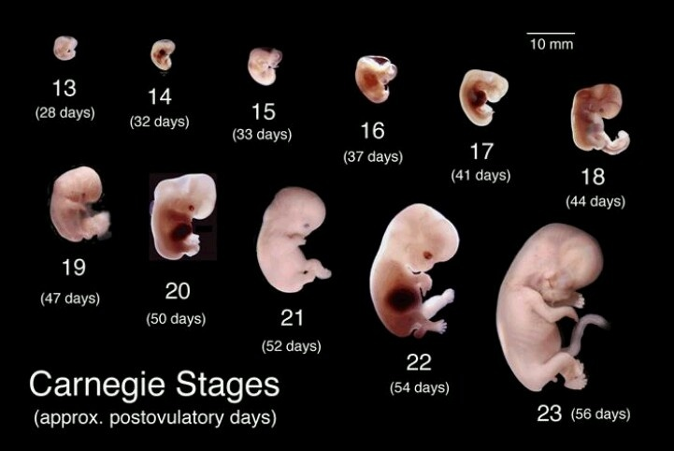
Why is Timing of ART
Exposure Important?

Slide 12
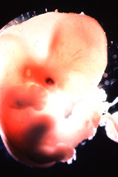
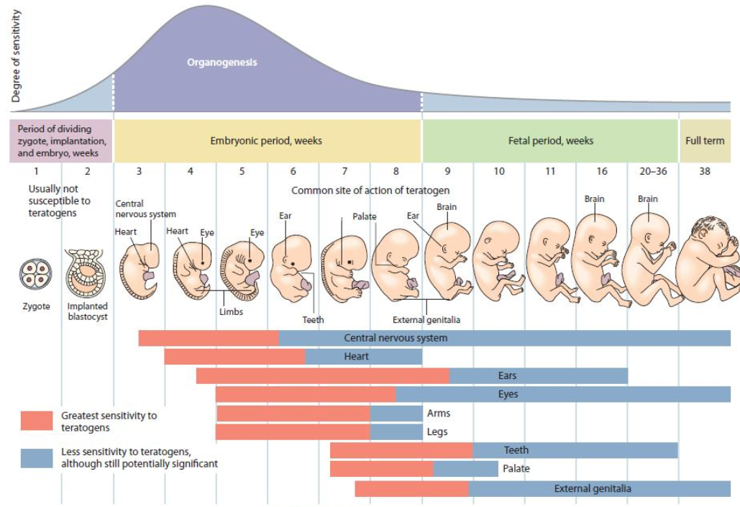
Timing of In Utero ARV Exposure
and Fetal Risk

Slide 13
Timing of In Utero ARV Exposure
and Fetal Risk
First 2.5 Weeks Post-Fertilization:
Pre-Organogenic Period
generally not sensitive to teratogens

Slide 14
Timing of In Utero ARV Exposure
and Fetal Risk
Examples:
Neural Tube Closure by
Day 28
(e.g. myelomeningocele)
Oral Structure Formation by
Day 36
(e.g. cleft palate)
Weeks 3 to 8 Post Fertilization
Embryogenesis: Period of Major Organ Development
most sensitive period to teratogens

Slide 15
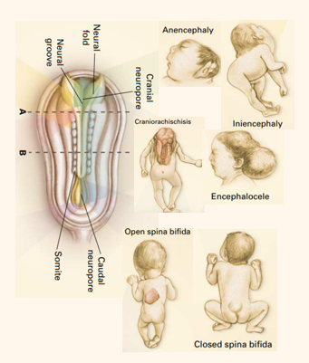
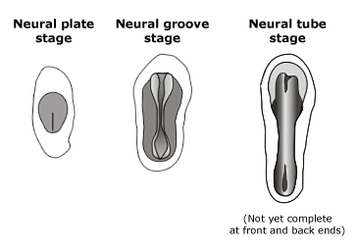
Neural Tube Closure Normally Occurs by 28 Days Post-Conception
Different phenotypes of
neural tube defects
Cranial neuropore closes on 25th day after conception; caudal neuropore normally closes ~ 2 days later
NEJM Botto 1999
Cranial neuropore
multi-site
closure
process
Fusion of the neural tube may have several origins of fusion
Fusion
proceeds in both cephalad and caudal directions, forming anterior and posterior neuropores
Caudal neuropore
Phenotype depends on location & level of the defect, whether crosses CNS segmental boundaries
UpToDate Online 17.2: McLone DG, Bowman RM

Slide 16
Multifactorial Pathogenesis of Neural Tube Defects
Development of the neural tube is a multi-step process strictly controlled by genes but modulated by a host of environmental factors (including drugs)
Exact etiology remains poorly understood
It is generally agreed that most NTD cases are of multifactorial origin, having a genetic sensitivity to their etiology that interacts with a number of environmental risk factors (e.g., folate, drugs)
Occurrence NTD in abortuses and stillbirths is many-fold higher than that in live births

Slide 17
Neural Tube Defects Are Not One Defect but Many
NTD is a spectrum of maldevelopment affecting the neural tube, associated meninges and axial skeleton; depending onset time during development, can affect different regions of neural tube and non-neural organs.
Two types: Open and Closed
  Open: arise during process of primary neurulation, primary failure of neural tube closure (~17-20 post-fertilization days); tissues of unclosed neural tube (brain, spinal cord) are exposed. Most frequent open NTD are anencephaly and open spina bifida.
  Closed: is neural tube defect which is covered by skin; may occur post-neurulation. Encephaloceles and other skin covered lesions are examples of closed NTD.

Slide 18
Timing of In Utero ARV Exposure
and Fetal Risk
Examples:
Alcohol after 24 weeks &
fetal-alcohol syndrome
Smoking after 20 weeks
and IUGR
After 8 Weeks Post-Fertilization
Fetal Development Period
Fetal growth; teeth; external genitalia; continued brain develop

Slide 19
Timing of In Utero ARV Exposure
and Fetal Risk
Greatest risk for serious defects is not in women starting during pregnancy but in those who conceive while receiving drug -
but most studies do not distinguish between 1st trimester and preconception exposure

Slide 20
Do Birth Outcomes
(Other than Birth Defects)
Differ if Starting ART
Before or During Pregnancy?

Slide 21
Preterm Delivery and Preconception ART
Uthman OA et al. Lancet HIV 2016. Meta-analysis studies through 2016
  Meta-analysis 10 studies: ART started preconception in 9,443; during pregnancy in 7,773
  Preconception ART associated with increased risk PTD: RR 1.20 (1.01-1.44); highest association LMIC
Since 2016, 7 new publications address this; 6 of 7 also report association of preconception ART with PTD
 | Start Before | Start During | Start before vs during pregnancy
Ramokolo Open Forum Infect Dis 2017 | 616 | 780 | Yes: AOR, 1.7 (1.1–2.5)
Sebitloane Niger J Clin Prac 2018 | 312 | 423 | Trend (not signif): OR 1.24 (0.9,1.8)
Chetty PlosOne 2018 | 1002 | 1591 | No
Favarato AIDS 2018 | 3090 | 2983 | Yes: AOR 1.27 (1.01, 1.61)
Rough NEJM 2018 | 434 | 1187 | Yes: Higher preconception
Snijdewind PLosOne 2018 | 550 | 842 | Yes: 1.38 (1.02,1.85)
Zash JPIDS 2018 | 502 | 550 | Yes: 1.33 (1.04, 1.7) vs 2/3rd trim

Slide 22
Preterm Delivery and Preconception ART
Uthman OA et al. Lancet HIV 2016. Meta-analysis studies through 2016
  10 studies: 9443 start ART preconception, 7773 during pregnancy
  Preconception ART associated with increased risk PTD: RR 1.20 (1.01-1.44); highest association LMIC
Since 2016, 7 new publications address this; 5 of 7 also report association of preconception ART with PTD.
→Preterm delivery (and very preterm delivery) may be increased with preconception ART compared to first starting ART during pregnancy
 | Start Before | Start During | Start before vs during pregnancy
Ramokolo Open Forum Infect Dis 2017 | 616 | 780 | Yes: AOR, 1.7 (1.1–2.5)
Sebitloane Niger J Clin Prac 2018 | 312 | 423 | No (trend): OR 1.24 (0.9,1.8)
Chetty PlosOne 2018 | 1002 | 1591 | No
Favarato AIDS 2018 | 3090 | 2983 | Yes: AOR 1.27 (1.01, 1.61)
Rough NEJM 2018 | 434 | 1187 | Yes: Higher preconception
Snijdewind PLosOne 2018 | 550 | 842 | Yes: 1.38 (1.02,1.85)
Zash JPIDS 2018 | 502 | 550 | Yes: 1.33 (1.04, 1.7) vs 2/3rd trim

Slide 23

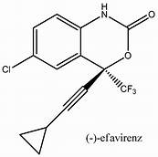
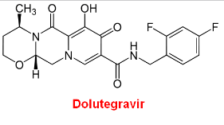
When Started During Pregnancy,
Do Pregnancy Outcomes
Differ Between Women on
DTG vs EFV-Based ART Regimens?

Slide 24
When Started During Pregnancy, No Difference Pregnancy Outcomes EFV vs DTG-Based ART
Zash R et al. Lancet Global Health 2018;6:e804-10
No difference:
Major Birth Defects with
First Trimester Exposure
EFV: 1/395 (0.3%)
DTG: 0/280 (0%)
(no NTD either drug)

Slide 25
However, HIV-Uninfected Women Still Have Better Outcomes than HIV+ Women on EFV or DTG ART
Zash R et al. Lancet Global Health 2018;6:e804-10

Slide 26
However, HIV-Uninfected Women Still Have Better Outcomes than HIV+ Women on DTG or EFV ART
Zash R et al. Lancet Global Health 2018;6:e804-10
→When started during pregnancy, EFV and DTG appear equivalent in terms of pregnancy outcomes (including birth defects)
→But adverse outcomes with EFV or DTG ART are still higher than in HIV-uninfected women

Slide 27
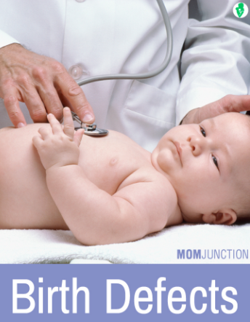
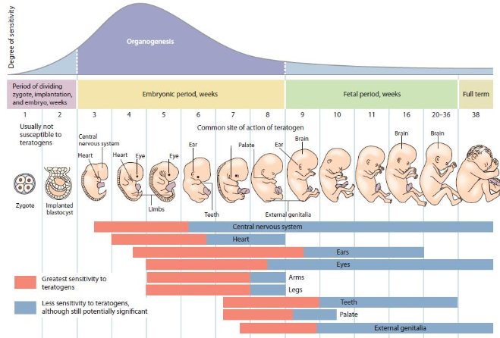
Safety
Birth Defects

Slide 28
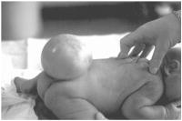
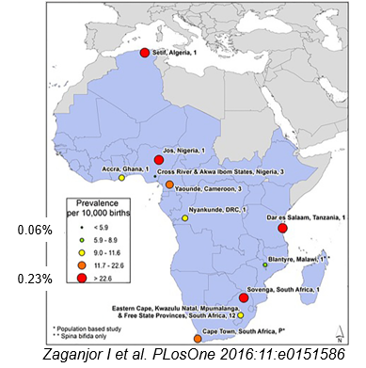
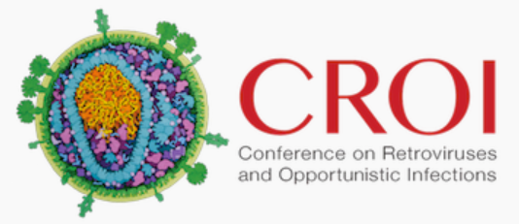
Expected Incidence of Neural Tube Defects
Blencowe H et al. Ann NY Aca Sci 2018;1414:31-46
Estimated prevalence of NTD in 2015 globally was 0.19% (0.15% to 0.23%) [19 (15–23)/10,000 birth outcomes]
About 50% of cases were elective terminations or stillbirths, so evaluation of only live births gives underestimation
African Region: Data from 11 studies from 8 countries analyzed
Median prevalence of NTD in Africa was 0.12% (range 0.06% to 0.23%)
P Musoke – CROI 2018 Abs 829
43,293 births (4,634 HIV+ women, 77% on EFV ART) in Uganda
Prevalence NTD: HIV-uninfected 0.09%, HIV+ 0.04%

Slide 29
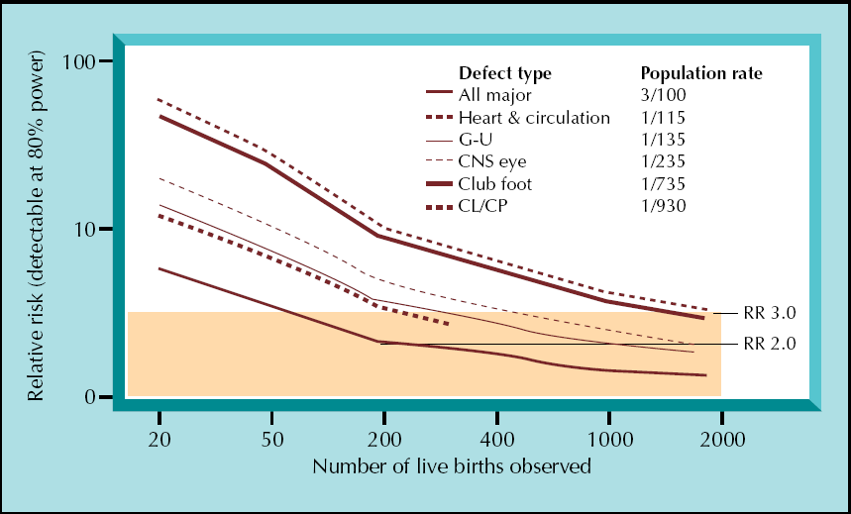
Ability to Rule-Out ↑ Birth Defect is Related to Incidence Defect and Number Observed Preconception/1st Trimester Exposures
200 exposures can rule out a 2-fold ↑ in overall birth defects (incidence 3%)
Overall defects
Incidence 3%
RR 2.0
Watts DH. Curr HIV/AIDS Rep 2007;4:135-140

Slide 30
Ability to Rule-Out ↑ Birth Defect is Related to Incidence Defect and Number Observed Preconception/1st Trimester Exposures
However, to rule-out a 3-fold increase in a relatively rare event like NTD (incidence 0.1%), need about 2,000 exposures
Neural tube defect
Incidence 0.1%
RR 3.0
Overall defects
Incidence 3%
RR 2.0
Watts DH. Curr HIV/AIDS Rep 2007;4:135-140

Slide 31

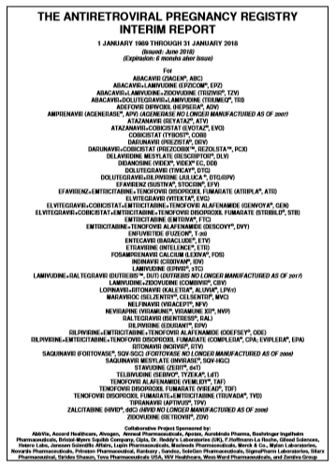



Birth Defect Surveillance:
Antiretroviral Pregnancy Registry
Antiretroviral Pregnancy Registry began in 1990 as Zidovudine in Pregnancy Registry
Currently international registry including 128 antiretroviral drugs – 49 brand, 79 generic drugs
  Provider prospectively reports women on ART during pregnancy to the APR prior to delivery outcome
  To provide early warning signal; estimates risk of major birth defects compared to general population
Registry is only as good as reporting to it!

Slide 32
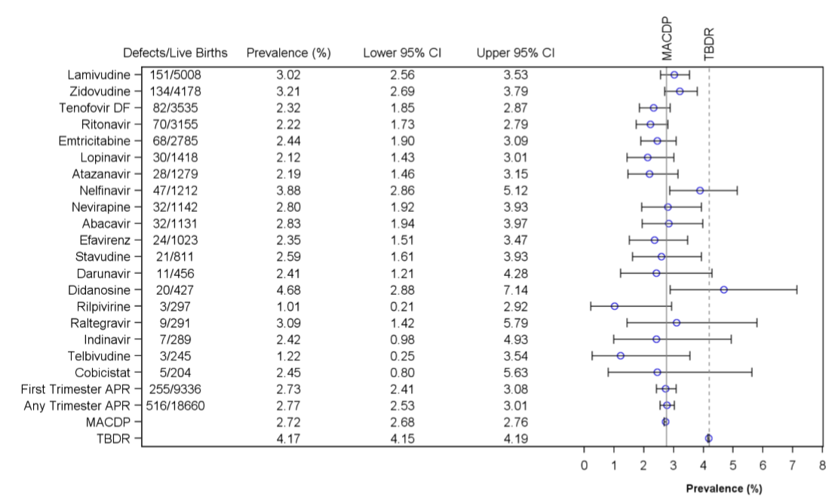
Drug-Specific Birth Defect Rates*
Prevalence of Birth Defects (95% CI): 1 January 1989 – 31 January 2018
First Trimester Exposure
*For drug to be included for comparison with population rates, a drug must meet threshold of having ≥ 200 1st trimester exposed pregnancies
Metropolitan Atlanta
Congenital Defects
Program
(2.7%)
Texas Birth
Defects Registry
(4.2%)
2.7% (CI 2.4-3.1%)
MACDP: Metropolitan Atlanta Congenital Defects Program
TBDR: Texas Birth Defects Registry

Slide 33
Drug-Specific Birth Defect Rates*
Prevalence of Birth Defects (95% CI): 1 January 1989 – 31 January 2018
First Trimester Exposure
Other than rilpivirine, raltegravir, and cobicistat, there are insufficient data on newer ARV drugs (bictegravir, carbotegravir, dolutegravir, elvitegravir, etravirine tenofovir alafenamide….) to be able to rule out a 2-fold increase in overall birth defects, let alone rare events like NTD
*For drugs meeting threshold of ≥ 200 1st trimester exposed pregnancies
Metropolitan Atlanta
Congenital Defects
Program
(2.7%)
Texas Birth
Defects Registry
(4.2%)
2.7% (CI 2.4-3.1%)
MACDP: Metropolitan Atlanta Congenital Defects Program
TBDR: Texas Birth Defects Registry

Slide 34

Drug Therapy in Pregnancy
Balancing act
Risk of
Adverse
Fetal Effects
Benefit of
Maternal
Treatment
Unfortunately there are often only limited data to make recommendations

Slide 35
Dolutegravir in Pregnancy
Balancing act
Risk of
Adverse
Fetal Effects
Benefit of
Maternal
Treatment
DTG:
Rapid VL decline
Better tolerated
Less expensive
DTG:
Potential signal for neural tube defect with preconception exposure

Slide 36


Dolutegravir in Pregnancy
Balancing act
Risk of
Adverse
Fetal Effects
Benefit of
Maternal
Treatment
DTG:
Rapid VL decline
Better tolerated
Less expensive
DTG:
Potential signal for neural tube defect with preconception exposure
Maternal-baby boxing match!

Slide 37
Dolutegravir in Pregnancy
Balancing act
Benefit of
Maternal
Treatment
Risk of
Adverse
Fetal Effects
DTG:
Rapid VL decline
Better tolerated
Less expensive
DTG:
Potential signal for neural tube defect with preconception exposure
As you will hear, more data will be available to confirm/refute this signal in the next year
In the meantime, we need to figure out how to maximize outcomes for both mother and child (without pitting one against the other…)

Slide 38

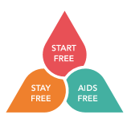
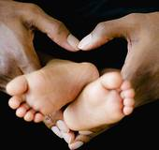

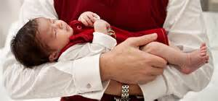
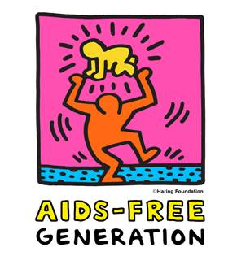
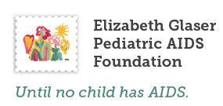
Thank you for your attention!

