Slide 1



The Newest Science in Cure and Vaccine
R. Brad Jones, PhD
#AIDS2018 | @AIDS_conference | www.aids2018.org
Notes:
I have the priviledge today to represent a dedicated global community of biomedical researchers who will NOT stop until we have a cure and vaccine for HIV.
Today I am going to take you behind the scenes and present some of the really fundamental challenges that we are facing, and progress that we have made towards overcoming these.

Slide 2
No Conflicts of Interest to Disclose
Notes:
First, I declare that I have no conflicts of interest

Slide 3
Part I : Towards a Cure for HIV
Part II : HIV Vaccine Development
Notes:
We’ll break this talk into two parks – first talking about progress towards a cure for HIV, and then about the development of an HIV vaccine

Slide 4
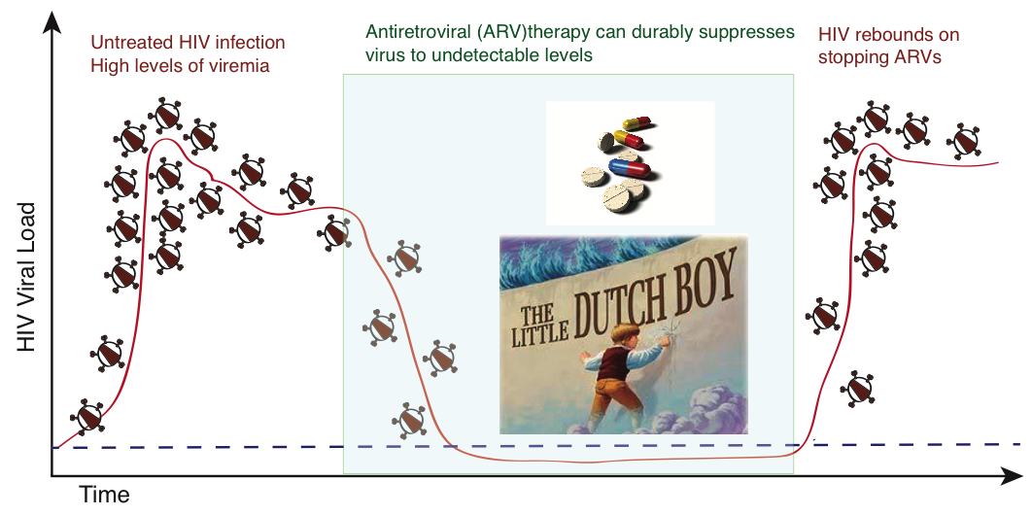

Part I of II: Towards a Potential Cure for HIV
Notes:
We live in an era where – for those with access to current medications it’s possible to suppress HIV in the bodies to where it is Undetectable and UnTransmittable.
I wish that was the end of the story… but unfortunately this is not an ideal long-term solution, because if one ever stops ARVs then the virus quickly comes back.
To discuss how we might do better, I will borrow from an locally relevant story of another lifesaving but impermanent solution – and that is the story of the little Dutch boy, who spots a leak in the dam and saves his town by plugging it with his finger until help can arrive

Slide 5
How Can We Prevent HIV From Rebounding Off of Therapy?
Drain the HIV reservoir
Eliminate HIV-infected cells
HIV Reservoir
(in a person)
Notes:
So in this metaphor, the water represents the HIV reservoir in a person, and the little dutch boy is ARVs. We can see that there are two ways to relieve the Little Dutch Boy of his duty – or stop the need for ARVs.
First, we can drain the reservoir – which is analogous to eliminating all HIV-infected cells, through a strategy such has kick and kill

Slide 6
How Can We Prevent HIV From Rebounding Off of Therapy?
Drain the HIV reservoir
Eliminate HIV-infected cells
2) Reinforce the dam
Boost the immune response to HIV
HIV Reservoir
(in a person)
Notes:
Or, second, we can reinforce the dam. So the water – or virus – is still present, but is contained – for example - by the immune system and no damage is done.

Slide 7
How Can We Prevent HIV From Rebounding Off of Therapy?
Drain the HIV reservoir
Eliminate HIV-infected cells
“Sterilizing cure”
2) Reinforce the dam
Boost the immune response to HIV
“functional cure/ remission”
HIV Reservoir
(in a person)
Notes:
These are the approaches that are often termed ‘sterilizing cure’ – eliminate the virus / drain the reservoir, and functional cure or remission – control the remaining virus

Slide 8
Therapeutic Strategies which Aim to Cure HIV Infection
‘Kick and kill’ – reactivate latent HIV with drugs and kill with immune system
Gene therapy to delete HIV out of cells
Gene therapy to make cells resistant to HIV
Vaccines / Immunotherapies – enhance immune responses to control virus
‘Block and lock’ – permanently silence HIV expression (force into deeper latency)
Notes:
3:08 = 23 minutes
We can use this metaphor to categorize the different cure strategies which are currently being pursued. As mentioned, kick and kill aims to empty the reservoir – by reactivating latent HIV with drugs and killing them with the immune system. Gene therapy to delete HIV from cells is another way to empty the reservoir. Whereas another type of gene therapy that makes new cells resistant to HIV infection is a way of controlling HIV, or re-enforcing the damn. Another very promising way of reinforcing the damn is through the use of vaccines or immunotherapies. Finally, you may have heard of ‘block and lock’ which aims to permanently shut down HIV – and this is analogous to stopping the flow of water by freezing the lake.

Slide 9


May Require Both Reducing Reservoir and Boosting Immune Responses
Smaller HIV reservoir likely to be more easily contained by immune system
Notes:
Is is likely wise to pursue combinations of these approaches – drain the reservoir as much as we can, and strengthen the dam to hold back any remaining water. To illustrate this consider that the ocean requires monumental dam systems, such as this dutch one which I guess might be keeping us dry currently; whereas in my native Canada smaller dams such as this are a common sight.
4:30 to here

Slide 10
Challenges and Advances in Measuring the HIV Reservoir
Notes:
So it’s critical to now how large the HIV reservoir is – both so that we know what we’re dealing with, and also so we’ll be able to measure if we’ve drained it. As it turns out, this is quite challenging to do and I want to spend some time highlighting advances in this area.

Slide 11
Measuring the HIV-Infected Cells that Persist on ARV Treatment
Measurements after virus reactivation
Measure production
of viral RNA
from initial cells
Measure after days
of culture. How much
virus was infectious
Direct Measurements
Cells from blood or tissues
Reactivate
Latent HIV
(force out
of hiding)
Adapted from: Massanella and Richman, JCI 2016
Notes:
11
Ways of measuring the HIV reservoir can be divided into two broad category. The first involves direct measurements of HIV genetic material – RNA or DNA – either in body fluids, or in plasma – one version of this is the standard viral load test. The second is to do something to cause the release of HIV in a test tube, and then measure how much is produced. Quantitative viral outgrowth assays – or QVOAs – are a common version of this.

Slide 12
Measuring Total HIV DNA versus Replicating Virus
~1,000x more cells harbor HIV DNA than can be induced to produce infectious virus
10,000
1,000
100
10
Why this Discrepancy?
Notes:
The first surprise, is that when we directly measure the frequencies of cells with HIV DNA – we find that it is 1,000x greater than the number of cells that can be reactivated to produce infectious virus. ~1,000 – 1. So why is this?

Slide 13

Large Majority of HIV Proviruses are Defective in People on ART
Intact HIV genome
Only ~2% of HIV proviruses are intact
Defective HIV genomes with deletions
The other 98% are ‘defective’
ex. have deletions, and will
not cause viral rebound
Ho et al, Cell, 2013; Bruner et al, Nature Med 2016

Slide 14
Intact Provirus ddPCR Analysis of Participant Samples
More selective measurement of intact
vs defective proviruses
Faster, cheaper, more scalable than viral
outgrowth assays
Bruner et al, submitted
Siliciano lab
Notes:
Here are what actual data look like measuring HIV from clinical samples – courtesy of Katie Bruner from Bob Siliciano’s lab. In the green you have the 5’ deleted virus – which only have the tail, which gives a large number, and in blue you have the 3’ deleted viruses – which only has the head, and which also gives a large number – but if you look at which droplets have both halves of the virus you get a number which is substantially lower, and closer to the actual intact viruses that can cause viral rebound. This assay has the advantage of being faster, cheaper, and more scalable than viral outgrowth assays – but one disadvantage is that it likely still overestimates infectious viruses – as the virus, or the queen bee may be missing other parts.

Slide 15
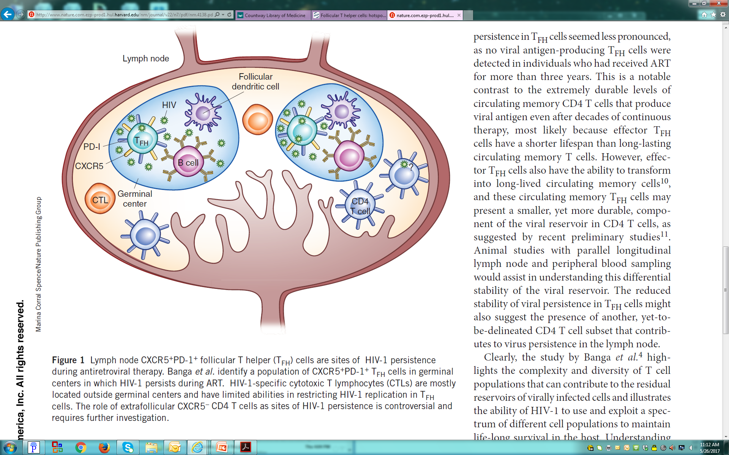

Other Challenges in Measuring HIV Persistence: Beyond the Latent Reservoir in Blood
Anatomic sanctuaries:
  Infected cells persist in lymph node follicles, which are deficient in cytotoxic T-cells
Connick E et al, J Immunol 2007; Connick E et al, J Immunol, 2014. Fukazawa Y et al, Nat Med 2015. Banga R et al, Nat Med, 2016;
Other tissues/
compartments likely
contribute to rebound
Paiardini and Lichterfeld, Nature Med, 2016
Notes:
5:32? For 23 minutes
Beyond whether a virus is intact or defective, there are multiple other challenges to measuring the HIV reservoir. We like to measure HIV in the blood, because it’s relatively easy and non-invasive… but it’s known that HIV persistence is focused in other anatomical sites. In particular, due to the pioneering work of Liz Connick – we know that lymph node follicles are a sanctuary for HIV. HIV may also persist in sites that cannot be sampled in person living with HIV, such as in the brain – and these are just two examples of compartments other than the blood where HIV may persist.

Slide 16



Interplay between Proviral, Cellular, & Anatomical Factors in
Determining Viral Rebound
* Theoretical depiction
Identifying ‘nodes’ of rebound will help
guide and evaluate cure strategies
Partially effective intervention
Contribution to
Viral rebound
Anatomical site
(ex. lymph node, blood)
100
Ineffective intervention
Will measurements in clinical trials
miss an effect? Give a false negative
signal?
0
Composition of Provirus
(intact or defective? Integration site)
Cell type and state
(ex. resting CD4 cell)
Notes:
I would propose that if we really want to understand where HIV comes from when ARVs are stopped, we need to consider at least three parameters in parallel. First, what is the composition of the HIV provirus – as we just talked about – are they defective or intact? Second, what type of cell are we measuring? Resting T-cells? Activated T-cells? macrophages? Third, wich tissue or fluid are we measuring? Blood? Lymph nodes. What I would propose is that there are nodes in these three dimensions that disproprtionately contribute to rebound. For example, the pink node may be intact proviruses from resting CD4+ T-cells in lymph nodes – or may be something else. We do not yet have these data in the field – this is an entirely theoretical depiction. If we could generate these data then knowing where the virus comes from would help guide and evaluate cure strategies. To understand where the virus comes from when therapy is stopped we will probably need to perform treatment interruption studies. Until we truly understand where virus comes from when treatment is interrupted, I fear we run the risk of either missing an effect in clinical trials – or getting a false positive signal. This knowledge will also help us target therapeutic strategies – where an effective strategy might look something like this, and an ineffective strategy may be off of the mark in either one of these dimensions. So, we have some work to do! But we are making progress.
9 minutes to here

Slide 17
Interplay between Proviral, Cellular, & Anatomical Factors in
Determining Viral Rebound
* Theoretical depiction
Representation of improved relevance
to viral rebound of intact provirus ddPCR
assay vs total HIV DNA
Contribution to
Viral rebound
Anatomical site
(ex. lymph node, blood)
100
0
Composition of Provirus
(intact or defective? Integration site)
Cell type and state
(ex. resting CD4 cell)
Notes:
7:44 for 23 minutes
For example, by focusing just on intact proviruses we hope to have improved our resolution in one dimension and focused in on the virus that can cause rebound.
9 mins to here
7 minutes for this segment? – 10.5 total

Slide 18

Advances in Understanding Clonal Expansion HIV Reservoirs
and Possible Implications
Cells with defective HIV proviruses
Cells with intact HIV proviruses
Notes:
The second topic that I’d like to highlight with respect to HIV persistence or cure is something that we call clonal expansion. So we’ve known for some time that sheep can be cloned. More recently, we’ve learned that HIV-infected cells clones themselves in our bodies – and this is true whether we are talking about the defective or the intact proviruses.

Slide 19
Infected Cells Proliferate
Yet total numbers of infected cells
do not increase
Siliciano, J.D.,… Siliciano R.F., Nat. Med., 2003
Suggests that some infected cells
must be dying off
Notes:
What we’ve learned recently is that individual HIV infected cells actually divide and proliferate in people living with HIV. This is unexpected, because we know that the total number of HIV infected cells does not increase – i.e: this line is not going up. So to reconcile these two observations it must be the case that some infected cells are dying off over time in people living with HIV

Slide 20
2018, PMC5856552
TT
The HIV Reservoir
Is Dynamic!
Notes:
A recent study demonstrated this directly by looking at multiple clones of HIV infected cells – depicted here by two different queen bees, and seeing that the frequencies of these waxed and waned over time. So if you like at time 1 there are a large number of this green clone and few of the purple one, but if you look a bit later at this time point the situation has reversed, and you have more of the purple clone and less of the green one. So the HIV reservoir is dynamic!

Slide 21
Do HIV Reservoirs Undergo Evolution?
Considering HIV-infected cell (not virus )as biological unit
Requirements for Evolution to Occur:
Variation in population
Replication and heritability
Selective pressure -> differential rates of cell death
i) Proliferation advantage (Wagner, T.A., et al., Science 2014, Maldarelli, F., et al., Science 2014)
ii) Survival advantage? Resistance to being killed?
Notes:
Why is this important?... And this may be a bit provocative… but based on available data, I think that based on recent findings we can now reasonably make the case that HIV reservoirs may be undergoing evolution. I’m not talking about viral evolution, since this is suppressed by ARVs, but considering an HIV infected cell as the biological unit. The first hint of this was from two publications from a few years ago which suggested that HIV may be interesting into the host genome in a way that enhanced survival and proliferation.

Slide 22

Have Clonally Expanded HIV-Infected Cells been Selected for Survival?
2018
2018
2016
One of critical questions currently
being asked by the field
Notes:
10:36 for 23 minutes
More recently, a number of papers have implicated the involvement of pathways that enhance cell survival – such as BIRC-5, or BCL-2 - in the persistence of the HIV reservoir – and we have presented data suggesting that the cells that harbor HIV reservoirs may be inherently hard to kill.

Slide 23
Challenges in Measuring
the HIV Reservoir
Dynamic Nature
of HIV Reservoir
HIV Reservoir may
be Primed for Survival
Interpreting Results of Clinical Trials
Notes:
So now what I want to try to do is to take the three topics that we just covered, and see how they can be applied to interpreting results of clinical trials

Slide 24
Kick and Kill
Notes:
For this, we are going to focus on Kick and Kill. The central idea here is that we have latently-infected cells which do not produce virus and therefore hide from the immune system. We want to treat them with a latency-reversing agent so that they show themselves, and then bring in immune cells such as cytotoxic T-cells or natural kill cells to kill infection. This is what a cytotoxic T-cell looks like as a cartoon – let’s see what it looks like in real life.

Slide 25
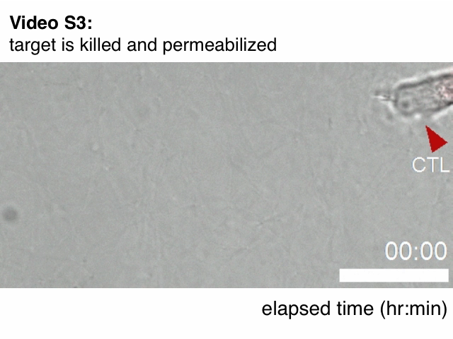
Cytotoxic T-cells Kill HIV-Infected Cells
Foley et al, PLoS One, 2013
Notes:
The cytotoxic T-cell is indicated here in red – it’s going to move through tissue hunting for target cells, such as HIV-infected cells, and when it finds one – it kills it

Slide 26
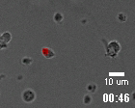
Advances in Kick and Kill to Cure HIV
Some clinical trials have shown evidence for in vivo increases in HIV expression (kick), but
have not significantly reduced HIV reservoirs Archin, N.M… Margolis, D.M., et al, Nature, 2012
Søgaard, O.S… Tolstrup M., et al., PLoS Pathogens, 2015
Elliott, J.H… Lewin, S.R. et al, Lancet HIV, 2015
Why not?
Red – HIV-specific cytotoxic T-cell
Kick not sufficiently strong to reactivate relevant latent reservoirs? too small?
Kill was insufficiently strong?
Jones et al,
PLoS Path,
2014
Notes:
So, where do we stand with attempting to bring Kick and Kill to the clinic. We have some indications of at least partial success with the ‘kick’ – as several clinical trials have shown increases in HIV expression in vivo – so we’ve woken the virus up – but unfortunately, so far, this has not significantly reduced reservoirs. So, the question is – why not? We aren’t sure of the answer to this – but here are some likely candidates. First, our kick was not strong enough to reactivate the HIV reservoir. If you think back to the metaphor of draining the HIV reservoir, perhaps we didn’t use a big enough bucket? Another option is that our kill was insufficiently strong. I just showed you a movie of a very effective cytotoxic T-cell – but not all cells are so potent. Here is an example of a less successful cell that seems to bumble around for a bit – then grabs onto the infected cell – but it’s all a bit pathetic and the cell gets away.
.
RIVER study, may also reference ingenol study being presented,

Slide 27
Advances in Kick and Kill to Cure HIV
Contribution to
Viral rebound
100
Why not?
Anatomical site
(ex. lymph node, blood)
Targeted or measured wrong infected cell populations?
Reservoir-harboring cells resistant to being eliminated?
0
Composition of Provirus
(intact or defective? Integration site)
Cell type and state
(ex. resting CD4 cell)
Notes:
13:10 = 23 minutes
Another possibility is that we either targeted or measured the wrong part of the HIV reservoir – if you’ll think back to this 3D graph, measuring the total HIV DNA in the blood may not be the best indication of reduction in the real reservoir.
Lastly, the possibility that reservoir-harboring cells may be intrinsically resistant to being eliminated – in my lab we’ve found It surprisingly hard to eliminate these even in the test tube, which is something that we are following up on.

Slide 28
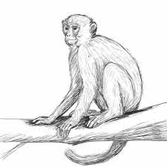
Advances Towards Cure in
Non-Human Primate Models of HIV
Notes:
As we continue to try to understand the results from human clinical trials we can draw some optimism from non-human primate models of HIV, which are showing some signs of success

Slide 29
HIV-Specific Abs Can Both Neutralize Virus and Target Infected Cells for Killing
Blocks infection of new cells
Targets infected cells for killing
by ‘natural killer cells’
Natural killer cell
Notes:
Another option in addition to cytotoxic T-cells to deliver the kill are HIV-specific antibodies. We often think of antibodies as acting to block viruses from infected new cells. But they can also bind to the surfaces of infected cells and flag these to be killed by another type of cell called a natural killer cell.

Slide 30
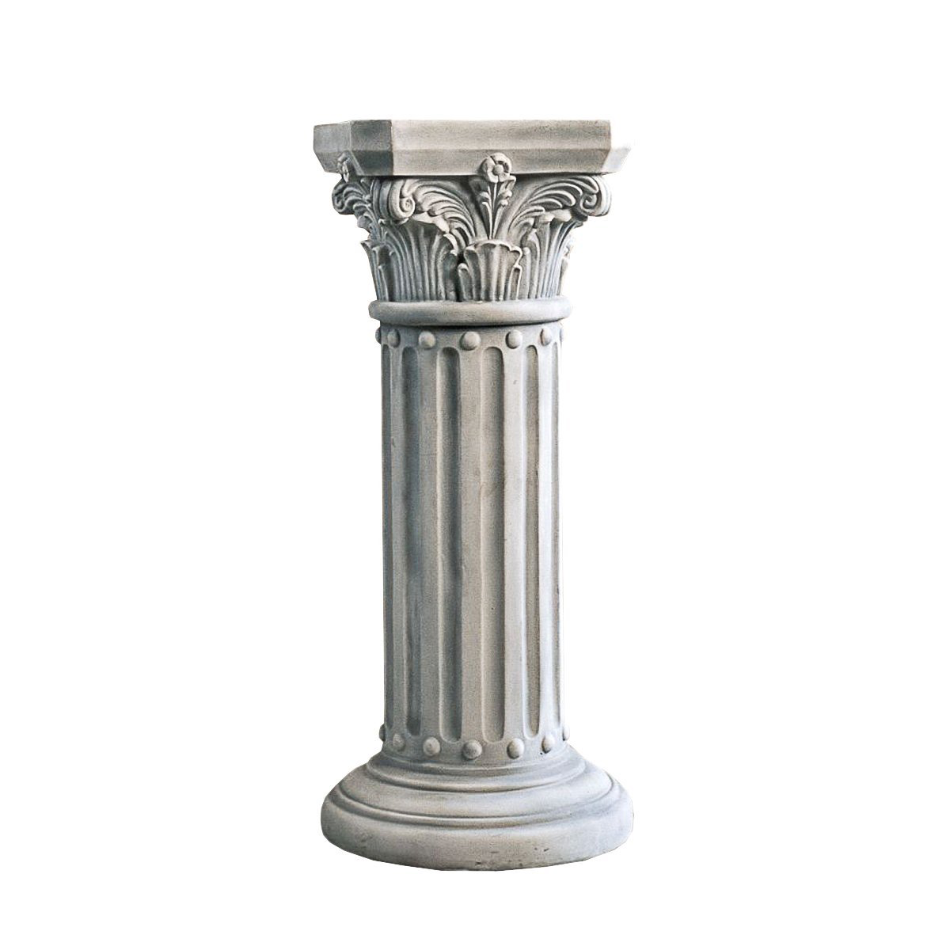
Broadly Neutralizing Antibodies (bNAb)
bNAb – binds to and neutralizes
very diverse HIV isolates
Notes:
I mentioned earlier that antibodies can label HIV-infected cells for elimination by the immune system. Now, I’d like to briefly introduce a special type of antibody called a broadly neutralizing antibody. These are unique in that they can bind to cells infected with very diverse isolates of HIV, whereas other antibodies will only bind to a narrow subset of viruses.

Slide 31
Can bNAbs + Immune Activation Lead to Cure or Remission
in Non-Human Primate Model of HIV
Will this translate to humans/HIV?
Animals were treated with ARVs
very early – is this a key component of success?
Borducchi, E… Barouch D., et al, CROI 2018 Abstract 73LB
PGT121 = broadly neutralising antibody; TLR = toll like receptor
Notes:
A team in Dan Barouch’s lab asked the question whether a type of kick and kill strategy could lead to viral remission in monkeys infected with SHIV – which is a monkey version of HIV. This is a negative control group looking at viral RNA after stopped ARV therapy, and what you see is the virus coming back quickly in all animals. When we add just the TLR-7 agonist, which is the kick, the picture is very similar with rebound in 91% of animals, when you add just the broadly neutralizing antibody – called PGT121 – which provides the kill, we see that virus comes back in 82% of animals. Very encouragingly when you provide the kick and the kill together, the virus only came back in 55% of animals – which is a significant improvement over the control animals. So this study found that a kick and kill strategy led to delays in viral rebound and reduced viral loads in rhesus macaques. Will this translate to humans infected with the HIV virus – trials to test this are moving forwards. Another important point is that the animals in this study were treated with ARVs very early after infection. An important question is whether tis early treatment was critical to success.

Slide 32
Take Home Messages for Part I of II (Cure Research)
Therapies aimed at reducing viral reservoirs or inducing remission are showing promise
– however a cure for HIV remains a long-term goal
Basic science research is needed to improve methods of targeting and measuring
persistent sources of virus
HIV reservoirs are dynamic – proliferation of some infected cells balanced by death of
other infected cells
Understanding these dynamics may lead to new or improved strategies
to reduce HIV reservoirs
Notes:
Take home message for part I - read

Slide 33
Part II: HIV Vaccine Development
Notes:
15 minutes?
We’ll now switch gears for the second part of the talk to cover HIV vaccine development. We spent most of the time on cure – my area of research – but I do want to emphasize that to end the HIV epidemic, there is no greater need than for a safe and effective vaccine to prevent infection.

Slide 34
Broadly Neutralizing Antibodies Protect from
Infection in Multiple Animal Models
Passive immunization with a bNAb protects humanized mice from HIV infection
(Gauduin, M.C… Koup, R.A et al, Nat. Med. 1997; Balazs, A.B… Baltimore D et al, Nat. Med, 2014;
Horwitz, J.A… Nussenzweig, M.C et al, PNAS, 2013)
Passive immunization with a bNAb protects monkeys from SHIV infection
(Mascola, J.R… Lewis, M.G., Nat. Med. 2000; Shibata R… Martin, M.A. Nat Med, 1999;
Parren, P… Burton, D.R. J. Virol, 2001; Gautum, R… Martin M.A et al, Nature, 2016;
Julg, B… Barouch, DH., et al, Sci Transl Med, 2017)
Notes:
7 minutes for vaccines
We previously introduced broadly neutralizing antibodies in terms of their promise for cure. Now we can also show that in preclinical models, such as non-human primates, there is compelling data to suggest that these antibodies can also prevent infection. Here, animals were given the bNAbs PGDM1400 and PGT121 alone and in combination and then challenged with SHIV – a monkey version of HIV – and you can see that monkeys that received this combination were completely protected from infection.

Slide 35
Can Broadly Neutralizing Antibodies be Elicited in Humans by Vaccination?
Not easily…
Broadly neutralizing antibodies emerge only after years of infection, and have unusual
features (high degree of somatic mutation and long CDR3 loops)
Notes:
One of the foremost goals of the field for some time has been to try to develop a vaccine that would elicit broadly neutralizing antibodies in people. Unfortunately, this turns out to be very difficult to achieve. This can be linked to the fact that these antibodies emerge in people living with HIV only after several years of infection, and they have unusual features including a high degree of mutation, and an unusual shape, with longer than usual CDR3 loops. So these antibodies are difficult to elicit and the vaccines that have been tested so far have failed to generate them.

Slide 36
May Require Guiding Antibody Development Through Multiple Steps
Gorman, J., .,… Kwong, P.D., Structures of HIV-1 Env V1V2 with broadly neutralizing antibodies reveal commonalities that enable vaccine design. Nat. Struct. Mol. Biol., 2016.
Jardine, JG.,… Nemazee, D., Priming a Broadly neutralizing antibody response to HIV-1 using a germline-targeting Immunogen. Science, 2015.
Steichen, J.M.,… Schief, W.R., HIV vaccine design to target germline precursors of glycan-dependent broadly neutralizing antibodies. Immunity, 2016.
Tian, M.,… .,…Alt, F.W., Induction of HIV neutralizing antibody lineages in mice with diverse precursor repertoires. Cell, 2016.
Notes:
How can we improve upon this? One approach is called lineage-based vaccine design. In this approach we seek to understand the natural evolution of these antibodies in people (remember, they take years to develop) and then to use a series of vaccines to try to recreate this evolution. It’s thought that this will require a number of different very specialized immunogens to coax the immune response down the right path. This is obviously very challenging – but there have been very encouraging advances in a number of preclinical models which would seem to suggest that we are on the right path.
mature antibody lineages for (B)
VRC01-class antibodies (Jardine et al., 2015;
Tian et al., 2016), (C) PGT121-class antibodies
(Steichen et al., 2016), and (D) PG9-class antibodies
(Gorman et al., 2016).

Slide 37
Iterative Approach to Multi-Stage Neutralizing
Antibody-based HIV Vaccine Design
Andrabi et al, Curr Opin Immunol. 2018
Notes:
I’d refer you to this review paper from Dennis Burton’s lab for a more in-depth look at these approaches. Here, I just want to make the point that these multi-stage vaccine strategies are being pursued through iterations of highly sophisticated strategies which use multiple animal models and really leverage the most advanced biomedical technologies – including single cell sorting, deep sequencing, structural biology, and protein engineering. When this succeeds in eliciting broadly neutralizing antibodies it will be a true triumph of human ingenuinity, technology, and persistence.

Slide 38
Unusually long ‘CDR3’ loops are a common
feature of human broadly neut Abs
Repeated immunization with well-ordered BG505-SOSIP
HIV envelope trimer -> broad and potent neutralizing Abs.
Cow antibodies have very long CDR3 loops
(26-70 amino acids, vs 12-16 for most vertebrates
Suggests focusing on immunization strategies that favor
the selection of long CDR3 Abs
Notes:
In the meantime, it’s encouraging to see that with the advances made to date, vaccination can already elicit broadly neutralizing antibodies in cows. Remember I mentioned that broadly neutralizing antibodies have an unusual shape – a long version of something we call a CDR3 loop? It turns out that in cows it is more typical to have long versions of these loops. When you take a carefully engineered protein called an HIV envelope trimer and vaccinate cows you get responses that are both very broad – here in black depicts the numbers of viruses that the cow antibodies neturalized and it approaches 100%, and in colors these are the potencies

Slide 39
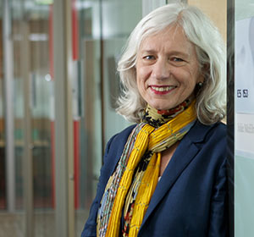
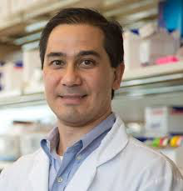
Julie McElrath, MD, PhD
Lancet, July 6, 2018
Dan Barouch, MD, PhD
Notes:
Broadly neutralizing antibodies are not the only promising approaches to developing an effective HIV vaccine, and you may have seen some headline recently of another approach that is showing promise

Slide 40
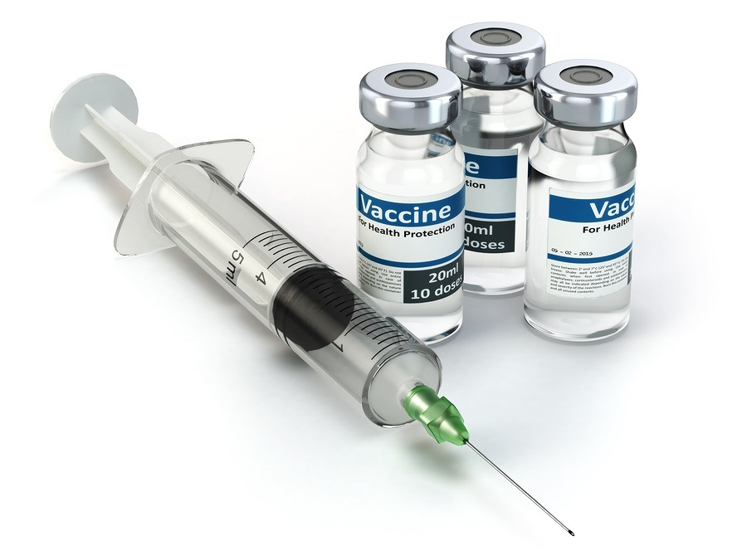
Matched vaccines
Measure Immune Responses
Using Matched Assays
67% Protection from SHIV Infection
in Monkeys
Challenge animals
with SHIV-SF162P3

Slide 41
Immune Responses to Vaccine Similar Between Monkeys and Humans
Antibody
T Cell

Slide 42
Matched vaccines
Measure Immune Responses
Using Matched Assays
Will this vaccine protect humans from infection?
(as it did for monkeys)
Phase 2b efficacy study
In 2,600 women in Africa
Challenge animals
with SHIV-SF162P3
Notes:
I was

Slide 43
Take Home Messages Part II of II (Vaccine Research)
Diverse approaches are in early phase development: DNA + MVA, adenovirus,
replicating vectors, & mRNA
Elicitation of broadly neutralizing antibodies is being pursued through the iterative
evaluation of engineered antigens
Proof of principle has been established in pre-clinical models for many of the strategies
aimed at eliciting broadly neutralizing antibody responses
‘Ad26’ based vaccine showed similar immune responses in monkeys and humans
- it protected monkeys from infection with ‘SHIV’, will it protect humans from HIV?
Notes:
Instead of ending with that cliff hanger I want to end by sharing a thought that I find inspiring – of how, with some help from science, a devastating pandemic can sew the seeds for cures well into the future

Slide 44
One case to date of HIV cure
Bone marrow transplant – donor cells
contained ‘CCR5 delta 32 mutation’
Where did this mutation come from?
Timothy Ray Brown
Notes:
–You will know that we have one case of HIV cure to date – that of Mr. Timothy Ray Brown. This cure was achieved through a bone marrow transplant – which is much too dangerous to be an alternative for antiretroviral therapy – but which has inspired us all by showing that a cure is possible. This cure was made possible by a genetic mutation called delta32, which makes cells resistant to HIV infection. So where did this mutation come from?

Slide 45
Delta 32 Mutation Selected by Past Pandemic (Smallpox or Plague?)
Notes:
What’s clear, is that it was selected by some past pandemic – which killed a lot of people and caused a lot of suffering.
Maybe it was the plague, or smallpox, we’re not sure – but there was some disease that people with this mutation were resistant to, and so the mutation became prevalent in Europe.
And so from this past tragedy the seeds for an HIV cure drifted across time, until they were found by basic scientists and implemented by a pioneering clinician and a brave participant

Slide 46

Discoveries in HIV Cross-Fertilize Other Areas of Human Health
Day, C.L… Walker BD, et al, Nature 2006
Trautmann, L… Sekaly, R.P, et al, Nat. Med. 2006
Petrovas, C., Koup, R.A., et al, J. Exp. Med, 2006
Contribution to
anti-PD-1 Immunotherapy
for cancer
Credit: Thinkstock
Notes:
Through biomedical research done in close partnership with the community of people living with HIV and our clinical colleagues, we are sewing seeds of discovery at a scale that is unprecedented far greater than the random mutation that gave rise to delta32.
We can already point to cases where progress in HIV research has improved the lives of people suffering from other conditions. As just one example, the first demonstrations of a role for PD-1 in the human immune system came from HIV – contributing to the development of immunotherapies that are saving lives today.

Slide 47
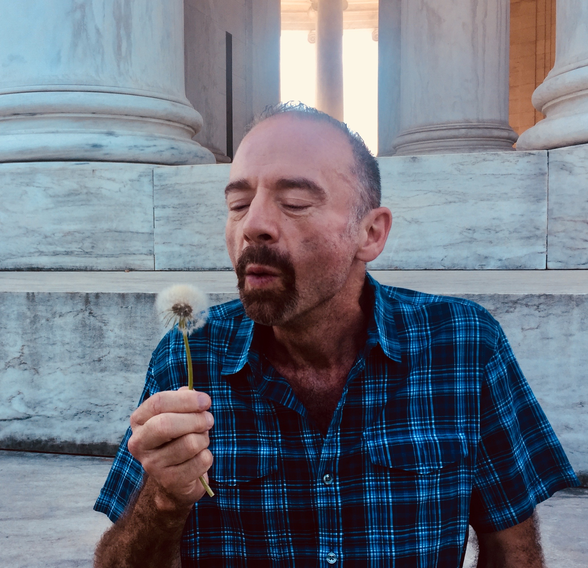

Photo credit:
Talia Mota
Notes:
Our focus needs to be on developing a cure for HIV to improve the lives of people living with the virus, and on developing a vaccine – which we need to end the global epidemic; as well as on the co-morbidities of today – including tuberculosis, which is the leading killer of people with HIV today.
But we should also know that the seeds of discovery that we generate in the process will drift into the future and will have positive benefits on human health long after the HIV epidemic is over. That will be the enduring legacy of the special community that we’ve built – and it will emerge from the altruism of people living with HIV, including those who continue to participate in research after they themselves are healthy. People like the man in this picture and so many of you whom I’ve had the honor to speak to today.

Slide 48






Acknowledgments
All Study Participants
Sharon Lewin
Input and Advice:
Rajesh Gandhi
Shy Genel
Romas Geleziunas
Bruce Walker
Darrell Irvine
John Mellors
Toni Young
Robert Siliciano
Greg Laird
Talia Mota
Yanqin Ren
Szu Han Huang
Jones lab members
Weill Cornell Infectious
Disease Division Members
Conference Project Manager:
Gearóid Fitzmaurice
Douglas Nixon
Trip Gulick
Notes:
I’d like individuals on this slide for their contributions to this presentation, in particulary Sharon Lewin, Douglas Nixon, Trip Gulick - as well as the NIH and amfAR for their steadfast commitment to funding HIV research. And thank you for your attentinon.

