Slide 1
Non-Communicable Diseases (NCDs): The Challenges for People Living With HIV LUNG DISEASES AND “SMOKING”
Ken Kunisaki, MD, MS
University of Minnesota &
Minneapolis VA Health Care System
Minneapolis, USA

Slide 2
Disclosures
I have received consultancy fees from GlaxoSmithKline
I receive National Institutes of Health (NIH) funding for research in HIV-associated lung disease and HIV-associated sleep disorders

Slide 3
Goals
Emerging data regarding lung disease in HIV
Lung disease in low to middle income settings
Role of ‘smoking’ and environmental exposures

Slide 5
cART-Era HIV-Lung Disease
Bacterial pneumonia still problematic

Slide 6
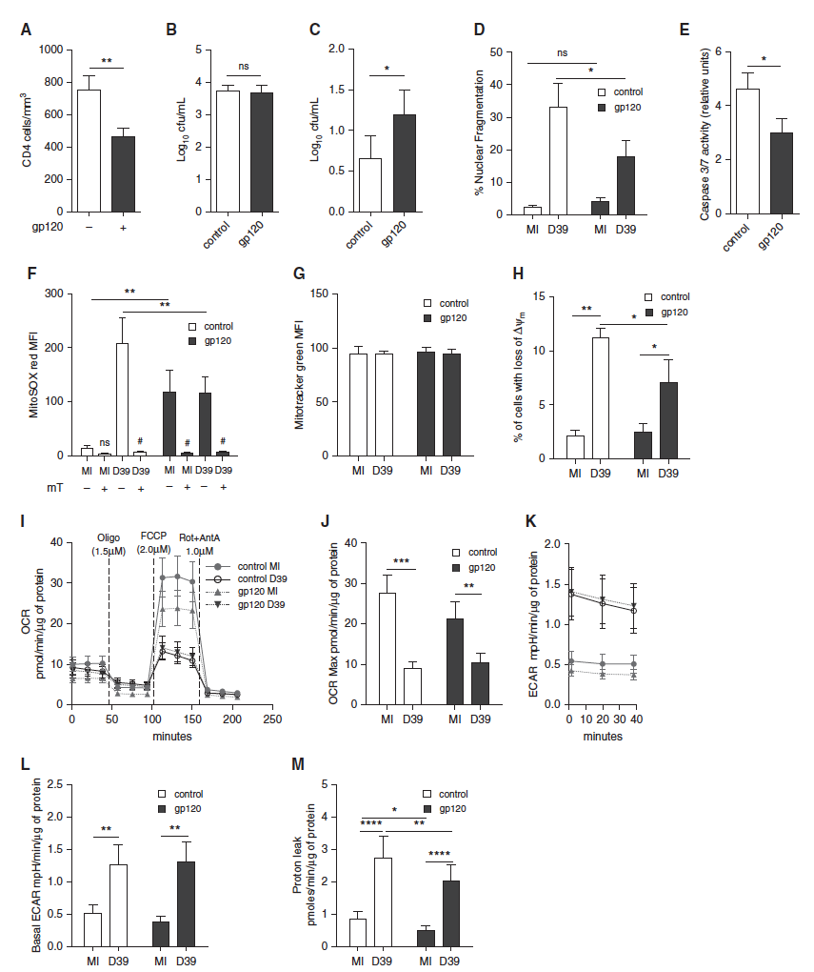
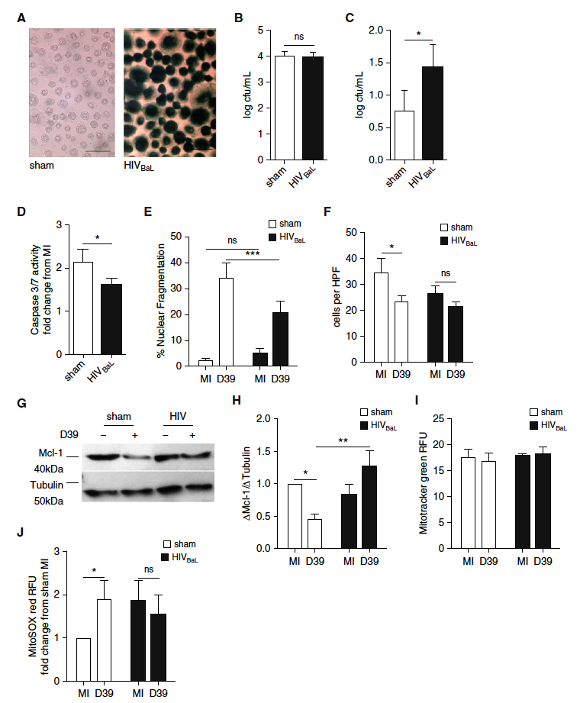
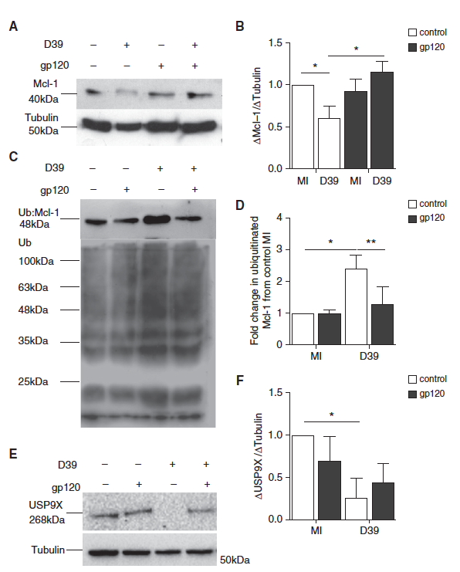
Bacterial Pneumonia on ART

Slide 7
Emerging HIV-Lung Disease
Bacterial pneumonia still problematic
NCDs of the Lung
COPD
Lung cancer
Pulmonary HTN

Slide 8
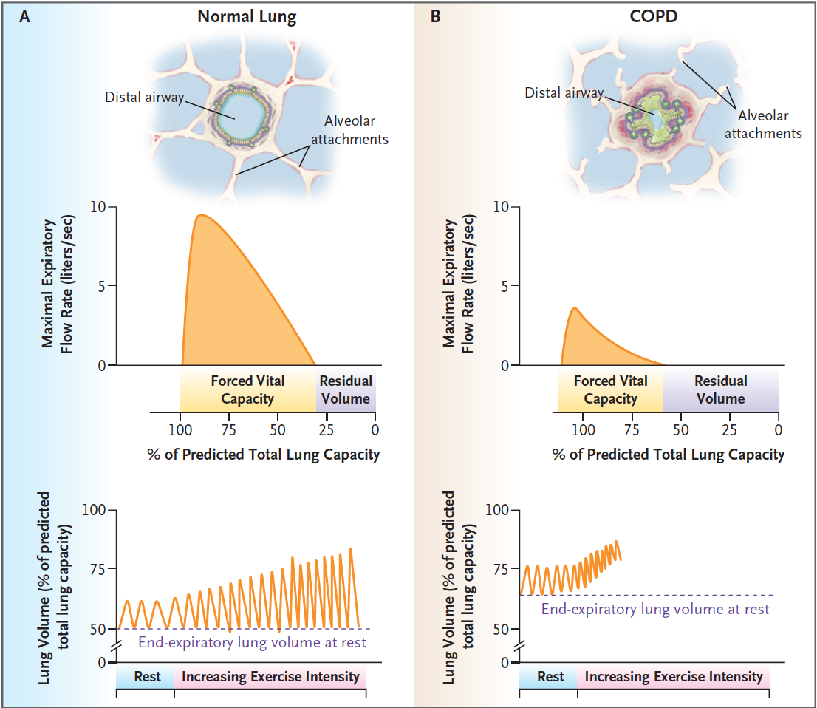
What is COPD?
Collapsible
Inflamed
Fibrosed
Niewoehner DE. N Engl J Med 2010;362:1407

Slide 9
What is COPD?
Collapsible
Inflamed
Fibrosed
Niewoehner DE. N Engl J Med 2010;362:1407

Slide 10
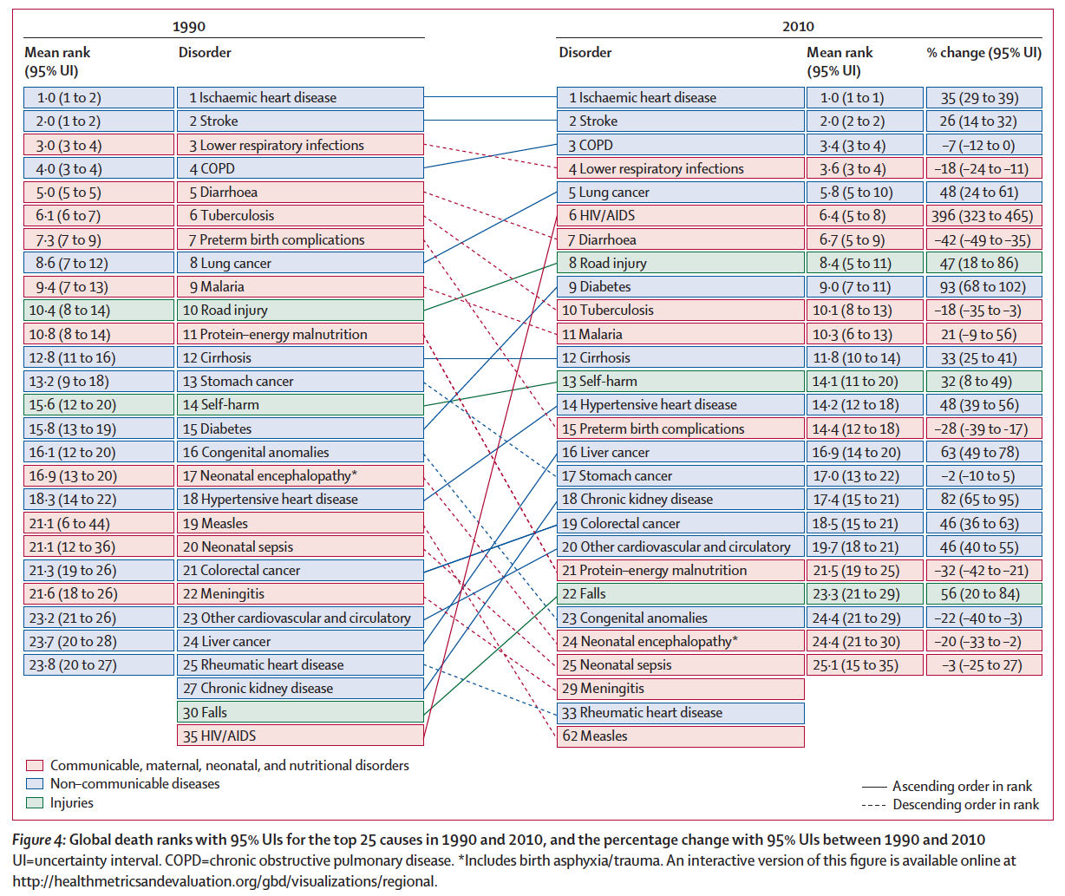
Global Burden of Disease Study. Lancet 2012;380:2095-2128

Slide 11
HIV-COPD

Slide 12
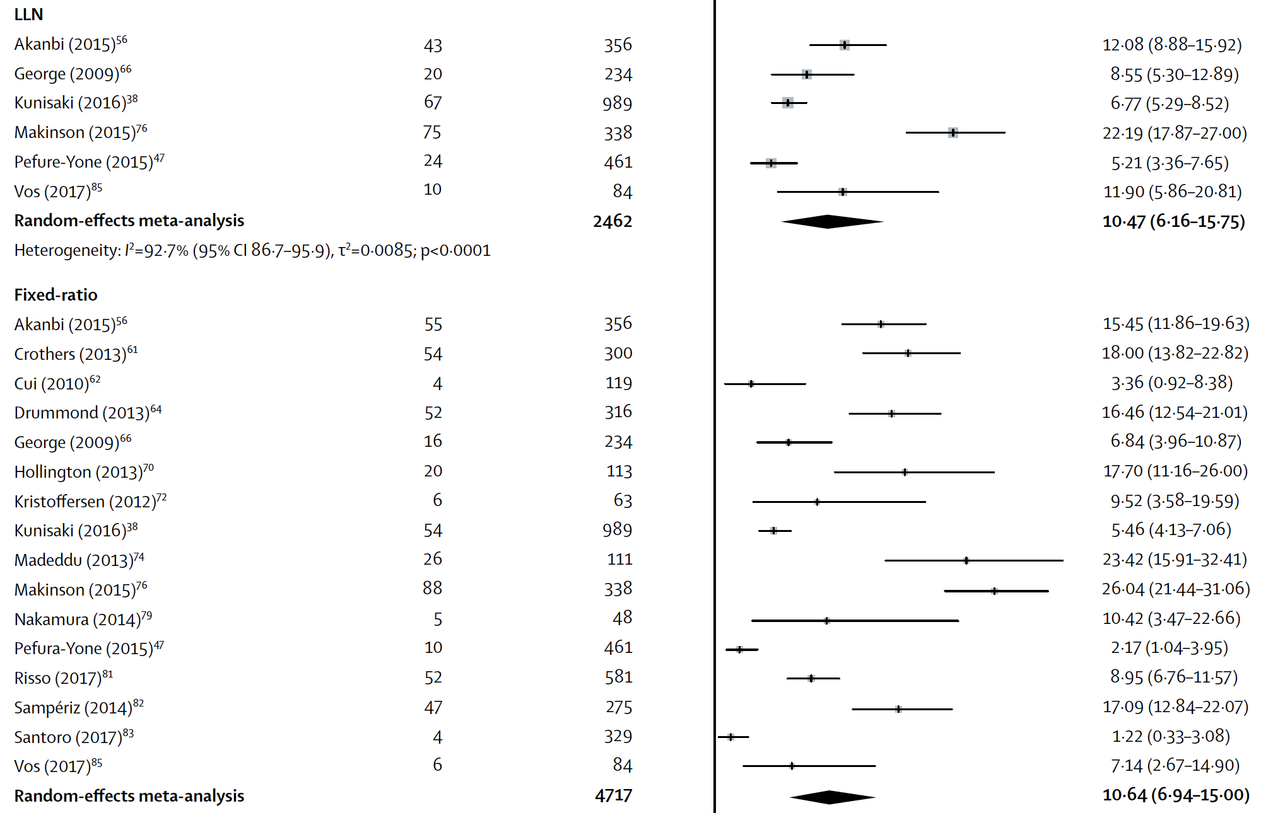
606
606
Notes:
Nigeria, Cameroon, and S Africa

Slide 14
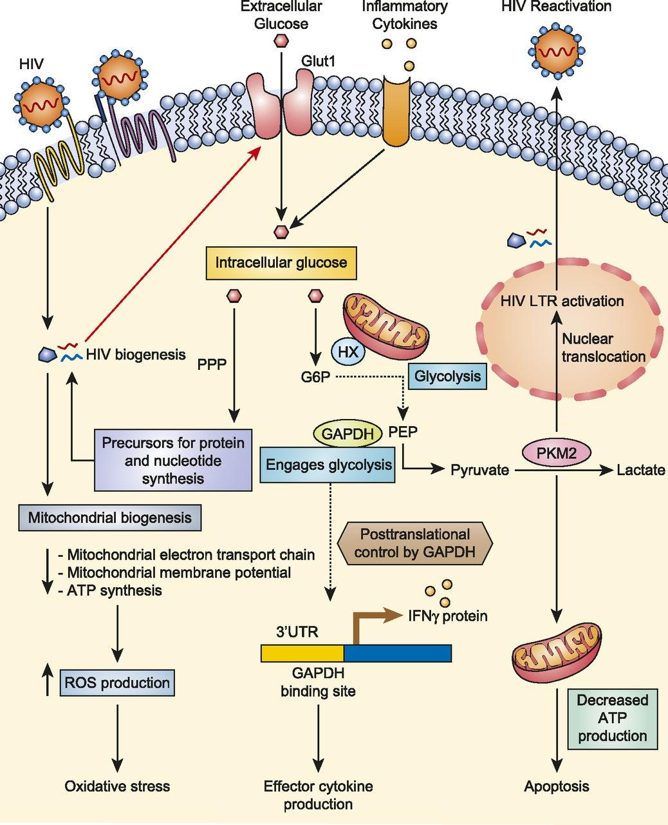
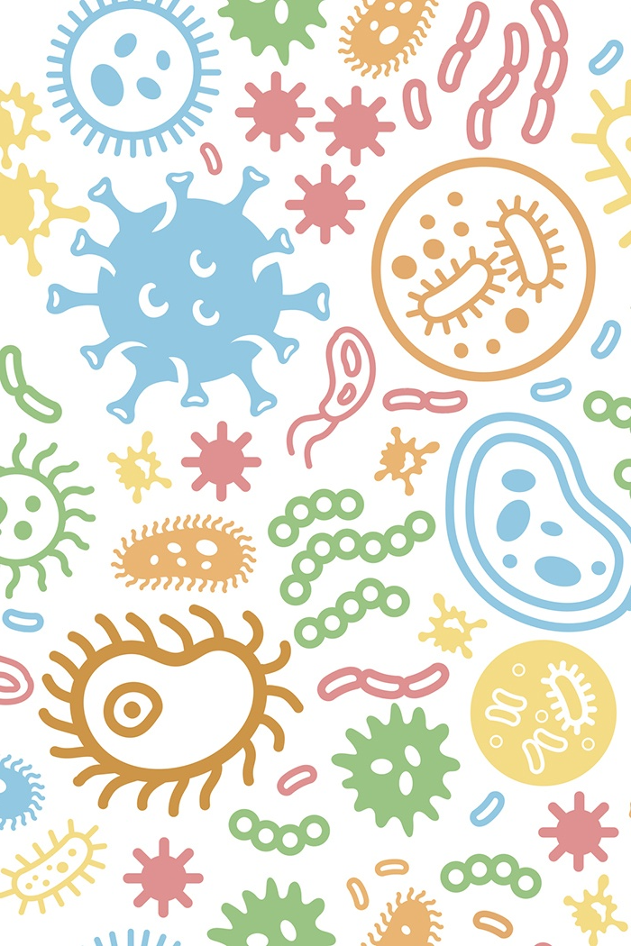
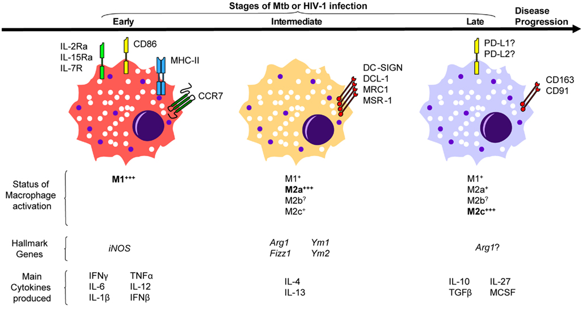
Why is COPD Prevalence High in HIV?
Palmer CS. J Immunol 2016
Lugo-Villarino. Front Immunol 2011

Slide 15
Earlier ART not likely to reduce lung disease in HIV

Slide 16
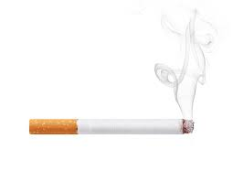
Why is COPD Prevalence High in HIV?
Palmer CS. J Immunol 2016

Slide 17
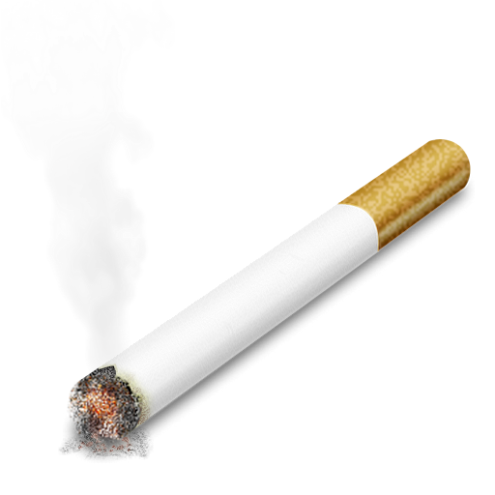
Smoking and COPD

Slide 18
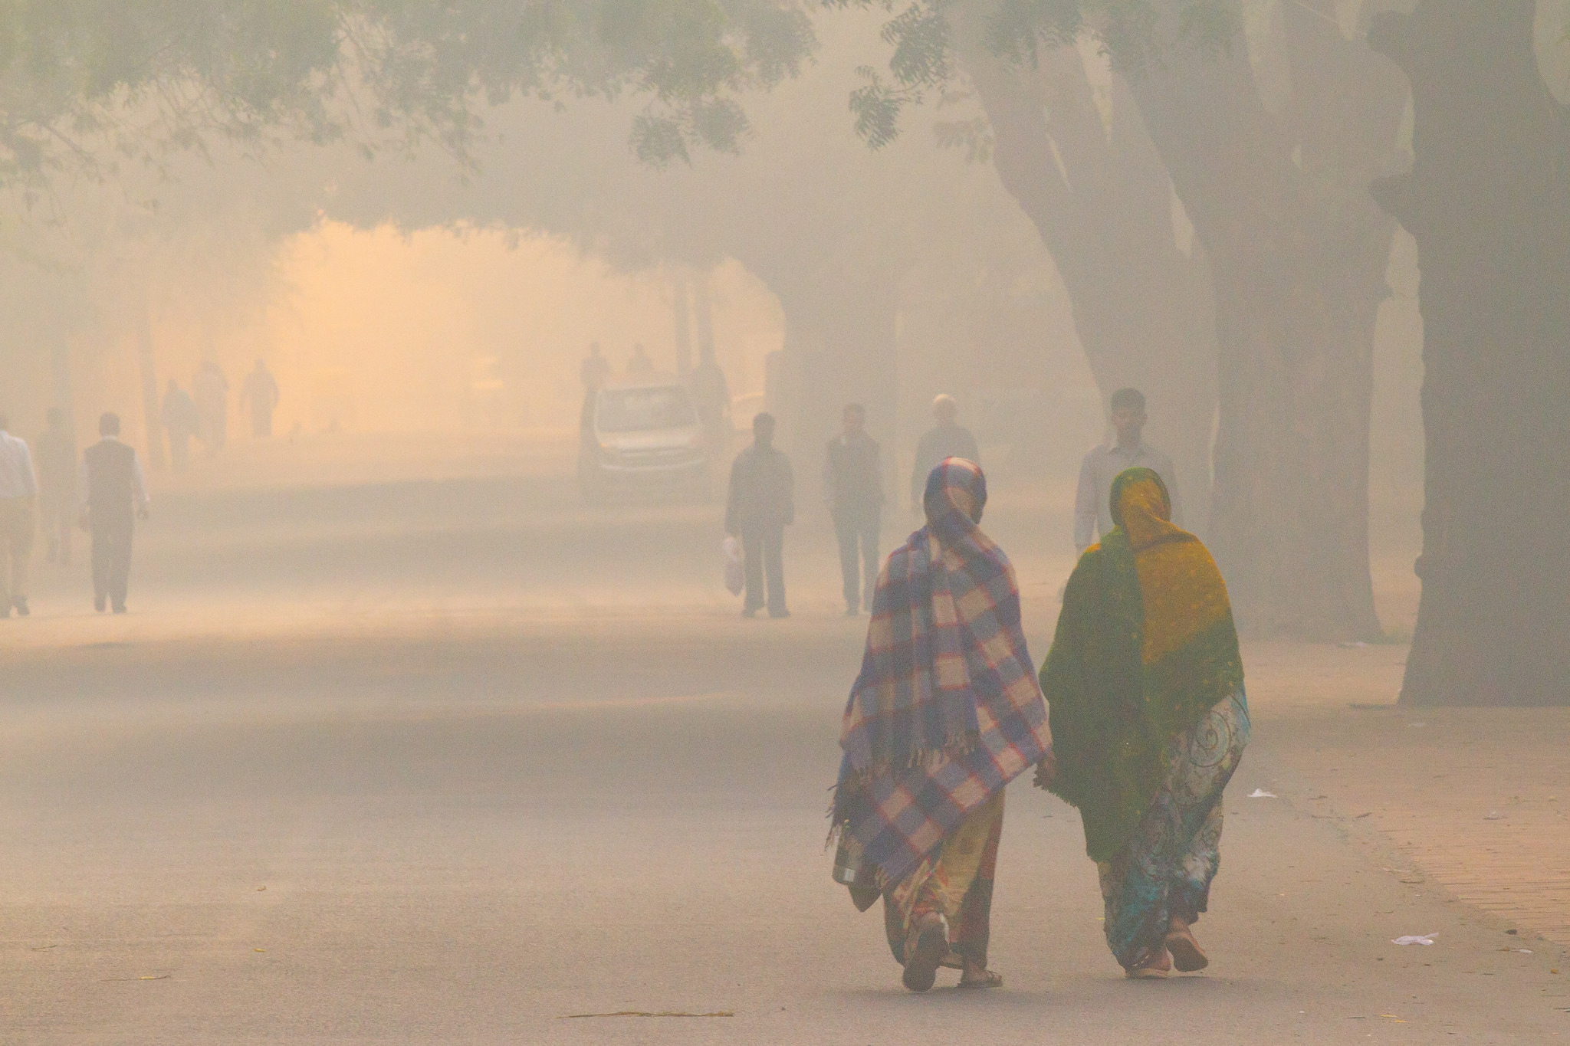
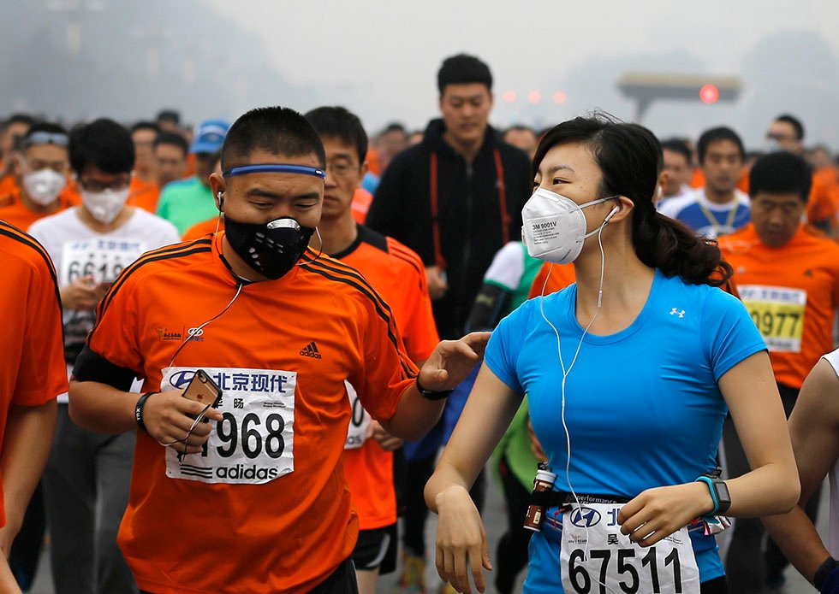
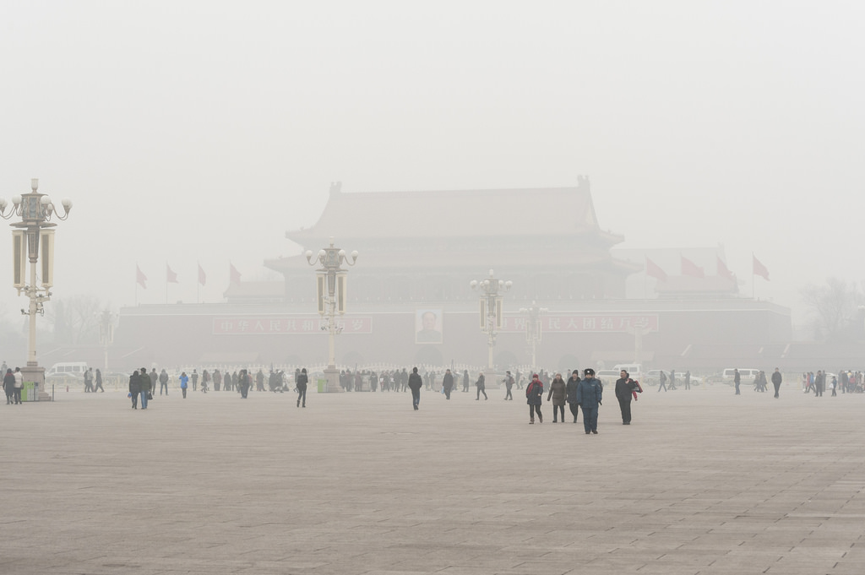
Non-cigarette COPD

Slide 19
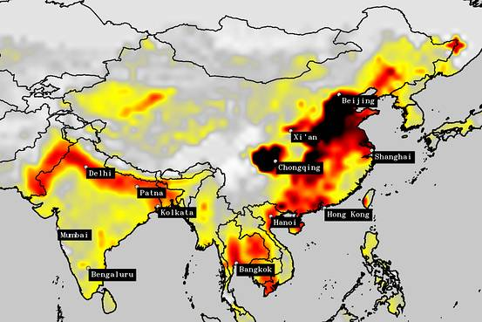
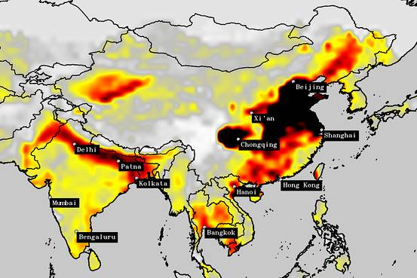
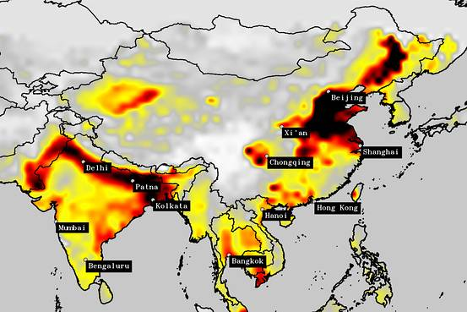
2005
2011
Washington Post 22 Feb 2016
2015

Slide 20
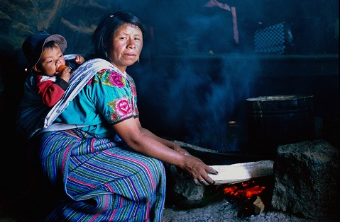
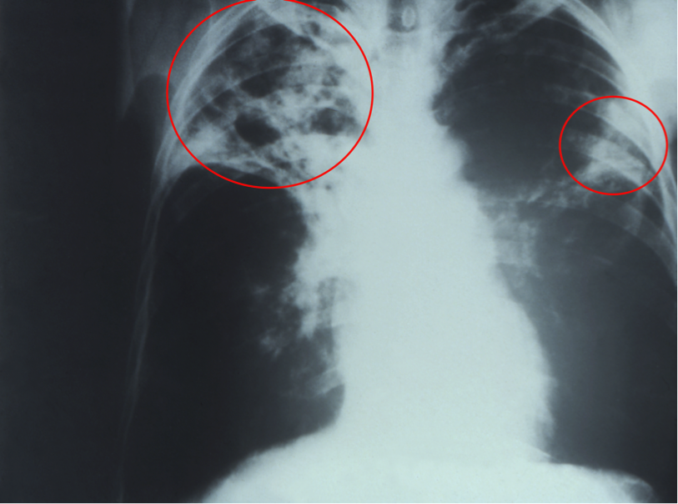
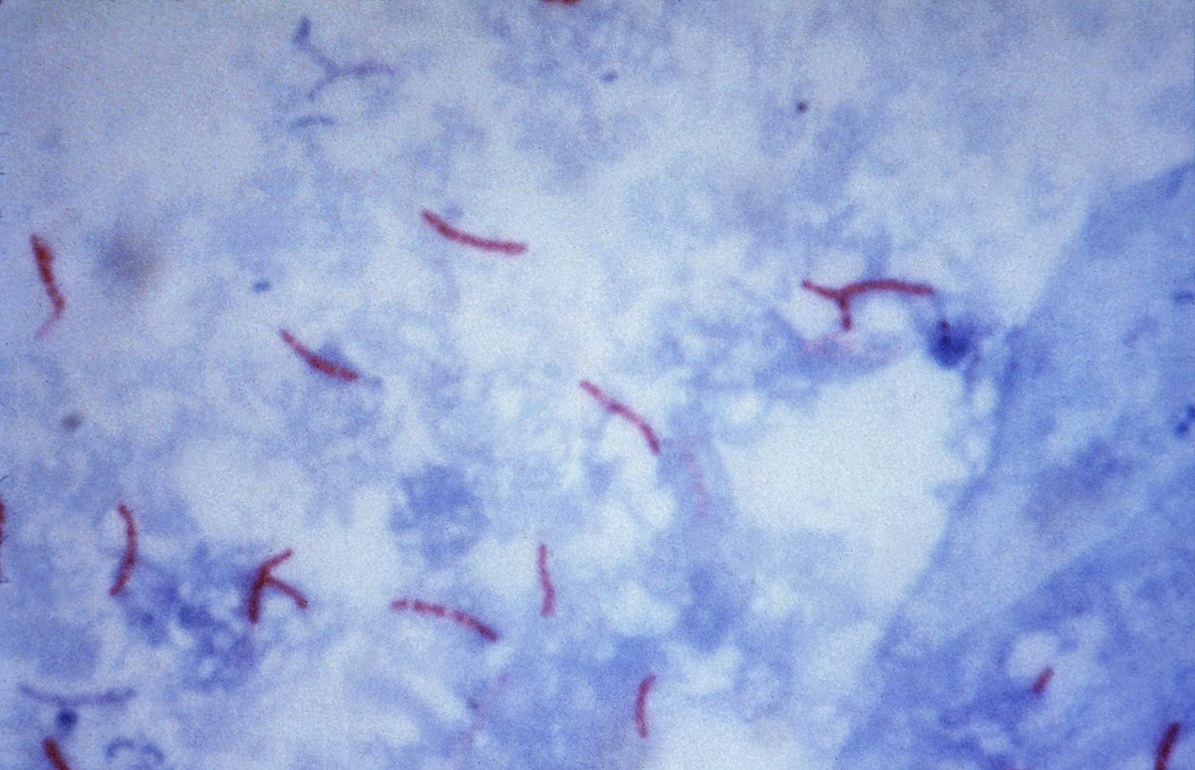
Non-cigarette COPD

Slide 21
HIV-COPD
Common
Likely multi-factorial
Immune dysfunction
Abnormal inflammation / viral persistence
Infections
Bacterial pneumonia
Tuberculosis
Respiratory microbiota?
‘Smoking’
Cigarettes
Outdoor air pollution
Indoor air pollution

Slide 22
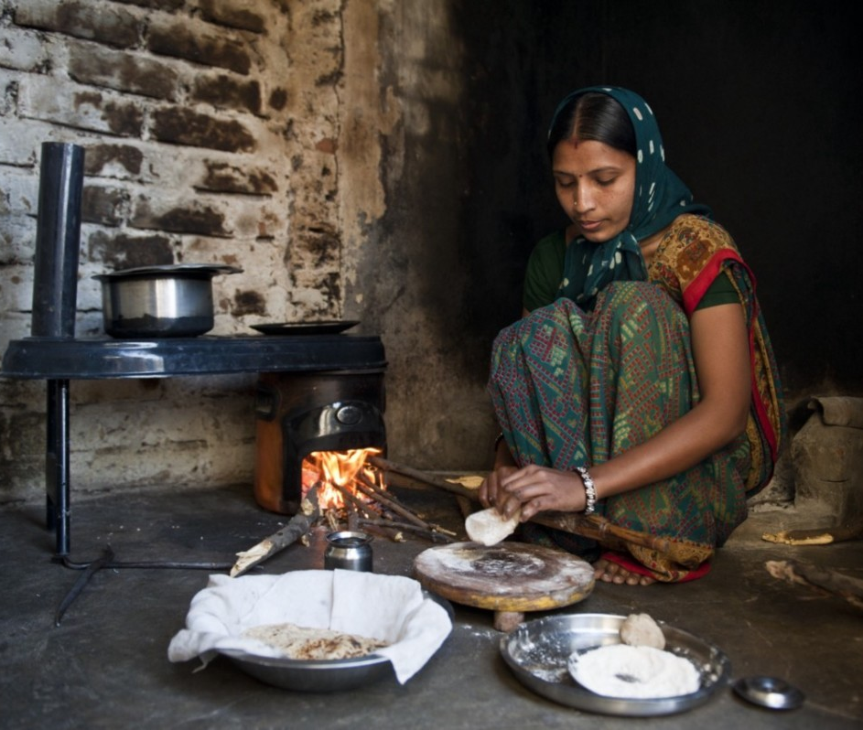
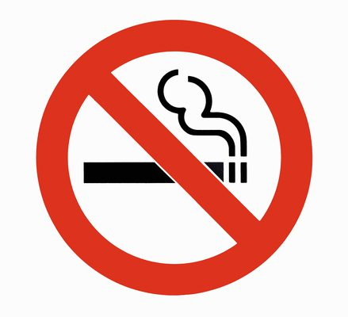
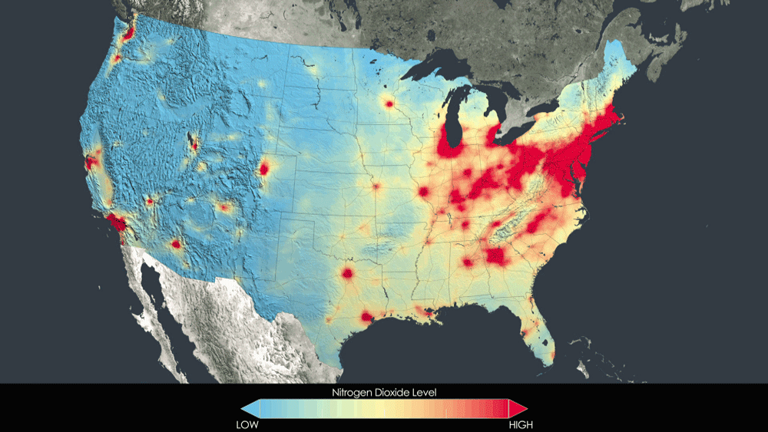
Reducing Lung Disease in HIV
2005→2011

Slide 23
Thank you
kunis001@umn.edu
These are my personal views, and not those of the US Government, Department of Veterans Affairs, or affiliated funders/institutions

